Slide 1



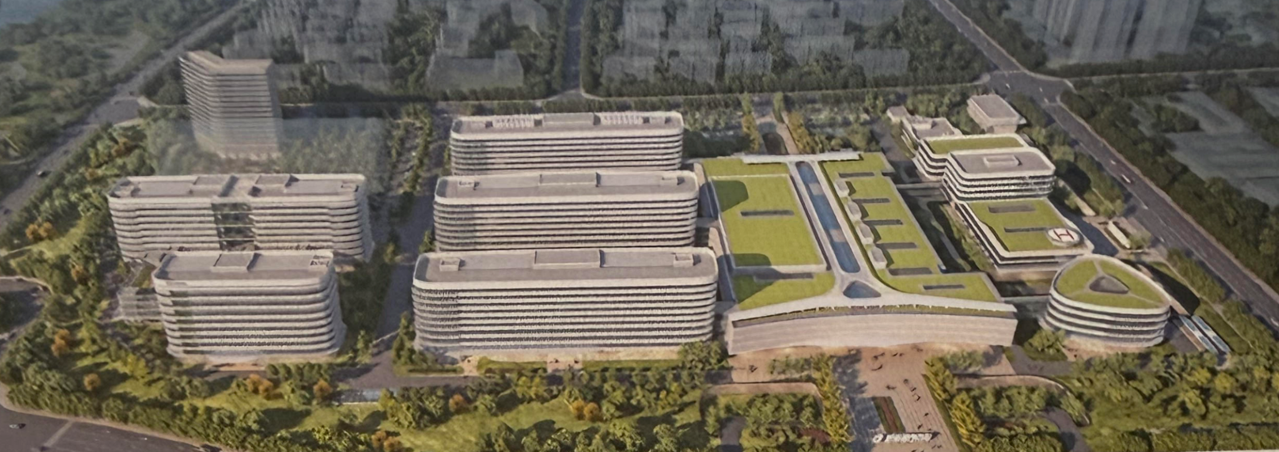


ChiNor Brain Science Research
AI-assisted Glioma Research
Imaging, Tumor-Brain Interactions, and Cognition
2026 China-Europe Neurosurgery Academic Symposium, Jinan, 22-25 October 2026
Arvid Lundervold BSc, MD, PhD
Professor em. medical information technology and physiology
Department of Biomedicine, University of Bergen, Norway
Mohn Medical Imaging and Visualization Center, Department of Radiology, Haukeland University Hospital Bergen, Norway
https://github.com/arvidl/brainweb_fisher_kpp
https://github.com/arvidl/glioma-growth
https://github.com/arvidl/glioma-connectivity-and-cognition
https://github.com/arvidl/glioma-brain-digital-twin-public
← Raw, hands-on educational and research material →
https://github.com/arvidl/AI-assisted-glioma-research
https://github.com/arvidl/high-precision-glioma-segmentation

Slide 2
AI-assisted Glioma Research
Imaging, Tumor-Brain Interactions, and Cognition
Motivation and Inspiration
Understanding glioma through AI-assisted imaging and modeling

Slide 3

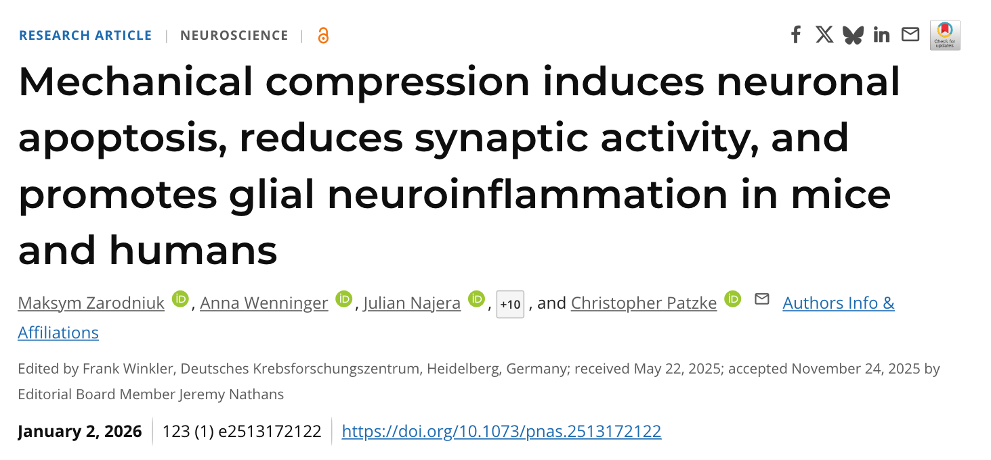
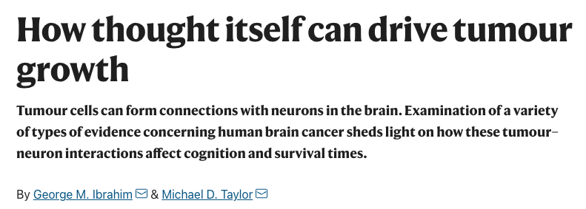
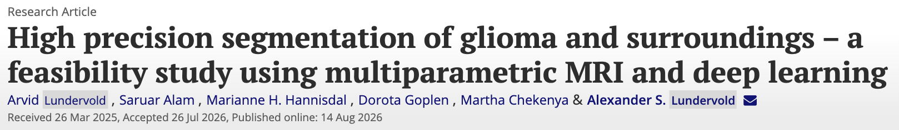
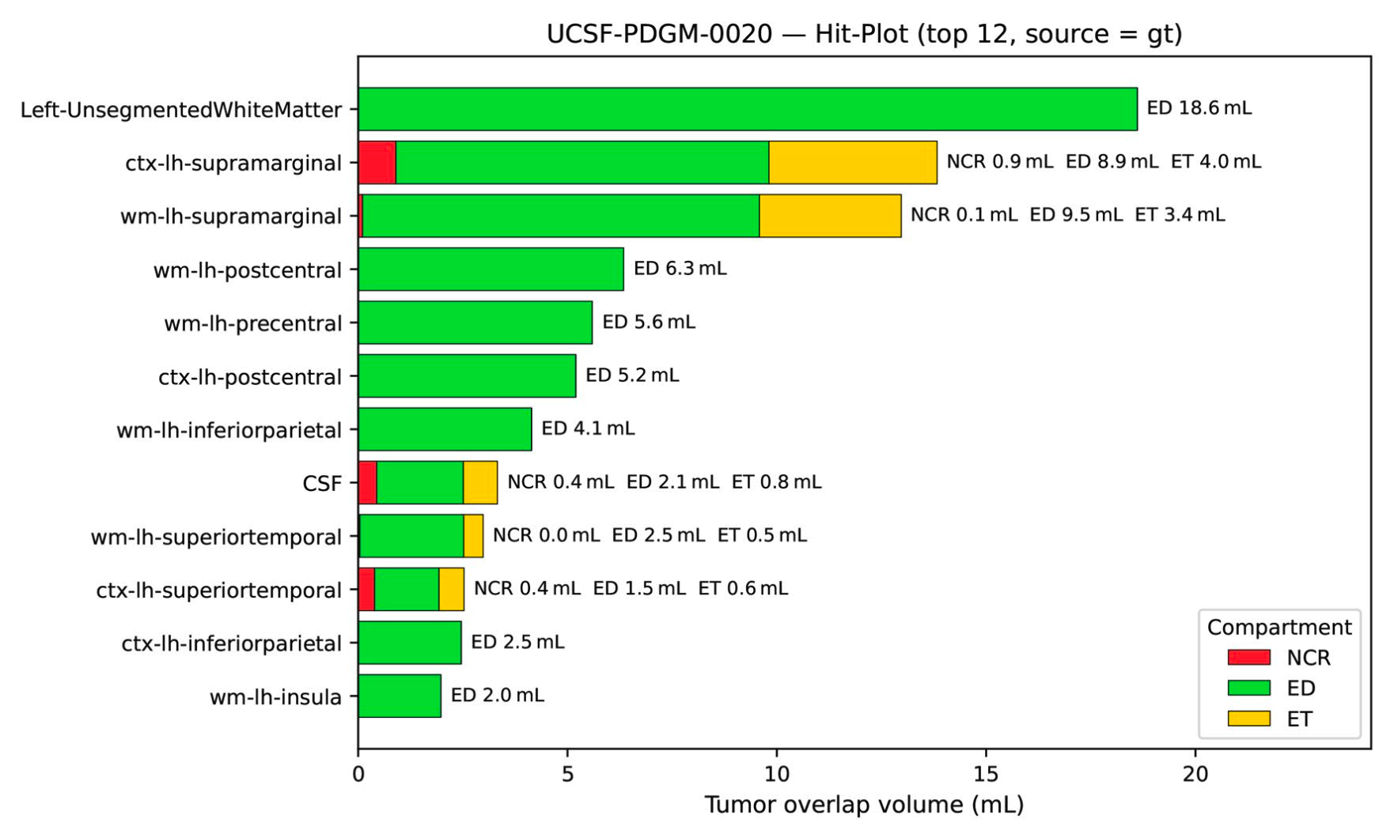
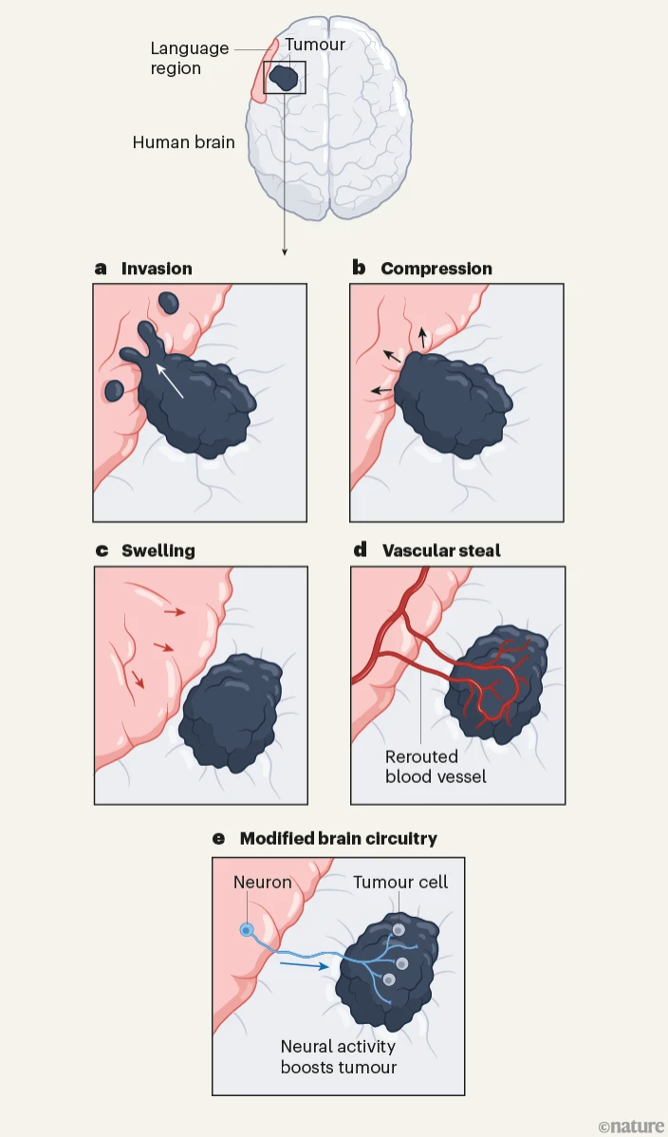
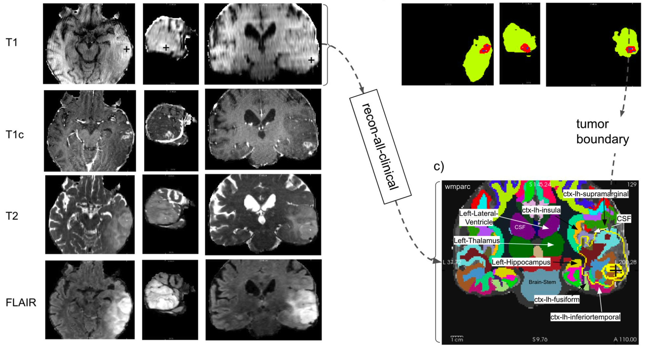
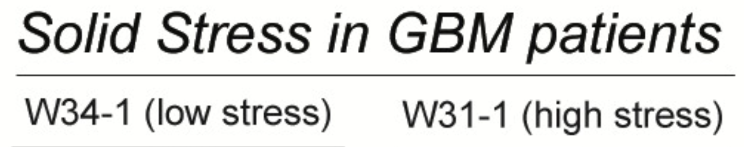
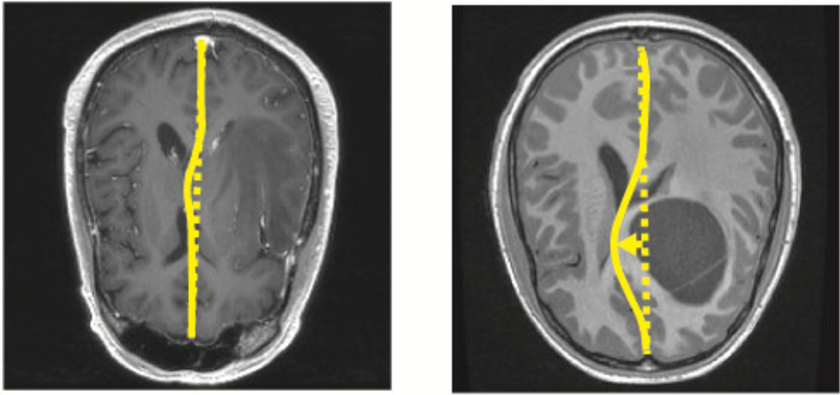
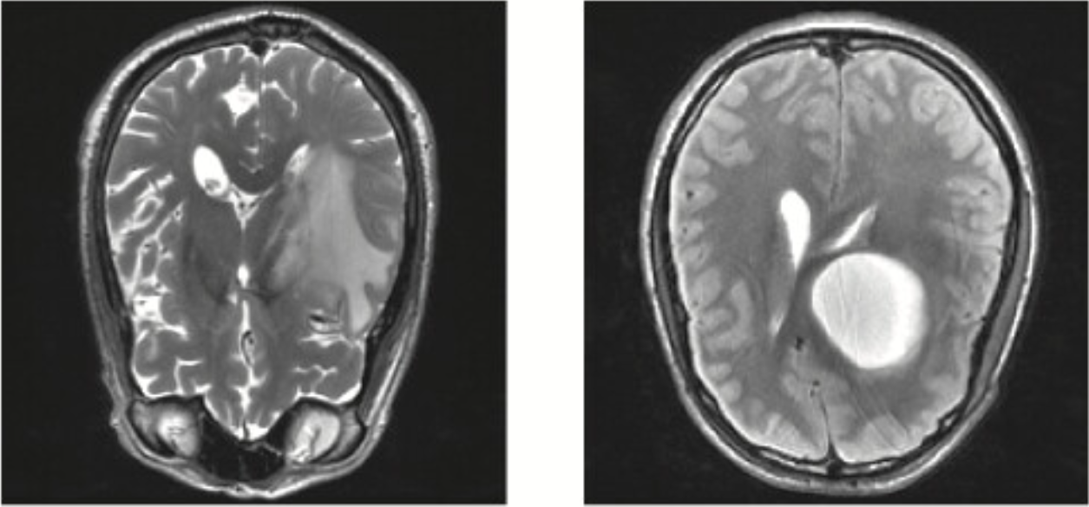
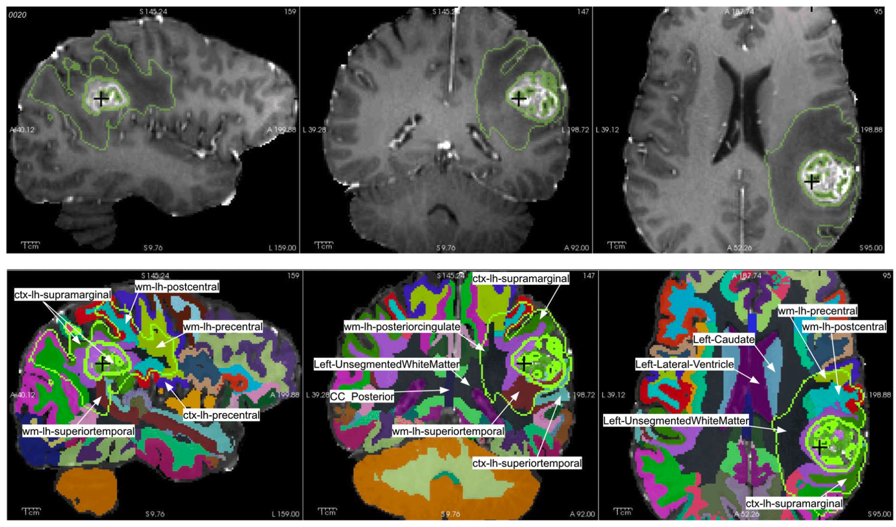

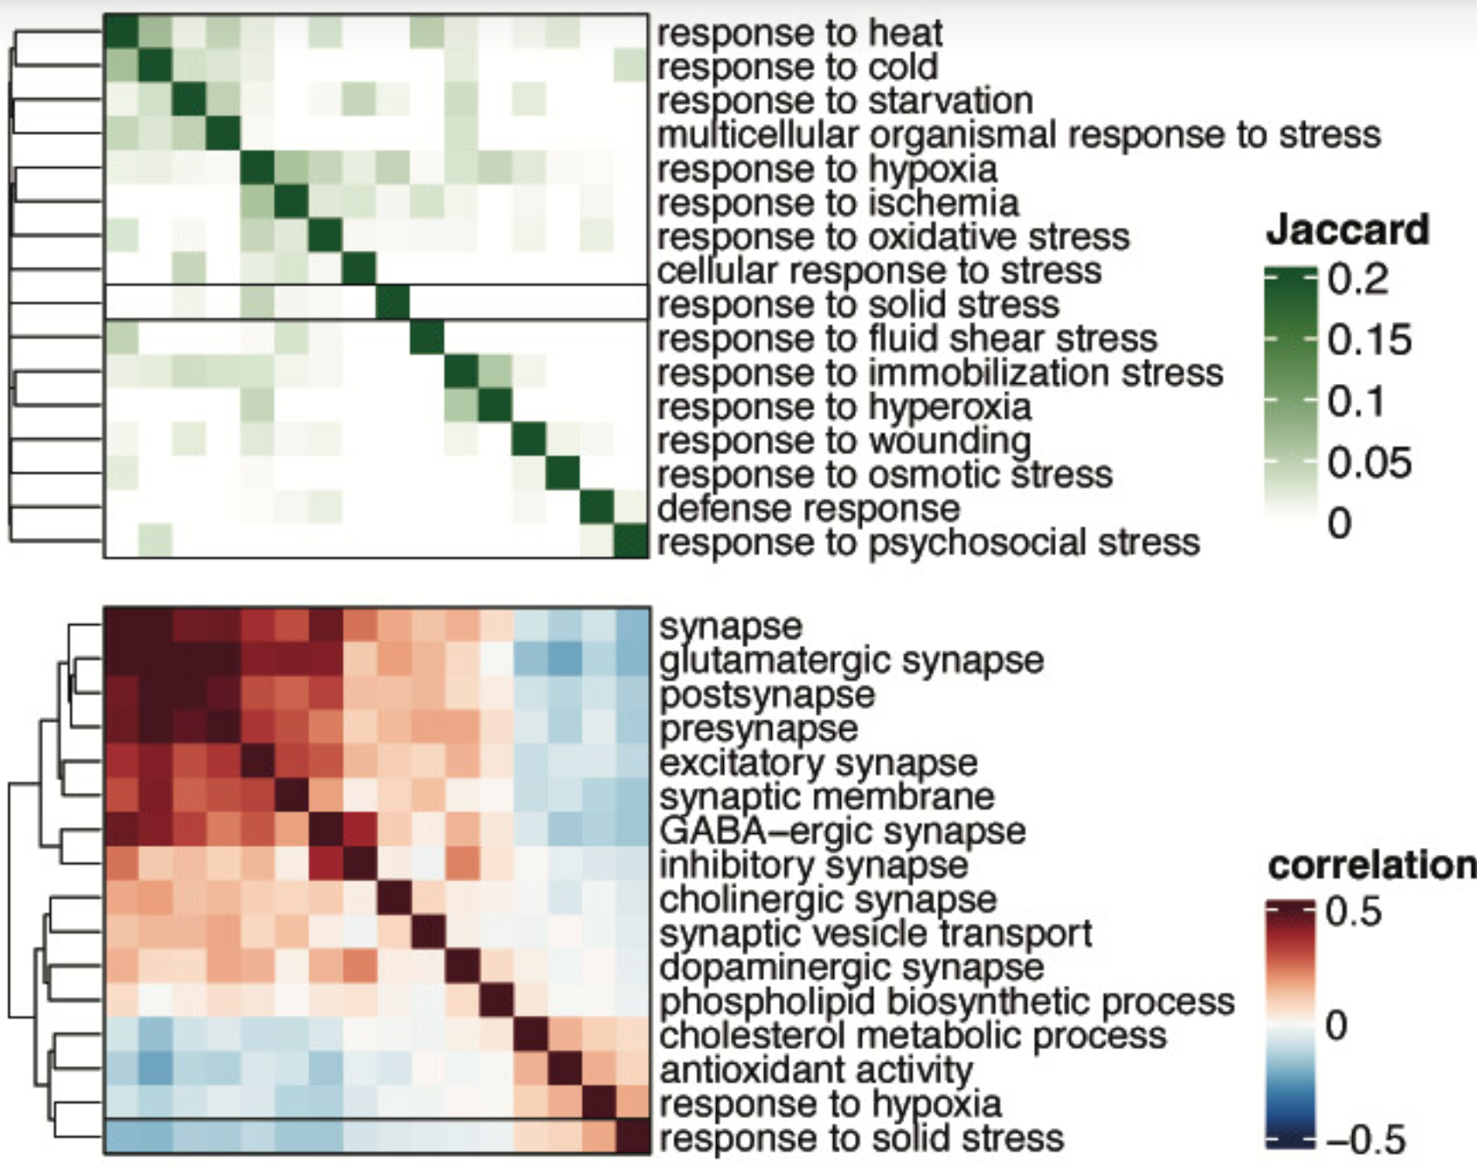

Nature 2023;617:469-471 [link]
[link]
https://doi.org/10.1073/pnas.251317212
T1
Tumor volume intersection with brain structures
“Hit Plots”
T2
Jaccard similarity matrix shows overlap between our solid stress response signature and Gene Ontology gene sets related to other stressors.
Cancer
neuro-
science
Spearman correlation matrix showing a negative relationship between the solid stress response and synapse maintenance gene expression programs in excitatory neurons from GBM patients.
Figure 1 | Models for cognitive problems associated with brain tumours. The human brain contains regions that are important for language processing, such as an area on the left side of the brain.
Figure 5 Solid stress promotes hypoxic and inflammatory gene expression programs in vivo.
Figure 4. Tumour location and anatomical neighbourhoods from the study UCSF-PDGM-0020.

Slide 4
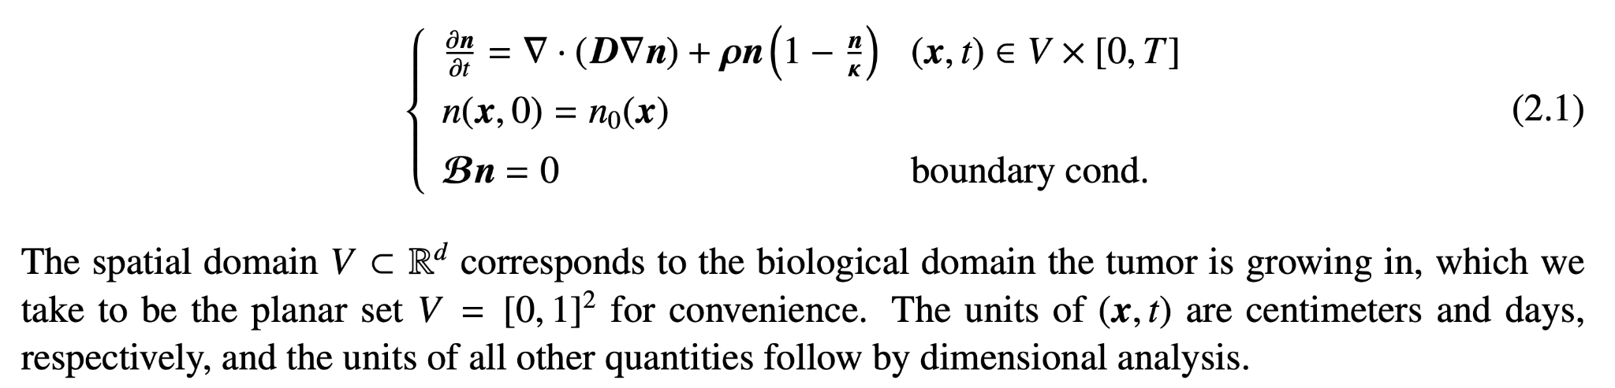
Biophysics modeling of tumor growth
The go-or-grow hypothesis*
Tumor progression as a cycle of two phases:
An initially exclusively proliferative phase followed by an invasion of tumor cells into surrounding tissues
This second phase can then possibly transition back to a proliferating phenotype, which encourages recurrence
and growth of metastatic tumors
Kolmogorov, Petrovsky, Piskunov (1937)
The Fisher-KPP model for tumor growth in the absence of treatment takes the form of a nonlinear reaction-diffusion type Partial Differential Equation (PDE) for a density of tumor cells n = n(x,t) (units number per unit volume):
diffusion
logistic growth
The first term with D is a diffusion operator that models the migration of cancerous cells into surrounding healthy tissue.
The second term with ρ models the proliferation of tumor cells that can be a logistic growth function
initial condition at time t=0
zero flux boundary condition
*H. Hatzikirou et al. 'Go or grow': the key to the emergence of invasion in tumour progression? Mathematical Medicine and Biology 2012;29(1):49-65.
**R. Everett et al. A tutorial review of mathematical techniques for quantifying tumor heterogeneity. Mathematical Biosciences and Engineering 2020;17(4):3660-3709
https://www.aimspress.com/article/10.3934/mbe.2020207

Slide 5
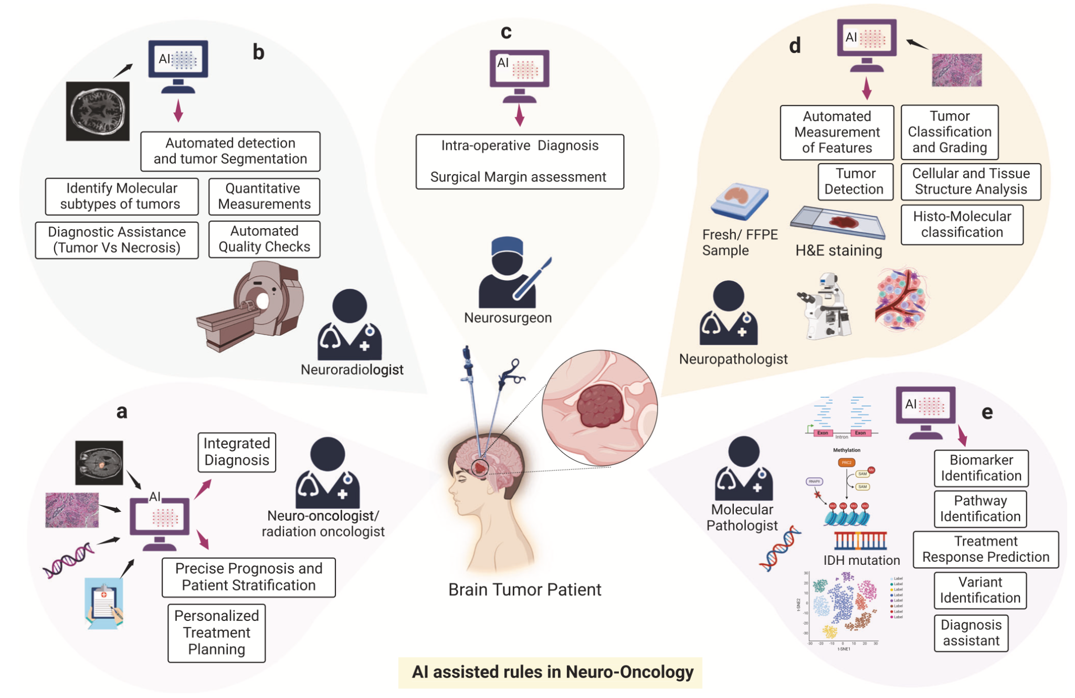

Towards AI-driven personalized treatment planning of glioma
Precision segmentation
- surgical resection
+
- radiation planning
(proton therapy)
S. Khalighi et al. Artificial intelligence in neuro-oncology: Advances and challenges in brain tumor diagnosis, prognosis, and precision treatment, npj Precision Oncology 2024;8:80 [link]

Slide 6
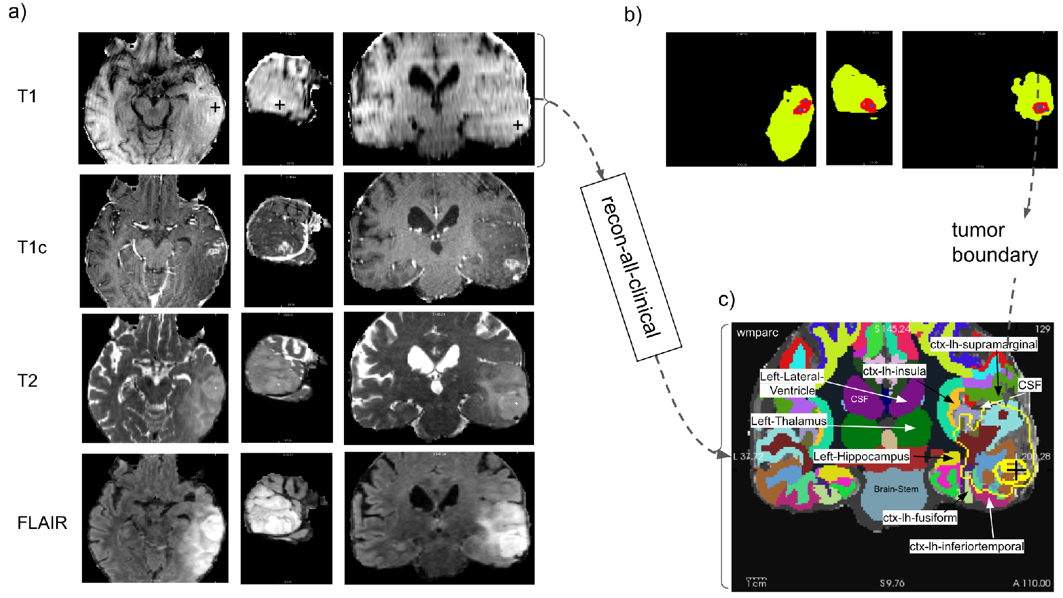
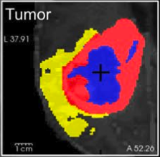
Our imaging foundation: compartments and anatomy
T1, T1c, T2, FLAIR
Trained imaging AI
MONAI SegResNet
NCR
ED
ET
FreeSurfer anatomy
Lundervold et al. 2026, Fig. 1, CC BY 4.0. UCSF-PDGM-0085; reference-mask illustration
Regional overlap volumes
Paper: Published feasibility study & Code: https://github.com/arvidl/high-precision-glioma-segmentation
AI-assisted Glioma Research
Notes:
Published imaging AI methods · 1:12 · cumulative 2:36
Our recent feasibility paper provides the imaging foundation. We combine
multiparametric MRI with three-compartment tumor segmentation and
subject-specific anatomical parcellation. The trained deep-learning imaging model, the unified MONAI BraTS SegResNet
pipeline uses T1, contrast-enhanced T1, T2 and FLAIR. The compartments are
non-enhancing or necrotic core, edema and enhancing tumor. FreeSurfer supplies
anatomical labels, and intersections produce overlap volumes and regional
profiles. In this published illustration, the compartment panel uses the
dataset's reference masks. It shows the anatomical workflow, rather than a new
prediction generated today. The public code accompanies the study. Our teaching
repository quotes its results and reuses attributed figures; it does not rerun
the trained model. [Point from MRI sequences to compartments and anatomy.]
Sources
https://doi.org/10.1080/03091902.2026.2713703
https://github.com/arvidl/high-precision-glioma-segmentation

Slide 7
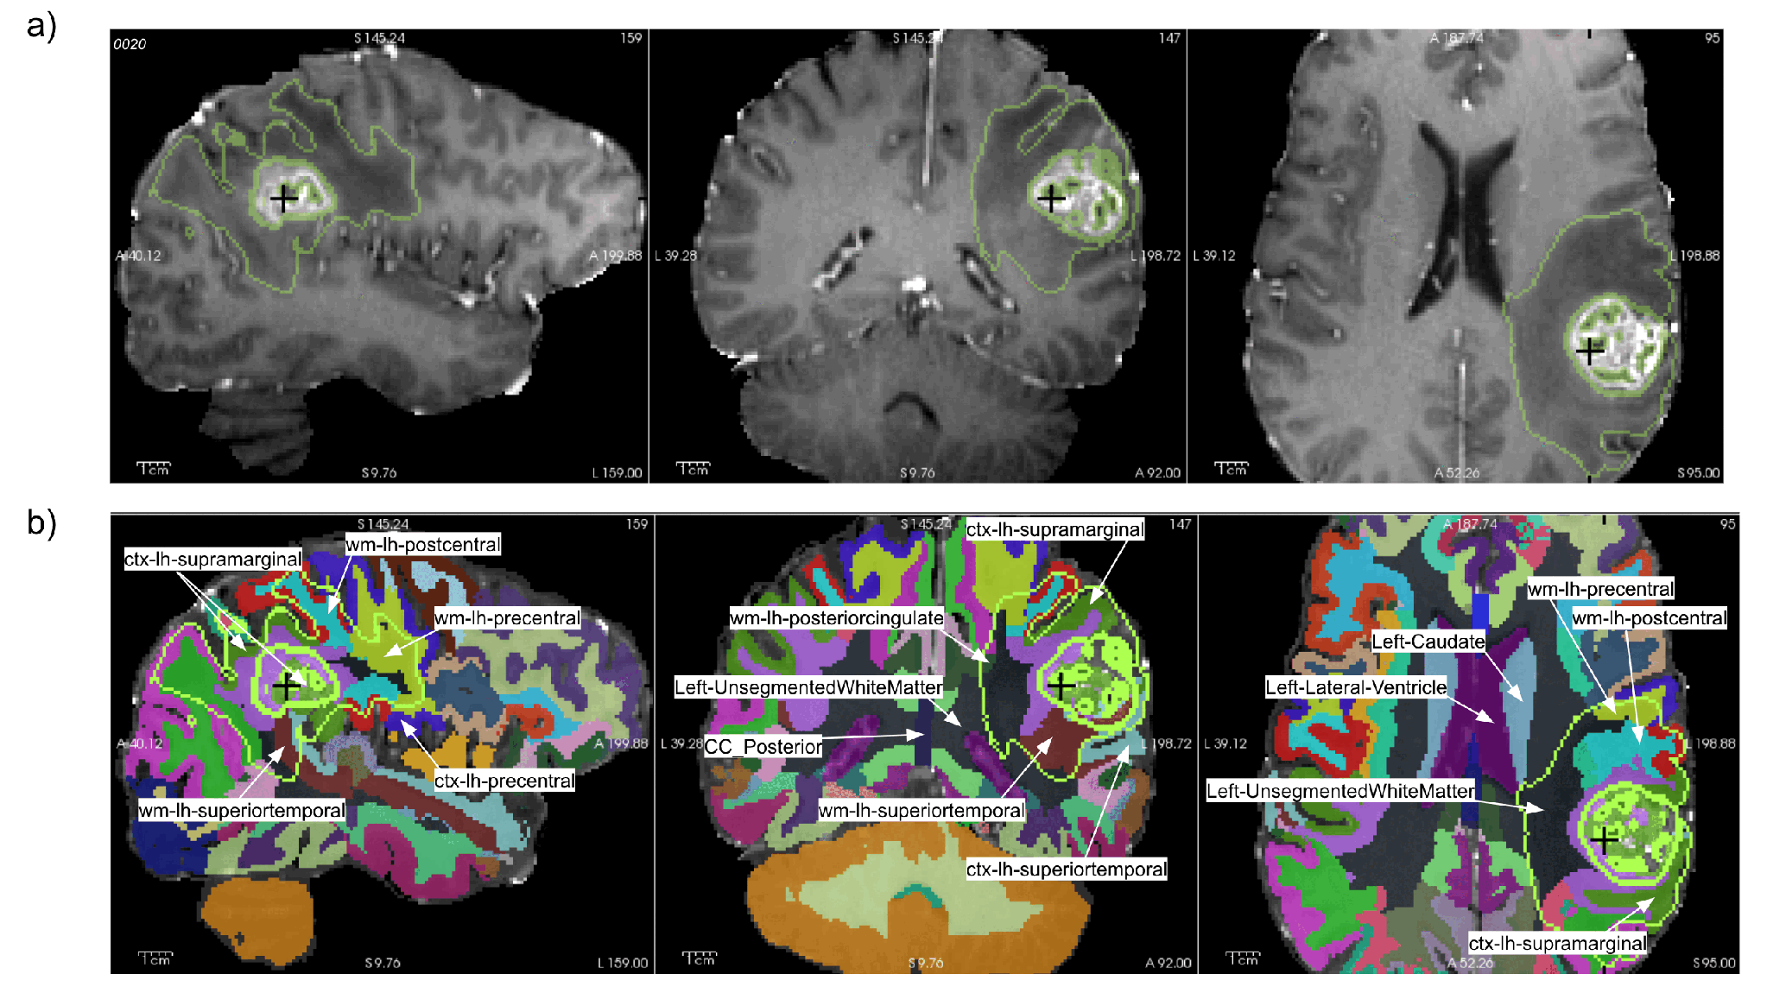
Regional tumor burden - the tumor-brain interface measured by mpMRI
Detect abnormality
Tumor size and shape
Tumor compartments
Describe anatomy
Fine-grained brain parcellation Tumor location & neighbourhood
Choose the next measurement
Physiology? dMRI, fMRI (BOLD), …
Tissue sampling?
Cognition? CANTAB, …
AI role: Deep learning automated brain segmentation, Deep learning tumor segmentation, AI-assisted coding and visualization
Published Fig. 4a–b, UCSF-PDGM-0020; Lundervold et al. 2026, CC BY 4.0.
Anatomical labels and MRI compartments do not establish functional eloquence or cell programs.
AI-assisted Glioma Research
Notes:
Regional burden · 1:12 · cumulative 3:48
The top row shows published tumor-compartment boundaries over MRI in three
orthogonal views; the bottom row shows anatomy in the same subject space.
This locates a question: which region is involved, and what further observation
would be useful? A language assessment or physiological recording may be
appropriate. An anatomical label alone does not establish functional eloquence,
and a FLAIR-related compartment does not identify a cell program or a neuron–glioma
synapse. The AI supplies compartment segmentation in the published workflow;
anatomical interpretation still needs review. The backup hit-plot summarizes
intersections in milliliters. [Explain the shared location; do not read each
small region label.]
Sources
https://doi.org/10.1080/03091902.2026.2713703

Slide 8
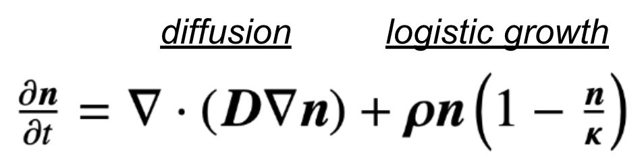

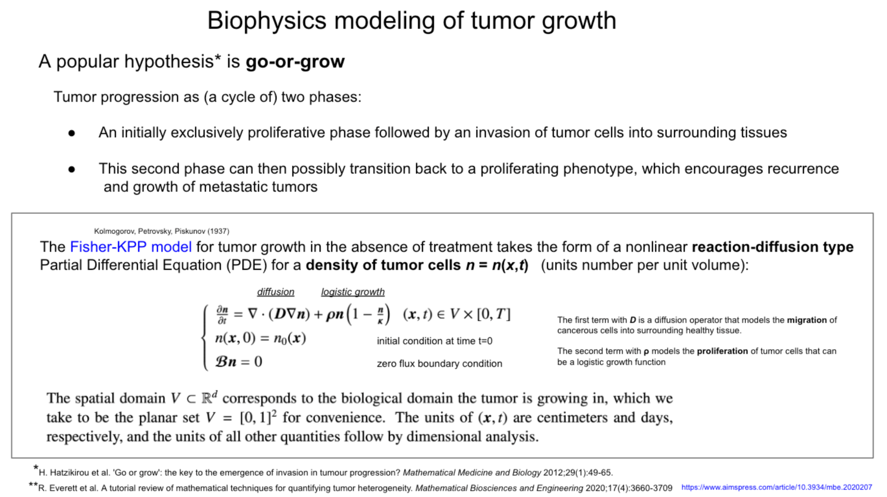
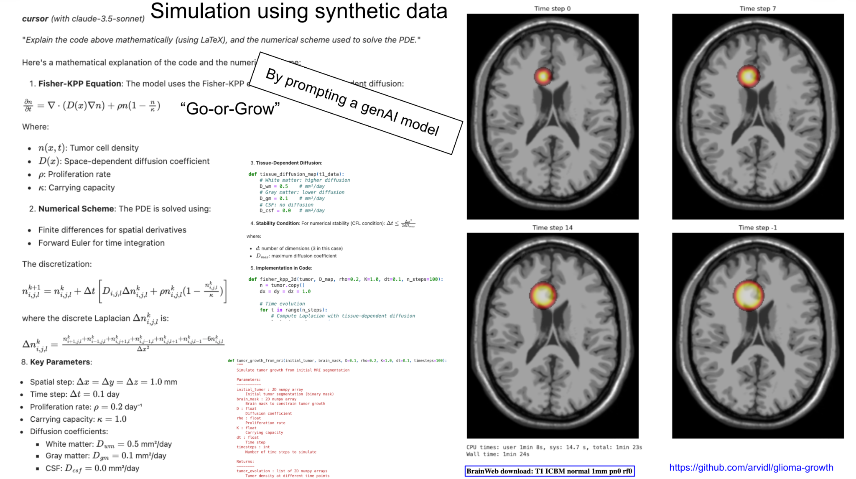
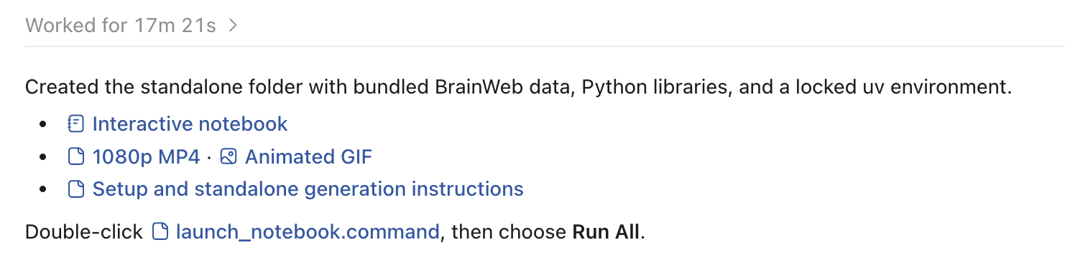
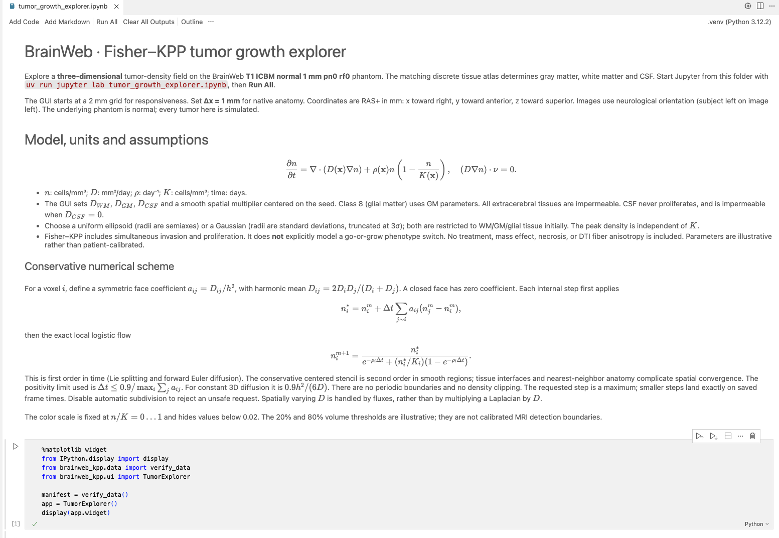
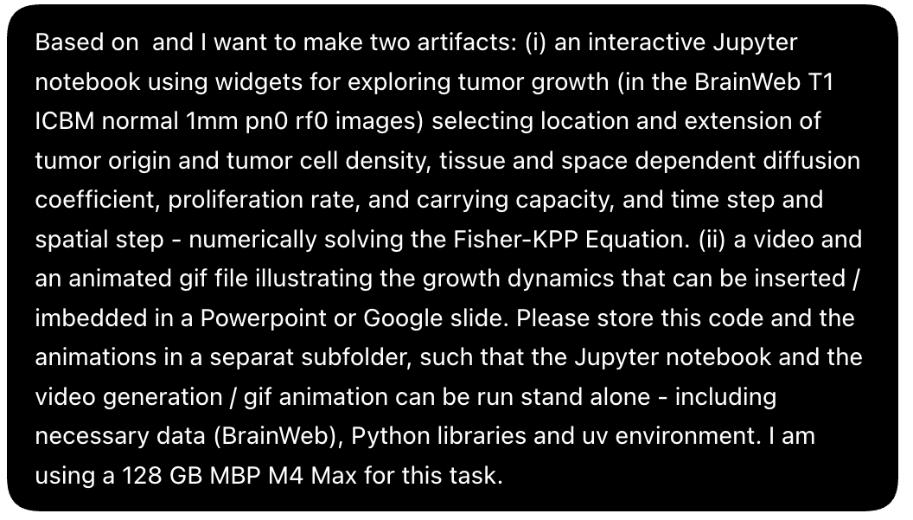
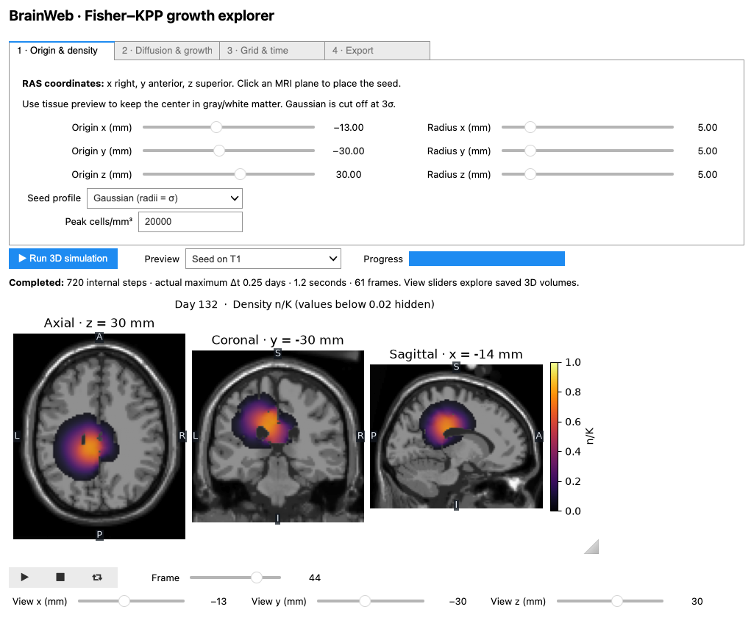
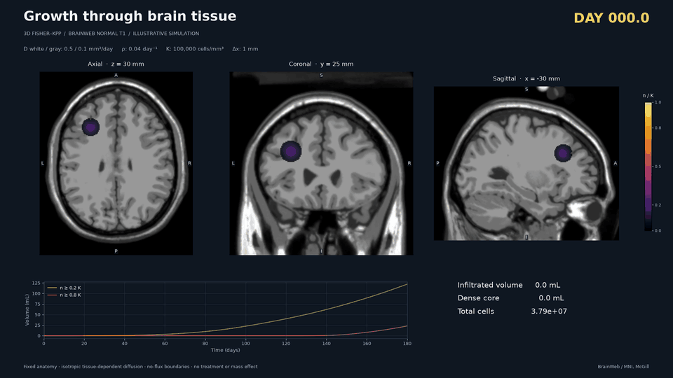

AI-assisted tumor growth modelling
Prompt:
https://github.com/arvidl/brainweb_fisher_kpp

Slide 9
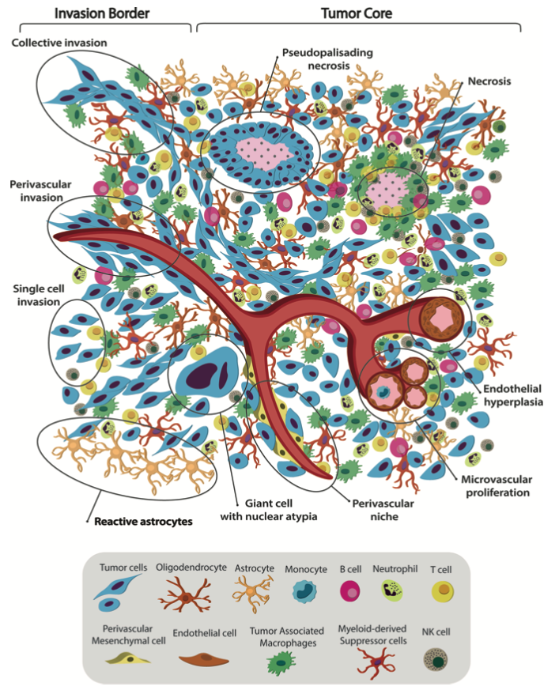
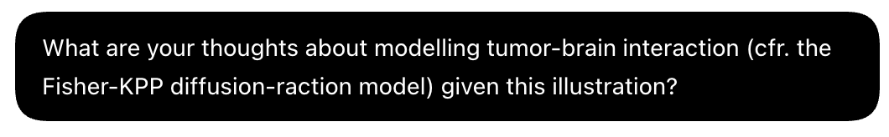
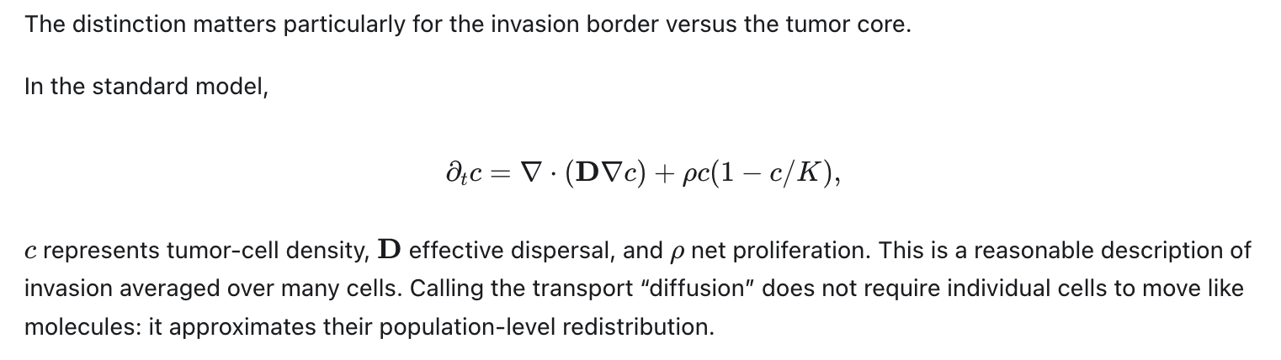
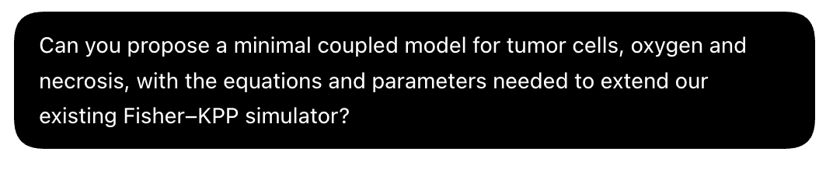
Follow-up
prompt:
A. Comba et al. Uncovering Spatiotemporal Heterogeneity of High-Grade Gliomas. Front Oncol 2021;11;703764

Slide 10
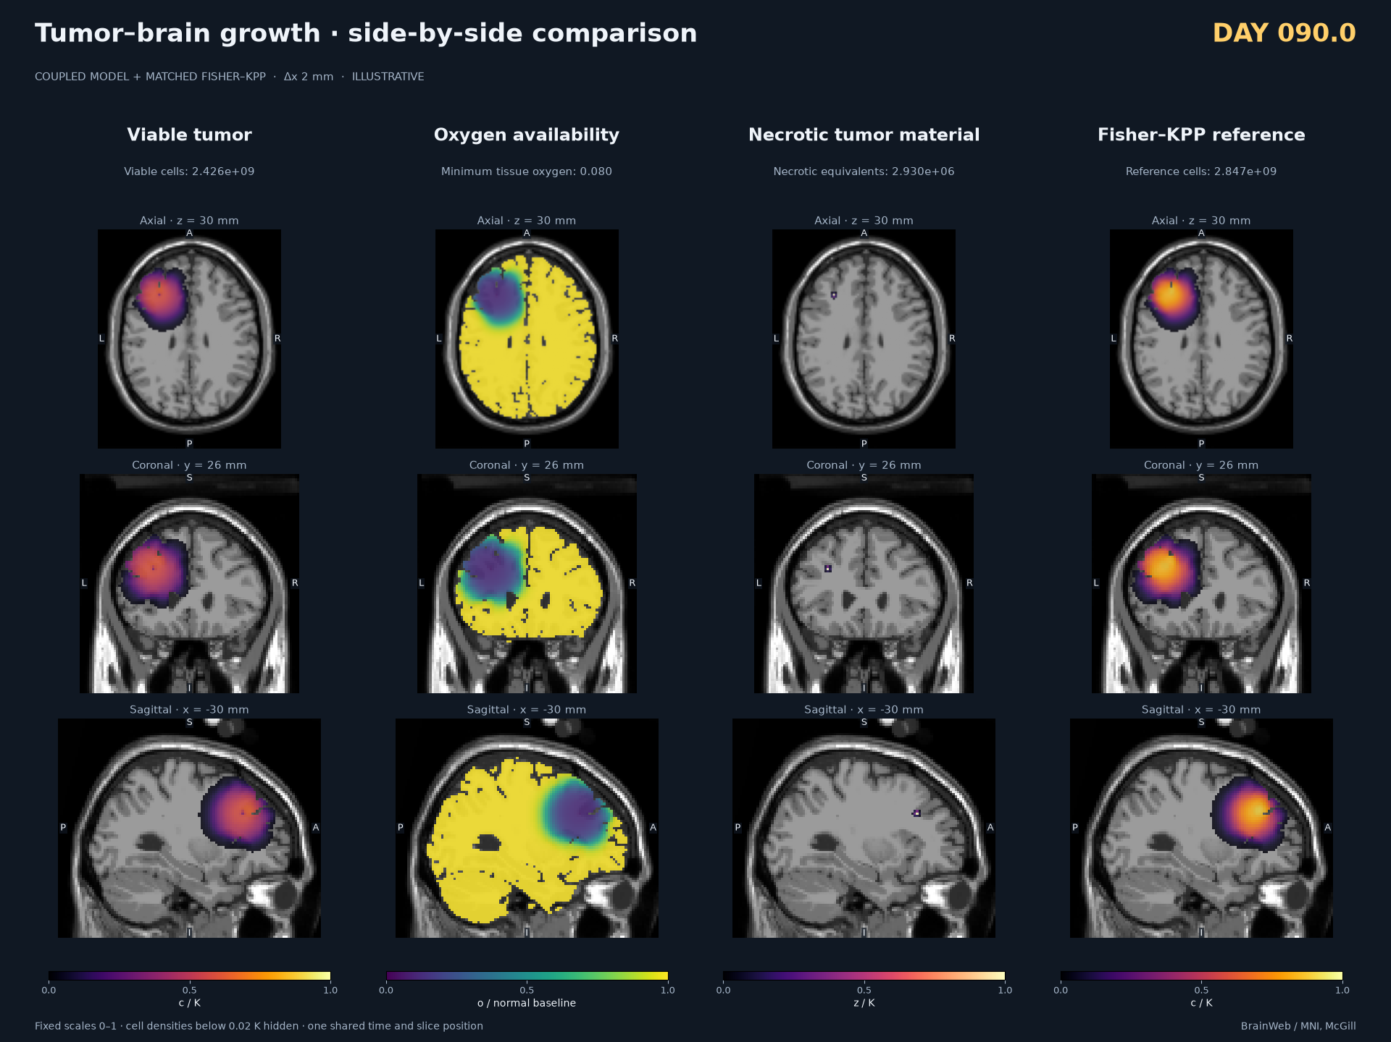
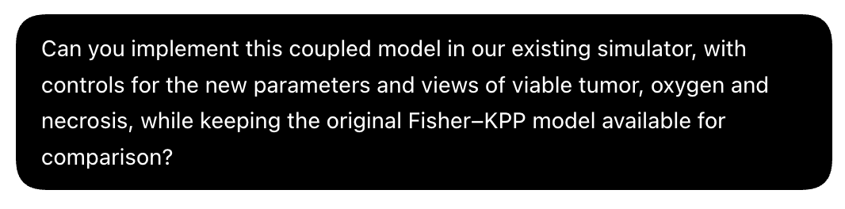
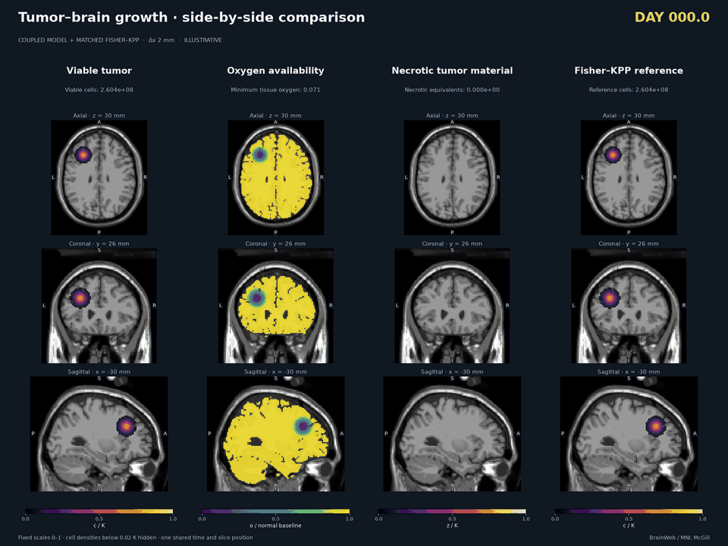
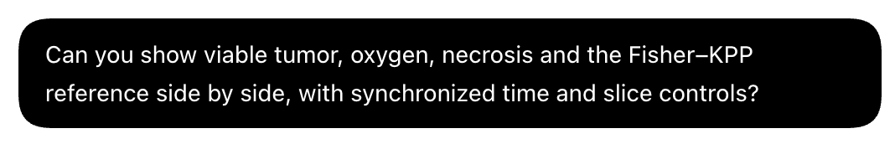
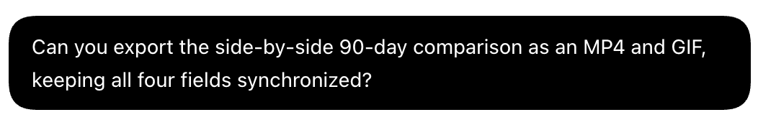
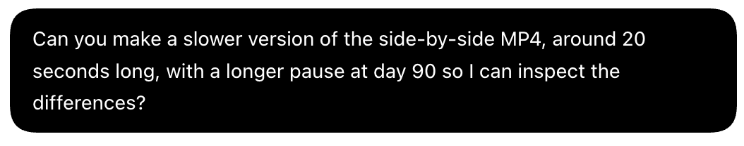

3D implementation
visualisation
https://github.com/arvidl/brainweb_fisher_kpp

Slide 11
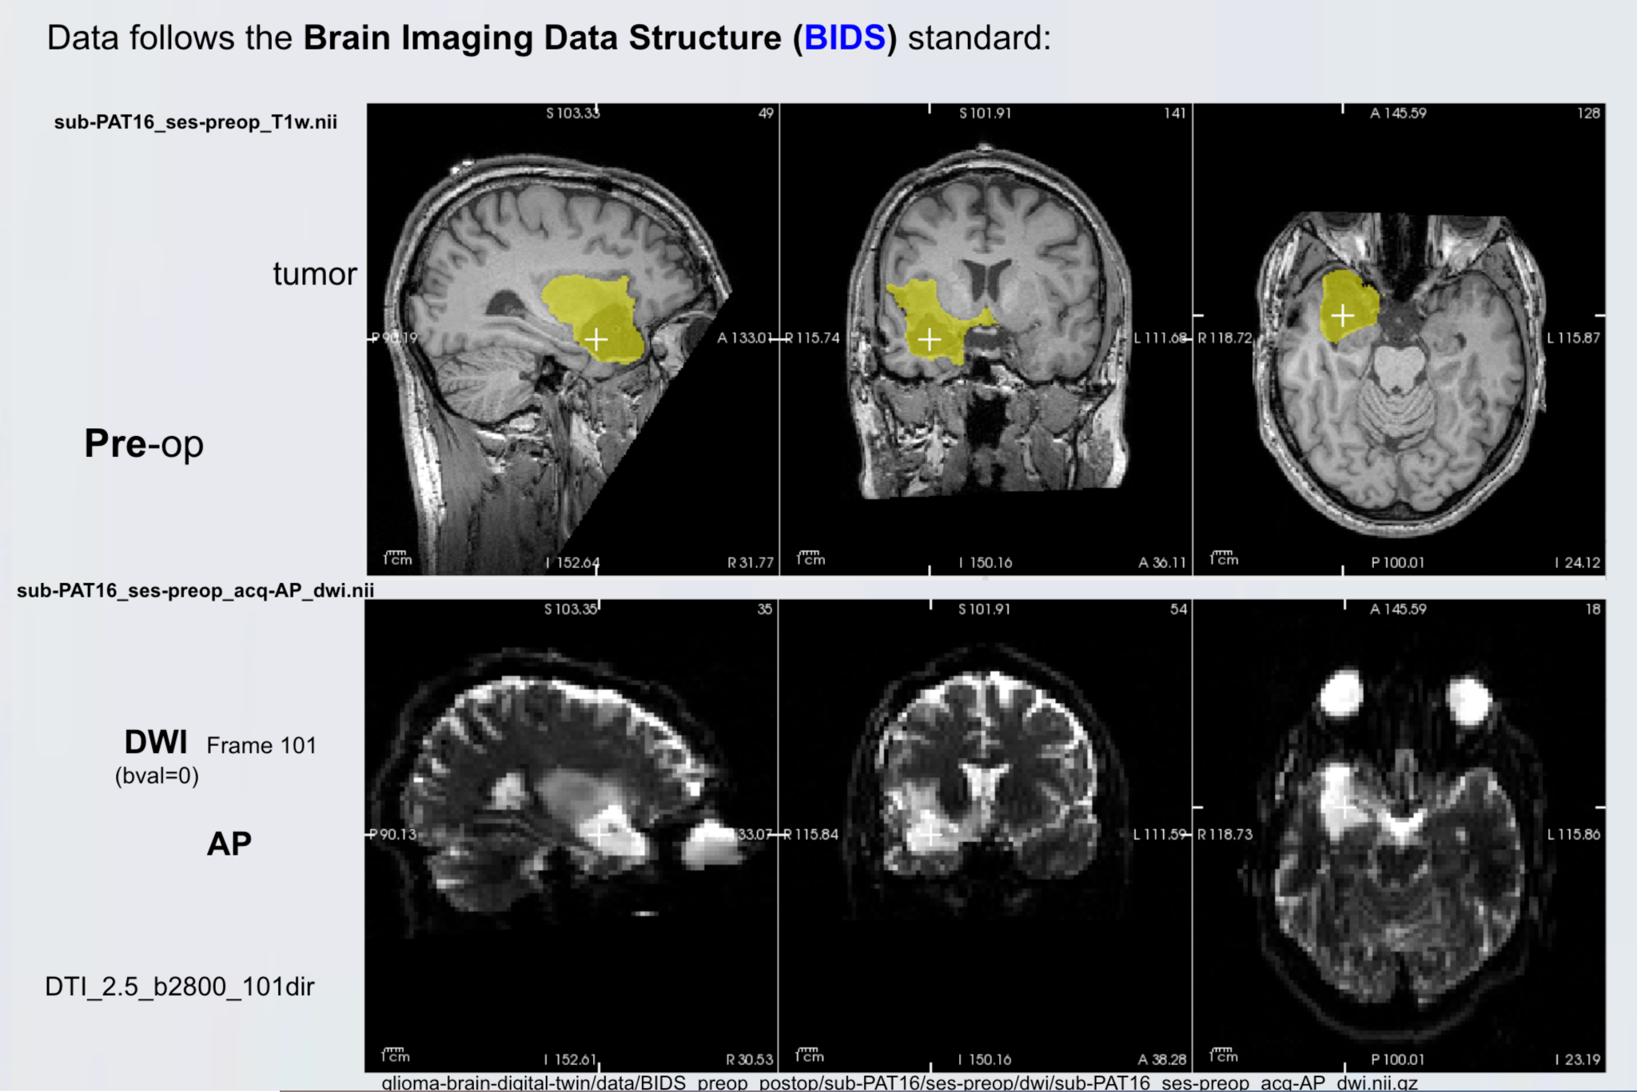
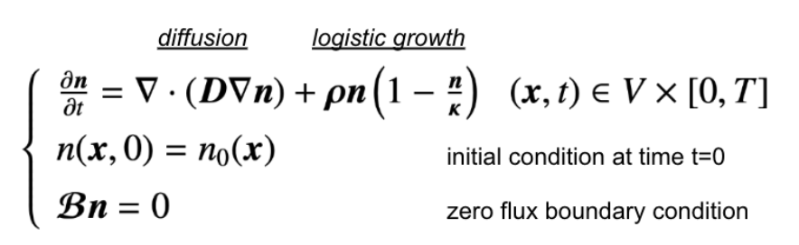
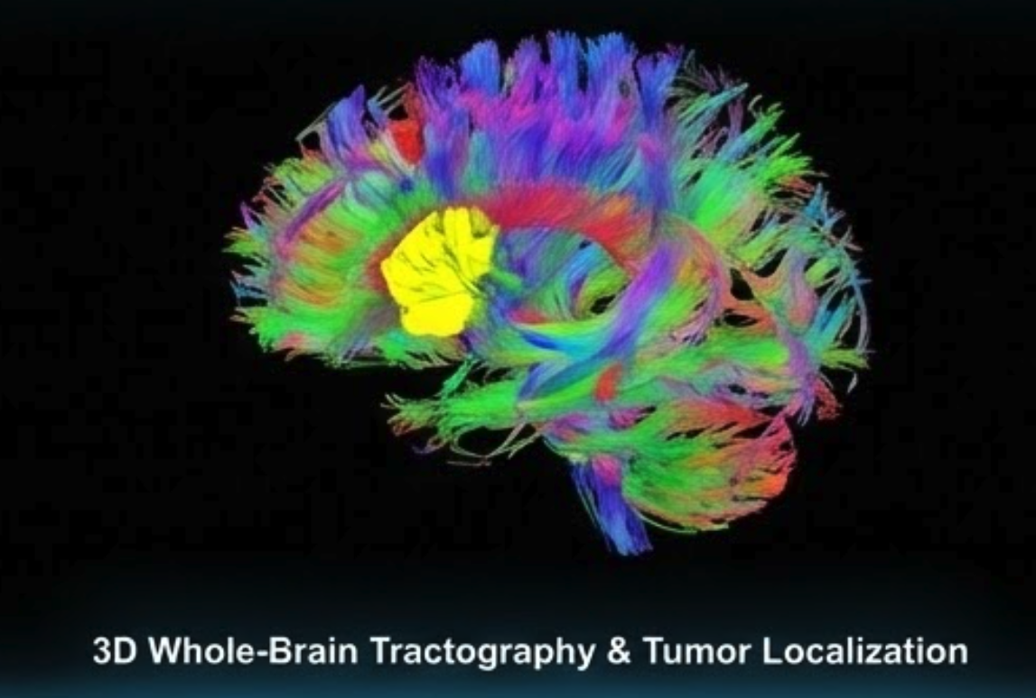
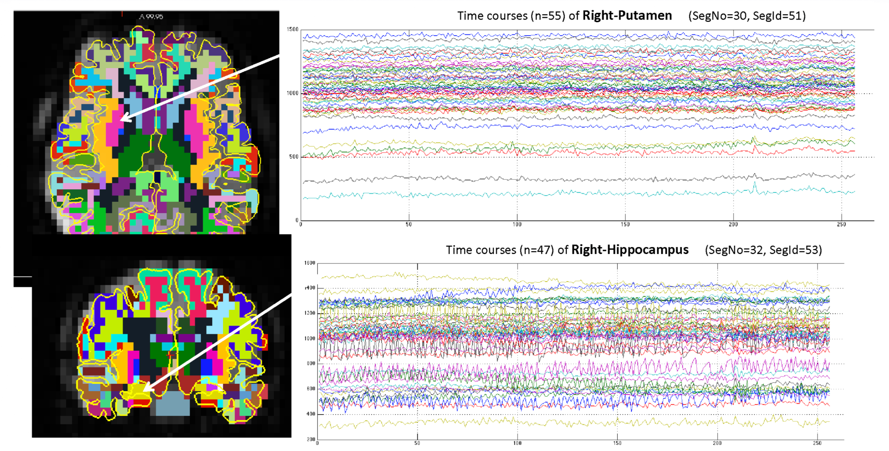
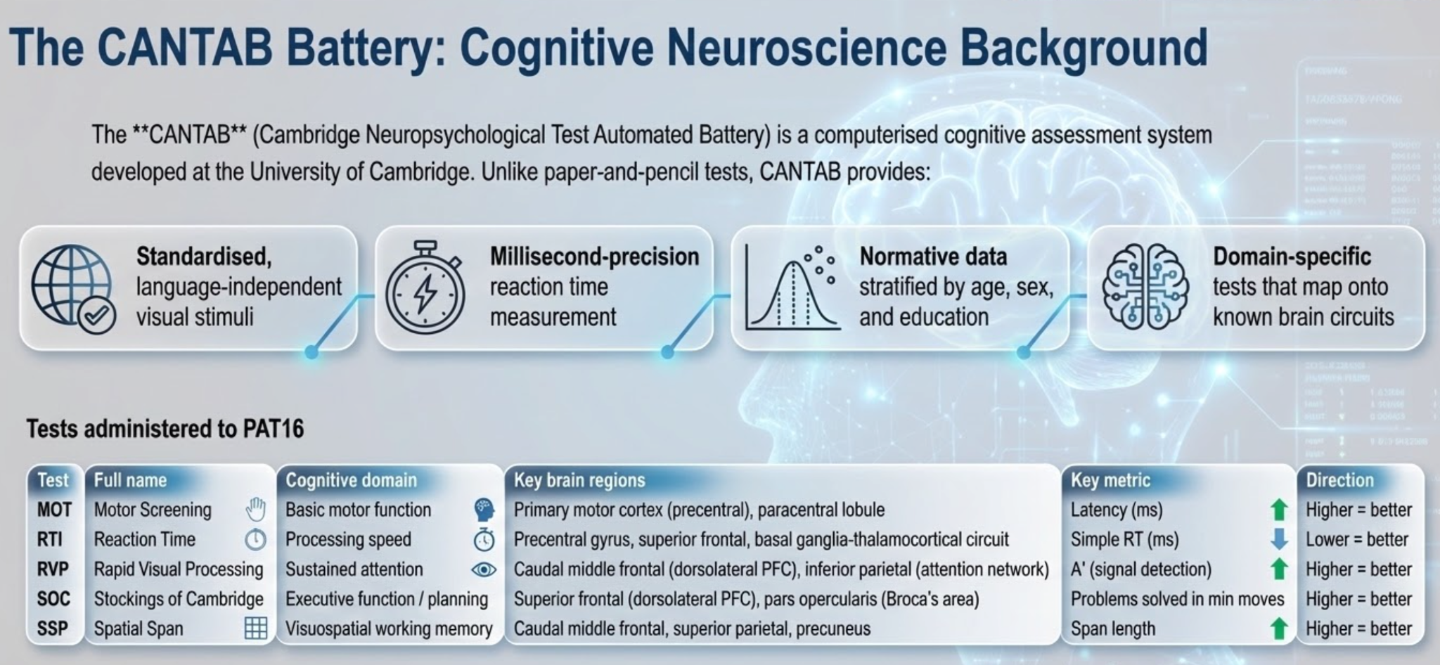
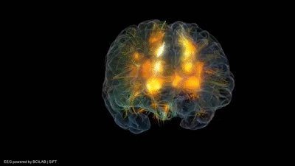
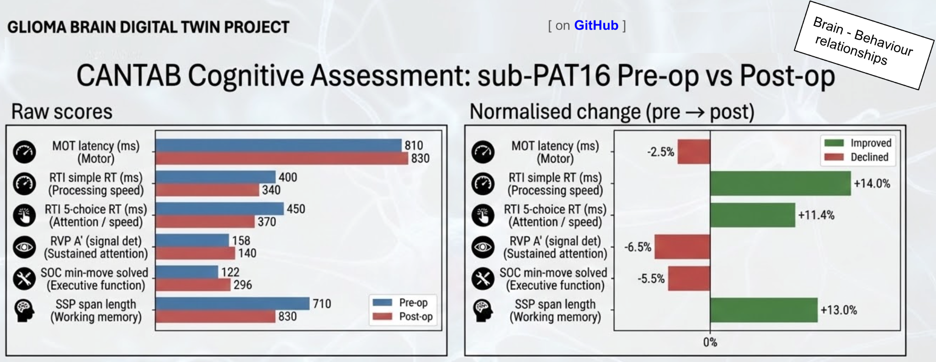
sub-PAT16
└── ses-preop
├── anat
│ ├── sub-PAT16_ses-preop_T1w.json
│ └── sub-PAT16_ses-preop_T1w.nii.gz
├── dwi
│ ├── sub-PAT16_ses-preop_acq-AP_dwi.bval
│ ├── sub-PAT16_ses-preop_acq-AP_dwi.bvec
│ ├── sub-PAT16_ses-preop_acq-AP_dwi.json
│ ├── sub-PAT16_ses-preop_acq-AP_dwi.nii.gz
│ ├── sub-PAT16_ses-preop_acq-PA_dwi.bval
│ ├── sub-PAT16_ses-preop_acq-PA_dwi.bvec
│ ├── sub-PAT16_ses-preop_acq-PA_dwi.json
│ └── sub-PAT16_ses-preop_acq-PA_dwi.nii.gz
└── func
├── sub-PAT16_ses-preop_task-rest_bold.json
└── sub-PAT16_ses-preop_task-rest_bold.nii.gz
└── ses-postop
├── anat
│ ├── sub-PAT16_ses-postop_T1w.json
│ └── sub-PAT16_ses-postop_T1w.nii.gz
├── dwi
│ ├── sub-PAT16_ses-postop_acq-AP_dwi.bval
│ ├── sub-PAT16_ses-postop_acq-AP_dwi.bvec
│ ├── sub-PAT16_ses-postop_acq-AP_dwi.json
│ ├── sub-PAT16_ses-postop_acq-AP_dwi.nii.gz
│ ├── sub-PAT16_ses-postop_acq-PA_dwi.bval
│ ├── sub-PAT16_ses-postop_acq-PA_dwi.bvec
│ ├── sub-PAT16_ses-postop_acq-PA_dwi.json
│ └── sub-PAT16_ses-postop_acq-PA_dwi.nii.gz
└── func
├── sub-PAT16_ses-postop_task-rest_bold.json
└── sub-PAT16_ses-postop_task-rest_bold.nii.gz
From detailed imaging and diffusion-reaction modeling of tumor growth in 3D+time
A more “holistic” approach to structural and functional connectivity and cognition

Slide 12
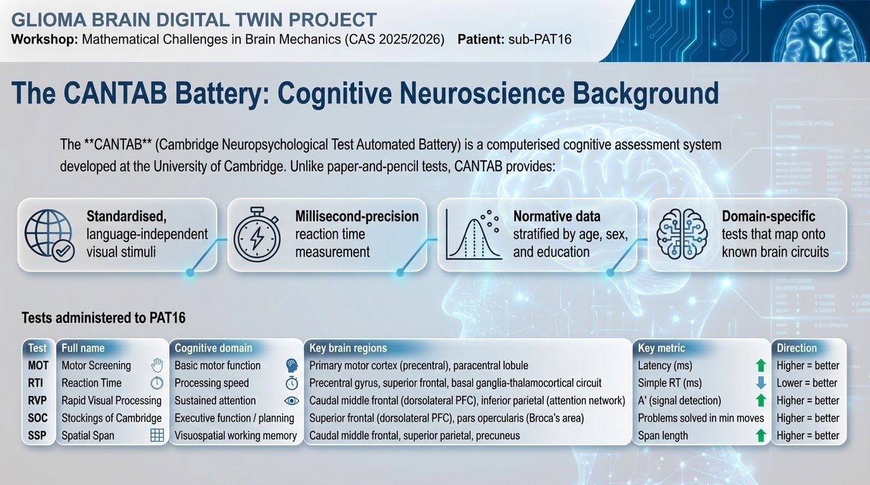
[ on GitHub ]

Slide 13
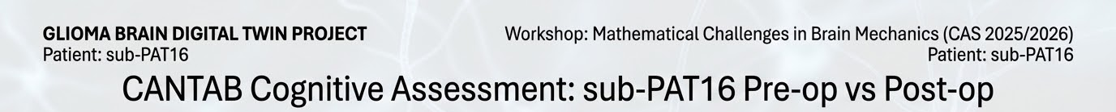
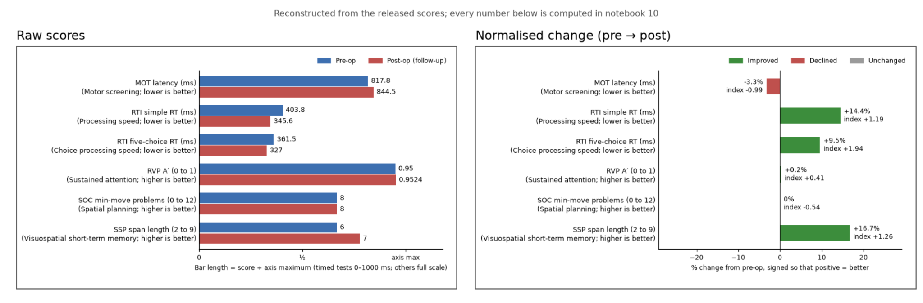
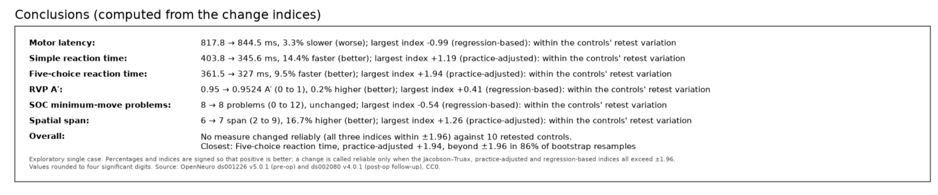
[ on GitHub ]
Brain - Behaviour
relationships

Slide 14
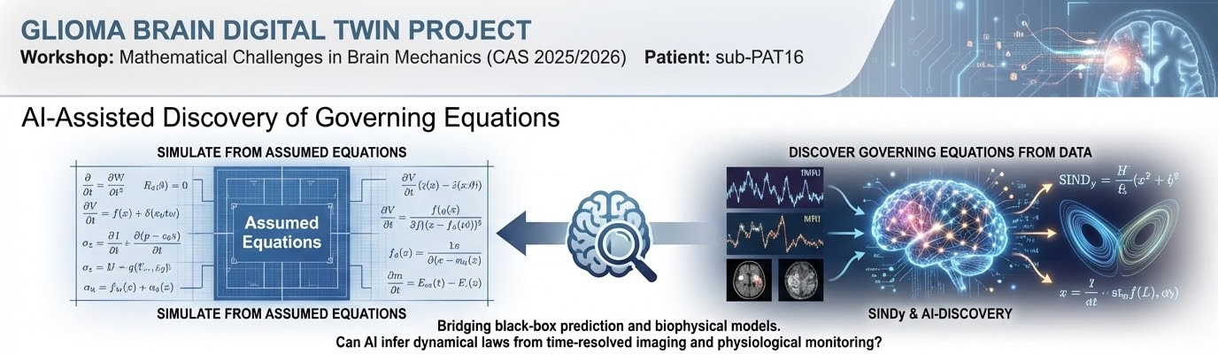

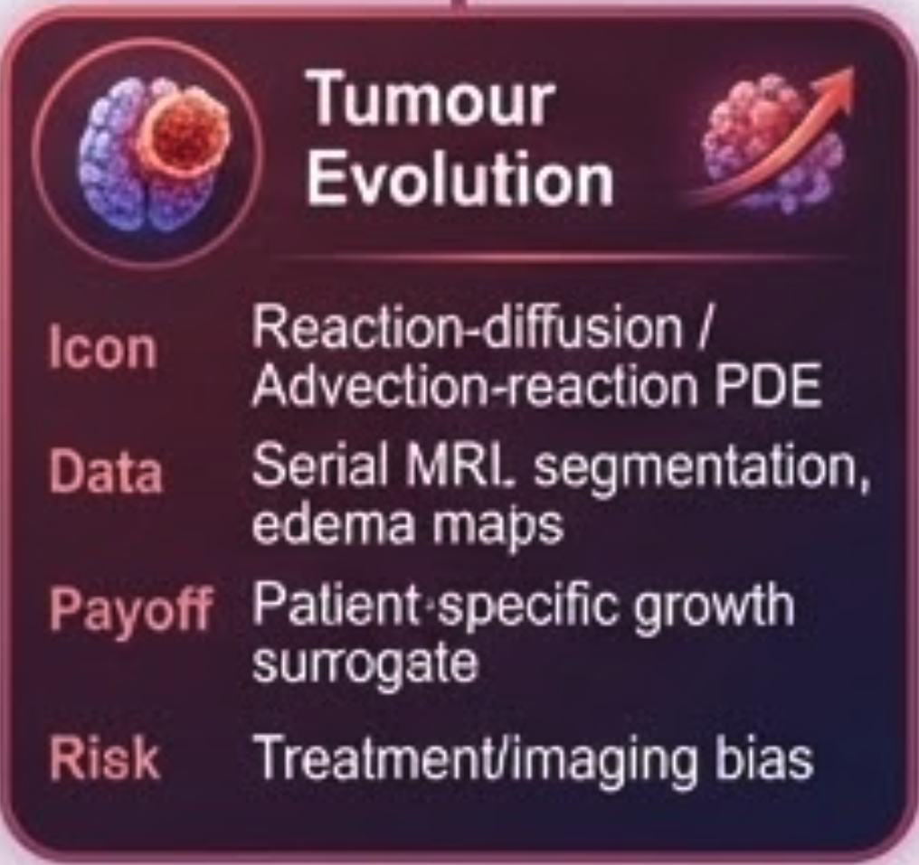
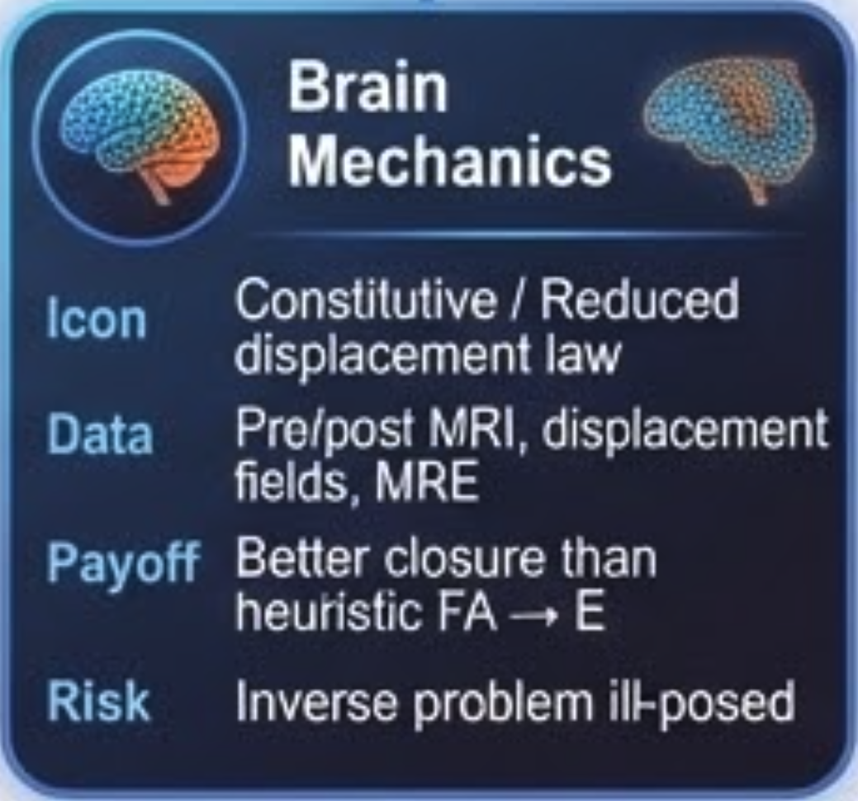
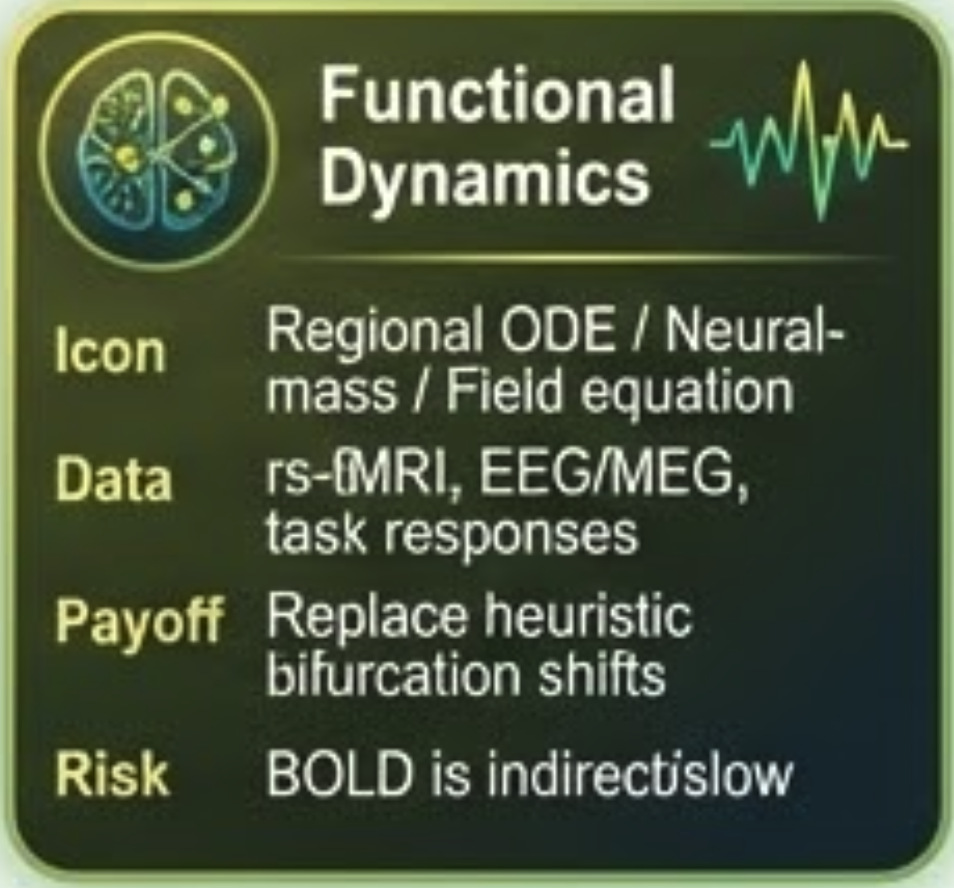





[ on GitHub ]
https://link.aps.org/doi/10.1103/d4tm-92vb
https://www.pnas.org/doi/10.1073/pnas.1517384113
https://doi.org/10.1186/s40708-025-00283-w
https://doi.org/10.1093/bib/bbaf722
https://link.aps.org/doi/10.1103/d4tm-92vb
https://www.pnas.org/doi/10.1073/pnas.1517384113
https://doi.org/10.1186/s40708-025-00283-w
https://doi.org/10.1093/bib/bbaf722

Slide 15

The Research Workflow
(from idea to reporting)
Idea
  Initial concept or question
Literature Review
  Existing research, knowledge gaps
Research Questions
  Precisely testable hypothesis or question
Study Design
  Methodology, participants, variables
Applications
  Ethics approval
  Financing
Implementa-
tion
  Execution, collection of data
Data Analysis
  Processing, analysis, statistics, interpretation
Reporting
  Publishing, peer reviews
  Dissemination
Further Studies
  New studies and collaboration
  Research-
based teaching
KI-akselerert forskning
AI support / AI collaborator / AI agents
https://github.com/arvidl/AI-assisted-glioma-research

Slide 16


Thank you !
CODE

