Slide 1
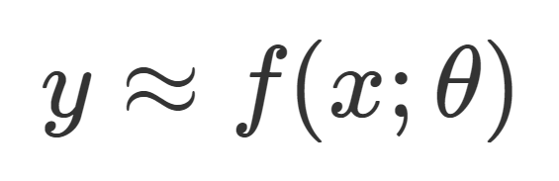
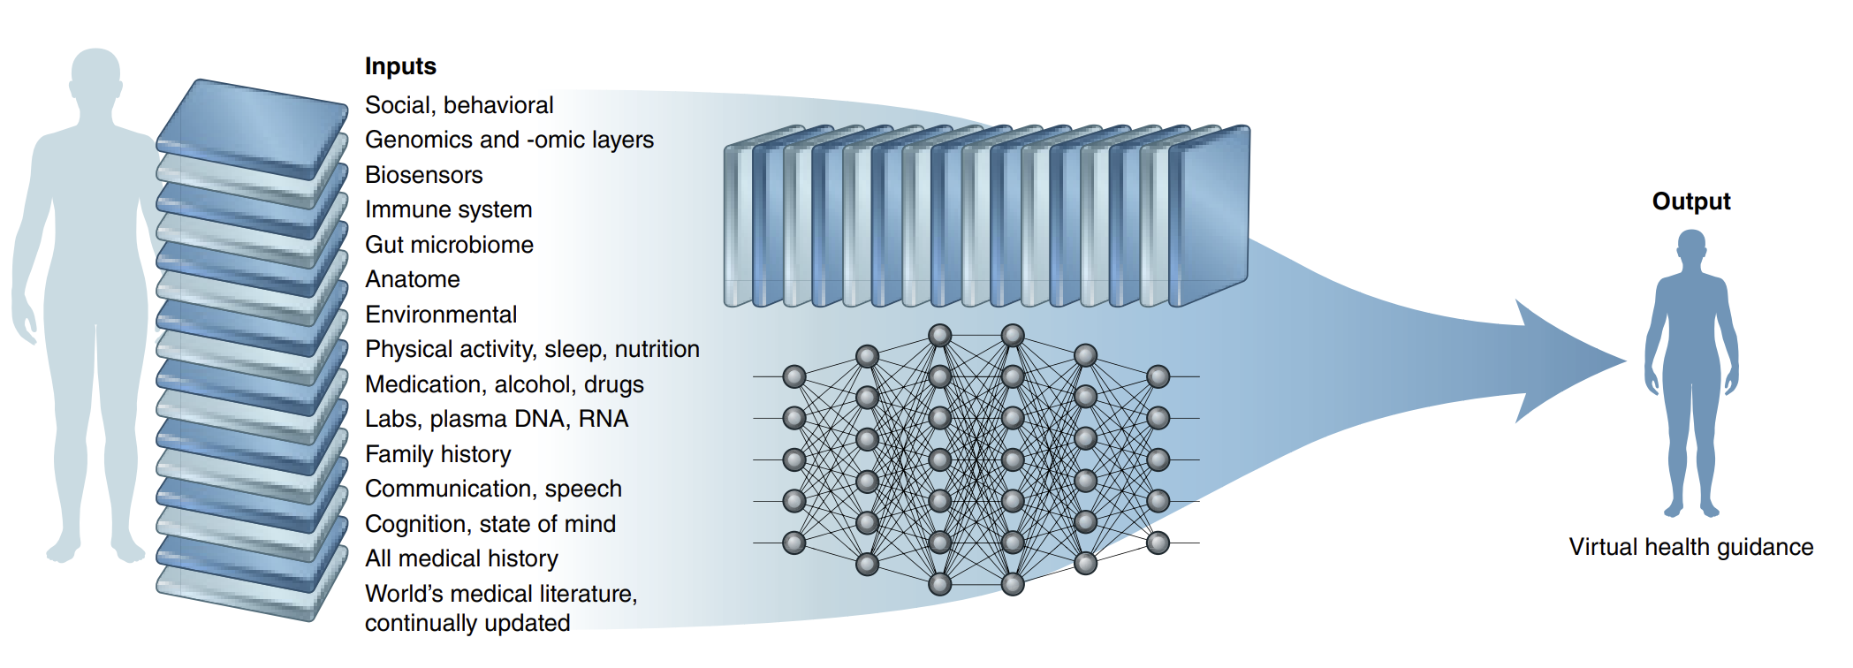
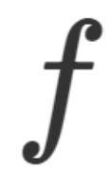

Data:
Trained modell:
Prediction:
- model architecture
Inference
Health guidance
Diagnosis
Phenotype
Survival (OS)
...
model parameters
Imaging-derived information
A medical deep learning model with multimodal input data and algorithms to provide individualized health guidance, diagnosis, etc.
Modified from: E. J. Topol, ‘High-performance medicine: the convergence of human and artificial intelligence’, Nature Medicine 2019;25:44–56. https://www.nature.com/articles/s41591-018-0300-7

Slide 2
Data:
Trent modell:
Prediksjon:
- modell-arkitektur
Inferens
Helseveiledning
Diagnose
Fenotype
Overlevelse (OS)
...
modell-parametre
Bilde-avledet informasjon
En tenkt medisinsk dyplærings-modell med multimodale inndata og algoritmer for å gi individualisert helseveiledning, diagnose, mm.
Modified from: E. J. Topol, ‘High-performance medicine: the convergence of human and artificial intelligence’, Nature Medicine 2019;25:44–56. https://www.nature.com/articles/s41591-018-0300-7

