Slide 1
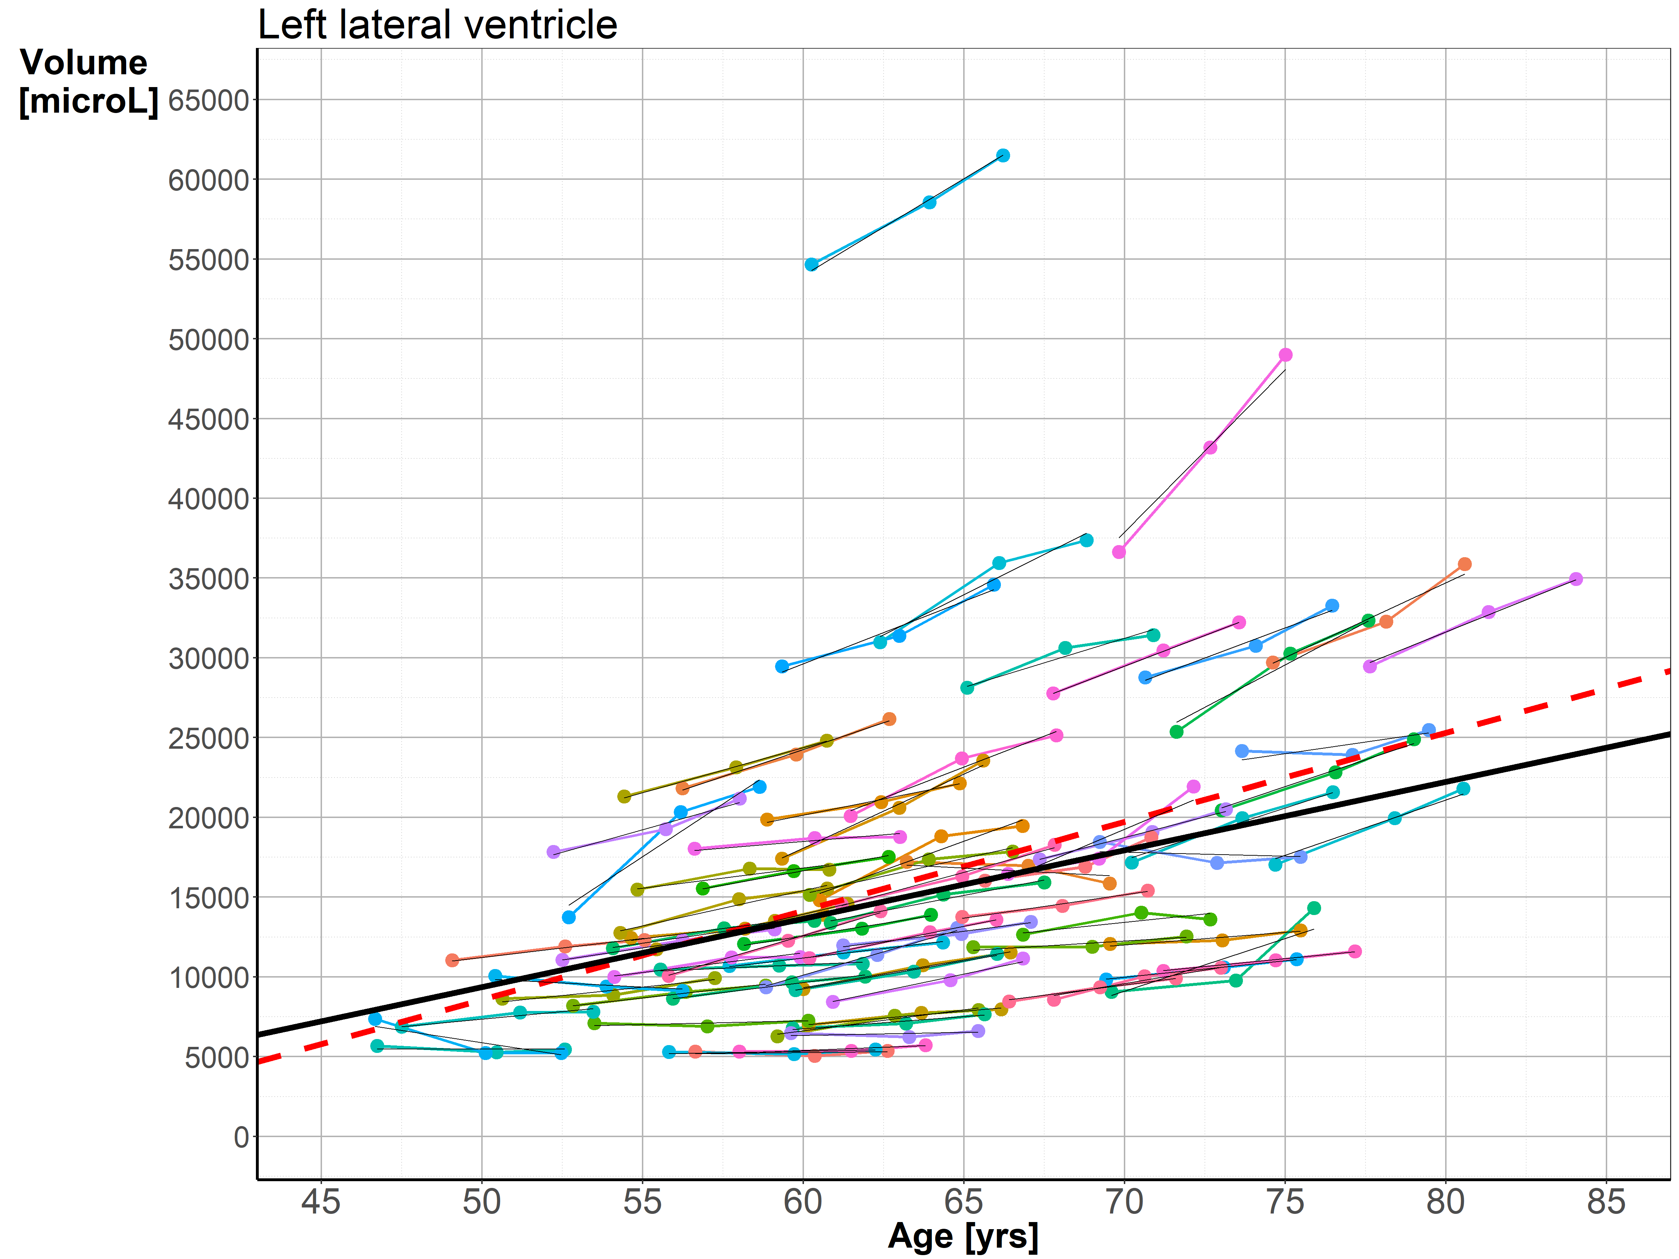
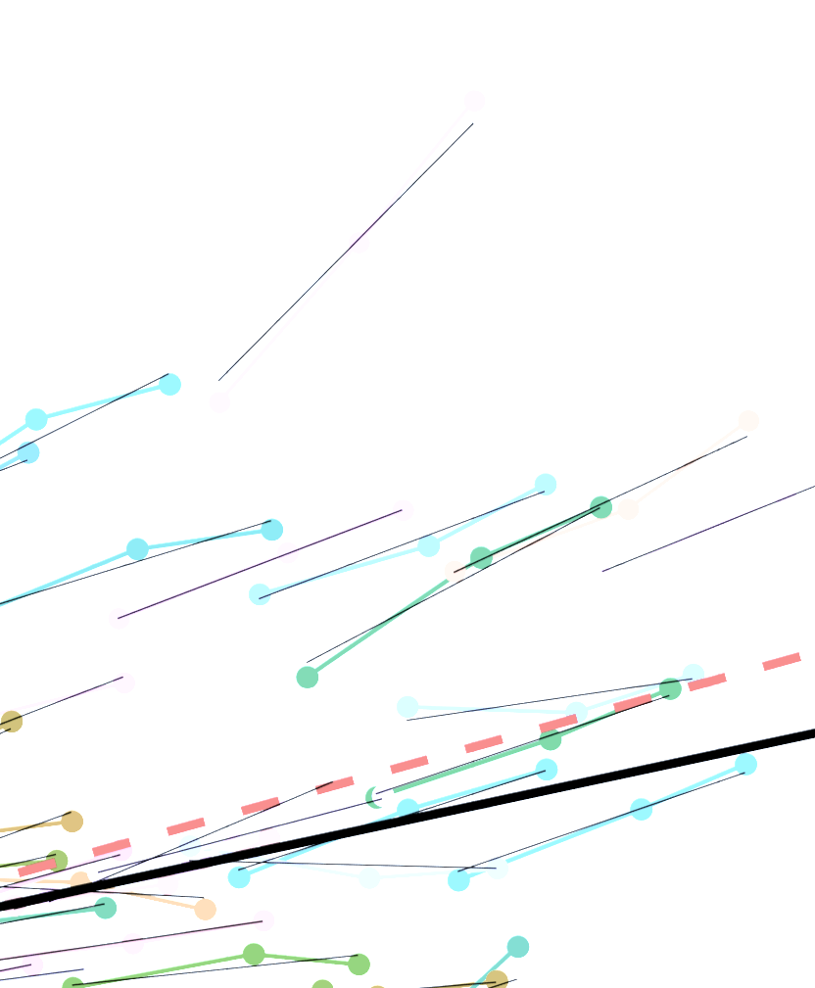
Steepness of individual volume trajectory - b1i
Volume deviation from cohort at wave 1 - Vdev
b1iL
VdevL
Cohort fixed effect
Vol_{ij} = β₀ + β₁ Age_{ij} + (b_{0i} + b_{1i} Age_{ij}) + ϵ_{ij}
10_rpy2_lmer_left_ventricle.pdf
10_rpy2_lmer_right_ventricle.pdf
Notes:
The first set gives a measure of the steepness of individual volume trajectory, and equals the slope of the random effects.
The second set gives information about the ventricular volume of a given individual when he or she was included in the study, defined as the distance between the observed volume and the expected volume at a given age according to the cohort fixed effects line.
These four measures were included in the further analysis to represent core features of individual trajectories of lateral ventricle volumes.

