Slide 1




Facial Expression Classifier
Image prediction with neural networks
Arvid Yuen

Slide 2
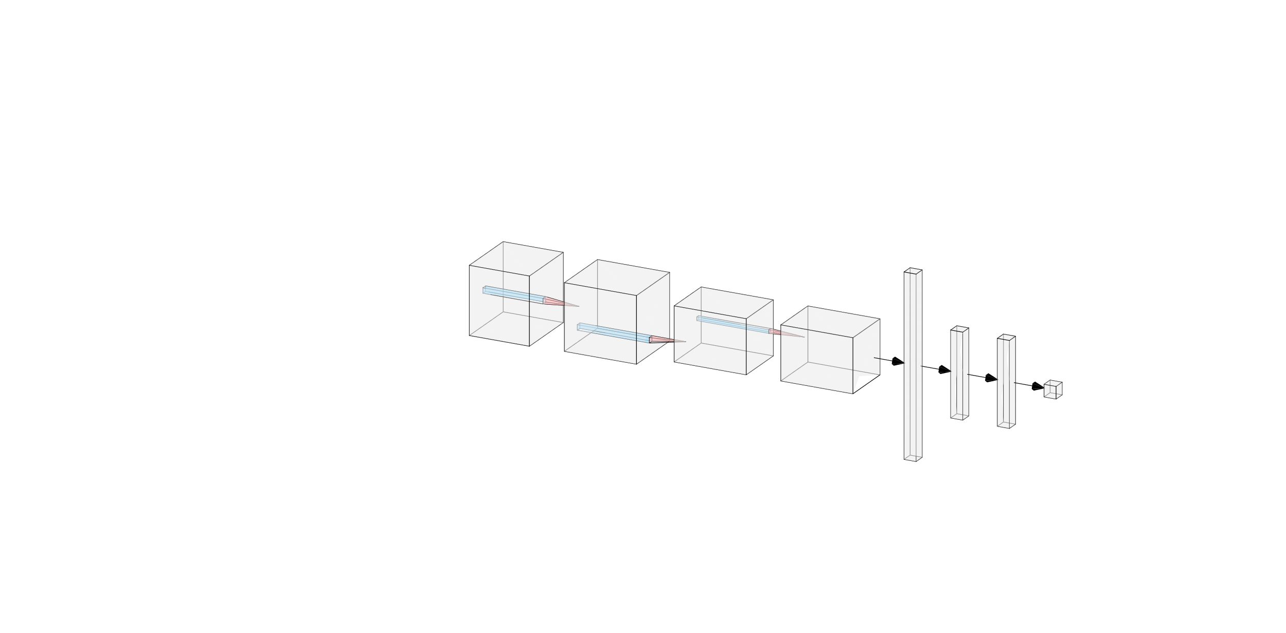

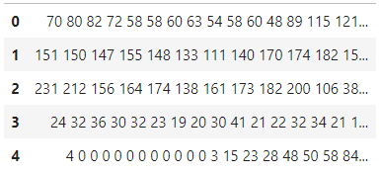
Process Overview
1. Clean and pre-process data
3. Build & evaluate models
?
4. Prediction probabilities
2. Convert to images
Angry %
Happy %
Sad %
Surprise %
Neutral %

Slide 3
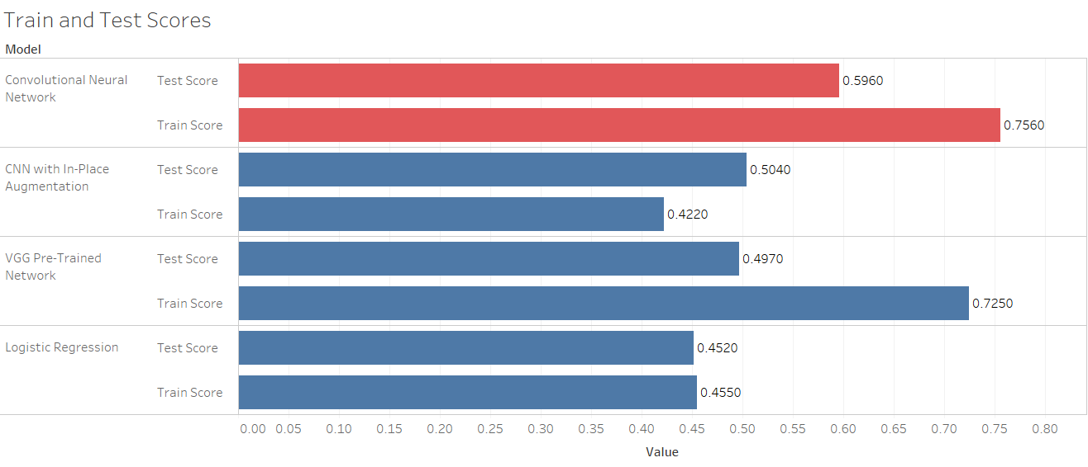
Model Evaluation

Slide 4
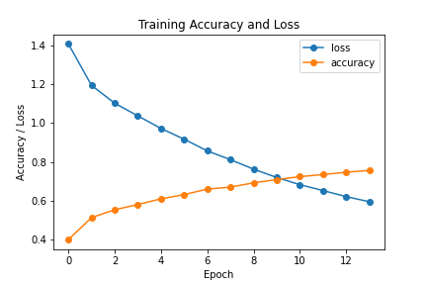
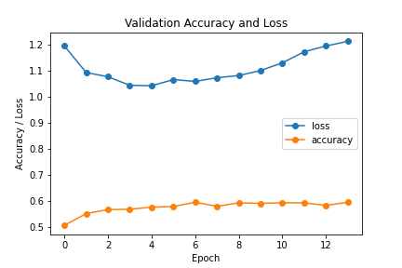
CNN Model Accuracy

Slide 5


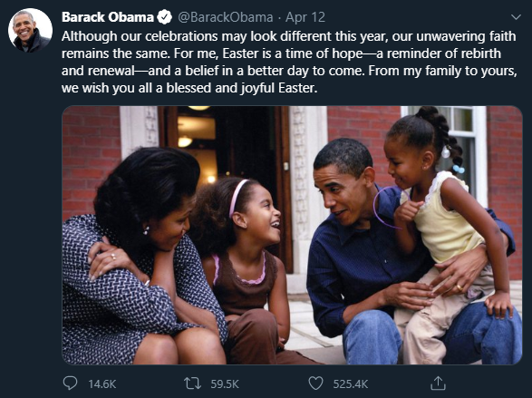
Applications
Sentiment Analysis
Smart Applications

Slide 6


Thank You
github.com/arvidyuen7
linkedin.com/in/arvidyuen7

