Slide 1

FIFA 21 Project
By Arvind Bandesha

Slide 2

General info about FIFA21 Dataset
FIFA 21 Dataset is scraped from sofifa.com
17,125 observations of 107 variables
Each row is data on a player
['Age', 'OVA', 'Growth', 'Value', 'Attacking', 'Crossing', 'Finishing', 'Heading Accuracy', 'Short Passing', 'Volleys', 'Dribbling', 'Curve', 'FK Accuracy', 'Long Passing', 'Ball Control', 'Movement', 'Acceleration', 'Sprint Speed', 'Agility', 'Reactions', 'Power', 'Shot Power', 'Stamina', 'Long Shots', 'Mentality', 'Aggression', 'Positioning', 'Vision', 'Penalties', 'Composure', 'SM', 'IR', 'PAC']

Slide 3

Data Preprocessing

Slide 4
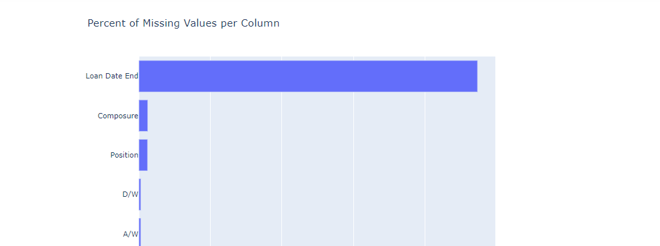
Dropping Problematic Variables
Loan Date End being the most problematic column
> fifa21.drop(['Loan Date End','Joined','Hits','Gender'],axis=1,inplace=True)

Slide 5
Formatting Object Types
Before
Wage | Value | Release Clause | Height | Weight
€625K | €600M | €1M | 5’7” | 150lb
Wage, Value and Release Clause based on the last character.
Height formatted based on first character plus the character between the quotations
Weight formatted by removing last 2 characters
After
Wage | Value | Release Clause | Height | Weight
625000 | 600000000 | 1000000 | 67 | 150

Slide 6
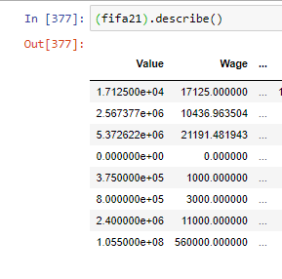

Dropping Zeroes for Wage, Value
Observations removed might be far removed players
Although we lost many observations, the good stuff is still there

Slide 7

Feature Engineering

Slide 8
BMI
Body Mass Index of Players

Slide 9

Feature Selection

Slide 10

PCA + Clustering

Slide 11

Modeling

Slide 12

Linear Regression

Slide 13

Random Forest Regression

Slide 14

Neural Network (Keras, Tensorflow)

