Slide 1
Occipitoatlantoaxial Malformation
A neurologic condition caused by inherited bone deformities in the spinal column in Arabian Horses
-Finno Lab

Slide 2
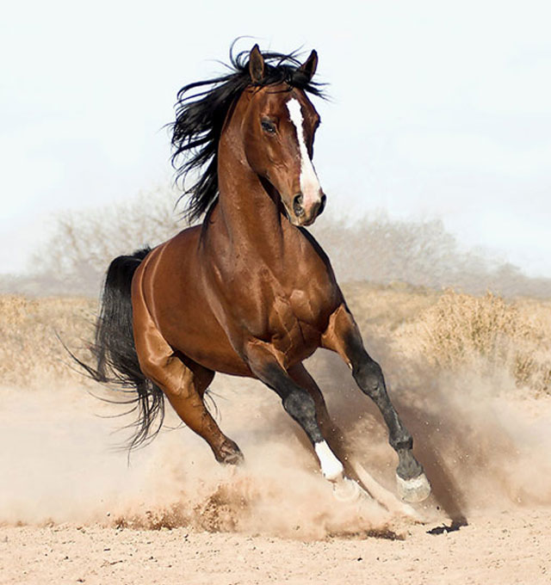
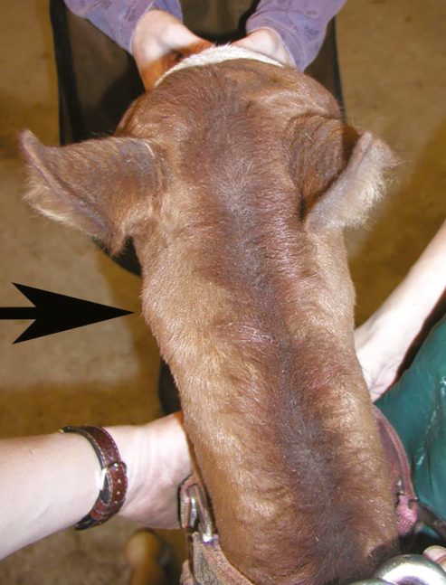
The Phenotype
Ataxia or tetraparesis
Abnormal Head Position
Progressive ataxia
Extended neck posture
Clicking noise during flexion and extension
Still born
http://horsebreedslist.com/Content/horse-images/97/big/arabian-picture-1.jpg

Slide 3
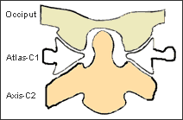
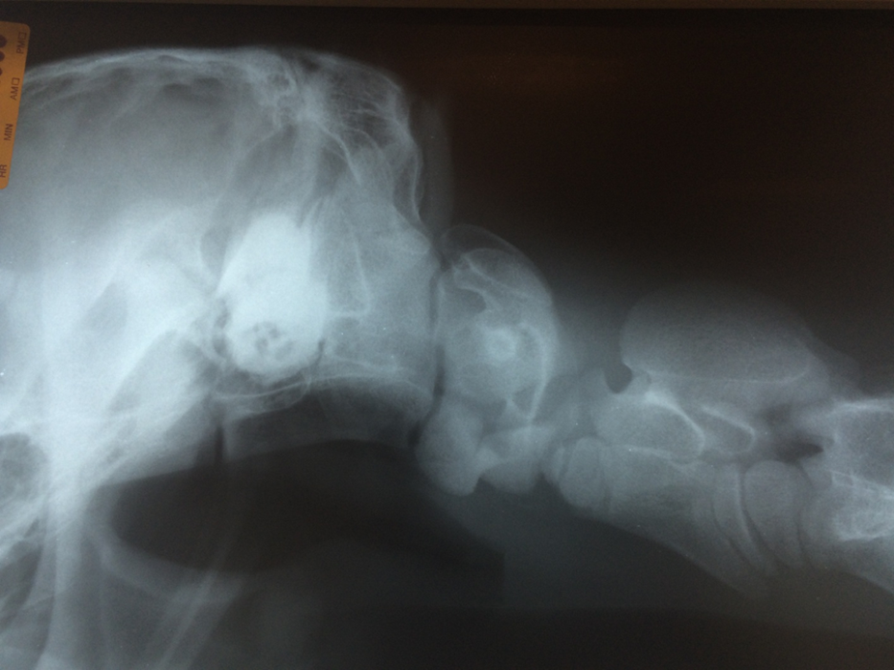
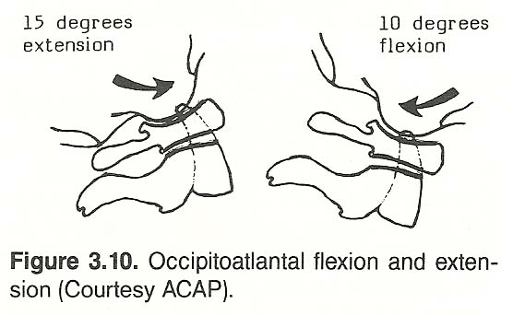
Occipitoatlantoaxial malformation (OAAM)
X-Ray: Lateral View, OAAM Affect Horse
http://www.upcspine.com/images/atlas_sub2.gif
http://www.chiro.org/ACAPress/GRAPHICS/THE_CERVICAL_SPINE/Cervical_Spine_Figure10.jpg

Slide 4
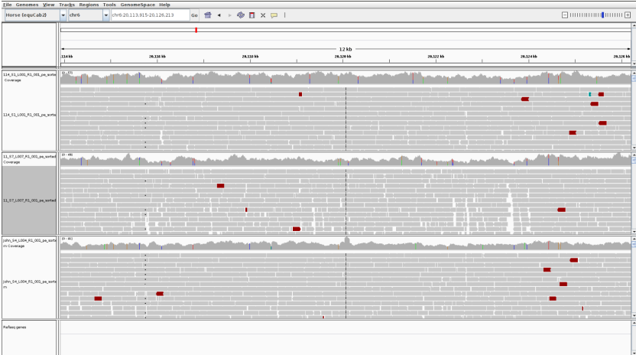
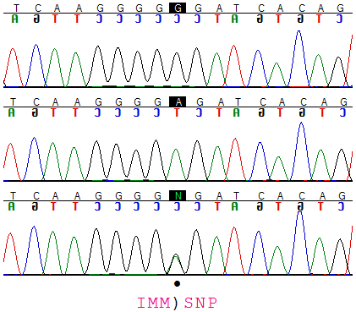
Data Creation
Whole Genome sequencing
13 X coverage
2 affected foals
Variant Analysis
Sanger sequencing of additional individuals

