Slide 1
Working on UC Davis Bioinformatics Core Administrated Computing Systems
Matt Settles
Last Updated Jan 24, 2017

Slide 2
Outline
Introduction/Questions
Explain user space (home directories) vs share space (lab directories/shares).
Working in a team, file/folder permissions.
The module system, when to request software, when to install software yourself.
Slurm

Slide 3
Quick Introduction to the UC Davis Bioinformatics Core

Slide 4
The mission of the Bioinformatics Core facility is to facilitate outstanding omics- scale research through these activities:
Data Analysis
The Bioinformatics Core promotes experimental design, advanced computation and informatics analysis of omics scale datasets that drives research forward.
Research Computing
Maintain and make available high-performance computing hardware and software necessary for todays data-intensive bioinformatic analyses.
Training
The Core helps to educate the next generation of bioinformaticians through highly acclaimed training workshops, seminars and through direct participation in research activities.
Data Analysis
Research Computing
Training
Data Analysis
Research Computing
Training
Data Analysis
Research Computing
Training
Data Analysis
Research Computing
Training
Intelligently analyzing data from genomics, and other projects, to help drive research forward
Helping build high-performance software and hardware bioinformatics solutions
Providing acclaimed training workshops that will equip people with in-demand bioinformatics skills
Intelligently analyzing data from genomics, and other projects, to help drive research forward
Helping build high-performance software and hardware bioinformatics solutions
Providing acclaimed training workshops that will equip people with in-demand bioinformatics skills
Intelligently analyzing data from genomics, and other projects, to help drive research forward
Helping build high-performance software and hardware bioinformatics solutions
Providing acclaimed training workshops that will equip people with in-demand bioinformatics skills
Intelligently analyzing data from genomics, and other projects, to help drive research forward
Helping build high-performance software and hardware bioinformatics solutions
Providing acclaimed training workshops that will equip people with in-demand bioinformatics skills

Slide 5
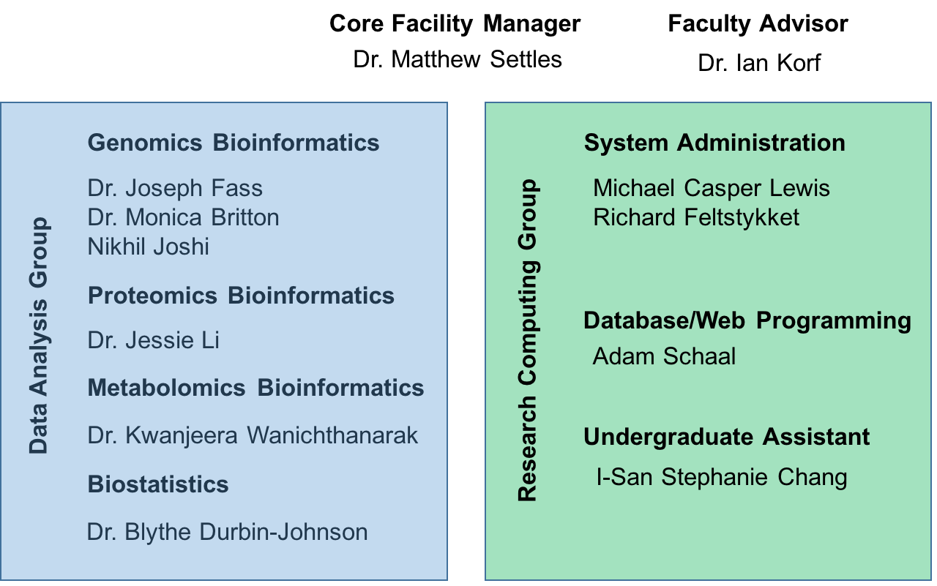
UC Davis Bioinformatics Core in the Genome Center

Slide 6
Contacts
Computing Issues, include but not limited to
User account questions, equipment failure/malfunction, software install, software failures (not related to use)
helpdesk@genomecenter.ucdavis.edu
Bioinformatics related questions, include but not limited to
bioinformatic methods questions, software use, data questions
Bioinformatics.core@ucdavis.edu

Slide 7
Home
Directories
Lab Share’s
Cabernet
Slurm
Scheduler
HPC14
Lab/PI Server

Slide 8
User space vs shared space AND Working in a team, file/folder permissions. Groups/Labs, etc.

Slide 9
What is a user account?
User account are not tied to PI/labs. Any personal who has a legitimate reason for requesting an account will be provided one. Users should only ever login as themselves and never as another user.
The Bioinformatics Core provides users with a home directory that is capped at 100Gb (we are exploring reducing that to 10Gb).
User home directories are ‘personal’ space, special permission must be given by university administration to explore a user’s home directory.
You now presumably can login to cabernet, but because your not yet associated with a group you can’t do much. Never ever work on cabernet.

Slide 10
Lab Groups
The UC Davis Bioinformatics Core manages lab group data shares, top level folder associated with a collective group. These are data storage resources purchased by a lab, or PI.
Groups/Labs/Collaborators work together in lab shares, found under /share/group_name
[ex. The Bioinformatics Core share is /share/biocore ]
All lab associated analysis should be performed in lab shares. Virtually nothing should be done in your home directory, I personally have:
A link to my labs share
Software I’ve installed for me

Slide 11
Linux permissions
Users on linux system have a user id and group(s) membership(s)
to see your group memberships on the command line type: groups
You may see an ‘error’ groups: cannot find name for group ID 1107119953 you can safely ignore this
Access to additional resources [data/compute] are driven by group permissions/memberships.
More information on linux permissions
https://www.linux.com/learn/understanding-linux-file-permissions

Slide 12
By default
By default, you have sole access to your home directory by both user and group.
By default the lab share is owned by the PI and the group may be the PI group id, or a special group id [ ex. subproject ].
By default, all shares are read accessible by everyone and write accessible by the user and the group.
By default, the group id on a share is a ‘sticky’ bit, this means that any files/folders created under that share folder inherit the same permission (group read/write) but are owned by the user which created them.

Slide 13
Working as a team
Groups and permissions are setup to facilitate team/group interactions.
When working on files shared with other Users you don’t have to request the other user to modify permissions, the group sticky bit takes care of that for you.
YOU DO HAVE TO BE CAREFUL of others work! Since you have group write ability you are able to modify, delete and otherwise impact others people work/project.
Once a file/folder has been created you can modify the permission to restrict access, however should the PI request the bioinformatics core to change it back, we will.

Slide 14
Linux Permissions
Last thing about permissions, I like to be very permissive, so in addition to the lab share group sticky bit, I also set, in my ~/.bash_profile
umask 0002
By default all files/folders I create are group read/write

Slide 15
Centralized Resources
Genomes – some genomes and mapping indexes (bwa/bowtie) are available centrally to be used by everyone, they can be found under
/share/genomes
Ensembl
genome_reference_consortium
Igenomes
Kraken
ncbi
ncbi_genomes
patric

Slide 16
Module system
For Software

Slide 17
Modules
The Environment Modules package provides for the dynamic modification of a user's environment via module files.
Each module file contains the information needed to configure the shell for an application. Once the Modules package is initialized, the environment can be modified on a per-module basis using the module command which interprets module files. Typically module files instruct the module command to alter or set shell environment variables such as PATH, MANPATH, etc. module files may be shared by many users on a system and users may have their own collection to supplement or replace the shared module files.
Modules are useful in managing different versions of applications. Modules can also be bundled into meta-modules that will load an entire suite of different applications, or ensure dependencies are loaded.

Slide 18
Modules
Users can manage their environment (software available on the path) via modules.
Users benefit from a familiar applications environment across UC Davis Bioinformatics Core systems (on and off-campus).
Requests for software from any user becomes available to all users.
Efficient system administration pooling software install/testing efforts from different projects/machines.
Additional information https://en.wikipedia.org/wiki/Environment_Modules_(software)

Slide 19
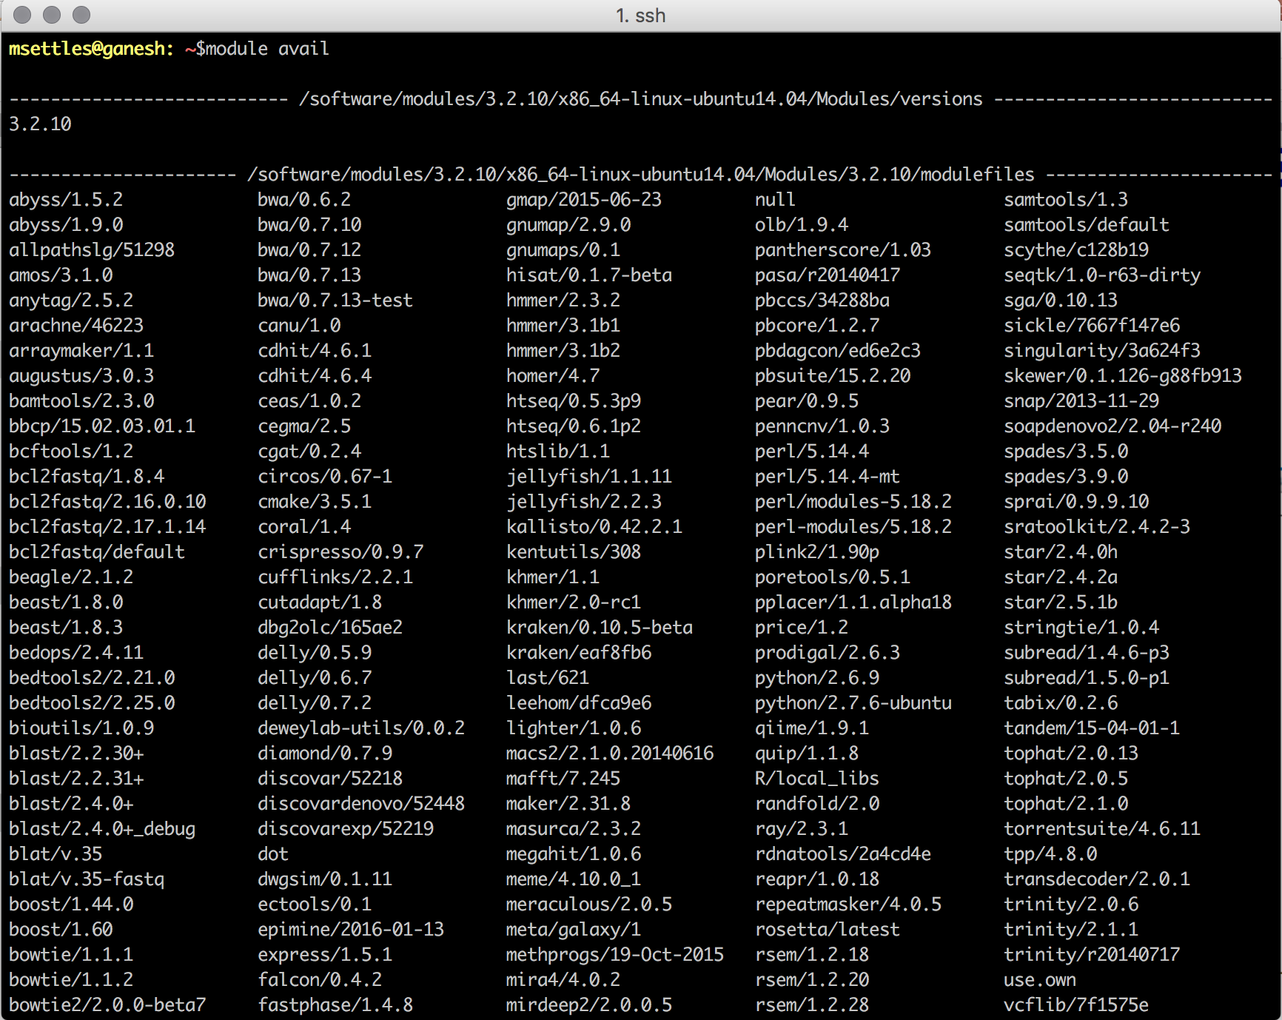

Slide 20
Module basics
module avail, show, load, list, unload
$ module avail # shows the currently available module to the system # format is application/version
$ module show beast/1.8.3 # shows information, such as what-is, other modules loaded and path information
$ module load beast/1.8.3 # load the module beast version 1.8.3
$ module list # show currently loaded modules
$ module unload beast # unload the module beast

Slide 21
An Example
$ module list # no modules are loaded by default
$ module avail # lets see what modules are present, lets load beast
$ which beast # currently unavailable
$ module show beast/1.8.3 # show its load parameters
$ module load beast/1.8.3 # load beast v. 1.8.3 into our environment
$ module list # show the modules currently loaded
$ which beast # now we see beast is available on our path
We can now use beast

Slide 22
Modules are great for
Modules are great for keeping track of what software and specifically what version of the software is being used in an analysis.
You can keep track by
Doing an analysis from a bash script, loading the modules at the beginning of a script.
Copy/paste recording all commands to a file (ex. Analysis.txt) to save the commands for review later
Use history at the end of an analysis and save all commands including module load commands
Note of caution: There are some applications available as a part of the system (ex. samtools) we are working to identify and remove these.

Slide 23
When to install software or request a module
Benefits to having software in a module:
System administrators install, with troublesome software or difficult dependencies they can solve issues others can’t.
Modules are available to all users, to so request benefits many
Difficulties with software in a module:
Can take time for a system administrators to install, we manage over 400 servers and 5 clusters, we do our best to be responsive.
If you’re just trying something out that may or may not be useful can waste valuable system administrator time.

Slide 24
When to install software or request a module
If you feel the software will be broadly applicable, request a module
If it’s a tough install, can’t get it installed yourself, request a module
If you just want to try something out, install it yourself
If you need it right now, install it yourself
If you installed it yourself AND requested a module, once the module is available delete your instance.

Slide 25
Slurm scheduler

Slide 26
SLURM
Simple Linux Utility for Resource Management
Manages compute resources
Schedules jobs using those resources
Original developed at Lawrence Livermore National Labs
Open Source
Supports plugins extending or enhancing functionality
Increasingly being used at academic research computing centers and national labs
Berkeley
UCSD Super Computer

Slide 27
Slurm Commands
sinfo, squeue, sacct, srun, sbatch, scancel
sinfo reports the state of partitions and nodes managed by Slurm. It has a wide variety of filtering, sorting, and formatting options.
squeue reports the state of jobs or job steps. It has a wide variety of filtering, sorting, and formatting options. By default, it reports the running jobs in priority order and then the pending jobs in priority order.
sacct is used to report job or job step accounting information about active or completed jobs.
srun is used to submit a job for execution or initiate job steps in real time. srun has a wide variety of options to specify resource requirements. A job can contain multiple job steps executing sequentially or in parallel on independent or shared resources within the job's node allocation.
sbatch is used to submit a job script for later execution. The script may contain one or more srun commands to launch parallel tasks.
scancel is used to cancel a pending or running job or job step. It can also be used to send an arbitrary signal to all processes associated with a running job or job step.

Slide 28
Slurm Commands - SINFO
sinfo reports the state of partitions and nodes managed by Slurm. It has a wide variety of filtering, sorting, and formatting options.
sinfo --summarize
Node
Nodes are computers/servers, multiple cpu with shared memory
Partitions are logical groups of nodes (possibly overlapping)
gc64, gc128, gc256, gc512
Partition gc is the collection of gc64, gc128 and gc256 and is the default queue

Slide 29
Slurm Commands – SQUEUE
squeue reports the state of jobs or job steps. It has a wide variety of filtering, sorting, and formatting options. By default, it reports the running jobs in priority order and then the pending jobs in priority order.
Use squeue to view jobs currently queued and running
--user=username
--states=[running or pending]
--long # long format
--start # sometimes gives approximate start time

Slide 30
Slurm Commands -SBATCH
sbatch is used to submit a job script for later execution [non-interactive]. The script may contain one or more srun commands to launch parallel tasks.
Login to cluster
Create a job script
I use a .slurm extension so that I know it’s a job script
Submit the script to the cluster using sbatch
sbatch script.slurm
Slurm will respond with a jobid:
Submitted batch job 311533
See example on github

Slide 31
Example Job script
#!/bin/bash
#SBATCH --partition=gc # partition to submit to
#SBATCH --job-name=“myjob” # Job name
#SBATCH --nodes=1 # single node, anything more than 1 will not run
#SBATCH --ntasks=1 # equivalent to cpus, stick to around 20 max on gc64, or gc128 nodes
#SBATCH --mem=1G # memory pool all cores, default is 2GB per cpu
#SBATCH --time=0-01:30:00 # expected time of completion in hours, minutes, seconds, default 1-day
#SBATCH --output=my_output.out # STDOUT
#SBATCH --error=my_output.err # STDERR
#SBATCH --mail-user=you@gmail.com
#SBATCH --mail-type=ALL
# This will be run once for a single process
/bin/hostname
module load blat/v.35-fastq
echo “HELLO”

Slide 32
Slurm Commands – SCANCEL
scancel is used to cancel a pending or running job or job step. It can also be used to send an arbitrary signal to all processes associated with a running job or job step.
To delete a job
scancel <jobid>
Jobs not running yet (queued) are deleted, jobs running will be killed
To delete many jobs
scancel <jobid1> <jobid2> <jobid3> …

Slide 33
Slurm Command – srun and helper scripts
srun is used to submit a job for execution or initiate job steps in real time. srun has a wide variety of options to specify resource requirements. A job can contain multiple job steps executing sequentially or in parallel on independent or shared resources within the job's node allocation.

Slide 34
An interactive session (preferred way)
slurmlogin
srun -N 1 -n 1 --pty /bin/bash
slurmlogin-wholenode
srun -N1 --exclusive --pty /bin/bash
Slurmlogin-gc512
srun -p gc512 --mem 500000 -N1 --exclusive --pty /bin/bash
If using ‘screen’,
‘screen’ on Cabernet,
then srun,
then exit when done.

Slide 35
Task Arrays
Job arrays offer a mechanism for submitting and managing collections of similar jobs quickly and easily; job arrays with millions of tasks can be submitted in milliseconds (subject to configured size limits).
Slurm parameter, --array=a-b , where a and b are numeric number ex. 1-5
Sets the environment variables
SLURM_ARRAY_JOB_ID will be set to the first job ID of the array.
SLURM_ARRAY_TASK_ID will be set to the job array index value.
The value of $SLURM_ARRAY_TASK_ID can be used to reference rows in a file containing values to use for that job
See example on github

Slide 36
Pipelines – using dependency
sbatch returns the jobid after submission
Can use that jobid and the sbatch argument --dependency to launch another job once the first one finishes
--dependency=<type:job_id[:job_id][,type:job_id[:job_id]>
See example on github
after:jobid[:jobid...] | job can begin after the specified jobs have started
afterany:jobid[:jobid...] | job can begin after the specified jobs have terminated
afternotok:jobid[:jobid...] | job can begin after the specified jobs have failed
afterok:jobid[:jobid...] | job can begin after the specified jobs have run to completion with an exit code of zero (see the user guide for caveats).
singleton | jobs can begin execution after all previously launched jobs with the same name and user have ended. This is useful to collate results of a swarm or to send a notification at the end of a swarm.

Slide 37
Coming soon
HPC16
UC Davis Bioinformatics Core Portal
Request users accounts
Manage groups/labs/access
View available modules and info
Request modules and see status of request
Request Sys Admin Support

Slide 38
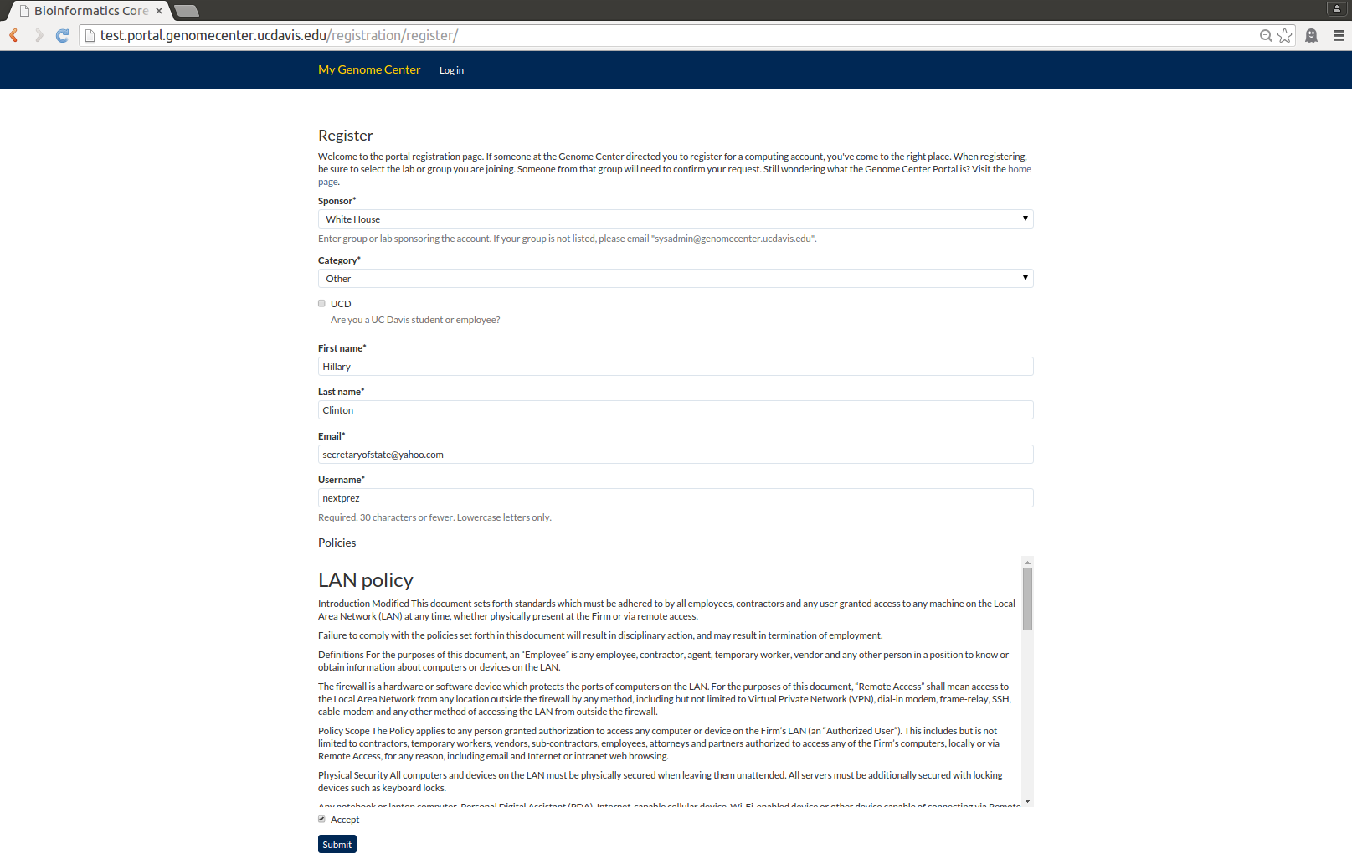
Account registration

Slide 39
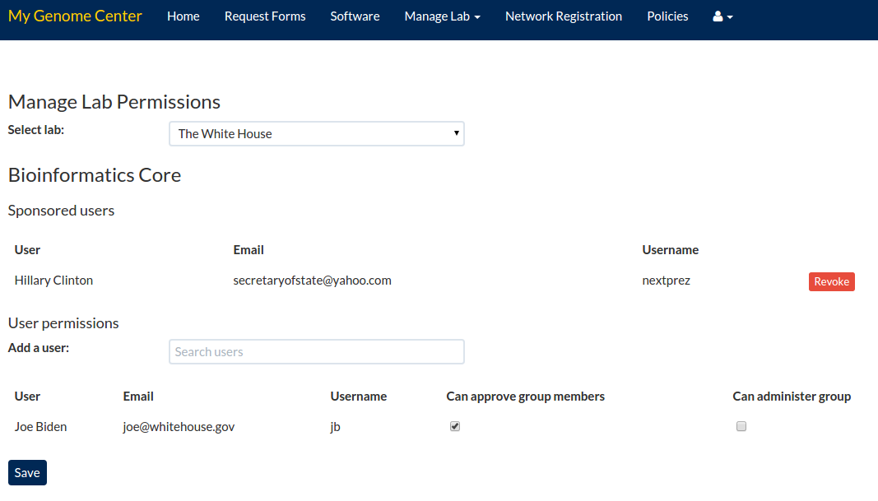
Group memberships

Slide 40
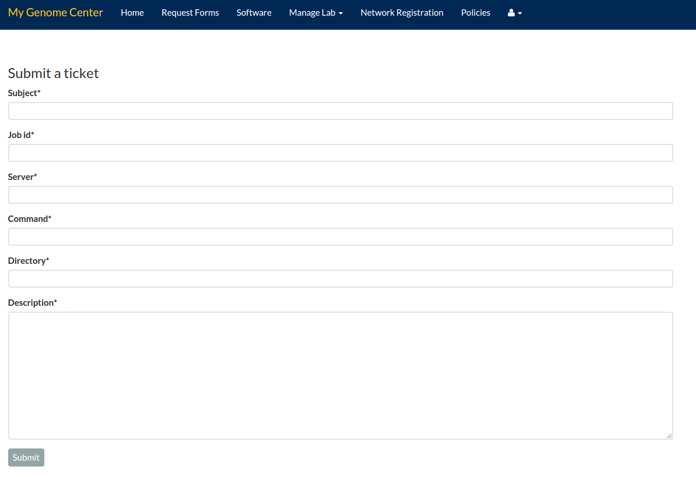
Request help

Slide 41
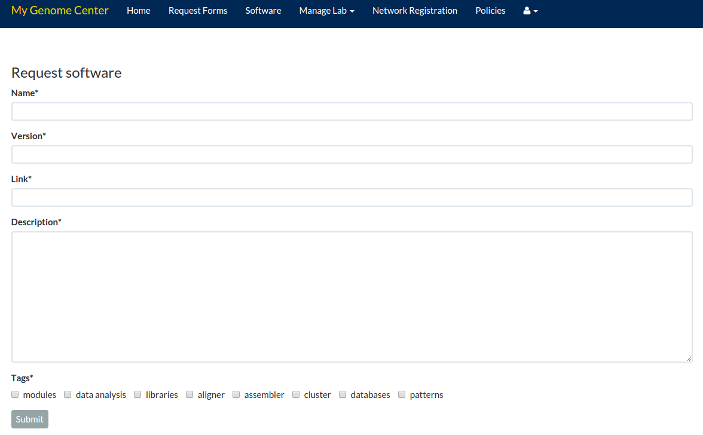
Software Request

Slide 42
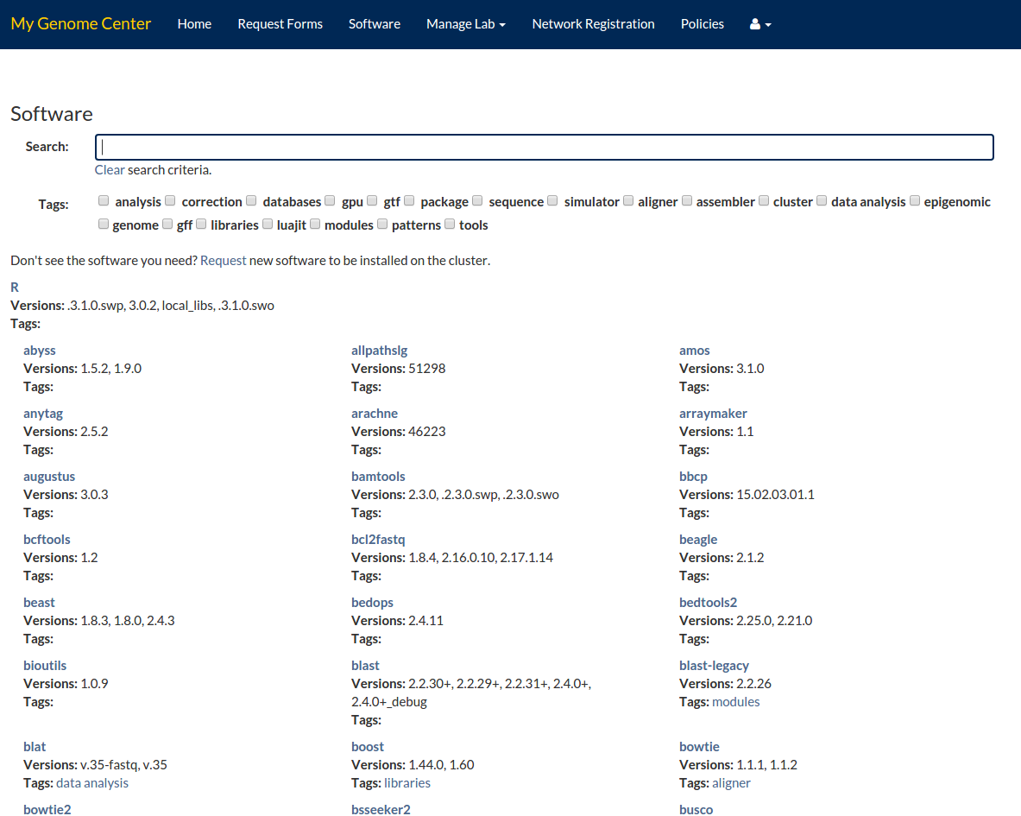
Software List

Slide 43
Contact
sysadmin@genomecenter.ucdavis.edu
bioinformatics.core@ucdavis.edu
settles@ucdavis.edu
training.bioinformatics@ucdavis.edu

