Slide 1
Introductions Schedule
UC Davis Bioinformatics Core

Slide 2
-omics is “Collaborative Research”
Todays experiments are complex and getting more complex.
No one person, or even one group typically has the needed capabilities in all areas.
Life
Sciences
Bioinformatics
Molecular
Expertise

Slide 3
The mission of the Bioinformatics Core facility is to facilitate outstanding omics- scale research through these activities:
Data Analysis
The Bioinformatics Core promotes experimental design, advanced computation and informatics analysis of omics scale datasets that drives research forward.
Research Computing
Maintain and make available high-performance computing hardware and software necessary for todays data-intensive bioinformatic analyses.
Training
The Core helps to educate the next generation of bioinformaticians through highly acclaimed training workshops, seminars and through direct participation in research activities.
Data Analysis
Research Computing
Training
Data Analysis
Research Computing
Training
Data Analysis
Research Computing
Training
Data Analysis
Research Computing
Training
Intelligently analyzing data from genomics, and other projects, to help drive research forward
Helping build high-performance software and hardware bioinformatics solutions
Providing acclaimed training workshops that will equip people with in-demand bioinformatics skills
Intelligently analyzing data from genomics, and other projects, to help drive research forward
Helping build high-performance software and hardware bioinformatics solutions
Providing acclaimed training workshops that will equip people with in-demand bioinformatics skills
Intelligently analyzing data from genomics, and other projects, to help drive research forward
Helping build high-performance software and hardware bioinformatics solutions
Providing acclaimed training workshops that will equip people with in-demand bioinformatics skills
Intelligently analyzing data from genomics, and other projects, to help drive research forward
Helping build high-performance software and hardware bioinformatics solutions
Providing acclaimed training workshops that will equip people with in-demand bioinformatics skills

Slide 4
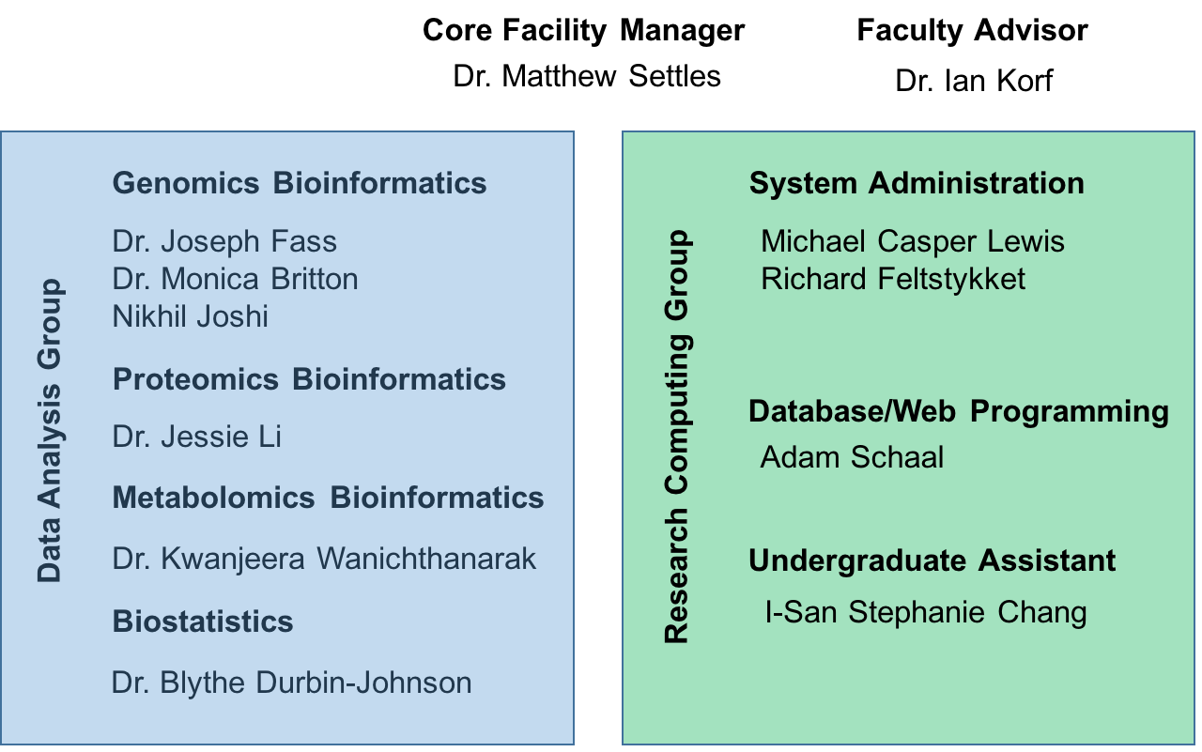
UC Davis Bioinformatics Core in the Genome Center
DNA Technologies Core Manager
Dr. Lutz Froenicke

Slide 5
Special Guest - Zev Kronenberg
Post Doc in Even Eichler Lab in the Dept. of Genome Sciences at UW
PhD, Human Genetics, Univ. of Utah
M.S., Biological Sciences, Univ. of Idaho
B.S., Mol. Biology & BioChem, Univ. of Idaho
Significant experience in variant analysis.

Slide 6
Monday Dec 12, 2016
9:30 | - | 10:00 | Introductions | Matt Settles
10:00 | - | 11:00 | Introduction to the Bioinformatics Core’s Computing | Lutz Froenicke, Manager DNA Technologies Core
11:00 | - | 12:00 | Sample Preparation, Importance of High Molecular Weight DNA | Matt Settles
12:00 | - | 1:00 | Lunch
1:00 | - | 2:30 | Pacific Biosciences, Experimental Design | Matt Settles
2:30 | - | 4:30 | Pacific Biosciences, Falcon Assembly | Jessie Li

Slide 7
Tuesday Dec 13, 2016
9:30 | - | 10:30 | Pacific Biosciences, Falcon Unzip | Jessie Li
10:00 | - | 12:00 | Comparative Genomics | Zev Kronenberg
12:00 | - | 1:00 | Lunch
1:00 | - | 4:30 | Comparative Genomics | Zev Kronenberg

Slide 8
Wednesday Dec 14, 2016
9:30 | - | 10:30 | 10x Genomics, Experimental Design | Matt Settles
10:30 | - | 12:00 | 10x Genomics, Supernova Assembly | Matt Settles
12:00 | - | 1:00 | Lunch
1:00 | - | 3:30 | Evaluating Assemblies | Joe Fass
3:30 | - | 4:30 | Lightning Round, Close | Matt Settles

