Slide 1
Genome Assembly Technology

Slide 2
Bottom Line
The Bottom Line:
Spend the time (and money) planning and producing good quality, accurate and sufficient data for your experiment. Build a set of expectations.
Get to know to your data, develop and test expectations.
Result:
You’ll spend much less time (and less money) extracting biological significance and results during analysis.

Slide 3
Sequencing Costs
$0.014/Mb
$1245 per Human sized (30x) genome
Includes: labor, administration, management, utilities, reagents, consumables, instruments (amortized over 3 years), informatics related to sequence productions, submission, indirect costs.
http://www.genome.gov/sequencingcosts/

Slide 4
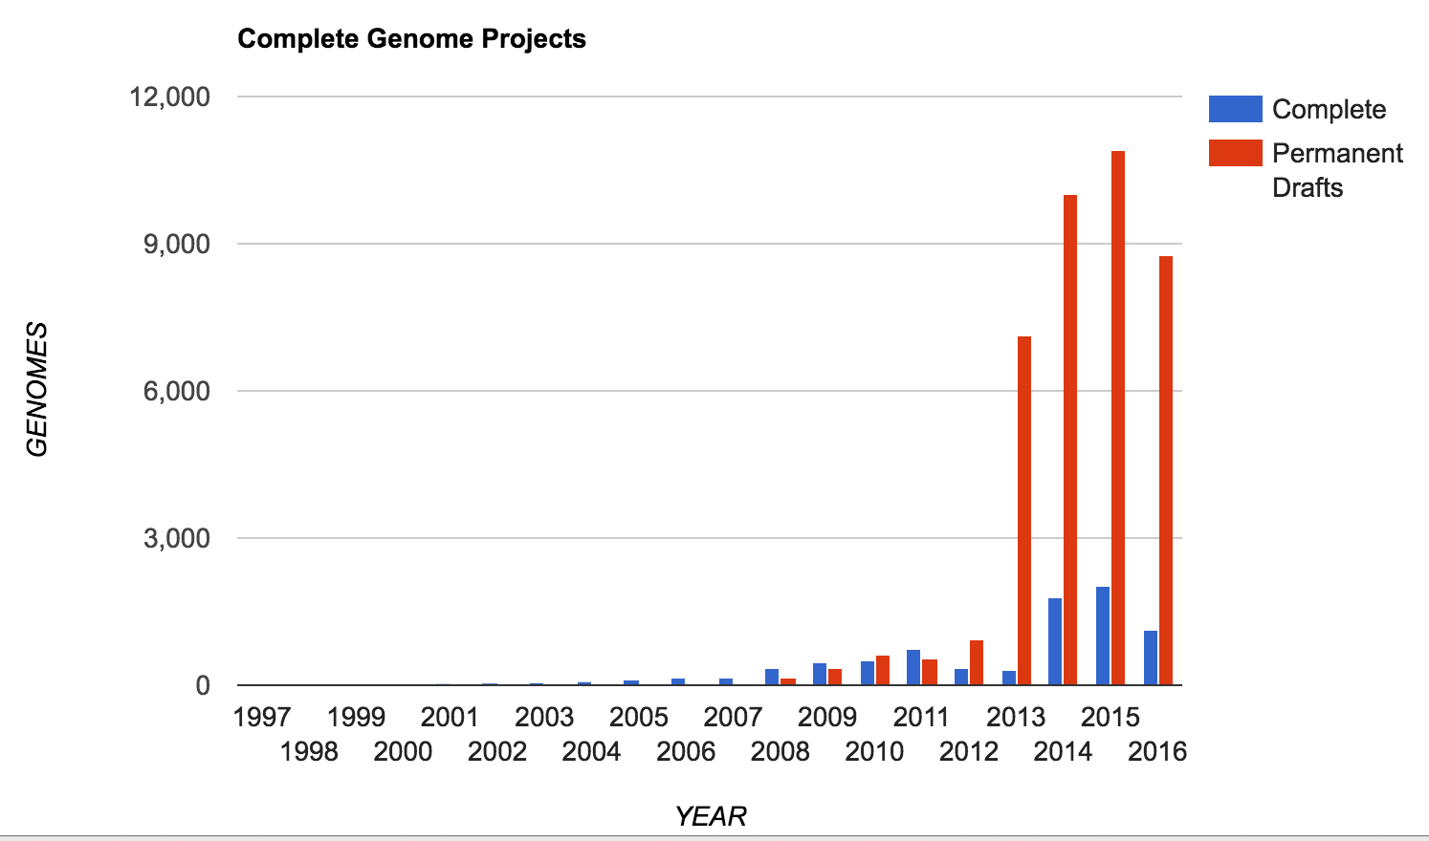
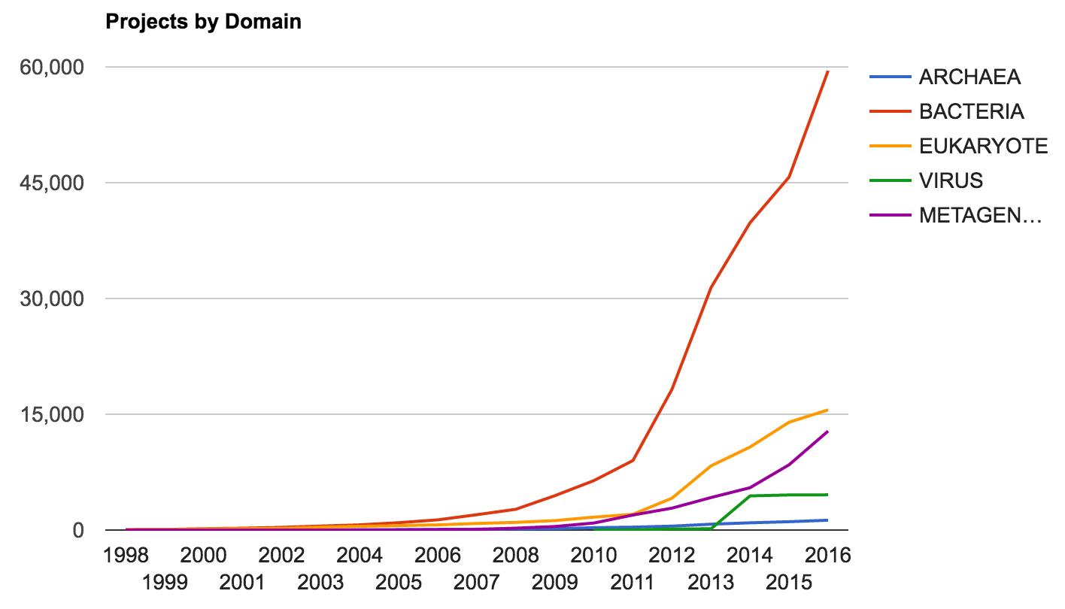
Increase in Genome Sequencing Projects
Lists > 3700 unique genus
JGI – Genomes Online Database (GOLD)
67,822 genome sequencing projects

Slide 5
Renewed focus on genomes
Sequencing has become more democratic. For example, it took more than 50 people, around a dozen centres, $50 million and half a decade to generate a draft chimpanzee genome, published in 2005. This year, Eichler's lab completed a gorilla sequence for about $70,000. “That, to me, is a big deal,” he says.
Also a big deal, says Eichler, is the quality of their sequences. An earlier version of a gorilla genome was published in 2012 but that was done with shorter pieces of DNA, and therefore left hundreds of thousands of gaps. His team used long-read technology, closed 90 percent of those gaps, and was able to complete many genes that were only partially sequenced in the first attempt.

Slide 6
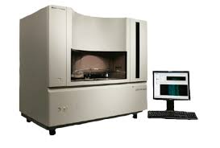
Sequencing Platforms
1986 - Dye terminator Sanger sequencing, technology dominated until 2005 until “next generation sequencers”, peaking at about 900kb/day

Slide 7
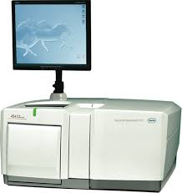
‘Next’ Generation
2005 – ‘Next Generation Sequencing’ as Massively parallel sequencing, both throughput and speed advances. The first was the Genome Sequencer (GS) instrument developed by 454 life Sciences (later acquired by Roche), Pyrosequencing 1.5Gb/day, ~500bp reads
Discontinued

Slide 8
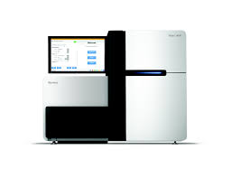
Illumina
2006 – The second ‘Next Generation Sequencing’ platform was Solexa (later acquired by Illumina). Now the dominant platform with 75% market share of sequencers and and estimated >90% of all bases sequenced are from Illumina machines, Sequencing by Synthesis > 200Gb/day, 2x150bp reads.

Slide 9
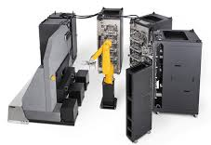
Complete Genomics
2006 – Using DNA nanoball sequencing, has been a leader in Human genome resequencing, having sequenced over 20,000 genomes to date. In 2013 purchased by BGI and is now set to release their first commercial sequencer, the Revolocity. Throughput on par with HiSeq
NOW DEFUNCT
Human genome/exomes only.
10,000 Human Genomes per year

Slide 10
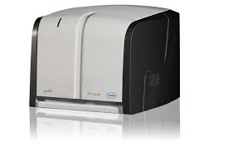
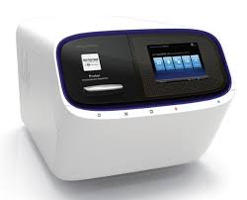
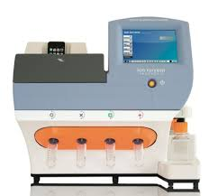
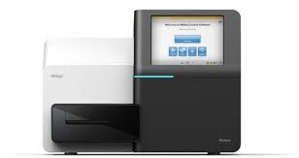
Bench top Sequencers
Roche 454 Junior
Life Technologies
Ion Torrent
Ion Proton
Illumina MiSeq

Slide 11
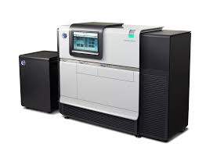
The ‘Next, Next’ Generation Sequencers (3rd Generation)
2009 – Single Molecule Read Time sequencing by Pacific Biosystems, most successful third generation sequencing platforms, RSII ~2Gb/day, new Pac Bio Sequel ~14Gb/day, near 100Kb reads.

Slide 12
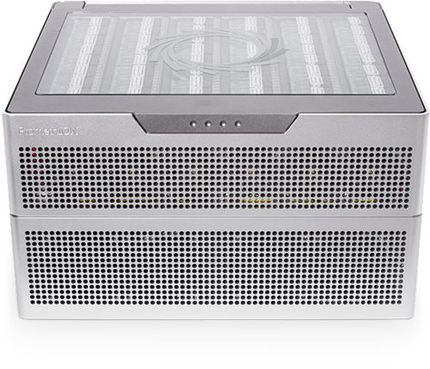
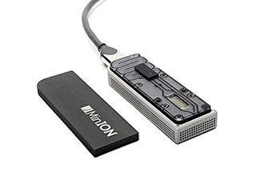
Oxford Nanopore
SmidgION: nanopore sensing for use with mobile devices
2015 – Another 3rd generation sequencer, founded in 2005 and currently in beta testing. The sequencer uses nanopore technology developed in the 90’s to sequence single molecules. Throughput is about 500Mb per flowcell, capable ofnear 200kb reads.
Fun to play with but results are highly variable
FYI: 4th generation sequencing is being described as In-situ sequencing

Slide 13
Bionano Irys
The Irys System puts the power of optical genome mapping. No more waiting for months to get a physical genome map. Irys’ Next-Generation Mapping (NGM) provides long-range information to reveal true genome structure. Assists genomes assembles to near chromosomal arms.
Not sequencing based

Slide 14
Short Read Sequencing, Flexibility
Single Multiplexing
1X
Genomic reduction allows for greater coverage and multiplexing of samples.
You can fine tune your depth of coverage needs and sample size
with the reduction technique
Whole Genome
Reduction Techniques
Capture Techniques
RADseq
Depth of Coverage
Fluidigm Access Array
Amplicons
Few or Single Amplicons
1KB
100000X
Read 2 primer
Greater Multiplexing
Read 2 (50-300bp)
DNA Sequence
Read 1 (50- 300bp)
Barcode (8bp)
Barcode Read primer

Slide 15
Sequencing Libraries
DNA-seq
RNA-seq
Amplicons
CHiP-seq
MeDiP-seq
RAD-seq
ddRAD-seq
Pool-seq
EnD-seq
DNase-seq
ATAC-seq
MNase-seq
FAIRE-seq
Ribose-seq
smRNA-seq
mRNA-seq
Tn-seq
QTL-seq
tagRNA-seq
PAT-seq
Structure-seq
MPE-seq
STARR-seq
Mod-seq
BrAD-seq
SLAF-seq
G&T-seq

Slide 16
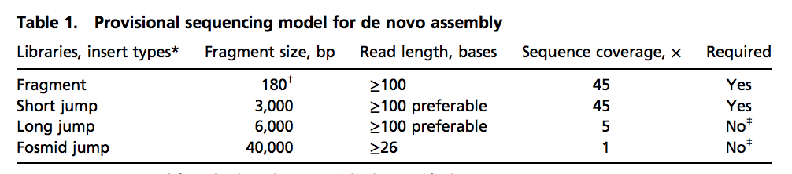
Genome Assembly is converging on more standardized data models
Trend is to consider sample, data generation and bioinformatics together.
ALLPATH-LG, started with specific requirement of sequencing libraries
Discovar
250 base paired-end PCR-free Illumina reads. No other libraries are required.

Slide 17
Post Short Read Assemblies
PacBio or Nanopore long-reads only assemblies
Falcon (Pacific Biosciences Assembler) and Canu (Univ. of Maryland).
Consider only reads > Xbp (ex. 10Kb reads or greater), ‘enough’ (ex. 30x coverage) of long reads are required. Read-to-read alignments to first ‘correct’ and trim reads, then combine to form unitigs.
10x Linked reads assembly with Supernova [Illumina Library Prep]
Generate short read data (2x150bp), use linked read information for scaffolding.
Scaffolding with Bionano optical maps or Dovetail synthetic Hi-C @ 150kb to 250kb.

Slide 18
Focus of the Future
To some extend we are limited by being able to generate enough high quality high molecular weight DNA.
Continued improvement to sequencing chemistries for consistent and longer reads, quality improvement has become secondary.
Incremental improvement of the computational algorithms, including improved alignment of error-prone reads.
Haplotyping – How to really use the data

