Slide 1
Pacific Biosciences
Technology
Experimental Design
Cost Estimation

Slide 2
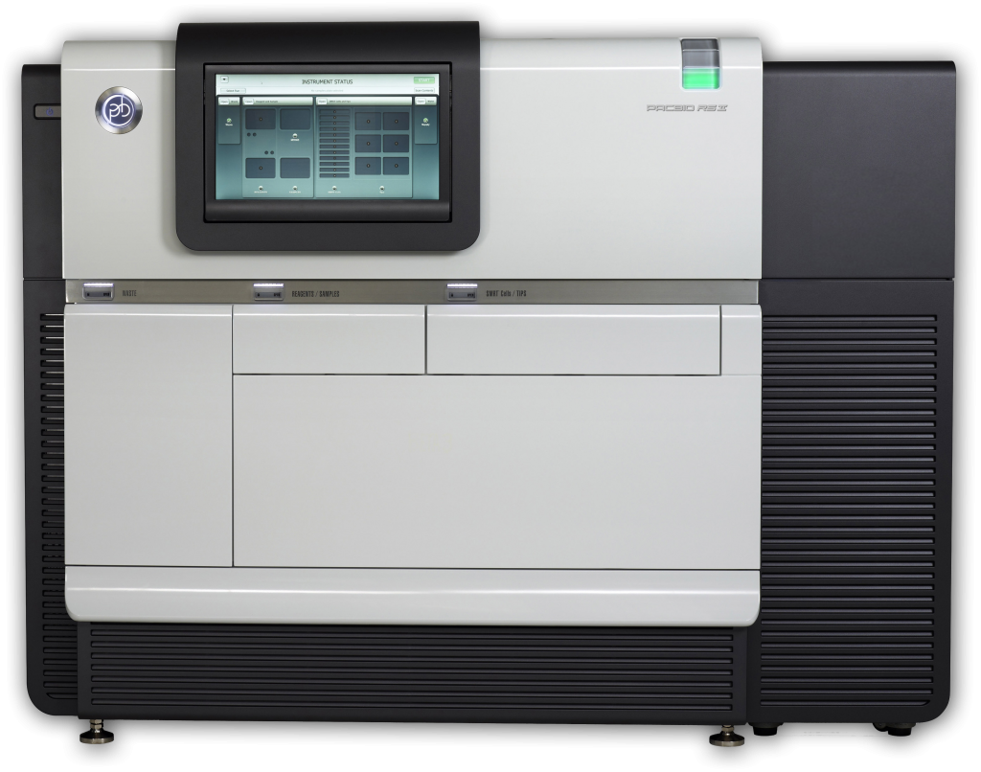
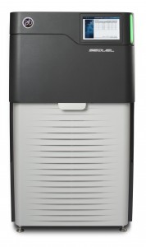
Pac Bio Systems
RSII System
Sequel System

Slide 3
Pac Bio Systems
RSII
150K ZMWs per SMRT Cell
Fasta file output
SEQUEL
1M ZMWs per SMRT Cell
6.5x more throughput
3x more expensive/SMRT cell
Potential range in SMRT cell sizes
Potential increase in library efficiency
Bam output
Length differential is currently significant, such that cost/base is about parity

Slide 4
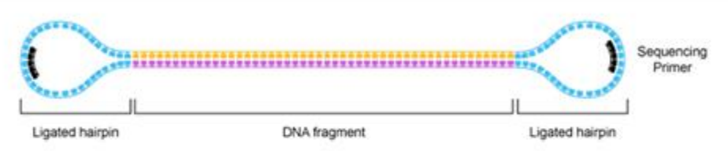
Pacific Biosciences Libraries
Structurally linear
Topologically circular
Structural homogeneity of templates
Provides sequences of both forward and reverse strands in the same trace.
Input recommends 15ug of DNA per library

Slide 5
Estimating Costs (UC Pricing)
Cost of extracting high-molecular weight DNA
Performed within the lab, or by a third-party vendor such as Amplicon Express
Library Preparation [ @ $470/library]
Blue Pippen size selection [ @ $142/2-libraries ]
First SMRT cell (calibrate loading) [ @ $429 ]
Remaining SMRT cells [ @ $383/SMRT, 10 SMRT cells per library ]
Bioinformatic Assembly [ 40 hours @ $97/hour ]
Use an estimate of 1Gb/SMRT cell and target > 65x coverage for a goal of > 30x coverage of > 10Kb reads.
http://dnatech.genomecenter.ucdavis.edu/prices/

Slide 6
Cost estimation exercises
Cost of a 200Mb Genome?
Cost of a 1Gb Genome?
Cost of human sized 3Gb Genome?
Cost of crazy salamander 15Gb genome?

Slide 7
Cost of a 200Mb Genome?
200Mb * 65x = 13Gb = 13 SMRT Cells, Means 2 Libraries, 1 Pippen
383*12+429*1+142*1+470*1+40*97 = $9,517
Cost of a 1Gb Genome?
1Gb * 65x = 65Gb = 65 SMRT Cells, Means 7 Libraries, 4 Pippen
383*65+429*1+142*4+470*7+40*97 = $33,062
Cost of human sized 3Gb Genome?
3GB * 65x = 195Gb = 195 SMRT Cells, Means 20 Libraries, 10 Pippen
383*195+429*1+142*10+470*20+40*97 = $89,814
Cost of crazy salamander 15Gb genome?
15GB * 65x = 975Gb= 975 SMRT Cells, Means 98 Libraries, 44 Pippen
383*975+429*1+142*98+470*44+40*97 = $ 412,330

