Slide 1
Pacific Biosciences
Technology
Experimental Design
Cost Estimation

Slide 2
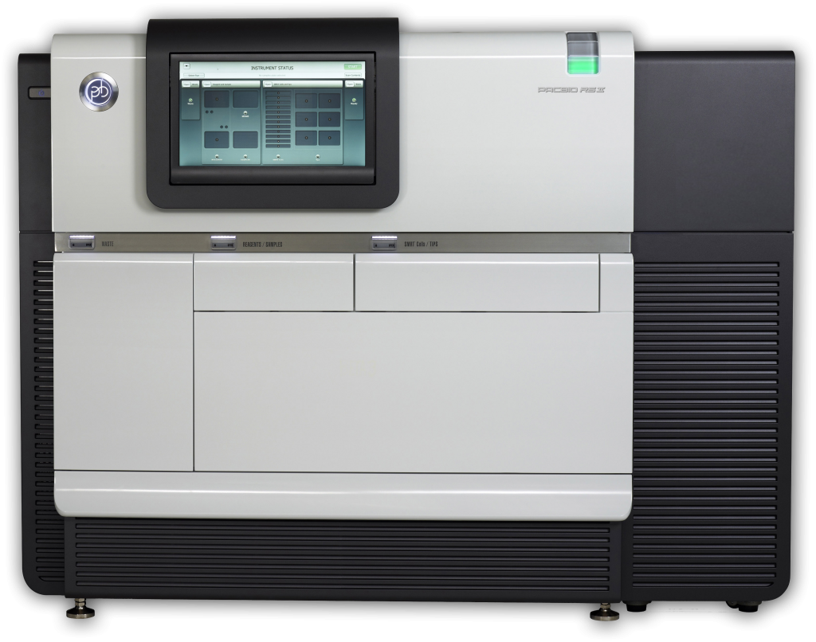
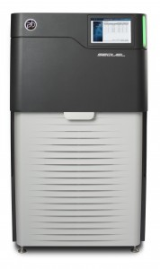
Pac Bio Systems
RSII System
Sequel System

Slide 3
Pac Bio Systems
RSII
150K ZMWs per SMRT Cell
Fasta file output
SEQUEL
1M ZMWs per SMRT Cell
6.5x more throughput
3x more expensive/SMRT cell
Potential range in SMRT cell sizes
Potential increase in library efficiency
Bam output
Length differential is currently significant, such that cost/base is about parity

Slide 4
Estimating Costs (UC Pricing)
Cost of extracting high-molecular weight DNA
Performed within the lab, or by a third-party vendor such as Amplicon Express
Library Preparation [ @ $470/library]
Blue Pippen size selection [ @ $142/2-libraries ]
First SMRT cell (calibrate loading) [ @ $429 ]
Remaining SMRT cells [ @ $383/SMRT, 10 SMRT cells per library ]
Bioinformatic Assembly [ 40 hours @ $97/hour ]
Use an estimate of 1Gb/SMRT cell and target > 65x coverage for a goal of > 30x coverage of > 10Kb reads.

Slide 5
Cost estimation exercises
Cost of a 200Mb Genome?
Cost of a 1Gb Genome?
Cost of human sized 3Gb Genome?
Cost of crazy salamander 15Gb genome?

Slide 6
Evaluating SMRT Cells
Result of RSII are fasta files

