Slide 1
Files and file types
Section 4

Slide 2
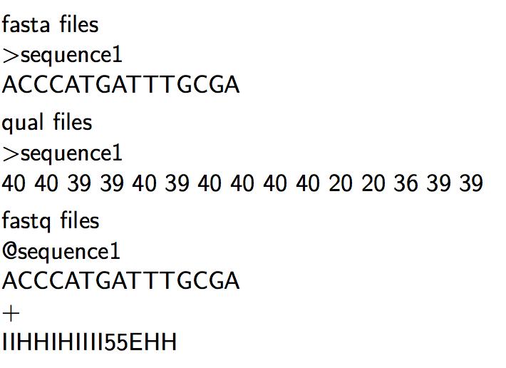
Sequencing Read files

Slide 3
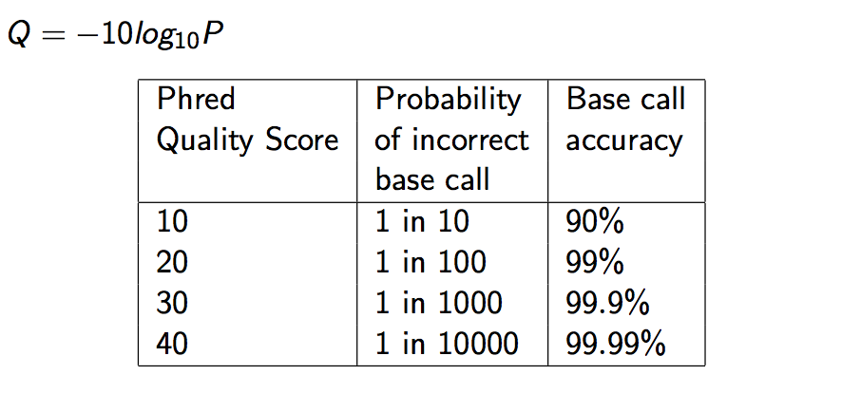
Quality Scores

Slide 4
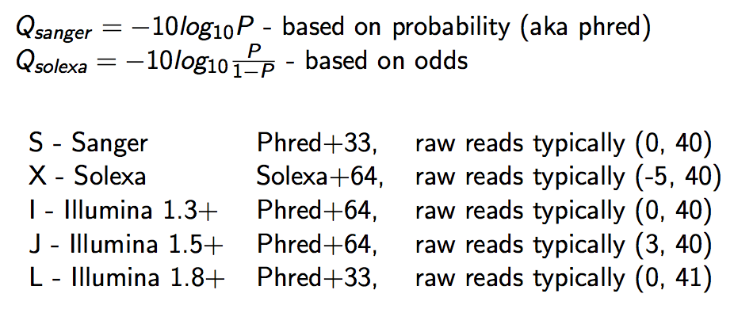
Qscore Conversion

Slide 5
Illumina Read naming conventions
CASAVA 1.8 Read IDs
@EAS139:136:FC706VJ:2:2104:15343:197393 1:Y:18:ATCACG
EAS139 the unique instrument name
136 the run id
FC706VJ the flowcell id
2 flowcell lane
2104 tile number within the flowcell lane
15343 ’x’-coordinate of the cluster within the tile
197393 ’y’-coordinate of the cluster within the tile
1 the member of a pair, 1 or 2 (paired-end or mate-pair reads only)
Y Y if the read fails filter (read is bad), N otherwise
18 0 when none of the control bits are on, otherwise it is an even number
ATCACG index sequence

Slide 6
SAM/BAM Files
SAM (Sequence Alignment/Map) format = unified format for storing read alignments to a reference sequence(Consistent since Sept. 2011).
http://samtools.github.io/hts-specs/SAMv1.pdf
http://samtools.github.io/hts-specs/SAMtags.pdf
BAM = binary version of SAM for fast querying

Slide 7
SAM/BAM files
SAM files contain two regions
The header section
Each header line begins with character ’@’ followed by a two-letter record type code
The alignment section
Each alignment line has 11 mandatory fields. These fields always appear in the same order and must be present, but their values can be ’0’ or ’*’, if the corresponding information if unavailable, or not applicable.

Slide 8
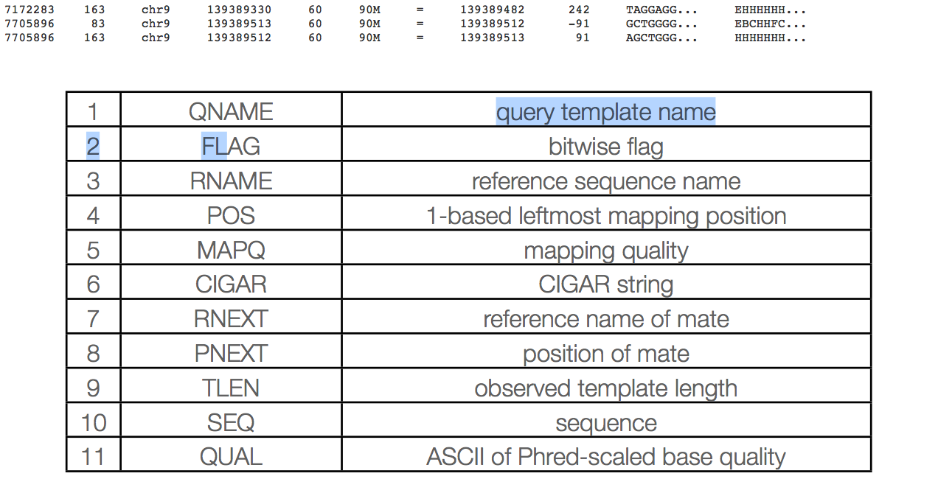
Sam columns

Slide 9
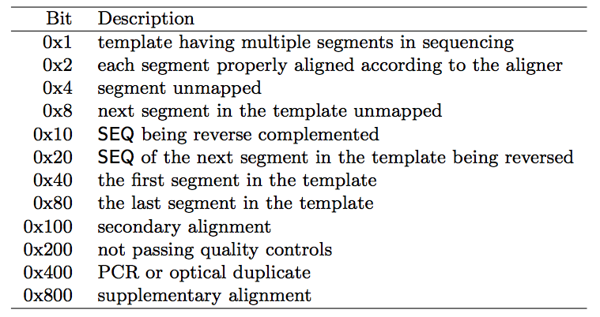
Sam flags

Slide 10
Mapq explained
MAPQ, contains the "phred-scaled posterior probability that the mapping position" is wrong.
In a probabilistic view, each read alignment is an estimate of the true alignment and is therefore also a random variable. It can be wrong. The error probability is scaled in the Phred. For example, given 1000 read alignments with mapping quality being 30, one of them will be incorrectly mapped to the wrong location on average.
A value 255 indicates that the mapping quality is not available.

Slide 11
Mapq explained
The calculation of mapping qualities is simple, but this simple calculation considers many of the factors below:
The repeat structure of the reference. Reads falling in repetitive regions usually get very low mapping quality.
The base quality of the read. Low quality means the observed read sequence is possibly wrong, and wrong sequence may lead to a wrong alignment.
The sensitivity of the alignment algorithm. The true hit is more likely to be missed by an algorithm with low sensitivity, which also causes mapping errors.
Paired end or not. Reads mapped in pairs are more likely to be correct.

Slide 12
Mapq explained
When you see a read alignment with a mapping quality of 30 or greater, it usually implies:
The overall base quality of the read is good.
The best alignment has few mismatches.
The read has few or just one ‘good’ hit on the reference, which means the current alignment is still the best even if one or two bases are actually mutations, or sequencing errors.
In practice however, each mapper seems to compute the MAPQ in their own way.

Slide 13
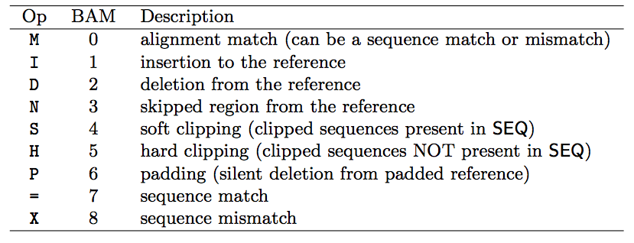
Sam cigar
Compact Idiosyncratic Gapped Alignment Report (CIGAR) SAM flag field:

Slide 14
CIGAR Example
0 0 0 0 0 0 0 0 0 1 1 1 1 1 1 1 1 1 1 2
Ref Pos: 1 2 3 4 5 6 7 8 9 0 1 2 3 4 5 6 7 8 9 0
Reference: C C A T A C T G A A C T G A C T A A C
Read: A C T A G A A T G G C T
POS: 5
CIGAR: 3M1I6M1D2M
** mismatches are not considered in standard CIGAR

Slide 15
GFF/GTF files
The GFF (General Feature Format) format consists of one line per feature, each containing 9 columns of data (fields). The GTF (General Transfer Format) is identical to GFF version 2.
Fields must be tab-separated and all fields must contain a value; “empty” fields should be denoted with a ‘.’.
Columns:
Seqname: Name of the sequence chromosome
Source: the program, or database, that generated the feature
Feature: feature type name, (e.g. gene, exon, cds, etc.)
Start: start position of the feature, sequences begin at 1
End: stop position of the feature, sequences begin at 1
Score: a floating point value (e.g. 0.01)
Strand: Defined as ‘+’ (forward),or ‘-’ (reverse)
Frame: One of ‘0’, ‘1’, ‘2’, ‘0’ represents the first base of a codon.
Attribute: A semicolon-separated list of tag-value pairs, providing additional information about each feature.

Slide 16
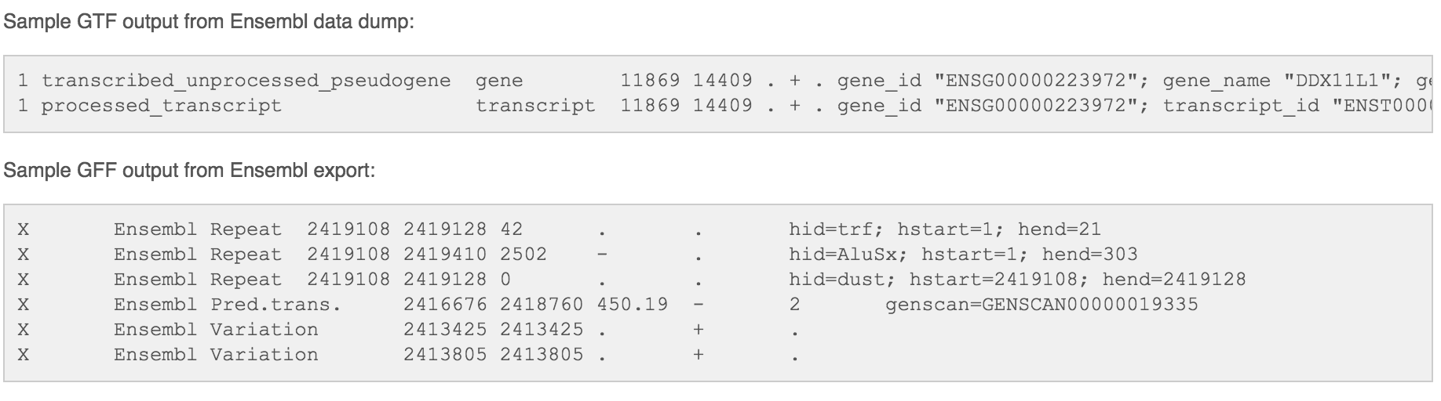
GFF/GTF files

