Slide 1
Experimental Design
Dr. Matthew L. Settles
Genome Center
University of California, Davis
settles@ucdavis.edu

Slide 2
Designing Experiments
Beginning with the question of interest ( and work backwards )
In many cases the final step is the application of a model your dataset.
Traditional statistical considerations and basic principals of statistical design of experiments apply.
Control for effects of outside variables, avoid/consider possible biases, avoid confounding variables in sample preparation.
Randomization of samples, plots, etc.
Replication is essential (triplicates are THE minimum)
You should know your final statistical model and comparison contrasts before beginning your experiment.

Slide 3
General rules for preparing and experiment/ samples
Prepare more samples then you are going to need, i.e. expect some will be of poor quality, or fail
Preparation stages should occur across all samples at the same time (or as close as possible) and by the same person
Spend time practicing a new technique to produce the highest quality product you can, reliably
Quality should be established using Fragment analysis traces (pseudo-gel images, RNA RIN > 7.0)
DNA/RNA should not be degraded
260/280 ratios for RNA should be approximately 2.0 and 260/230 should be between 2.0 and 2.2. Values over 1.8 are acceptable
Quantity should be determined with a Fluorometer, such as a Qubit.

Slide 4
Sample preparation
In high throughput biological work (Microarrays, Sequencing, HT Genotyping, etc.), what may seem like small technical details introduced during sample extraction/preparation can lead to large changes, or technical bias, in the data.
Not to say this doesn’t occur with smaller scale analysis such as Sanger sequencing or qRT-PCR, but they do become more apparent (seen on a global scale) and may cause significant issues during analysis.

Slide 5
Be Consistent
BE CONSISTENT ACROSS ALL SAMPLES!!!

Slide 6
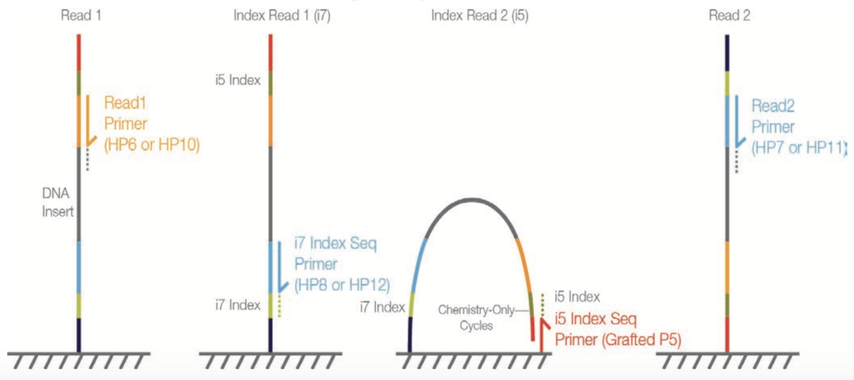
Illumina sequencing
Read 2 (50-300bp)
Illumina SBS
P5 BC2
Target Region
BC1 P7
BC1 (8bp)
Read 1 (50 - 300bp)
BC2 (8bp)
Insert size
Fragment length

Slide 7
Genomic Reduction
3GB
1X
Whole Genome
RADseq
GBSseq
RNAseq
Capture Techniques
Depth of Coverage
Genomic reduction allows for greater multiplexing of samples.
You can fine tune your depth of coverage needs and sample size
with the reduction technique
Fluidigm Access Array Amplicons
1KB
100000X
Few or Single Amplicons

Slide 8
Sequenced Basepairs per samples per lane
The first and most basic question is how many base pairs of sequence will I get
Factors to consider then are:
Number of reads being sequenced
Read length (if reads are paired, consider them as individuals for this calculations)
Number of samples being sequenced
Expected percentage of good bases/reads
The number of reads and read length data are best obtained from the manufacturer’s website (search for specifications) and always use the lower end of the estimate.

Slide 9

Genomic Coverage
Once you have the number of base pairs per sample you can then determine expected coverage
Factors to consider then are:
Length of the genome
Any extra-genomic sequence (ie mitochondria, virus, plasmids, etc.). For bacteria in particular, these can become a significant percentage
$$\frac{ExpectedCoverage}{sample}=\frac{\frac{\left(readLength ∗numReads\right)∗0.8}{numSamples}\text{∗ }\text{num}\text{.}\text{lanes}}{TotalGenomicContent}$$

Slide 10
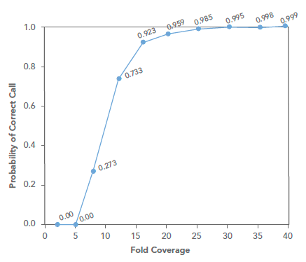
Variant Analysis
Probability of a correct SNP call, assuming base Q-score >30
Read length contributes to uniqueness of mapping
Paired reads are required to identify structure changes
For a single individual we target > 30x coverage.
In population studies, the greater the number of samples less coverage per samples that is required. (ex. with 1000 samples 2x coverage per sample may be sufficient)

Slide 11
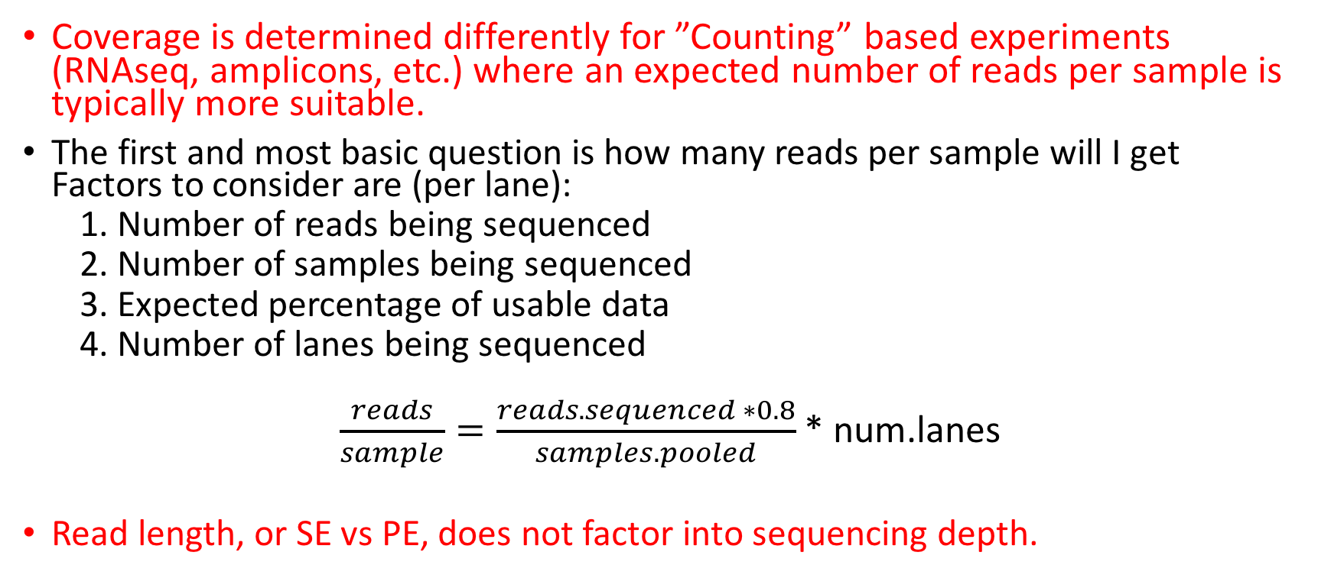
Sequencing Depth – Counting based experiments
Coverage is determined differently for ”Counting” based experiments (RNAseq, amplicons, etc.) where an expected number of reads per sample is typically more suitable.
The first and most basic question is how many reads per sample will I get Factors to consider are (per lane):
1. Number of reads being sequenced
2. Number of samples being sequenced
3. Expected percentage of usable data
4. Number of lanes being sequenced
$\frac{reads}{sample}=\frac{reads.sequenced ∗0.8}{samples.pooled}$* num.lanes
Read length, or SE vs PE, does not factor into sequencing depth.

Slide 12


Amplicon Sequencing (Communities, genotyping)
Considerations
Number of reads being sequenced
Proportion that is diversity sample (e.g. PhiX)
Number of samples being pooled in the run
The back of the envelope calculation
$$\frac{reads}{sample}=\frac{reads_sequenced∗\left(1 −diversity_sample\right)}{num_samples}$$
example
$$\frac{102,000}{sample}=\frac{18e6 ∗\left(1−0.15\right)}{150}$$
Recommendations
Illumina ‘recommends’ 100K per sample
I’ve used 30K per sample historically, others are fine with 3K per sample
Really should have as many reads as your experiment needs

Slide 13
Metagenomics Sequencing
Considerations (when a literature search turns up nothing)
Proportion that is host (non-microbial genomic content)
Proportion that is microbial (genomic content of interest)
Number of species
Genome size of each species
Relative abundance of each species
The back of the envelope calculation
$$\frac{numReads}{sample}=\frac{Coverage∗\left(AverageGenomeSize\right)}{ReadLen ∗DilutionFactor ∗(1−hostProportion)} ∗\frac{1}{0.8}$$
ReadLen = 200
Coverage = 30
hostProportion = 0.5
DillutionFactor = 0.01
AverageGenomeSize = 5Mb

Slide 14
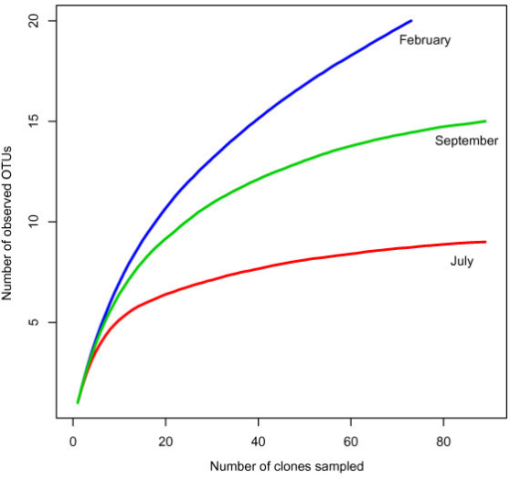
Community Rarefaction curves
’Deep’ sequence a number of test samples
amplicons: ~ 1M+ reads.
metagenomics: 1 full HiSeq lane
Plot rarefactions curves of organism identification, to determine if saturation is achieved

Slide 15
Take Homes
Experience and/or literature searches (other peoples experiences) will provide the best justification for estimates on needed depth.
‘Longer’ reads are better than short reads.
Paired-end reads are more useful than single-end reads
Libraries can be sequenced again, so do a pilot, perform a preliminary analysis, then sequence more accordingly.

Slide 16
Cost Estimation
Extractions from tissue (DNA/RNA): cost per sample
Sample quality assurance. Including quantification and sample degradation: cost per sample
PCR reactions: Cost per sample
Library generation and quantification: cost per sample
Pooling and quantification of libraries: cost per group
Sequencing (type if sequencing PE/SE, length of reads, number of lanes / runs): cost per lane/run
Bioinformatics, general rule is to estimate double your budget)
EX: http://dnatech.genomecenter.ucdavis.edu/prices/

Slide 17
Bioinformatics Costs
Bioinformatics includes:
Storage of data
Access and use of computational resources and software
System Administration time
Bioinformatics Data Analysis time
Back and forth consultation/analysis to extract biological meaning
Rule of thumb:
Bioinformatics can and should cost as much (sometimes more) as the cost of data generation.

Slide 18
Barcodes and Pooling samples for sequencing
Best to have as many barcodes as there are samples
Can purchase barcodes from vendor, generate them yourself and purchase from IDTdna (example), or consult with the DNA technologies core.
Best to pool all samples into one large pool, then sequence multiple lanes
IF you cannot generate enough barcodes, or pool into one large pool, RANDOMIZE samples into pools.
Bioinformatics core can produce a randomization scheme for you.
This must be considered/determined PRIOR to library preparation

Slide 19
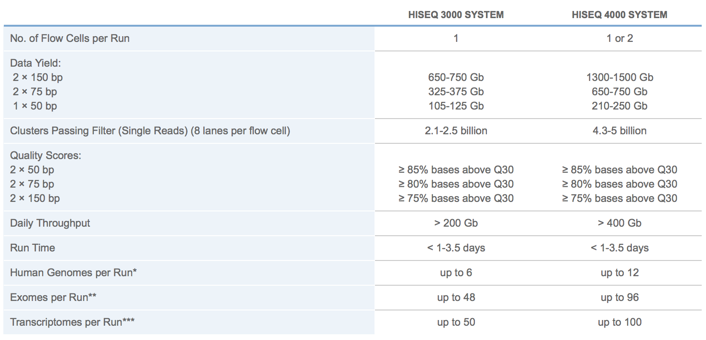
Illumina HISEQ sequencing
http://www.illumina.com/systems/hiseq-3000-4000/specifications.html

Slide 20
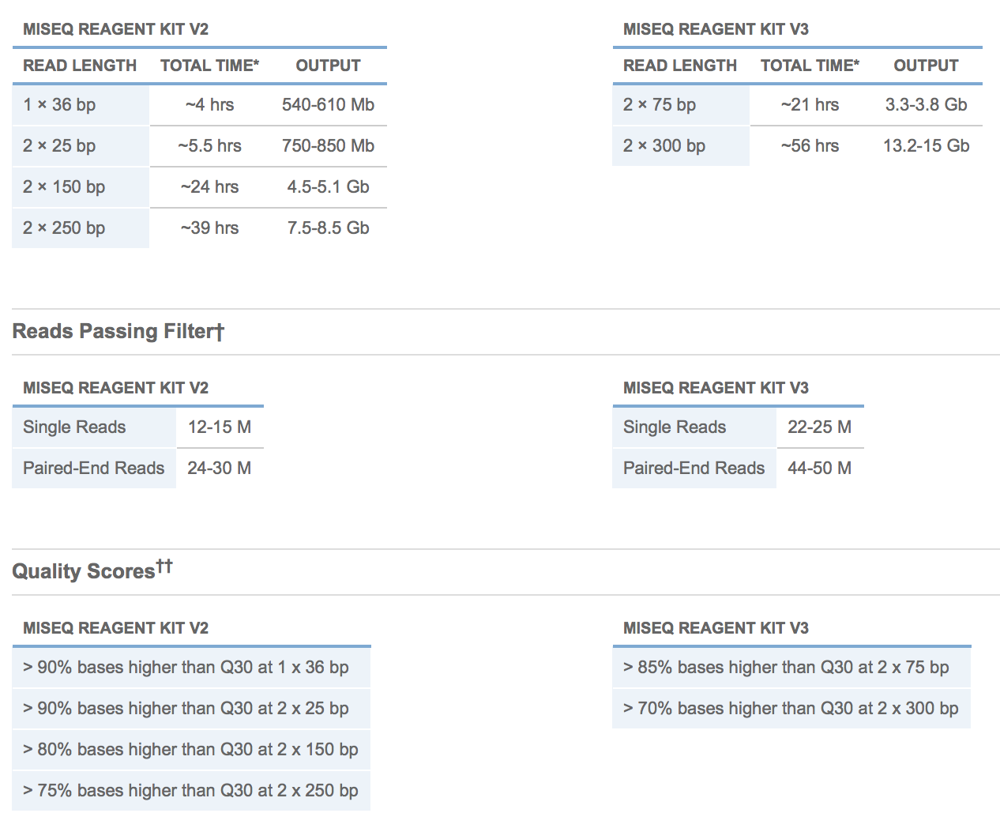
Illumina MISEQ SEQUENCING
MiSeq

Slide 21
Cost Estimation
DNA/RNA extraction and QA/QC (Per sample)
library preparation (Per sample)
Library QA/QC (Bioanalyzer and Qubit)
Sequencing (Number of lanes)
Bioinformatics (General rule is to estimate the same amount as data generation, i.e. double your budget)
http://dnatech.genomecenter.ucdavis.edu/prices/
Example: RNA - 12 samples, ribo-depletion libraries, target 30M reads per sample, Hiseq 3000 (2x100).

Slide 22
Cost Estimation
12 Samples
QA Bioanalyzer = $98 for all 12 samples
Library Preparation (ribo-depletion) = $383/sample = $4,596
Sequencing = $2,346 per lane PE100
2.1 - 2.5 Billion reads per run / 8 lanes = Approximately 300M reads per lane
Multiplied by a 0.8 buffer equals 240M expected good reads
Divided by 12 samples in the lane = 20M reads per sample per lane.
Target 30M reads means 2 lanes of sequencing $2346 x 2 = $4692
Bioinformatics, simple comparison design, DE only $2000
This is the most basic analysis, for in depth collaborative analysis double sequencing budget.
Total = $98 + $4596 + $4692 + $2000 = $11,386
Approximately $950 per sample @ 40M reads per sample

