Slide 1
Sequence Preprocessing: A perspective
Dr. Matthew L. Settles
Genome Center
University of California, Davis
settles@ucdavis.edu

Slide 2
Why Preprocess reads
We have found that aggressively “cleaning” and processing reads can make a large difference to the speed and quality of assembly and mapping results. Cleaning your reads means, removing reads/bases
that are:
other unwanted sequence (polyA tails in RNA-seq data)
artificially added onto sequence of primary interest (vectors, adapters, primers)
join short overlapping paired-end reads
low quality bases
originate from PCR duplication
not of primary interest (contamination)
Preprocessing also produces a number of statistics that are technical in nature that should be used to evaluate “experimental consistancy”

Slide 3
Read Preprocessing strategies, many over time
Identity and remove contaminant and vector reads
Reads which appear to fully come from extraneous sequence should be removed.
Quality trim/cut
“end” trim a read until the average quality > Q (Lucy)
remove any read with average quality < Q
eliminate singletons/duplicates
If you have excess depth of coverage, and particularly if you have at least x-fold coverage where x is the read length, then eliminating singletons is a nice way of dramatically reducing the number of error-prone reads.
Read which appear the same (particularly paired-end) are often more likely PCR duplicates and therefor redundant reads.
eliminate all reads (pairs) containing an “N” character
If you can afford the loss of coverage, you might throw away all reads containing Ns.
Identity and trim off adapter and barcodes if present
Believe it or not, the software provided by Illumina, either does not look for, or does a mediocre job of, identifying adapters and removing them.

Slide 4
Ribosomal RNA
Ribosomal RNA makes up 90% or more of a typical total RNA sample.
Library prep methods reduce the rRNA representation in a sample
oligoDt only binds to polyA tails to enrich a sample for mRNA
Ribo-depletion binds rRNA sequences
Neither technique is 100% efficient
Can screen (map reads to rRNA sequences) to determine rRNA efficiency and potentially remove those reads.

Slide 5
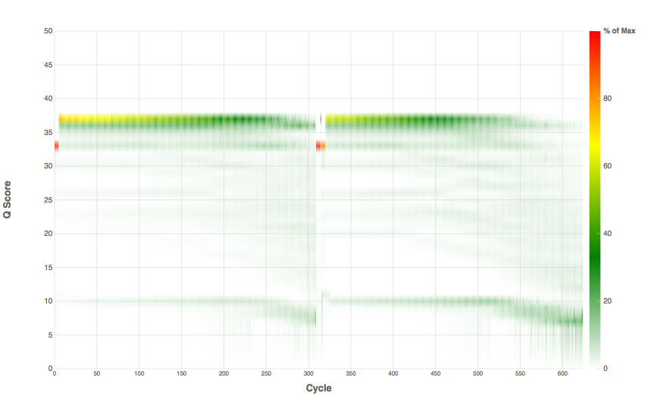
Library prep, fragmentation, adapter addition
PCR enrichment
DNA/RNA, could contain ‘contamination’
Final Library, size distribution
Possible addition of phiX
Sequencing Characteristics/ Quality

Slide 6
Preprocessing
Map reads to contaminants/PhiX and extract unmapped reads [bowtie2 --local
Remove contaminants (at least PhiX), uses bowtie2 then extracts all reads (pairs) that are marked as unmapped.
Super-Deduper [ PE reads only ]
Remove PCR duplicates (we use bases 10-35 of each paired read)
FLASH2 [ PE reads only ]
Join and extend, overlapping paired end reads
If reads completely overlap they will contain adapter, remove adapters
Identify and remove any adapter dimers present
Scythe [ SE Reads only ]
Identify and remove adapter sequence
Sickle
Trim sequences (5’ and 3’) by quality score (I like Q20)
cleanup
Run a polyA/T trimmer
Remove any reads that are less then the minimum length parameter
Produce preprocessing statistics

Slide 7
Why Screen for PhiX
PhiX is a common control in Illumina runs, facilities rarely tell you if/when PhiX has been spiked in
Does not have a barcode, so in theory should not be in your data
However
When I know PhiX has been spiked in, I find sequence every time
When I know PhiX has not been spiked in, I do not find sequence
Better safe than sorry and screen for it.

Slide 8
Super Deduper
Read 2
Read 1
Data | Alignment Algorithm | MarkDuplicates | Rmdup | Super Deduper | FastUniq | Fulcrum | Total # of Reads
PhiX | BWA MEM | 1,048,278 (0.25%) | 1,011,145 (1.05%) | 1,156,700 (13.7%) | 4,202,526 | 3,092,155 | 4,750,299
 | Bowtie 2 Local | 1,054,725 (6.62%) | 948,784 (10.2%) | 1,166,936 (14.0%) | 4,236,647 | 3,103,872 | 4,790,972
 | Bowtie 2 Global | 799,524 (0%) | 800,868 (0.12%) | 896,487 (9.92%) | 3,768,641 | 2,704,114 | 4,293,787
Acropora digitifera | BWA MEM | 5,132,111 (2.26%) | 6,906,634 (44.5%) | 5,133,339 (10.2%) | 12,968,469 | 2,103,567 | 54,108,240
 | Bowtie 2 Local | 4,688,809 (4.03%) | 5,931,862 (38.9%) | 3,971,743 (9.32%) | 9,893,903 | 4,259,619 | 41,728,154
 | Bowtie 2 Global | 1,457,865 (3.62%) | 1,512,966 (24.2%) | 1,185,838 (11.4%) | 3,014,498 | 1,286,031 | 11,600,847
https://github.com/dstreett/Super-Deduper

Slide 9
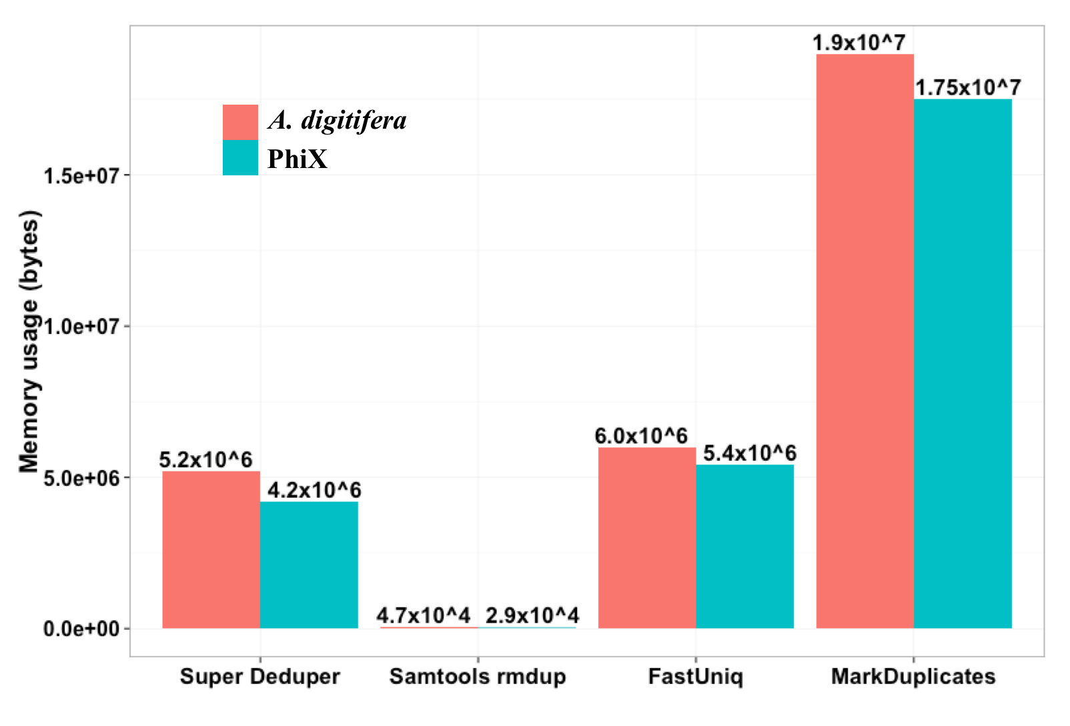
Super Deduper
Figure 1: ROC curves. Only a representative subset of the different start positions is shown. The image on the left shows the full ROC curves and the image on the left is a zoomed in view of corner of the curves. Each curve represents a start position and each point represents a length. The labeled point in the image on the right is the default start and length for Super Deduper.
We calculated the Youden Index for every combination tested and the point that acquired the highest index value (as compared to Picard MarkDuplicates) occurred at a start position of 5bp and a length of 10bps (20bp total over both reads)

Slide 10
Flash2 – overlapping of reads and adapter removal in paired end reads
Insert size
Insert size > length of the number of cycles
Read 2
Target Region
Read 1
Product: Read Pair
Insert size < length of the number of cycles (10bp min)
Insert size
Read 2
Target Region
Read 1
Product: Extended, Single
Insert size < length of the read length
Insert size
Read 2
Target Region
Read 1
Product: Adapter Trimmed, Single
https://github.com/dstreett/FLASH2

Slide 11
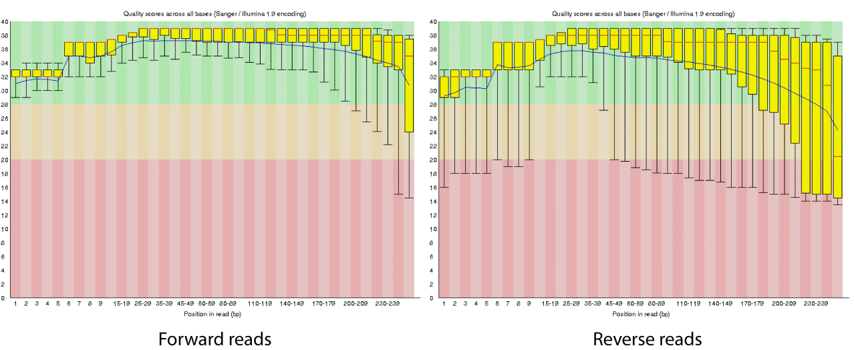
Quality Trimming - Sickle
Remove “poor” quality sequence from both the 5’ and 3’ ends

Slide 12
QA/QC
Beyond generating ‘better’ data for downstream analysis, cleaning statistics also give you an idea as to the quality of the sample, library generation, and sequencing quality used to generate the data.
This can help inform you of what you might do in the future.
I’ve found it best to perform QA/QC on both the run as a whole (poor samples can affect other samples) and on the samples themselves as they compare to other samples (REMEMBER, BE CONSISTANT).
Reports such as Basespace for Illumina, are great ways to evaluate the runs as a whole.
PCA/MDS plots of the preprocessing summary are a great way to look for technical bias across your experiment

Slide 13
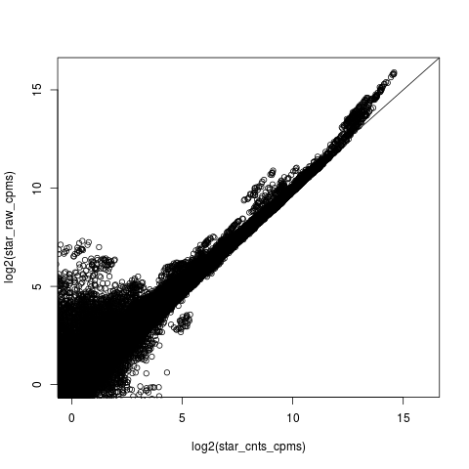
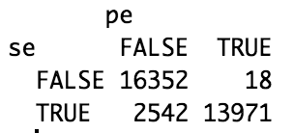
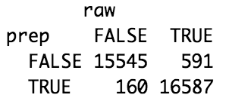
Comparing Mapping Raw vs Preprocessed with star

