Slide 1
So you want to do a RNAseq Experiment Differential Expression Analysis
Matt Settles
Director, Bioinformatics Core

Slide 2
Treating Bioinformatics as a Data Science
Seven stages to data science
Define the question of interest
Get the data
Clean the data
Explore the data
Fit statistical models
Communicate the results
Make your analysis reproducible
Data science done well looks easy and that’s a big problem for data scientists
simplystatistics.org
March 3, 2015 by Jeff Leek

Slide 3
What is Differential Expression
Differential expression analysis means taking the normalised sequencing fragment count data and performing statistical analysis to discover quantitative changes in expression levels between experimental groups.
For example, we use statistical testing to decide whether, for a given gene, an observed difference in fragment counts is significant, that is, whether it is greater than what would be expected just due to natural random variation.

Slide 4
Designing Experiments
Beginning with the question of interest ( and working backwards )
The final step of a DE analysis is the application of a linear model to each gene in your dataset.
Traditional statistical considerations and basic principals of statistical design of experiments apply.
Control for effects of outside variables, avoid/consider possible biases, avoid confounding variables in sample preparation.
Randomization of samples, plots, etc.
Replication is essential (triplicates are THE minimum)
You should know your final (DE) model and comparison contrasts before beginning your experiment.

Slide 5
Three outcomes Goldilocks and the three bears
Technical and/or biological variation exceeds that of experimental variation, results in 0 differentially expressed genes
Experiment induces a significant phenotype with cascading effects and/or little to no biological variation between replicates (ala cell lines), results in 1000s of DE genes. Some of which are directly due to experiment; however, most due to cascading effects.
Technical artifacts are controlled. Biological variation is induced in the experiment, and cascading effects are controlled, or accounted for, results in 100s of DE genes directly applicable to the question of interest.

Slide 6
Overview of RNA-SEQ data analysis

Slide 7
Prerequisites
Access to a multi-core (24 cpu or greater), ‘high’ memory 64Gb or greater Linux server.
Familiarity with the ’command line’ and at least one programming language.
Basic knowledge of how to install software
Basic knowledge of R (or equivalent) and statistical programming
Basic knowledge of Statistics and model building

Slide 8
RNA-seq pipeline overview

Slide 9
Sequence Preprocessing

Slide 10
Why Preprocess reads
We have found that aggressively “cleaning” and processing reads can make a large difference to the speed and quality of assembly and mapping results. Cleaning your reads means, removing reads/bases
that are:
other unwanted sequence (polyA tails in RNA-seq data)
artificially added onto sequence of primary interest (vectors, adapters, primers)
join short overlapping paired-end reads
low quality bases
originate from PCR duplication
not of primary interest (contamination)
Preprocessing also produces a number of statistics that are technical in nature that should be used to evaluate “experimental consistancy”

Slide 11
QA/QC
Beyond generating better data for downstream analysis, cleaning statistics also give you an idea as to the quality of the sample, library generation, and sequencing quality used to generate the data.
This can help inform you of what you might do in the future.
I’ve found it best to perform QA/QC on both the run as a whole (poor samples can affect other samples) and on the samples themselves as they compare to other samples (REMEMBER, BE CONSISTANT).
Reports such as Basespace for Illumina, are great ways to evaluate the runs as a whole.
PCA/MDS plots of the preprocessing summary are a great way to look for technical bias across your experiment

Slide 12
Sequence Mapping

Slide 13
Mapping vs Assembly
Given sequence data,
Assembly seeks to put together the puzzle without knowing what the picture is
Mapping tries to put together the puzzle pieces directly onto an image of the picture
In mapping the question is more, given a small chunk of sequence, where in the genome did this piece most likely come from.
The goal then is to find the match(es) with either the “best” edit distance (smallest), or all matches with edit distance less than max edit dist. Main issues are:
Large search space
Regions of similarity (aka repeats)
Gaps (INDELS)
Complexity (RNA, transcripts)

Slide 14
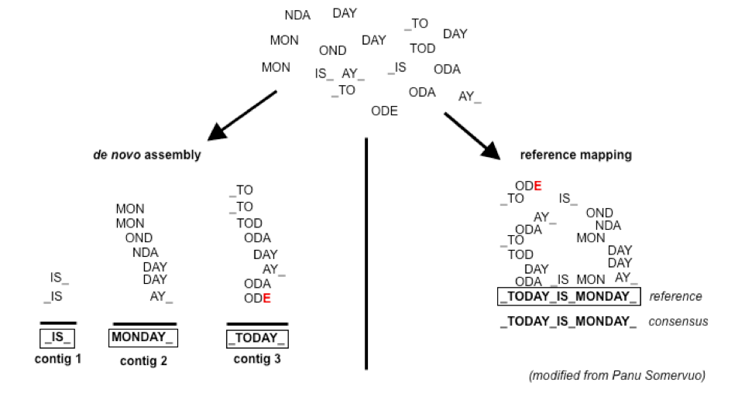
Example

Slide 15
Consideration
Placing reads in regions that do not exist in the reference genome (reads extend off the end) [ mitochondrial, plasmids, structural variants, etc. ].
Sequencing errors and variations: alignment between read and true source in genome may have more differences than alignment with some other copy of repeat.
What if the closest fully sequenced genome is too divergent? (3% is a common assumed alignment capability)
Placing reads in repetitive regions: Some algorithms only return 1 mapping; If multiple: map quality = 0
Algorithms that use paired-end information => might prefer correct distance over correct alignment.

Slide 16
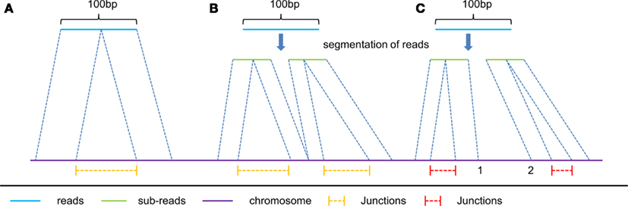
Intron/exon junctions
In RNA-seq data, you must also consider splice junctions, reads may span an intron

Slide 17
Some Aligners
Spliced Aligners
Tophat (Bowtie2)
GSNAP
SOAPsplice
MapSplice
TrueSite
star
Aligners that can ’clip’
Bowtie2 in local mode
bwa-mem
https://en.wikipedia.org/wiki/List_of_sequence_alignment_software

Slide 18
Genome vs Transcriptome Reference
May seem intuitive to map RNAseq data to transcriptome, but its not that simple.
Transcriptomes are rarely complete,
Which transcript, canonical transcript? Shouldn’t map to all splice variants as these would show up as multi-mappers
More so, a mapper will do its best to map every read, somewhere, provided the result meets its minimum requirements.
Need to provide a mapper with all possible places the read could arisen from, which is best represented by the genome. Otherwise you get mismapping because its close enough.

Slide 19
Genome and Annotation
Genome fasta files and Annotation files go together! Should be identified before beginning any analysis
Genome fasta files should include all primary chromosomes, unplaced sequences and un-localized sequences, as well as any organelles. Should not contain any contigs that represent patches or alternative haplotypes.
Annotation file should be GTF (preferred), and should be the most comprehensive you can find.
Chromosome names in the GTF should match those in the fasta, they don’t always do.
Star recommends the Gencode annotations for mouse/human

Slide 20
Preparing a sam file for counting and stats
Samtools is used to manipulate mapping files for counting, common steps include:
samtools view [to convert from sam to bam]
samtools sort [possibly by read and not by position, htseq-count requirement]
samtools index
samtools idxstats
samtools flagstat
samtools stats
Check with the counting application as to its input requirements.

Slide 21
QA/QC
Mapper produce summary statistics, view the summary report (in a text editor) and compare across samples.
Other additional summary statistics can be produced with:
samtools flagstat
samtools idxstats
samtools stats
Produce a multi-dimensional scaling (MDS) plots of the summary files, the purpose is to look for patterns in the plot that are non-random, and may be influenced by technical artifacts

Slide 22
Estimate known genes and transcripts expression – Counting

Slide 23
Counting as a measure of expression
The more you can count (and HTS sequencing systems can count a lot) the better the measure of copy number for even rare transcripts in a population.
Most RNA-seq techniques deal with count data. Reads are mapped to a reference genome, transcripts are detected, and the number of reads that map to a transcript (or gene) are counted.
Read counts for a transcript are roughly proportional to the gene’s length and transcript abundance.
technical artifacts should be considered during counting
mapping quality
mapability (uniqueness), the read is not ambiguous

Slide 24
Read Counting with HTSEQ-COUNT
Problem:
Given a sam/bam file with aligned sequence reads and a list of genomic feature (genes locations), we wish to count the number of reads (fragments) than overlap each feature.
Features are defined by intervals, they have a start and stop position on a chromosome.
For this workshop and analysis, features are genes which are the union of all its exons. You could consider each exon as a feature, for alternative splicing.
Htseq-count has three overlapping modes
union:
intersection-strict
intersection-nonempty

Slide 25
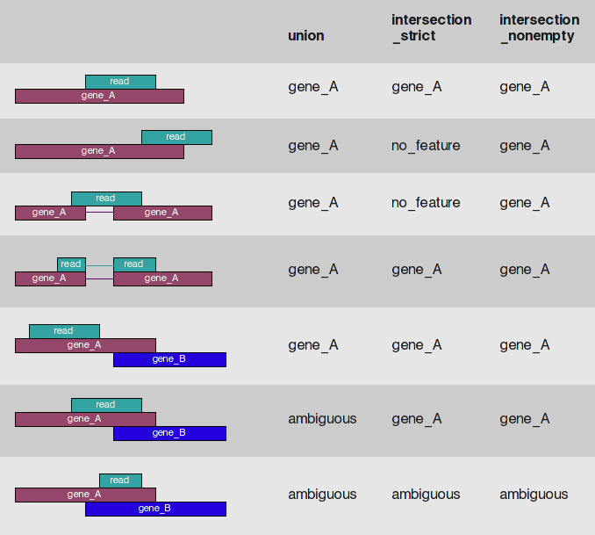
Htseq-count

Slide 26
Counting genes -- STAR
Counts coincide with Htseq-counts under default parameters. Need to specify GTF file at genome generation step or during mapping.
Output, 4 columns
GeneID
Counts for unstranded
Counts for first read strand
Counts for the second read strand
Chose the columns that makes sense and generate a matrix table, columns are sample, rows are genes.

Slide 27
QA/QC
View summary report (in a text editor)
Produce a multi-dimensional scaling (MDS) plots of the summary files, the purpose is to look for patterns in the plot that are non-random, and may be influenced by technical means.
Statistics such as:
% Multimapped reads
% Uniquely mapped reads
Splice sites
Unmapped
Chimeric
Etc.

Slide 28
Differential Expression Analysis using edgeR/Limma Voom

Slide 29
Differential Expression Analysis
Differential Expression between conditions is determined from count data, which is modeled by a distribution (ie. Negative Binomial Distribution, Poisson, etc.)
Generally speaking differential expression analysis is performed in a very similar manner to DNA microarrays, once and normalization have been performed.
A lot of RNA-seq analysis has been done in R and so there are many packages available to analyze and view this data. Two of the ‘best’ are:
DESeq, developed by Simon Anders (also created htseq) in Wolfgang Huber’s group at EMBL
edgeR/Voom (extension to Limma [microarrays] for RNA-seq), developed out of Gordon Smyth’s group from the Walter and Eliza Hall Institute of Medical Research in Australia
http://bioconductor.org/packages/release/BiocViews.html#___RNASeq

Slide 30
Basic steps procedure – edgeR/limma voom
Read the count data in
Filter genes(uninteresting genes, e.g. unexpressed)
Calculate normalizing factors (sample-specific adjustment)
Calculate dispersion (gene-gene variance-stabilizing transformation) [edgeR]
Fit a model of your experiment
Perform likelihood ratio tests on comparisons of interest (using contrasts)
Adjust for multiple testing, Benjamini-Hochberg (BH) is the defaults.
Check results for confidence
Attach annotation if available and write tables

Slide 31
Filtering genes
Most common filter is to remove genes that are less then X reads counts across a certain number of samples. EX.
rowSums(cpms <= 1) < 3 , require at least 1 cpm in at least 3 samples to keep
A second less used filter to is minimum variance across all samples, so if a gene isn’t changing (constant expression) its not interesting no need to test.

Slide 32
NORMALIZATION
In differential expression analysis, only sample-specific effects need to be normalized, NOT concerned with comparisons and quantification of absolute expression.
Sequence depth – is a sample specific effect and needs to be adjusted for.
RNA composition - finding a set of scaling factors for the library sizes that minimize the log-fold changes between the samples for most genes (uses a trimmed mean of M-values between each pair of sample)
GC content – is NOT sample-specific (except when it is)
Gene Length – is NOT sample-specific (except when it is)
Normalization in edgeR/Voom is model-based, you calculate normalizing factors using the function calcNormFactors function which by default uses TMM (trimmed means of M values).

Slide 33
RPKM vs FPKM vs CPM vs model based
RPKM - Reads per kilobase per million mapped reads
FPKM - Fragments per kilobase per million mapped reads
CPM/TPM – Counts per million [ after logging good for producing MDS plots, estimation of normalized values in model based ]
Model based - original read counts are not themselves transformed, but rather correction factors are used in the DE model itself.

Slide 34
Transformation
Transformation turn the gene count data into a distribution more suitable for statistical analysis (more ”normal” like).
Most common
Limma-trended transformation, logCPM, best when total counts per sample are relatively close to each other (~3-fold)
Voom, is best used when library sizes are quite variable across samples

Slide 35
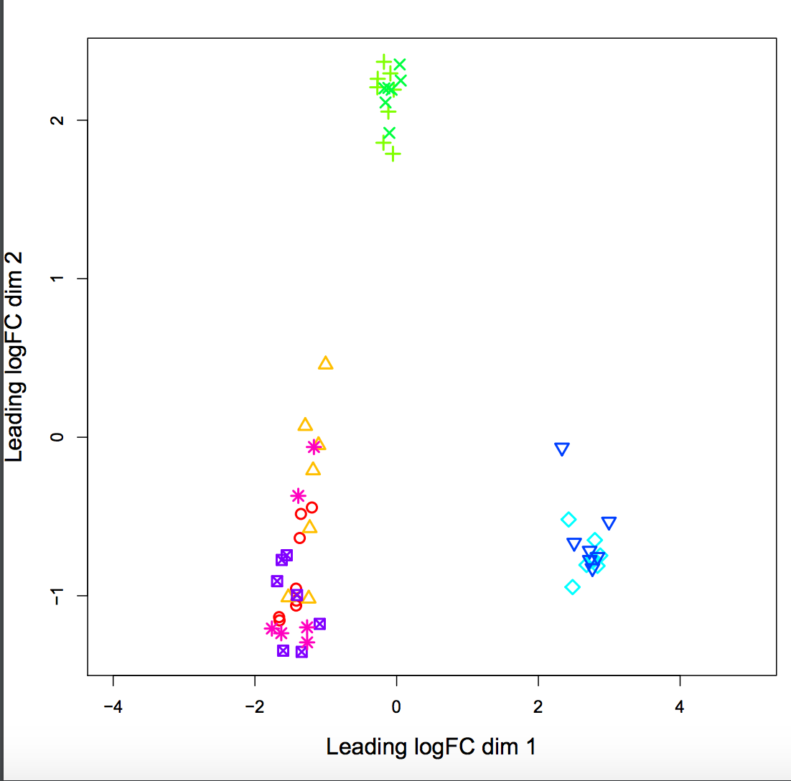
QA/QC
MDS plots of logCPM

Slide 36
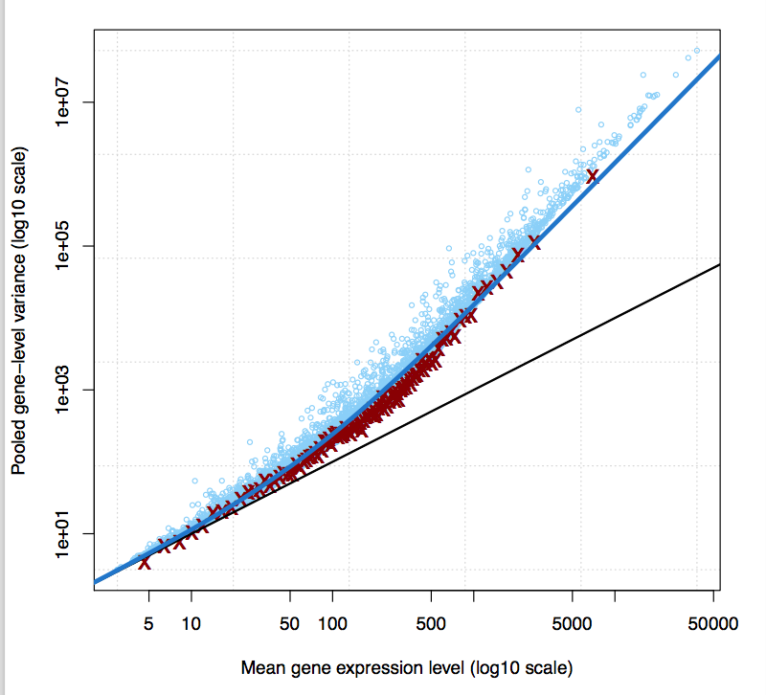
Variance Stabilization - eBayes
The variance characteristics of low expressed genes are different from high expressed genes, if treated the same, the effect is to over represent low expressed genes in the DE list.

Slide 37
Multiple testing correction
Simply a must! Best choices are
FDR (false discovery rate)
qvalue
The FDR (or qvalue) is a statement about the list and no longer about the gene. So a FDR 0.05, says you expect 5% false positives in the list of genes with an FDR of 0.05 and less.
The statement “Statistically significant” means FDR of 0.05 or less.
My opinion is these genes do not require further validation (eg qrtPCR)
You can dip below FDR 0.05, but in my opinion you then need to validate those genes.

Slide 38
EdgeR/Limma Manual
Both edgeR and limma voom have VERY comprehensive user manuals
Limma voom https://bioconductor.org/packages/release/bioc/vignettes/limma/inst/doc/usersguide.pdf
edgeR http://bioconductor.org/packages/release/bioc/vignettes/edgeR/inst/doc/edgeRUsersGuide.pdf

Slide 39
Summarization and Visualization

Slide 40
The Top Table
The basic table
Gene_ID: The Gene Id from the GTF file
logFC: log fold change, positive values indicate up-regulation, negative numbers indicate down-regulation
logCPM: log counts per million, average ‘expression’ value of the gene
LR: log ratio of the test (ignore)
Pvalue: raw p-value for that gene (best to sort on)
FDR: false discover rate for that gene
Annotation is added in additional columns (must first uncomment the line to do so in the R script

Slide 41
Visualization and Next step tools
Visualization
Integrated Genome Viewer (https://www.broadinstitute.org/igv/)
Further Annotation of Genes
DAVID (http://david.abcc.ncifcrf.gov/tools.jsp)
ConsensusPathdb (http://cpdb.molgen.mpg.de/)
NetGestalt (http://www.netgestalt.org/)
Molecular Signatures Database (http://www.netgestalt.org/)
PANTHER (http://www.pantherdb.org/)
Cognoscente (http://vanburenlab.medicine.tamhsc.edu/cognoscente.shtml)
Pathway Commons (http://www.pathwaycommons.org/)
Readctome (http://www.reactome.org/)
PathVisio (http://www.pathvisio.org/)
Moksiskaan (http://csbi.ltdk.helsinki.fi/moksiskaan/)
Weighed Gene Co-Expression Network Analysis (WGCNA)s
More tools in R Bioconductor

Slide 42
Gene Set enrichment analysis (GSEA) And GO/Pathway Enrichment
Gene set enrichment analysis
A computational method that determines whether an a priori set of genes (e.g. gene ontology group, or pathway) shows statistically significant, concordant differences between two biological states (e.g. phenotypes)
Gene Ontology/Pathways enrichment analysis
Given a set of genes that are up-regulated, which gene ontologies or pathways are over-represented (or under-represented) using annotations for that gene set.

Slide 43
Software
Preprocessing:
Python 2.7
Modules: argparse, optparse, distutils
bowtie2 - contaminant screening
http://bowtie-bio.sourceforge.net/bowtie2/index.shtml
Super-Deduper – Identify and remove PCR duplicates
https://github.com/dstreett/Super-Deduper
Sickle – Trim low quality regions
https://github.com/dstreett/sickle
Scythe – Identify and remove adapters in SE reads
https://github.com/ucdavis-bioinformatics/scythe
FLASH2 – Join overlapping reads, identify and remove adapter in PE reads
https://github.com/dstreett/FLASH2

Slide 44
Software
Mapping:
Bwa mem – map reads to a reference
http://sourceforge.net/projects/bio-bwa/files/
samtools – processing of sam/bam file
http://www.htslib.org/
Read Counting:
samtools – processing of sam/bam file
http://www.htslib.org/
HTeq-0.6.1 htseq_count – count reads occurrences within genes
http://www-huber.embl.de/users/anders/HTSeq/
OR simultaneous read mapping and counting:
Star
https://github.com/alexdobin/STAR [performs both alignment and counting]

Slide 45
Software
Analysis of differential expression:
R http://www.r-project.org/
R Packages: EdgeR, limma from bioconductor – differential expression analysis
http://bioconductor.org/packages/release/bioc/html/edgeR.html
http://bioconductor.org/packages/release/bioc/html/limma.html
https://genomebiology.biomedcentral.com/articles/10.1186/gb-2014-15-2-r29
RStudio
https://www.rstudio.com/

