Slide 1
TAGseq vs RNAseq
Dr. Matthew L. Settles
Genome Center
University of California, Davis
settles@ucdavis.edu
Sponsored by Lexogen

Slide 2
What is TagSeq
Generic name for 3’ biased transcriptome sequencing
Standard RNAseq has a bias associated with transcript length
In TagSeq methods one transcript -> one read
Interested in Differential Gene Expression AND not splice variation, transcript sequence, etc.

Slide 4

Lexogen QuantSeq
Lexogen sponsored a break during the workshop

Slide 5
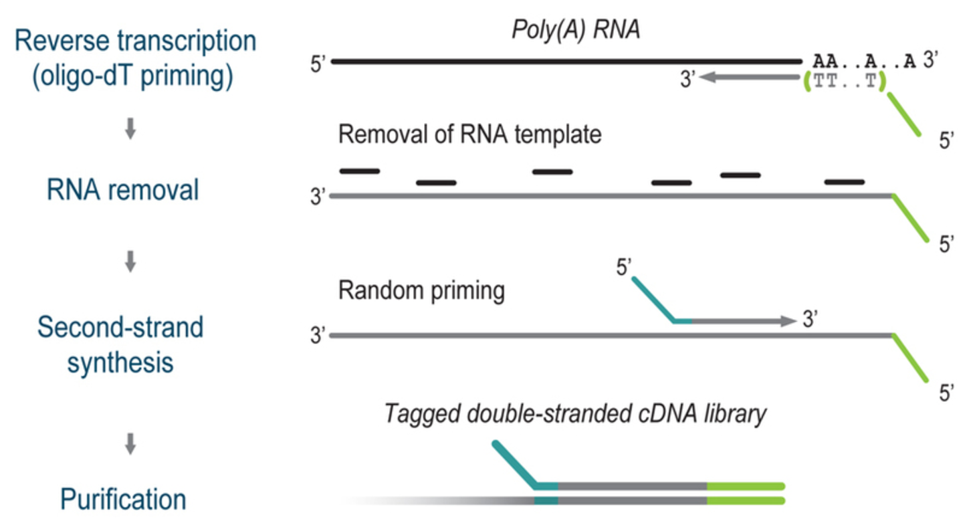
Protocol

Slide 6
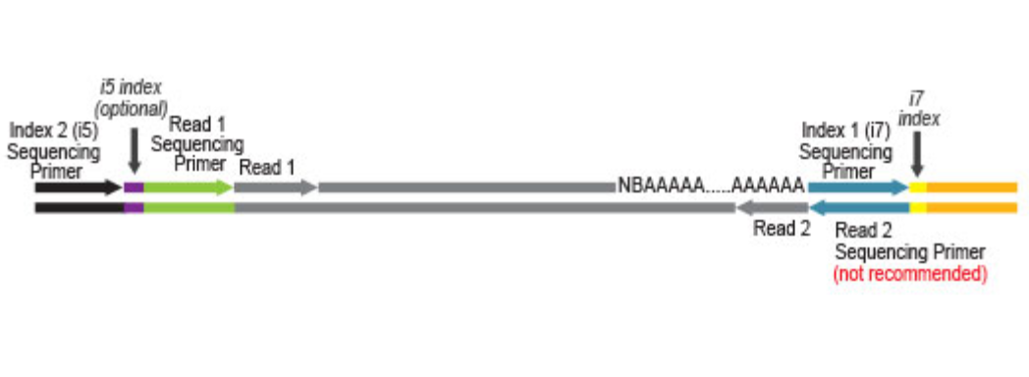
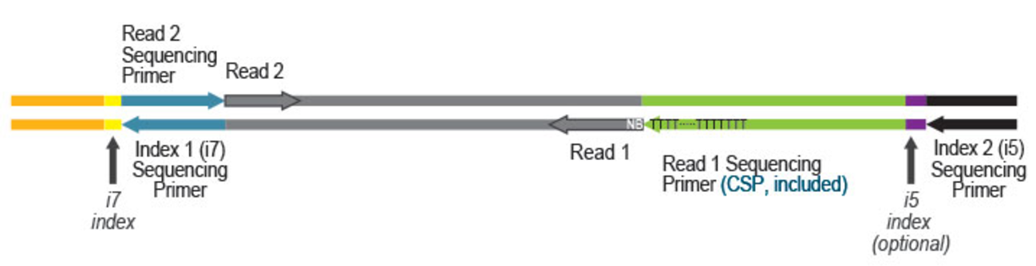
Lexogen Quant-Seq FWD/REV
Read orientation for QuantSeq FWD
Read orientation for QuantSeq REV with CSP

Slide 7
Benefits
Low input and low quality samples (say as low as 100pg)
Faster library preparation protocol, means cheaper libraries
Strand specific
Can pinpoint 3’ to polyA junctions and obtain accurate information about the 3’ UTR (REV kit)
Best suited for gene counting
Significant cost saving through multiplexing, need less sequencing per sample, comparable to microarrays
Single read sequencing is sufficient

Slide 8
Disadvantages
Data does not contain any transcript splicing information
Requires (sort of) a reference genome with good annotation (plus known UTRs)
Only applicable to Eukaryotic samples (requires polyA)
protocol is a (a bit) more sensitive to chemical contaminants (spin column cleaned RNA samples are recommended)

Slide 9
Bioinformatics
When sequencing only the interior (non-polyA) read
Need to trim off the first 11bp that represents the random primer
Align with STAR, which will soft clip off any potential adapter and span any intron-exon gap you may land in
When sequencing pairs, can follow the same protocol as ’normal’ RNAseq paired end, but need to also trim that same 11bp, now possibly on read2
Rest is the same as standard RNAseq

Slide 10
