Slide 1
Bioinformatics: A perspective
Dr. Matthew L. Settles
Genome Center
University of California, Davis
settles@ucdavis.edu

Slide 2
Outline
The World we are presented with
Advances in DNA Sequencing
Bioinformatics as Data Science
Viewport into bioinformatics
Training
The Bottom Line

Slide 3
Sequencing Costs
October 2016
$0.014/Mb
$1245 per Human sized (30x) genome
Includes: labor, administration, management, utilities, reagents, consumables, instruments (amortized over 3 years), informatics related to sequence productions, submission, indirect costs.
http://www.genome.gov/sequencingcosts/

Slide 4
Growth in Public Sequence Database
WGS > 1 trillion bp
http://www.ncbi.nlm.nih.gov/genbank/statistics

Slide 5
Short Read Archive (SRA)
> 1 quadrillion bp
http://www.ncbi.nlm.nih.gov/Traces/sra/

Slide 6
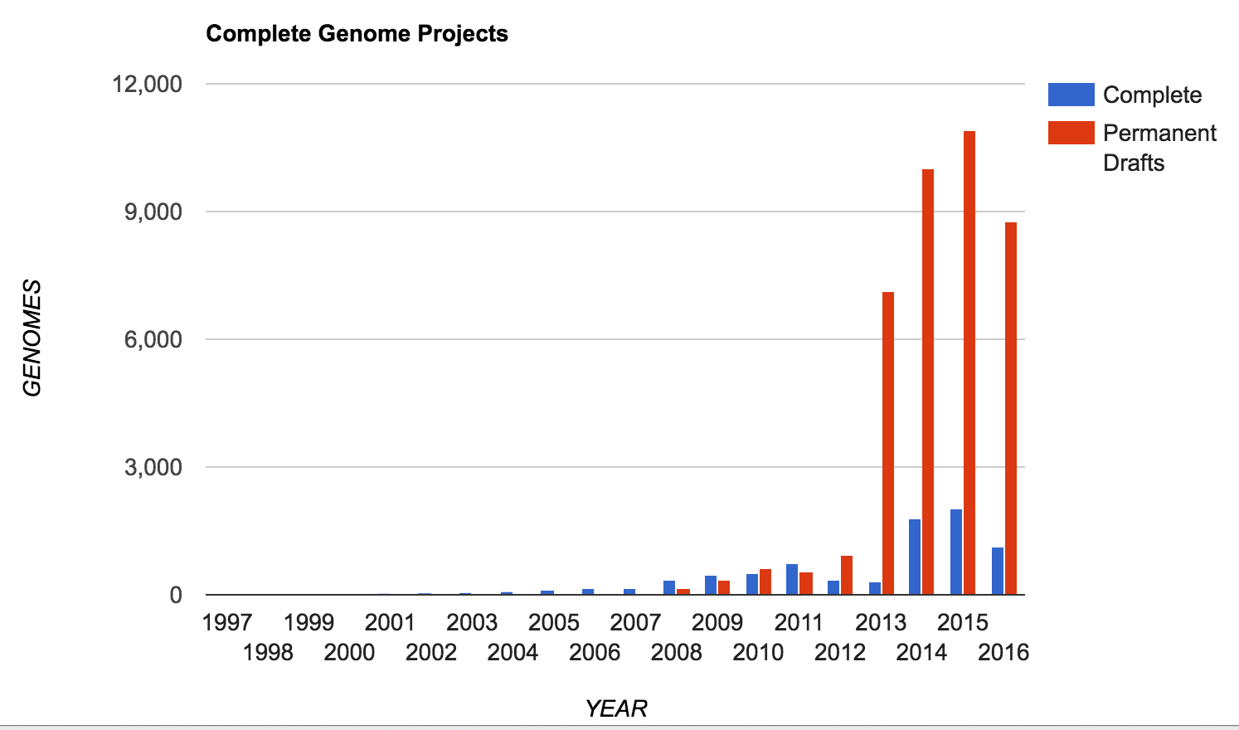
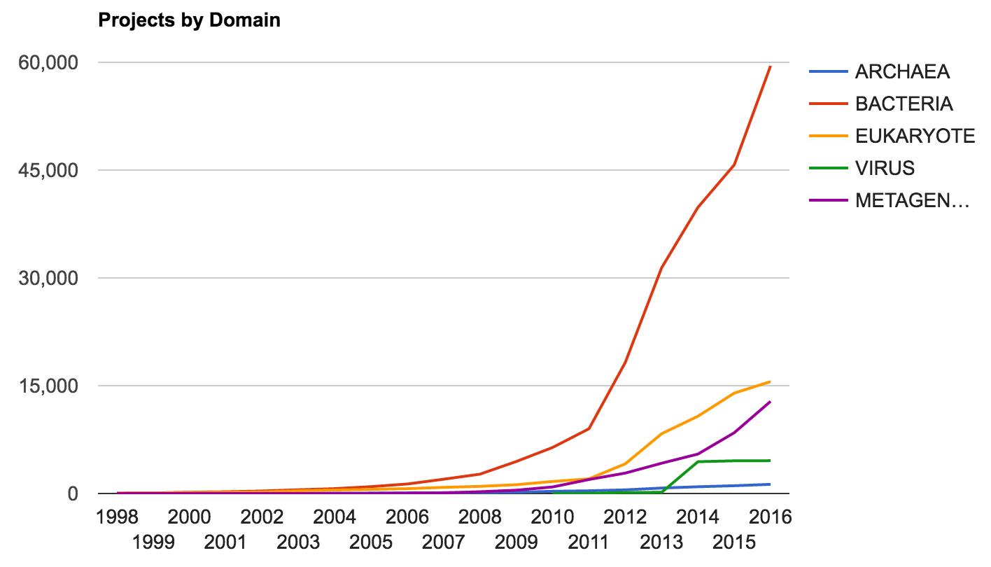
Increase in Genome Sequencing Projects
Lists > 3700 unique genus
JGI – Genomes Online Database (GOLD)
67,822 genome sequencing projects

Slide 7
Brief History

Slide 8
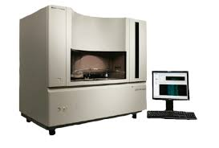
Sequencing Platforms
1986 - Dye terminator Sanger sequencing, technology dominated until 2005 until “next generation sequencers”, peaking at about 900kb/day

Slide 9
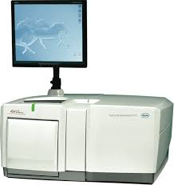
‘Next’ Generation
2005 – ‘Next Generation Sequencing’ as Massively parallel sequencing, both throughput and speed advances. The first was the Genome Sequencer (GS) instrument developed by 454 life Sciences (later acquired by Roche), Pyrosequencing 1.5Gb/day
Discontinued

Slide 10
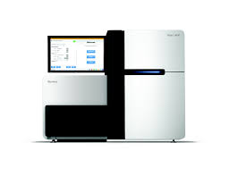
Illumina
2006 – The second ‘Next Generation Sequencing’ platform was Solexa (later acquired by Illumina). Now the dominant platform with 75% market share of sequencer and and estimated >90% of all bases sequenced are from an Illumina machine, Sequencing by Synthesis > 200Gb/day.
New NovaSeq

Slide 11
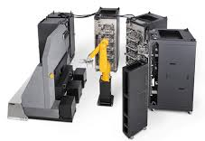
Complete Genomics
2006 – Using DNA nanoball sequencing, has been a leader in Human genome resequencing, having sequenced over 20,000 genomes to date. In 2013 purchased by BGI and is now set to release their first commercial sequencer, the Revolocity. Throughput on par with HiSeq
NOW DEFUNCT
Human genome/exomes only.
10,000 Human Genomes per year

Slide 12
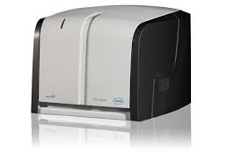
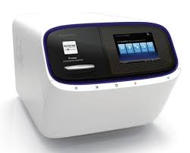
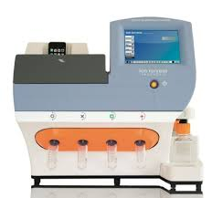
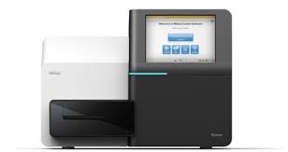
Bench top Sequencers
Roche 454 Junior
Life Technologies
Ion Torrent
Ion Proton
Illumina MiSeq

Slide 13
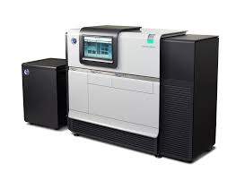
The ‘Next, Next’ Generation Sequencers (3rd Generation)
2009 – Single Molecule Read Time sequencing by Pacific Biosystems, most successful third generation sequencing platforms, RSII ~2Gb/day, newer Pac Bio Sequel ~14Gb/day, near 100Kb reads.
SMRT Sequencing
Iso-seq on Pac Bio possible, transcriptome without ‘assembly’

Slide 14
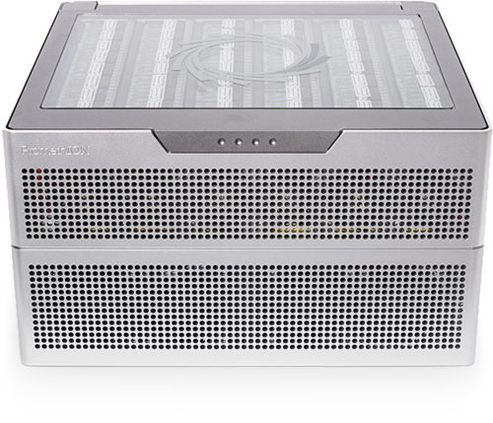
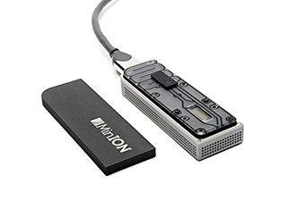
Oxford Nanopore
SmidgION: nanopore sensing for use with mobile devices
2015 – Another 3rd generation sequencer, founded in 2005 and currently in beta testing. The sequencer uses nanopore technology developed in the 90’s to sequence single molecules. Throughput is about 500Mb per flowcell, capable ofnear 200kb reads.
Fun to play with but results are highly variable
Nanopore Sequencing
FYI: 4th generation sequencing is being described as In-situ sequencing

Slide 15
Flexibility
Single Multiplexing
Genomic reduction allows for greater coverage and multiplexing of samples.
You can fine tune your depth of coverage needs and sample size
with the reduction technique
1X
Whole Genome
Reduction Techniques
Capture Techniques
RADseq
Depth of Coverage
Fluidigm Access Array
Amplicons
Few or Single Amplicons
1KB
100000X
Read 2 primer
Greater Multiplexing
Read 2 (50-300bp)
DNA Sequence
Read 1 (50- 300bp)
Barcode (8bp)
Barcode Read primer

Slide 16
Sequencing Libraries
DNA-seq
RNA-seq
Amplicons
CHiP-seq
MeDiP-seq
RAD-seq
ddRAD-seq
Pool-seq
EnD-seq
DNase-seq
ATAC-seq
MNase-seq
FAIRE-seq
Ribose-seq
smRNA-seq
mRNA-seq
Tn-seq
QTL-seq
tagRNA-seq
PAT-seq
Structure-seq
MPE-seq
STARR-seq
Mod-seq
BrAD-seq
SLAF-seq
G&T-seq

Slide 17
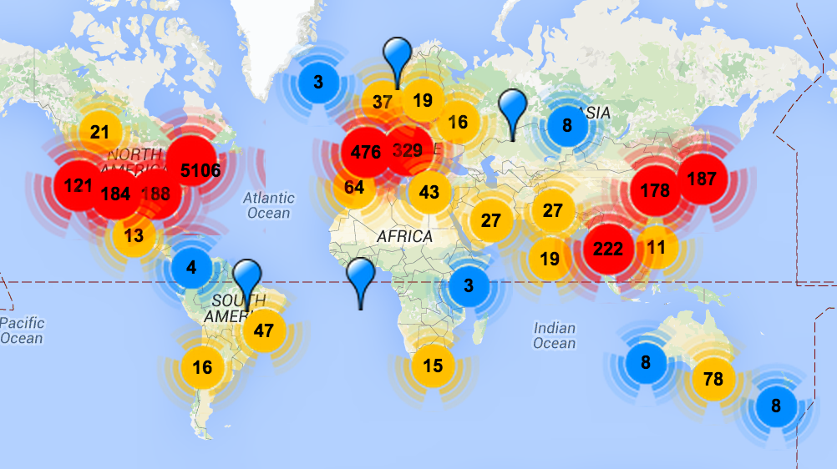
omicsmaps.com

Slide 18
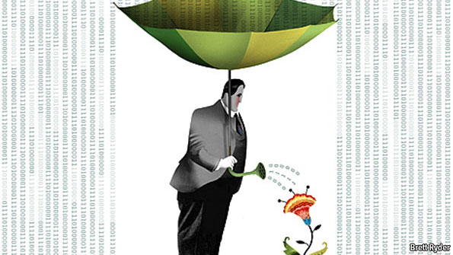
The data deluge
Plucking the biology from the Noise

Slide 19
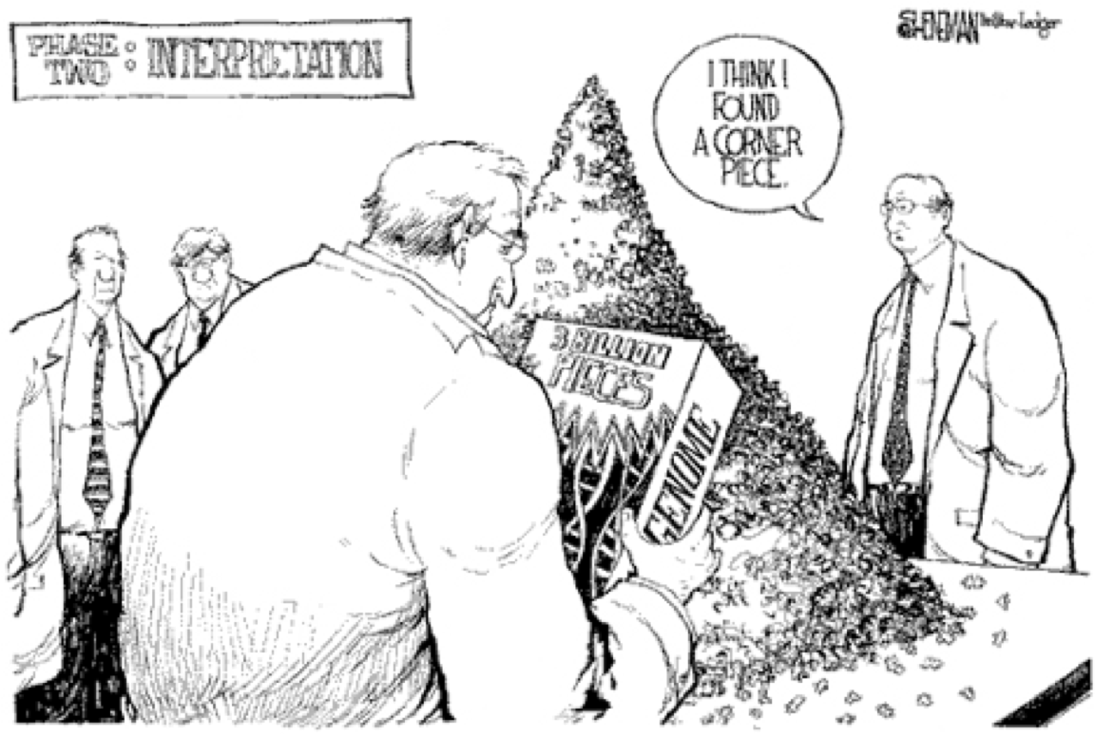
Reality
Its much more difficult than we may first think

Slide 20
The real cost of sequencing
Sboner et al. Genome Biology 2011 12:125 doi:10.1186/gb-2011-12-8-125

Slide 21
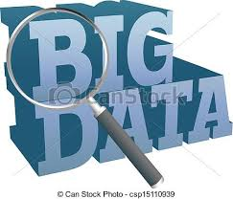

Bioinformatics is Data Science
Computational Biology
Biology
Math
Statistics
Computer
Science
Biostatistics
Bioinformatics
‘The data scientist role has been described as “part analyst, part artist.”’
Anjul Bhambhri, vice president of big data products at IBM
Notes:
Big data is an evolving term that describes any voluminous amount of structured, semi-structured and unstructured data that has the potential to be mined for information.
The Cloud is just a rebranding of

Slide 22
Data Science
Data science is the process of formulating a quantitative question that can be answered with data, collecting and cleaning the data, analyzing the data, and communicating the answer to the question to a relevant audience.
Five Fundamental Concepts of Data Science
statisticsviews.com November 11, 2013 by Kirk Borne
Notes:
Kirk Borne – George Mason University

Slide 23
7 Stages to Data Science
Define the question of interest
Get the data
Clean the data
Explore the data
Fit statistical models
Communicate the results
Make your analysis reproducible

Slide 24
Define the question of interest
Begin with the end in mind!
what is the question
how are we to know we are successful
what are our expectations
dictates
the data that should be collected
the features being analyzed
which algorithms should be use

Slide 25
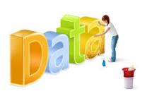
Get the data
Clean the data
Explore the data
Know your data!
know what the source was
technical processing in producing data (bias, artifacts, etc.)
“Data Profiling”
Data are never perfect but love your data anyway!
the collection of massive data sets often leads to unusual , surprising, unexpected and even outrageous.

Slide 26
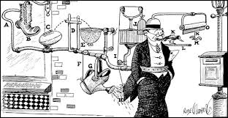
Fit statistical models
Over fitting is a sin against data science!
Model’s should not be over-complicated
If the data scientist has done their job correctly the statistical models don't need to be incredibly complicated to identify important relationships
In fact, if a complicated statistical model seems necessary, it often means that you don't have the right data to answer the question you really want to answer.

Slide 27
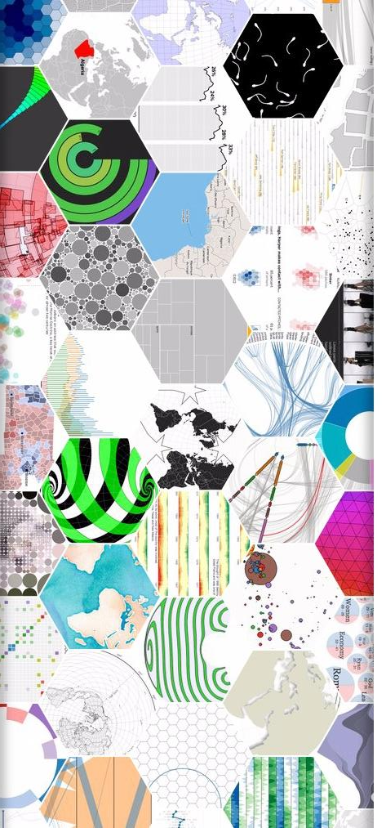
Communicate the results
Make your analysis reproducible
Remember that this is ‘science’!
We are experimenting with data selections, processing, algorithms, ensembles of algorithms, measurements, models. At some point these must all be tested for validity and applicability to the problem you are trying to solve.

Slide 28
Data science done well looks easy – and that’s a big problem for data scientists
simplystatistics.org
March 3, 2015 by Jeff Leek

Slide 29
Training: Data Science Bias
Data Science (data analysis, bioinformatics) is most often taught through an apprentice model
Different disciplines/regions develop their own subcultures, and decisions are based on cultural conventions rather than empirical evidence.
Programming languages
Statistical models (Bayes vs. Frequentist)
Multiple testing correction
Application choice, etc.
These (and others) decisions matter a lot in data analysis
"I saw it in a widely-cited paper in journal XX from my field"

Slide 30
The Data Science in Bioinformatics
Bioinformatics is not something you are taught, it’s a way of life
“The best bioinformaticians I know are problem solvers – they start the day not knowing something, and they enjoy finding out (themselves) how to do it. It’s a great skill to have, but for most, it’s not even a skill – it’s a passion, it’s a way of life, it’s a thrill. It’s what these people would do at the weekend (if their families let them).”
Mick Watson – Rosland Institute
Notes:
How-To: Workshops are by and large unaffected

Slide 31

Training - Models
Workshops
Often enrolled too late
Collaborations
More experience persons
Apprenticeships
Previous lab personnel to young personnel
Formal Education
Most programs are graduate level
Few Undergraduate

Slide 32
Bioinformatics
Know and Understand the experiment
“The Question of Interest”
Build a set of assumptions/expectations
Mix of technical and biological
Spend your time testing your assumptions/expectations
Don’t spend your time finding the “best” software
Don’t under-estimate the time Bioinformatics may take
Be prepared to accept ‘failed’ experiments

Slide 33
Bottom Line
The Bottom Line:
Spend the time (and money) planning and producing good quality, accurate and sufficient data for your experiment.
Get to know to your data, develop and test expectations
Result, you’ll spend much less time (and less money) extracting biological significance and results during analysis.

Slide 34
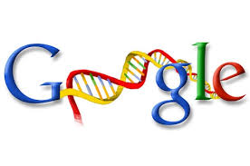

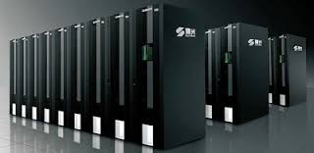
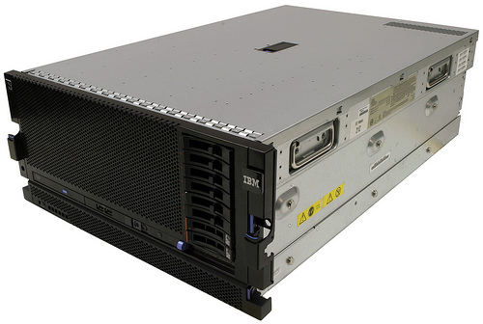
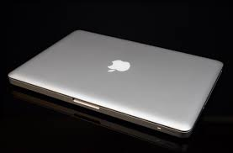
Substrate
Cloud
Computing
Cluster
Computing
LINUX
BASTM
Laptop & Desktop

Slide 35








Environment
“Command Line” and “Programming Languages”
VS
Bioinformatics Software Suite

Slide 36
Prerequisites
Access to a multi-core (24 cpu or greater), ‘high’ memory 64Gb or greater Linux server.
Familiarity with the ’command line’ and at least one programming language.
Basic knowledge of how to install software
Basic knowledge of R (or equivalent) and statistical programming
Basic knowledge of Statistics and model building

