Slide 1
AN INTRODUCTION TO CONVOLUTIONAL NEURAL NETWORKS

Slide 2
WHAT IS ANN BASICALLY??
Artificial Neural Networks (ANNs) are computational processing systems of which are heavily inspired by way biological nervous systems (such as the human brain) operate. ANNs are mainly comprised of a high number of interconnected computational nodes (referred to as neurons), of which work entwine in a distributed fashion to collectively learn from the input in order to optimise its final output.
The basic structure of a ANN can be modelled as loading the input, usually in the form of a multidimensional vector into the input layer which will distribute it to the hidden layers. The hidden layers will then make decisions from the previous layer and weigh up a stochastic change within itself which improves the final output, and this is referred to as the process of learning. Having multiple hidden layers stacked upon each-other is commonly called deep learning.

Slide 3
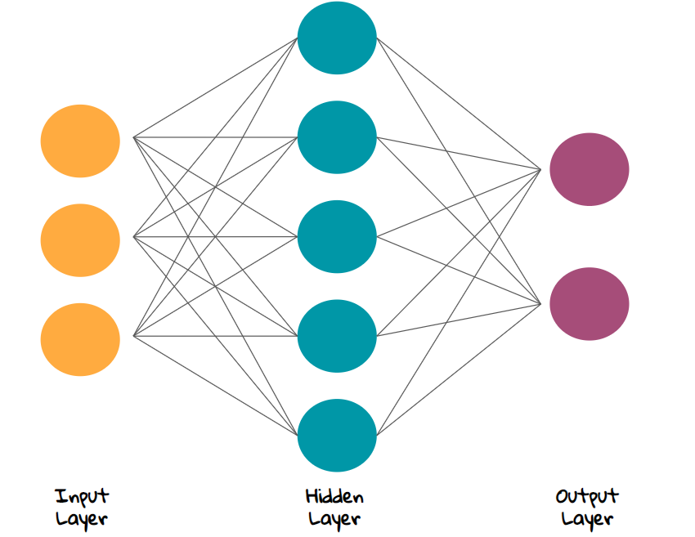
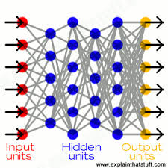

Slide 4
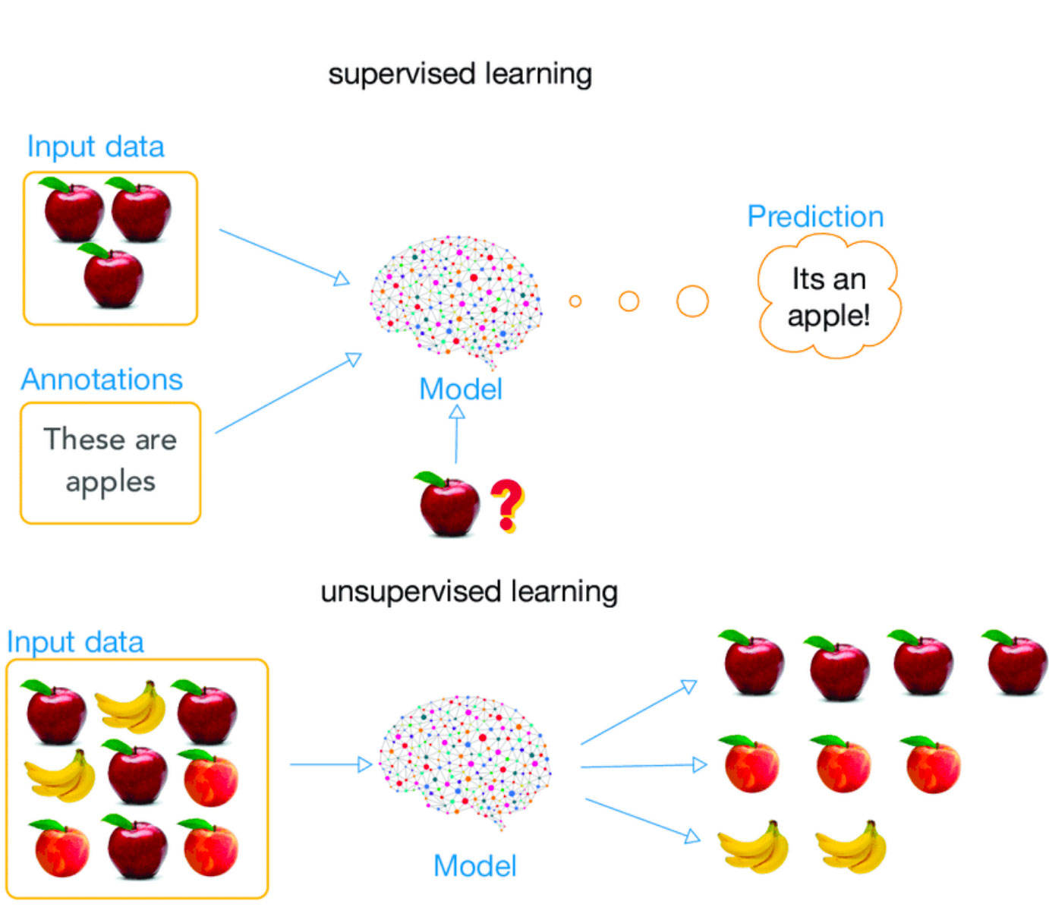
The two key learning paradigms in image processing tasks are supervised and
unsupervised learning.
Supervised learning is learning through pre-labelled inputs, which act as targets. For each training example there will be a set of input values (vectors) and one or more associated designated output values. The goal of this form of training is to reduce the models overall classification error, through correct calculation of the output value of training example By training.
Unsupervised learning differs in that the training set does not include any labels. Success is usually determined by whether the network is able to reduce or increase an associated cost function. However, it is important to note that most image-focused pattern-recognition tasks usually depend on classification usingsupervised learning.

Slide 5
INTRODUCTION TO CNN:
Convolutional Neural Networks (CNNs) are analogous to traditional ANNs in that they are comprised of neurons that self-optimise through learning. Each neuron will still receive an input and perform a operation (such as a scalar product followed by a non-linear function) - the basis of countless ANNs. From the input raw image vectors to the final output of the class score, the entire of the network will still express a single perceptive score function (the weight). The last layer will contain loss functions associated with the classes, and all of the regular tips and tricks developed for traditional ANNs still apply.
Overfitting is basically when a network is unable to learn effectively due to a number of reasons. It is an important concept of most, if not all machine learning algorithms and it is important that every precaution is taken as to reduce its effects If our models were to exhibit signs of overfitting then we may see a reduced ability to pinpoint generalised features for not only our training dataset, but also our test and prediction sets. This is the main reason behind reducing the complexity of our ANNs. The less parameters required to train, the less likely the network will overfit - and of course, improve the predictive performance of the model.
ARCHITECTURE OF CNN:
CNN are comprised of neurons organised into three dimensions, the spatial dimensionality of the input such as height and the width and the depth. The depth does not refer to the total number of layers within the ANN, but the third dimension of a activation volume. Unlike standard ANNS, the neurons within any given layer will only connect to a small region of the layer preceding it.
CNNs are comprised of three types of layers. These are convolutional layers, pooling layers and fully-connected layers. When these layers are stacked, a CNN architecture has been formed.

Slide 6
The basic functionality of CNN can be broken down into four key areas.
1)As found in other forms of ANN, the input layer will hold the pixel values of the image.
2. The convolutional layer will determine the output of neurons of which are connected to local regions of the input through the calculation of the scalar product between their weights and the region connected to the input volume. The rectified linear unit (commonly shortened to ReLu) aims to apply an ’elementwise’ activation function such as sigmoid to the output of the activation produced by the previous layer.
3. The pooling layer will then simply perform downsampling along the spatial dimensionality of the given input, further reducing the number of parameters within that activation.
4. The fully-connected layers will then perform the same duties found in standard ANNs and attempt to produce class scores from the activations, to be used for classification. It is also suggested that ReLu may be used between these layers, as to improve performance. Through this simple method of transformation, CNNs are able to transform the original input layer by layer using convolutional and downsampling techniques to produce class scores for classification and regression purposes

Slide 7
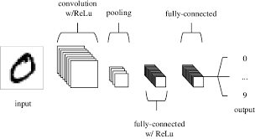

Slide 8
Convolutional layer
As the name implies, the convolutional layer plays a vital role in how CNNs operate. The layers parameters focus around the use of learnable kernels.
These kernels are usually small in spatial dimensionality, but spreads along the entirety of the depth of the input. When the data hits a convolutional layer, the layer convolves each filter across the spatial dimensionality of the input to produce a 2D activation map. As we glide through the input, the scalar product is calculated for each value in that kernel. These are commonly known as activations. Convolutional layers are also able to significantly reduce the complexity of the model through the optimisation of its output. These are optimised through three hyperparameters, the depth,the stride and setting zero-padding.
The depth of the output volume produced by the convolutional layers can be manually set through the number of neurons within the layer to a the same region of the input. This can be seen with other forms of ANNs, where the all of the neurons in the hidden layer are directly connected to every single neuron beforehand. Reducing this hyperparameter can significantly minimise the total number of neurons of the network, but it can also significantly reduce the pattern recognition capabilities of the model.

Slide 9
2. We are also able to define the stride in which we set the depth around the spatial
dimensionality of the input in order to place the receptive field. For example if
we were to set a stride as 1, then we would have a heavily overlapped receptive
field producing extremely large activations. Alternatively, setting the stride to a
greater number will reduce the amount of overlapping and produce an output
of lower spatial dimensions.
3. Zero-padding is the simple process of padding the border of the input, and
is an effective method to give further control as to the dimensionality of the
output volumes.
It is important to understand that through using these techniques, we will alter
the spatial dimensionality of the convolutional layers output. To calculate this,
you can make use of the following formula:
( (V- R) + 2Z)/(s+1)
Where V represents the input volume size (height*width*depth), R represents
the receptive field size, Z is the amount of zero padding set and S referring to
the stride. If the calculated result from this equation is not equal to a whole
integer then the stride has been incorrectly set, as the neurons will be unable to
fit neatly across the given input.

Slide 10
Pooling layer
Pooling layers aim to gradually reduce the dimensionality of the representation, and thus further reduce the number of parameters and the computational complexity of the model. The pooling layer operates over each activation map in the input, and scales its dimensionality using the “MAX” function. In most CNNs, these come in the form of max-pooling layers with kernels of a dimensionality of 2 2 applied with a stride of 2 along the spatial dimensions of the input. This scales the activation map down to 25% of the original size - whilst maintaining the depth volume to its standard size.
Due to the destructive nature of the pooling layer, there are only two generally observed methods of max-pooling. Usually, the stride and filters of the pooling layers are both set to 2 2, which will allow the layer to extend through the entirety of the spatial dimensionality of the input.
Furthermore overlapping pooling may be utilised, where the stride is set to 2 with a kernel size set to 3. Due to the destructive nature of pooling, having a kernel size above 3 will usually greatly decrease the performance of the model. It is also important to understand that beyond max-pooling, CNN architectures may contain general-pooling.
General pooling layers are comprised of pooling neurons that are able to perform a multitude of common operations including L1/L2-normalisation, and average pooling. However, this tutorial will primarily focus on the use of max-pooling.

Slide 11
Fully-connected layer
The fully-connected layer contains neurons of which are directly connected to the neurons in the two adjacent layers, without being connected to any layers within them.

