Slide 1
IT416 Computer Vision
211IT010 - Arvind Prabhu
211IT013 - Ashwani Kumar
211IT026 - Jaheer Khan

Slide 2
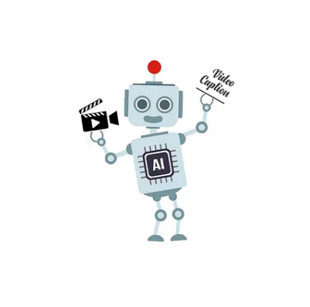
Problem Statement
Dense Multimodal Video Captioning:
Dense multimodal video captioning involves generating detailed, context-aware captions by analyzing and integrating both audio and visual content from complex, information-rich video sequences.

Slide 3
Introduction
The task of video captioning has become very popular in recent years. With all the platforms like YouTube, Twitch, and short videos like Instagram Reels, videos have become a very important means of communication in our daily life. According to Forbes, over 500 million people watch videos on Facebook every day. 72 hours of videos are uploaded to YouTube every minute. With videos gaining such high popularity AI products like video captioning for videos have become an all-time necessity.
To solve this problem we made a video captioning model.

Slide 4
Proposed Methodology
Dataset Overview: Train/test folders with videos, features, and captions in JSON files.
Feature Extraction: VGG16 extracts 4096 features/frame; 80 frames/video processed into (80, 4096) arrays.
Preprocessing: Captions tokenized, padded to 10 words, filtered (6-10 words), limited vocabulary of 1500 words.
Model: Encoder-decoder LSTM; encoder processes video features, decoder generates captions.
Data Handling: Batch size of 320, generator used for memory efficiency.
Training: 150 epochs on Colab (Tesla T4), ~40s/epoch.
Inference: Separate encoder/decoder; greedy search for real-time captioning.
Prediction: Decoder iteratively predicts words until <eos>.

Slide 5
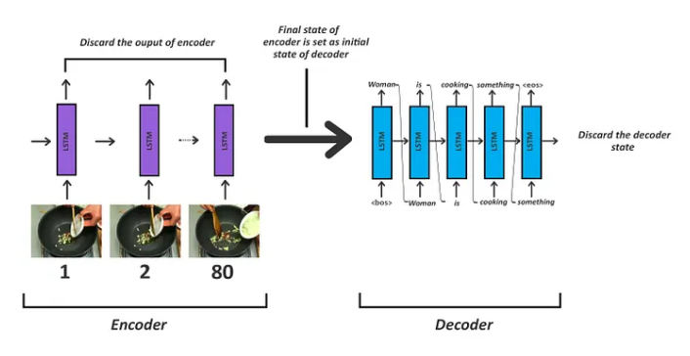
Inference Model

Slide 6
Implementation
Setup Environment: Installed required libraries: TensorFlow, Keras, OpenCV.
Feature Extraction:Extracted frames using cv2 and processing frames with VGG16 to get (80, 4096) feature arrays.
Preprocess Captions:Tokenizing and padding the captions to 10 words, using <bos> and <eos> tokens for model input/output.
Model Construction:
Build an encoder with LSTM layers to process video features.
Designed a decoder LSTM with dense layers for caption prediction.
Data Loading:Used a Python generator for batch processing to save memory.
Training:Trained the encoder-decoder model for 150 epochs on a GPU.
Inference Model:
Saved encoder and decoder models separately.
Implemented greedy search for real-time caption generation.
Caption Generation:Predict words one by one until <eos> is reached.

Slide 7
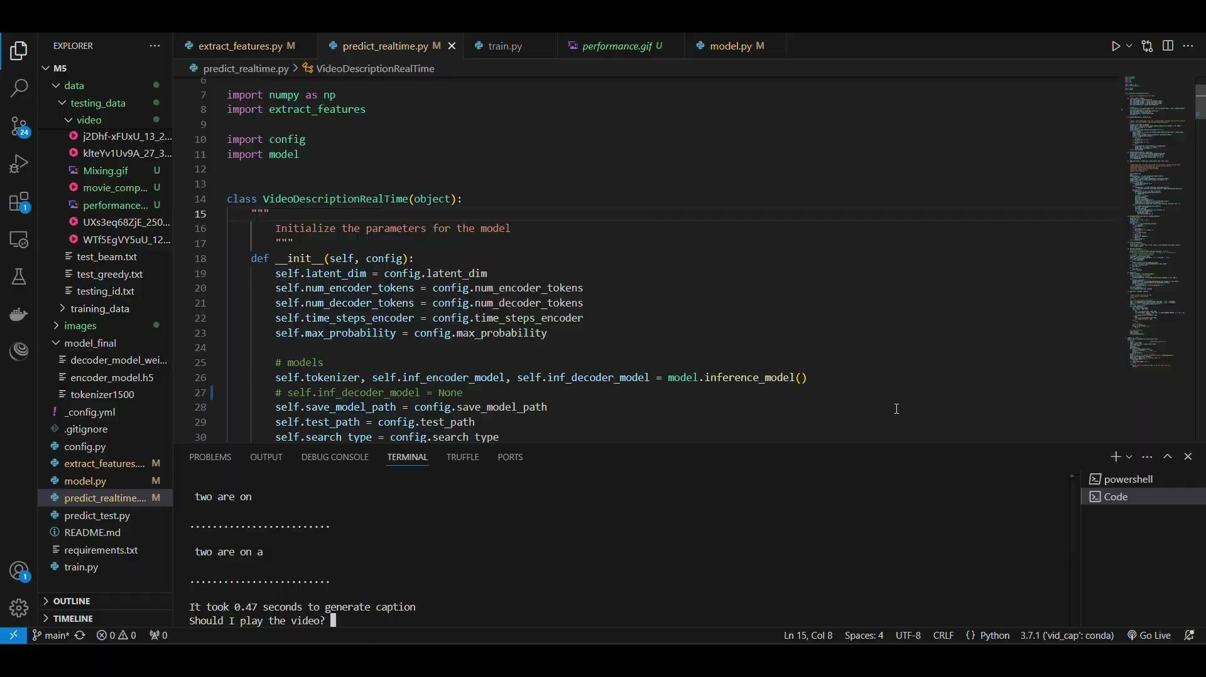
Result and Demo

Slide 8

Result and Demo
Metrics used:
BLEU-4: BLEU-4 measures how similar a generated sentence (e.g., a translation or generated text) is to one or more reference sentences.
METEOR: METEOR is designed to improve on BLEU by accounting for more factors in text similarity, such as synonymy, stemming, and paraphrasing, making it more sensitive to word choice variations.
Accuracy: Number of tokens correctly predicted.
METEOR has been shown to be highly correlated with human judgement in a situation with a limited number of reference(1 in this case).

Slide 9
Applications
Some of the applications of the project includes:
Better search algorithms: If each video can be automatically described search algorithms will have finer more accurate results.
Recommendation Systems: We could easily be able to cluster videos based on their similarity if the contents of the video can be automatically described.
Content Accessibility: Enhanced video captions improve accessibility for individuals with hearing impairments by providing detailed descriptions of both audio and visual elements.
Content Moderation: Automated video description enables faster detection of inappropriate or harmful content, aiding moderation efforts on social media and streaming platforms.

Slide 10
Conclusion and Future Work
Project Success: The dense multimodal video captioning project demonstrated the ability to generate accurate and coherent captions for video content using an encoder-decoder model.
Key Achievements:
Extracted video features with pre-trained VGG16.
Implemented LSTM-based architecture for encoding video features and decoding captions.
Improved video understanding, search algorithms, and recommendation systems through automated video captioning.
Advanced Techniques:
Integrate transformer-based models (e.g., Vision Transformer, GPT-4 Vision) for enhanced caption quality.
Implement beam search for more diverse and accurate caption generation.
Multi-language Support:
Expand the model's capability to generate captions in multiple languages.
Integrate NLP models for multilingual processing.

Slide 11
Thank you

