Slide 1
Pizza Runner Case Study #2

Slide 2
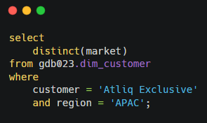
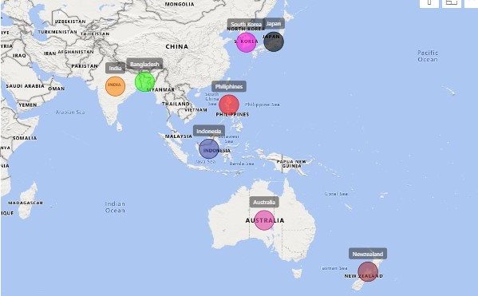
Result
Provide the list of markets in which customer "Atliq Exclusive" operates its business in the APAC region.
India
Australia
New Zealand
Bangladesh
Indonesia
Japan
Philiphines
South Korea

Slide 3
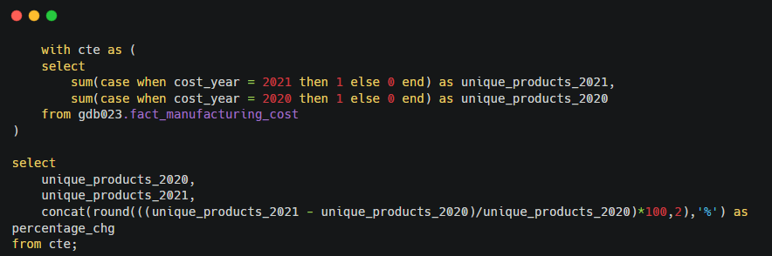
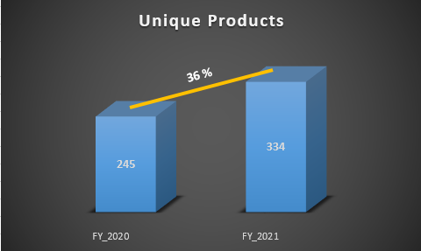
Result
What is the percentage of unique product increase in 2021 vs. 2020? The final output contains these fields - unique_products_2020 unique_products_2021 percentage_chg
There is 36%
increase in unique
products from FY
2020 to FY 2021

Slide 4
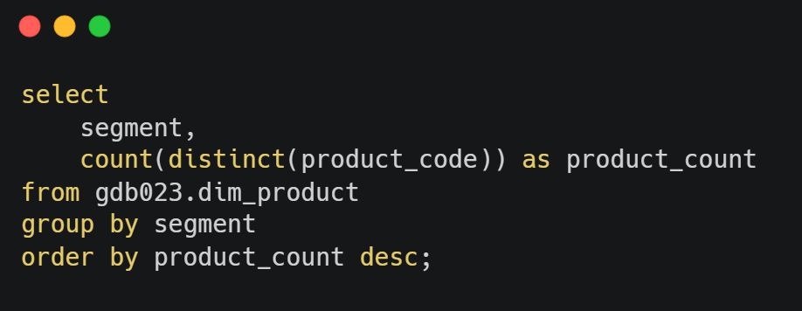
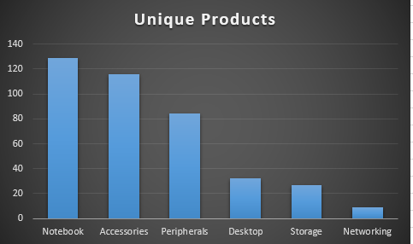
Result
Provide a report with all the unique product counts for each segment and sort them in descending order of product counts. The final output contains 2 fields – Segment & Product Count
Notebook segment has produced maximum unique products while Networking has the least

Slide 5
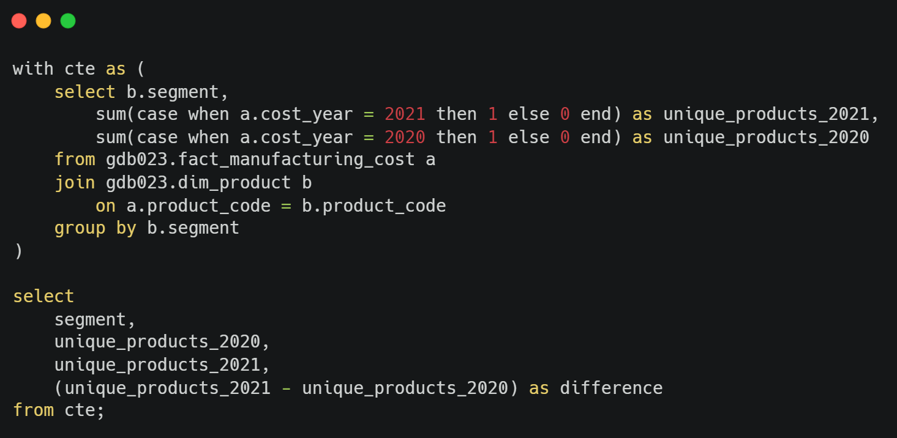
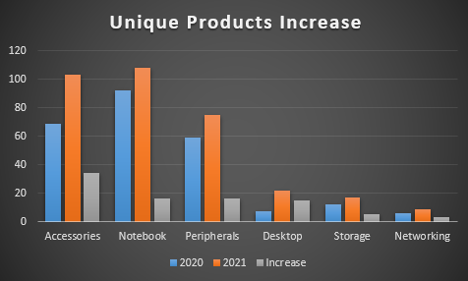
Result
Which segment had the most increase in unique products in 2021 vs 2020? The final output contains these fields - segment product_count_2020 product_count_2021 difference
Company produced more unique products in every segment in 2021 vs 2020
Accessories segment has most increase in unique products in 2021 vs 2020

Slide 6
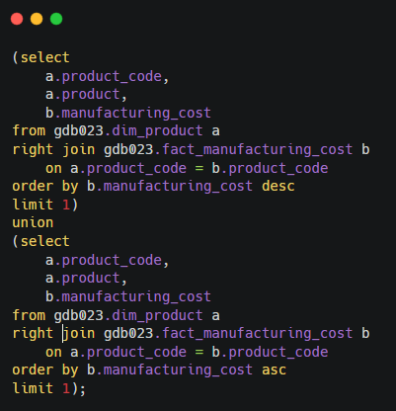
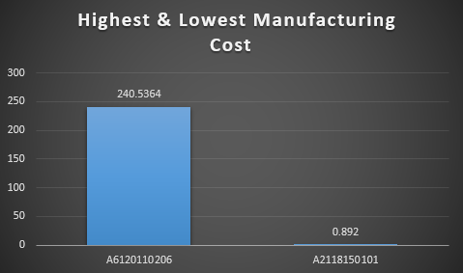
Result
Get the products that have the highest and lowest manufacturing costs. The final output should contain these fields - product_code, product & manufacturing_cost
AQ Home Alin 1 Gen 2 – Highest
AQ Master wired x1 Ms - Lowest

Slide 7
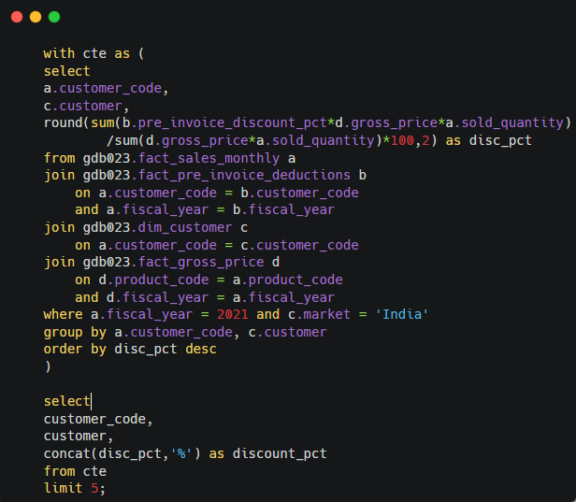
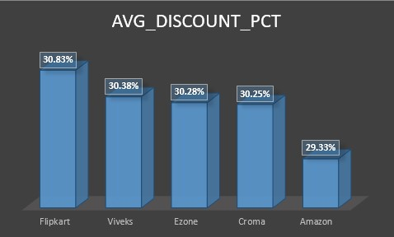
Result
Generate a report which contains the top 5 customers who received an average high pre_invoice_discount_pct for the fiscal year 2021 and in the Indian market. The final output contains these fields - customer_code, customer, average_discount_percentage.
Flipkart, Viveks, Ezon, Chroma, Amazon were top 5 customers to get the highest pre_invoice_discount_pct

Slide 8
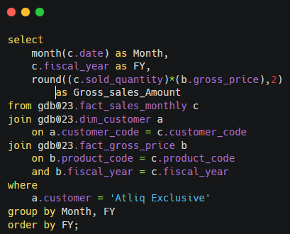
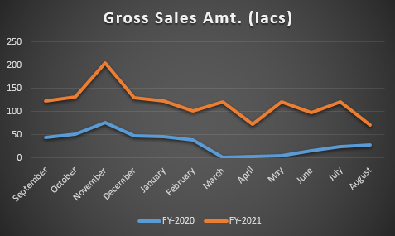
Result
Get the complete report of the Gross sales amount for the customer “Atliq Exclusive” for each month. This analysis helps to get an idea of low and high-performing months and take strategic decisions. The final report contains these columns: Month, Year, Gross sales Amount
Each year November had the highest Gross Sales.

Slide 9
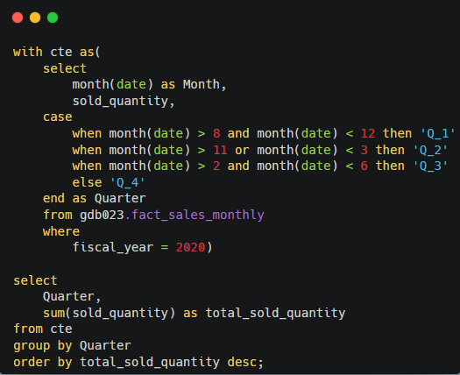
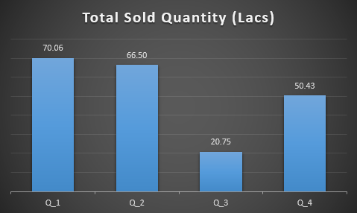
Result
In which quarter of 2020, got the maximum total_sold_quantity? The final output contains these fields sorted by the total_sold_quantity : Quarter, total_sold_quantity
Q_1 had the highest sales quantity
Q_3 had the lowest sales quantity

Slide 10
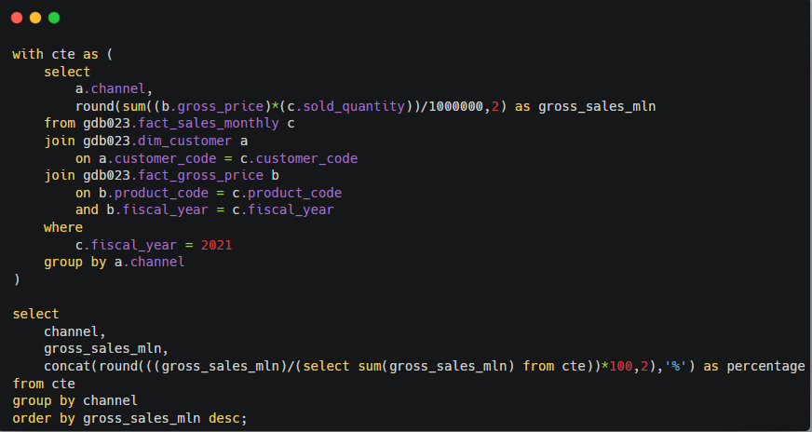
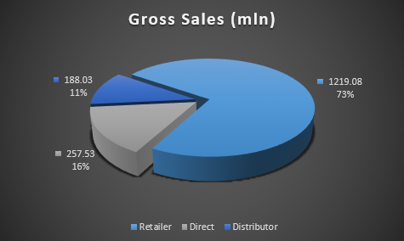
Result
Which channel helped to bring more gross sales in the fiscal year 2021 and the percentage of contribution? The final output contains these fields : channel, gross_sales_mln, percentage
Distributer did highest sales
Retailer did lowest sales

Slide 11
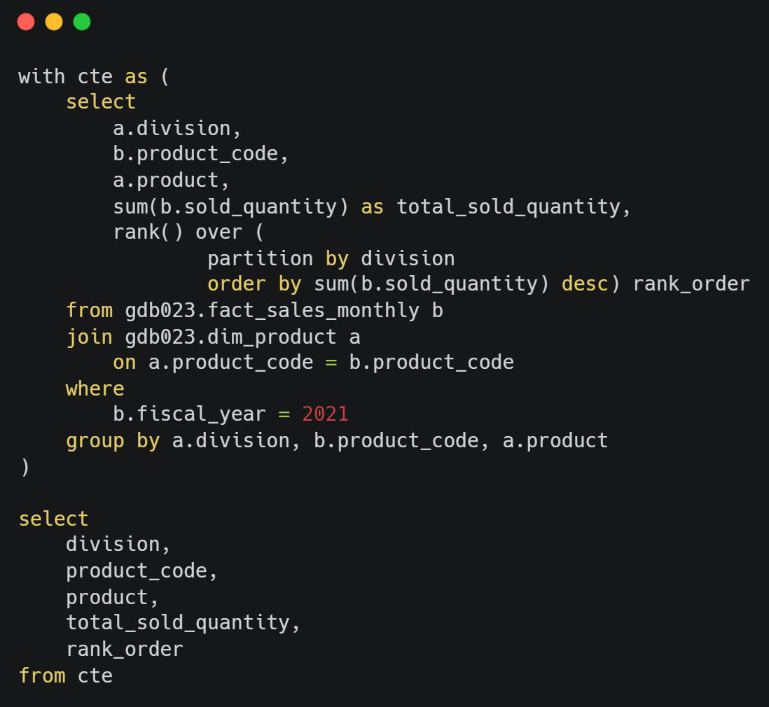
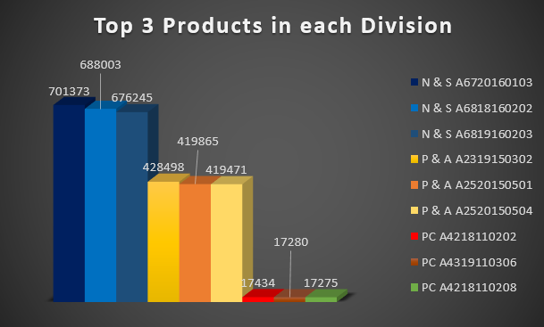
Get the Top 3 products in each division that have a high total_sold_quantity in the fiscal_year 2021? The final output contains these fields : division, product_code, product, total_sold_quantity, rank_order

