Slide 1
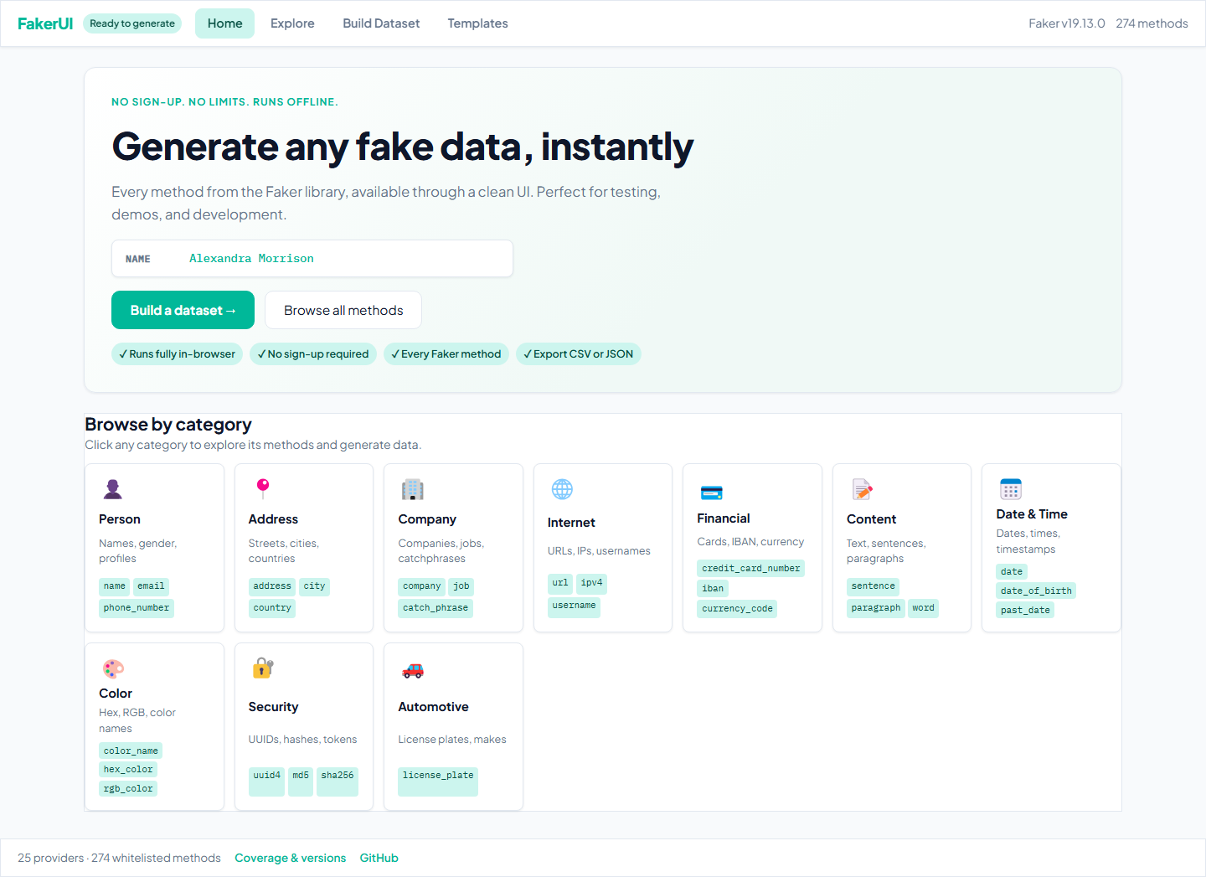
Synthora
Synthetic data generation
that feels like a product
Synthora gives developers, QA teams, and demo owners a fast path to realistic data without setup, signup, or backend infrastructure.
No signup
Runs in browser
JSON + CSV
Live demo
https://arvind3.github.io/Synthora/
Method catalog
Runtime
Output
274
Client-side
CSV / JSON

Slide 2
WHY THIS MATTERS
Synthora
Creating fake data is still more manual than it should be
The pain is rarely strategic, but it shows up in every test cycle, demo, and lower environment.
Manual setup
Privacy risk
Low realism
Delay cost
Spreadsheets, copied records, and one-off scripts slow teams down.
Real customer data should not travel into demos or non-production workflows.
Toy data breaks when teams need believable product scenarios.
Teams lose time before they can even start the real work.
Developers need credible data fast, not another setup task.
QA teams need repeatable synthetic datasets for regression and workflow validation.
Demo teams need realistic records without using sensitive customer information.
Non-technical users still need a guided path to export-ready data.

Slide 3
THE PRODUCT ANSWER
Synthora
Synthora turns fake data from a coding chore into a product workflow
It gives teams a clear path from discovery to export using the browser alone.
Discover
Build
Preview
Export
Search the live Faker method catalog through a clean UI instead of raw code.
Compose structured schemas with locale, rows, seed, and field mapping.
Inspect output before you download or hand it to another team.
Take clean JSON or CSV into testing, demos, or downstream workflows.
No signup required.
No infrastructure to stand up.
Client-side runtime execution.
One workflow for technical and non-technical users.
Primary value
Delivery model
Fast, safe, self-serve
Static web app
Runtime model
Trust model
Pyodide + Faker
Whitelisted methods

Slide 4
PRODUCT OVERVIEW
Synthora
The product value is visible in one screen
The homepage makes the workflow legible immediately: understand the promise, choose a path, start generating.
Build Dataset CTA
Category Browser
Runtime Signal
Jump directly into structured dataset creation.
Browse common data domains without learning library internals.
Clear status tells users when the browser runtime is ready.

Slide 5
CORE CAPABILITIES
Synthora
Built for the data types teams use every day
The experience covers the high-value domains most often needed in testing, demos, and environment setup.
Person
Address
Company
Internet
Profiles, names, email, phone
Street, city, country, postcode
Organization, job, catch phrase
URL, IP, username, domain
Financial
Content
Date and Time
Security
Cards, IBAN, currency
Sentence, paragraph, word
Dates, timestamps, birth dates
UUIDs, hashes, tokens
This breadth matters because the product can support both quick samples and realistic multi-field datasets from the same UI.

Slide 6
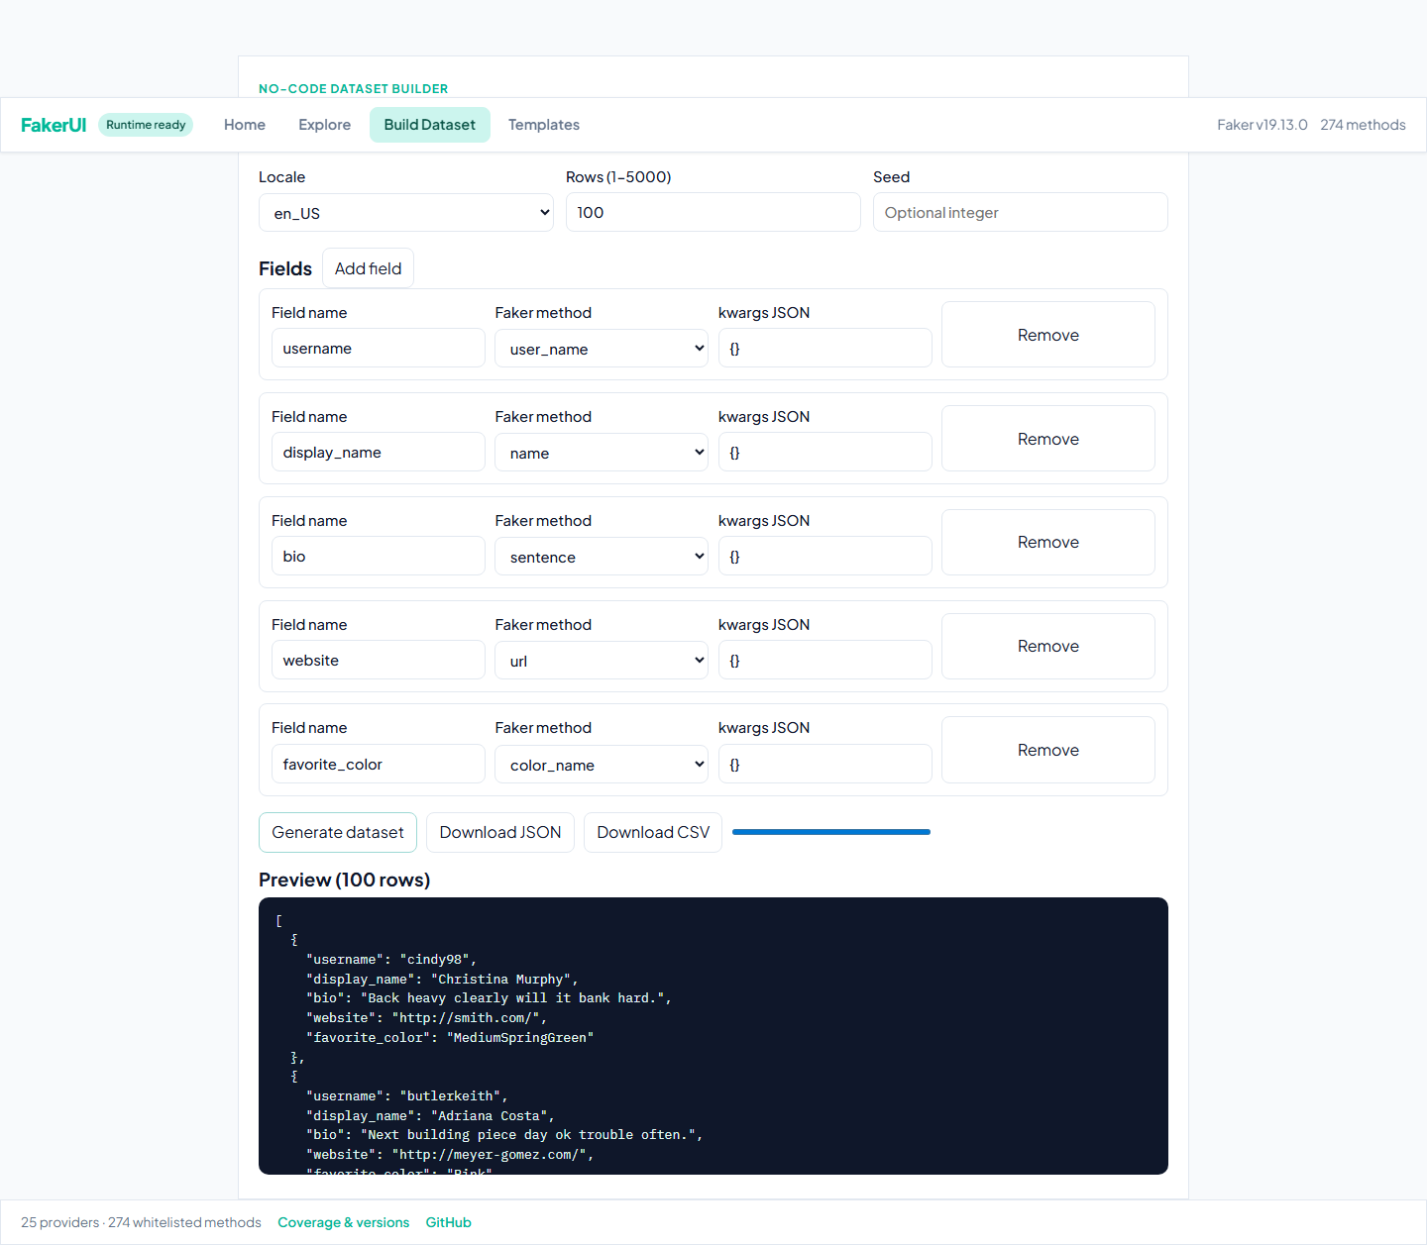
DATASET BUILDER
Synthora
The Schema Builder makes structured data a self-serve workflow
Users can choose fields, control rows, preview output, and export without leaving the page.
Field Mapping
Generation Controls
Preview Before Export
Each column is tied to a specific Faker method.
Locale, row volume, and seed make output more deliberate.
Inspect output before downloading JSON or CSV.

Slide 7
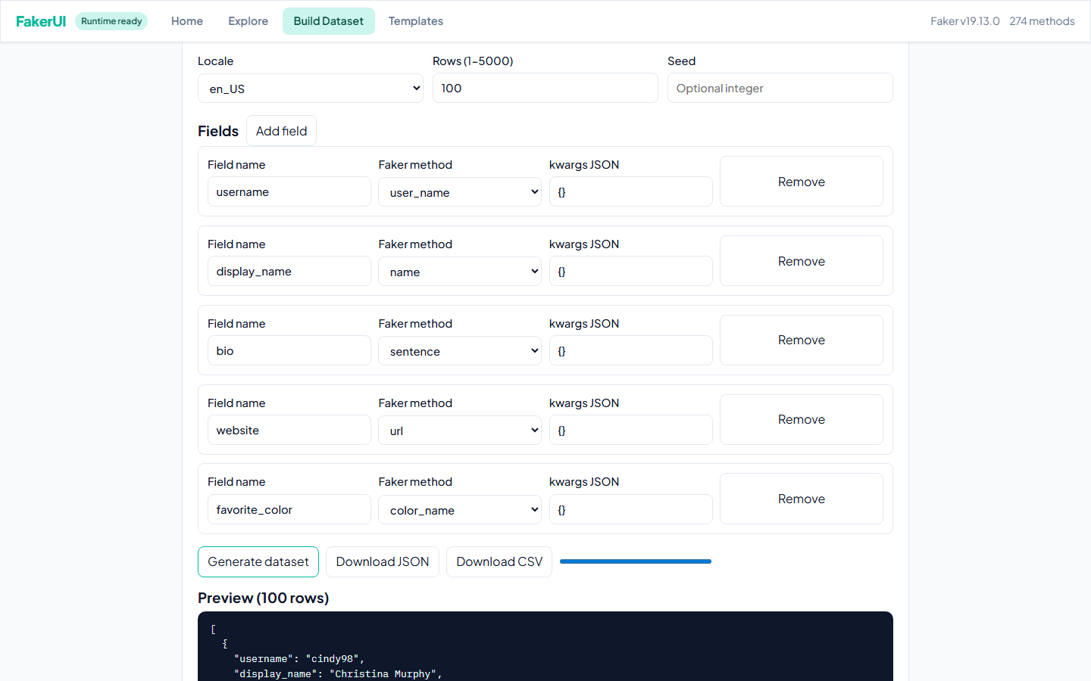
EXPORT
Synthora
The last mile stays simple
Build the data once, then move it directly into the workflow that needs it.
JSON Export
Use it for API mocks, fixtures, seeded app state, and developer flows.
CSV Export
Use it for spreadsheets, imports, QA validation, and business-friendly handoff.
Operational Value
Generated files can feed automation, demo resets, and lower-environment setup.

Slide 8
KEY FEATURES
Synthora
Designed for speed, safety, and usability
The product reduces friction without reducing capability.
Fully Browser-Based
No Signup Required
Searchable Method Catalog
Static delivery with no backend dependency.
Start immediately without account setup.
Browse the active Faker surface through a guided UI.
Interactive Generation
Templates
Export-Ready Output
Try methods and validate output before building full datasets.
Use starter schemas to move faster on common scenarios.
Download JSON or CSV when the dataset is ready.
One workflow now serves developers, testers, and non-technical users with less coordination overhead.

Slide 9
BENEFITS
Synthora
Different teams get a clear outcome from the same product
The value changes by audience, but the workflow stays shared.
Developers
QA and automation
Demo and product teams
Generate realistic seed data faster and stop writing throwaway setup scripts.
Prepare repeatable synthetic datasets for regression and workflow validation.
Populate environments with believable records before customer or stakeholder reviews.
Non-technical users
Platform and DevOps teams
Shared outcome
Use a guided interface instead of learning a library API or writing code.
Avoid standing up a separate internal service just to create sample data.
Less setup friction.
Better realism.
Safer data.

Slide 10
ARCHITECTURE
Synthora
Lightweight architecture, credible delivery model
The product keeps infrastructure minimal while preserving trust in what runs inside the browser.
React UI
Catalog artifacts
Worker runtime
Pyodide + Faker
Preview + Export
Home, Explore, Templates, Build Dataset
>
Generated catalog and runtime manifest
>
Execution isolated from the main thread
>
Python Faker runs in-browser
>
Rows become preview, JSON, and CSV
Build-time Python introspection generates catalog metadata and the runtime manifest.
Only whitelisted methods are exposed, aligning product behavior with runtime enforcement.
Generated rows remain in the browser session until the user previews or exports them.

Slide 11
USE CASES
Synthora
Real-world use cases map directly to everyday delivery work
The value is practical, immediate, and easy to explain across teams.
API testing
Regression testing
Product demos
Seed request payloads and mock response bodies.
Generate safe inputs for repeatable automation runs.
Populate dashboards, tables, and flows before reviews.
Load and perf prep
Training and sandbox data
Schema prototyping
Create bulk records for lower environments and test paths.
Prepare synthetic examples for onboarding and enablement.
Shape sample datasets before backend contracts are final.

Slide 12
WHY IT STANDS OUT
Synthora
Why teams choose this over ad hoc scripts and generators
The difference is not just the library. It is the quality of the workflow.
Fully client-side generation keeps data local to the browser session.
No infrastructure or account model is required to start using the product.
Open-source code and generated catalog metadata increase transparency.
Whitelisted runtime execution improves trust in what the UI can actually do.
The same experience supports both quick exploration and structured export.
Deployment model
Static site on GitHub Pages
Execution model
Pyodide + Faker in-browser
Trust model
Whitelisted runtime methods
Adoption model
Immediate self-service

Slide 13
LIVE DEMO
Synthora
The fastest proof is the product itself
A short live walkthrough communicates the value better than another feature list.
https://arvind3.github.io/Synthora/
Try first
Then explore
What to show
Open Build Dataset and generate a simple schema.
Search methods and use Try to validate the output shape.
Speed, simplicity, and export-ready output.
https://arvind3.github.io/Synthora/

Slide 14
ROADMAP
Synthora
Clear next steps already exist
The current product solves core workflows, with obvious room for expansion.
API mode
Richer templates
Tool integrations
Relationships
Expose generation through a more automation-friendly interface.
Expand reusable datasets for QA, retail, CRM, and ITSM.
Connect more directly with testing and developer workflows.
Support linked datasets across related entities.
Saved presets would help teams reuse common generation patterns.
Governed sharing could make approved templates easier to distribute across organizations.
Relational dataset modeling would open more advanced demo and testing scenarios.

Slide 15
CLOSING
Synthora
Synthora makes realistic data generation feel fast, safe, and usable.
Next step
It replaces hidden setup work with a browser-first product workflow teams can adopt immediately.
Open the live product and build a dataset in under five minutes.
Safer than reusing real data.
Faster than hand-building demo and test records.
Accessible to technical and non-technical users.
Ready for live use today.
https://arvind3.github.io/Synthora/

