Slide 1
Event Based Data Pipeline in GCP

Slide 2
Problem Statement
Many enterprises are choosing Event Driven Design Patterns for Data Ingestion wherein a subscriber performs actions in response to actions triggered by publisher services. This pattern is gaining popularity due to its interoperability, scalability and serverless capabilities.

Slide 3
Solution Approach
The solution will utilize the Google Cloud Platform serverless capabilities to build an event driven data pipeline. It will be based on some of the development practices widely adopted across the enterprises.

Slide 4
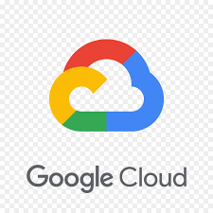

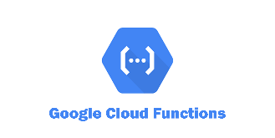
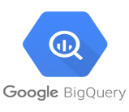
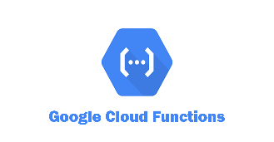
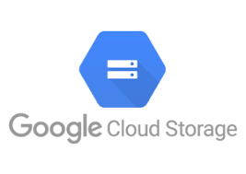
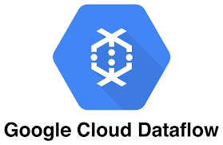
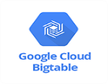
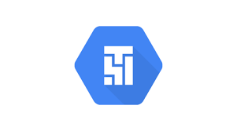

Solution Design
Google Cloud Platform
Source
Publish to
Pub/Sub
topic
Pub/Sub for Real time data Ingestion
Lightweight transformation and Ingestion to Big query
Covid Dataset
Stream
Pub/Sub Event trigger
Storage Event
trigger
Transform and store to GCS
Trigger Dataflow Job
Read from GCS and store to Big Table
Curated Area
Covid Dataset
CSV Files
Data Transfer via Airflow
Staging Area
Notify Pub/Sub
Transform and store to GCS
Trigger Dataflow Job
SSH to Data Server
Using airflow operator
Curated Area
Airflow/Composer for orchestrating Workloads
NoSQL Data store

Slide 5
Services Used/Tech Stack
Cloud Composer/Airflow - Scheduling and Orchestration
Google Cloud Storage(GCS) - Storage and Archival
Pub-Sub - Real time Ingestion and event based ingestion for batch
Cloud Functions- Event based lightweight transformations
BigQuery – Warehouse for storing structural data
BigTable – NoSQL DataStore
Python 3.7 – Programming Needs

Slide 6
DataSet
Covid Dataset will be used to prove the efficacy of this approach. Covid provide dataset for academic and research purposes which can be utilized without any restrictions.
Download Link - https://data.world/covid-19-data-resource-hub/covid-19-case-counts/workspace/data-dictionary

