Slide 1
Learn by comparing - R,Python,SparkR a hands-on session
Dr Arvind Betrabet (PhD) - Data Scientist, IBM Cloud
Vishwanath (Vish) Kamat – Data Science Architect, IBM Hybrid Cloud

Slide 2
Why R?
Essentially R is a language with roots in statistics, data analysis, data exploration, and data visualization.
R has excellent utilities for reporting and communication
RMarkdown (a method for integrating code, graphical output, and text into a journal-quality report)
Shiny (a tool for building prototype web applications, think minimum viable products, MVP).
R is growing quickly with the emergence of the tidyverse (https://www.tidyverse.org/), a set of tools with a common programming paradigm based on verbs (like mutate() and summarize() ) to perform intuitive operations connected by the pipe ( %>% ), which mimics how people read.
tidyverse gave a boost to R, making exploring of data highly efficient. It allows Iterating through exploratory analysis, as easy as writing a paragraph describing what has to be done to the data.
R lends itself very well to business, where organizations need to test some theories, clarify cause-and-effect relationships, iterate quickly, and help with actionable decisions.
Communicating the outcome with business reports, presentation slide decks, and web applications can be built using a reproducible workflow all within R

Slide 3
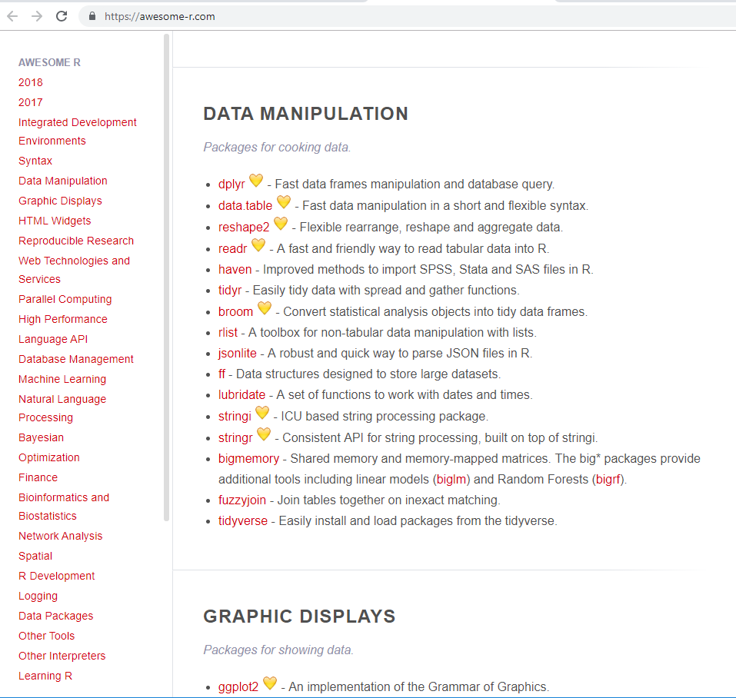
Packages in R for Data Science
Source:
https://awesome-r.com/

Slide 4
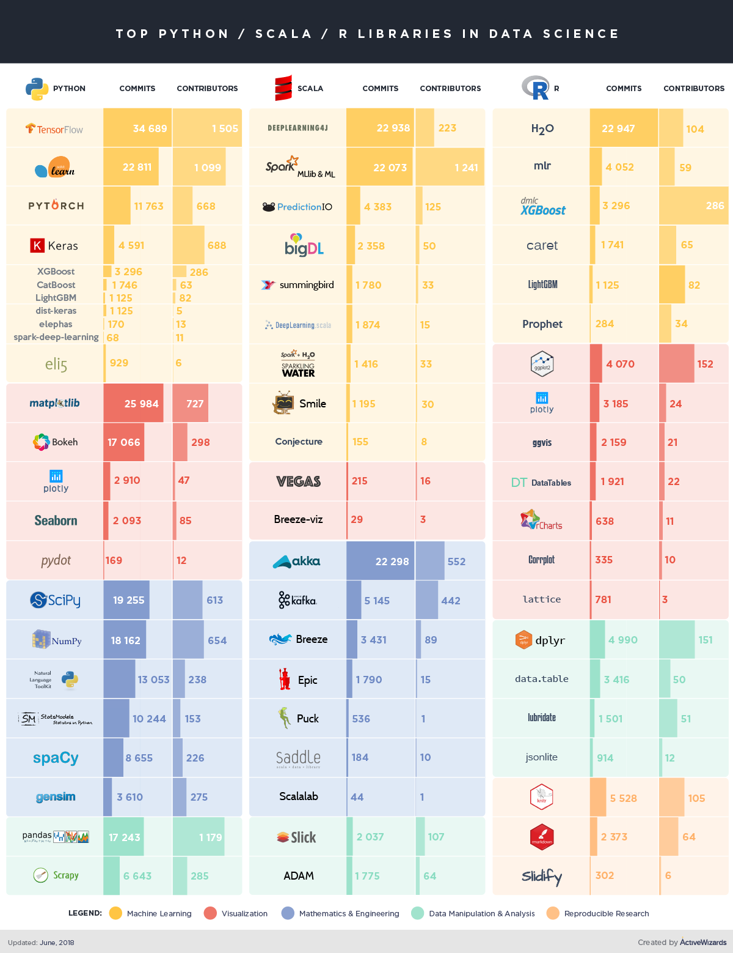
Why Python?
The Python language is a general-purpose programming language, created by Guido van Rossum (Computer Scientist) in 1991.
Python is versatile, with over 100,000 libraries for working with web frameworks, data base connectivity, networking, web scraping, scientific computing, text and image processing.
Although, Python was primarily written for students of Computer Science and Mathematics, it has quickly grown to perform image recognition, natural language processing, and machine learning.
Python has excellent data science libraries:
Scikit Learn , the most popular machine learning library
TensorFlow , a library developed at Google to perform deep learning, for image recognition and natural language processing tasks.
The language as such is easy to pickup, specially the Scikit Learn library, which contains support for pipelines to simplify the machine learning workflow and most all of the necessary ML algorithms.
Recent improvements have included tools to communicating the outcome with business reports and presentation slide decks

Slide 5
Packages in Python for Data Science
List of most commonly used packages for data scientists in Python are as follows:
Pandas — For data structures, data manipulation, and analysis in Python.
NumPy — For large, multidimensional arrays and matrices, plus high‐level mathematical functions to operate on these arrays.
SciPy — For scientific computing.
Matplotlib — For 2D plotting for graphs and data visualization.
Seaborn — Based on matplotlib, provides a high‐level interface for drawing attractive statistical graphics.
scikit‐learn — Machine learning library.
Statsmodels — For building statistical models.
Beautiful Soup — For web scraping.
Bokeh — A Python interactive visualization library that targets modern web browsers for presentation.
See Top-20 Python Libraries for Data Science

Slide 6
Let’s run side-by-side R and python

Slide 7

Spark
Cluster Managers
Standalone – a simple cluster manager included with Spark that makes it easy to set up a cluster.
Apache Mesos – a general cluster manager that can also run Hadoop MapReduce and service applications.
Hadoop YARN – the resource manager in Hadoop 2.
Kubernetes – an open-source system for automating deployment, scaling, and management of containerized applications.

Slide 8
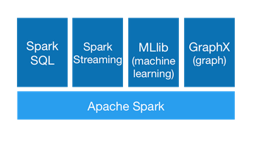
One framework, multiple interfaces

Slide 9
PySpark Packages
pyspark.sql module – SQL API
pyspark.streaming module – Streaming API
pyspark.ml package - DataFrame-based machine learning APIs to let users quickly assemble and configure practical machine learning pipelines
pyspark.mllib package – Older RDD based API

Slide 10
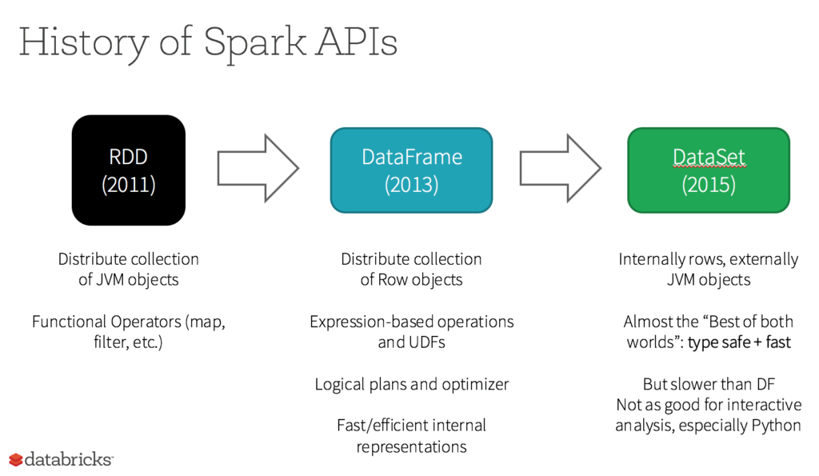
RDD,DataFrames,DataSet
Source : https://databricks.com/glossary/what-is-rdd

Slide 11
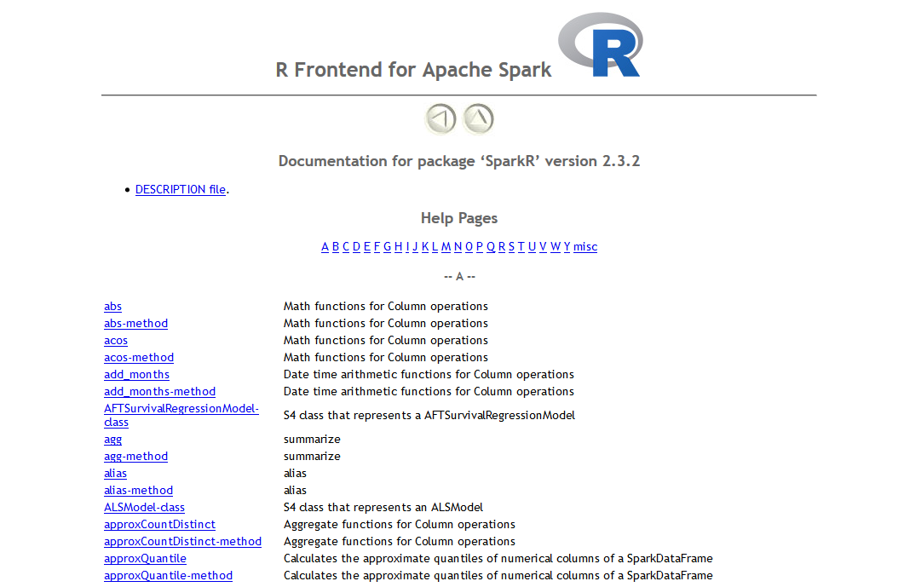
SparkR Packages
……. 860+ pkgs
Source : hhttps://spark.apache.org/docs/latest/api/R/index.html

Slide 12
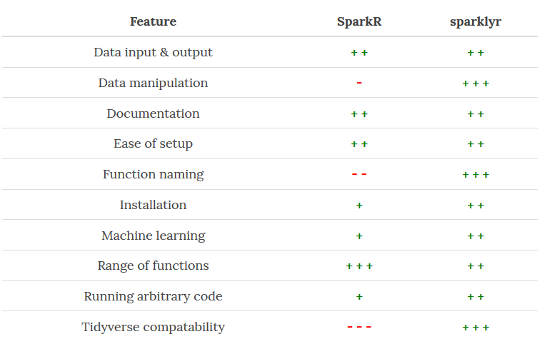
SparkR vs sparklyr

