Slide 1
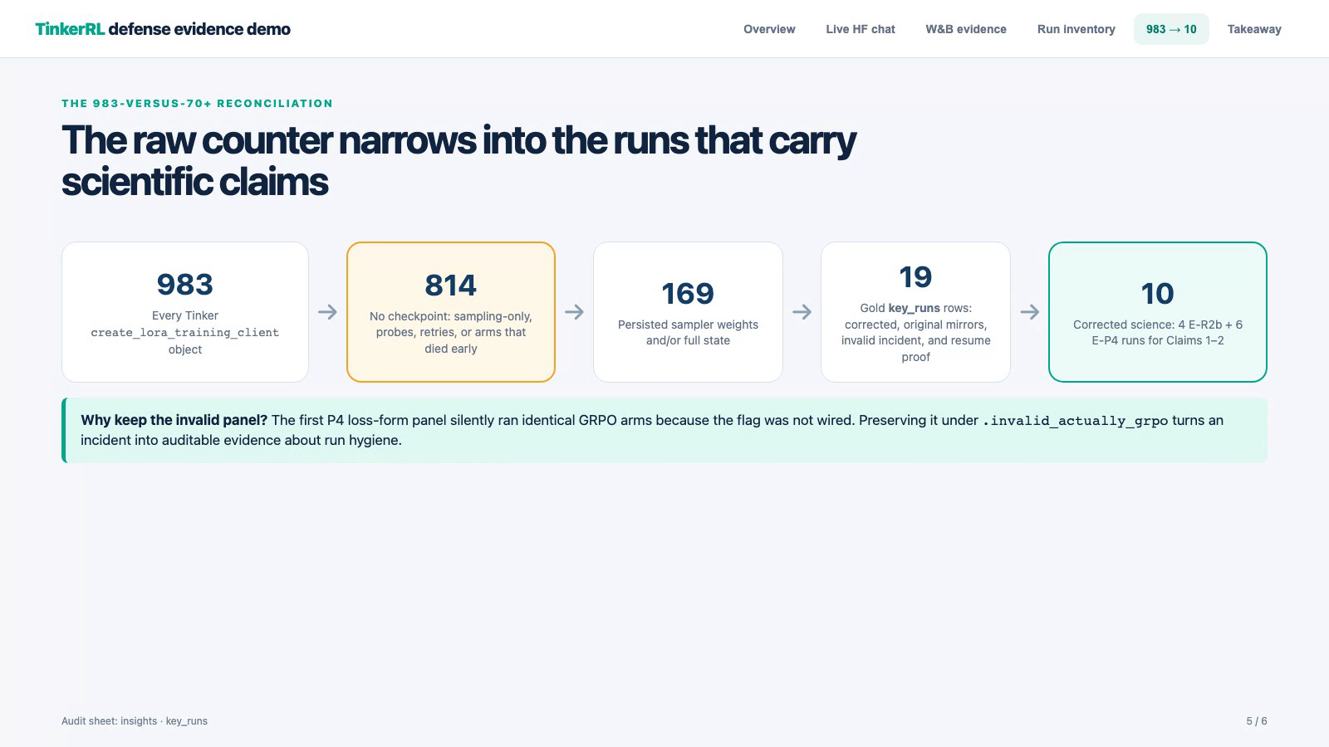
Opening demo — live HuggingFace + W&B walkthrough (recorded today, 91 s)
Click to play — embedded in the deck; no network needed.
Notes:
(optional 90 s) Recorded live demo: HuggingFace adapter repos + W&B zvf-training panel walkthrough, captured 12 Jul. Click to play. Use while people settle, or skip straight to the title if he wants to start immediately - the live demo slot is slide 14.

Slide 2
M.Tech Project — Phase 1 Review (Defense Format)
RL Post-Training of LLMs: Signal Starvation and Stack-Conditioned GRPO
Title decoded: GRPO learns from reward contrast inside groups of completions; when a group is all-correct or all-wrong it teaches nothing (signal starvation, measured by the Zero-Variance Fraction), and what a run "shows" depends on the software stack it ran on (stack-conditioned).
Arvind C R (Arvind Chitra Rajasekaran) · SRN: PES2PGE24DS140
Guide: Ramesh Prakash Guledgudd · Dept. of CSE, PES University · M.Tech Data Science & AI
Notes:
(1 min) Read the title, then decode it in one breath: GRPO trains on groups; when every completion in a group gets the same reward the group carries zero gradient — that is signal starvation; ZVF is the statistic that measures it; 'stack-conditioned' is the reproducibility finding that the same algorithm label gives different results on different software stacks. One measurement discipline, two claims, all artifacts audited.

Slide 3
Base Paper & My Understanding of It
• Base paper — GRPO, from "DeepSeekMath" (Shao et al., 2024; basis of DeepSeek-R1): replaces PPO's learned critic with a group-relative baseline — sample G completions per prompt, advantage = own reward − group mean.
• Why it matters: critic-free means cheap and stable at LLM scale with verifiable (binary) rewards; it is now the default RL post-training family. The study runs GRPO against PPO, REINFORCE, DPO, GSPO, Dr.GRPO and audited variant labels (slide 5).
• My understanding — the structural blind spot: if all G completions earn the SAME reward (all-correct or all-wrong), every centred advantage is exactly zero: the group consumes compute but contributes zero gradient. The reward curve cannot show this; it can read "success" precisely while learning has stopped.
• Secondary anchor — Dr.GRPO (Liu et al., 2025): claims GRPO's per-length/std normalisation biases updates toward verbosity. I test this claim under controlled conditions (Result 4).
• Thesis position: measure the blind spot (Zero-Variance Fraction, ZVF), calibrate it, budget it, and show what it changes in practice.
one prompt → G=4 completions, reward r ∈ {0,1}
group with contrast
1
0
1
0
A ≠ 0 gradient flows
all-correct group (the blind spot)
1
1
1
1
A = 0,0,0,0 zero gradient
A_i = r_i − mean(r) (the original also divides by the group std — the zero/nonzero structure is identical). Identical rewards zero every advantage; the reward curve still reads 1.0 while training has silently stopped.
Basketball analogy:
Each prompt is a shooting drill; the G completions are G shots at the same basket. GRPO has no absolute standard (no critic) — the coach grades each shot only against the others in that drill. Mixed makes and misses → he can tell what worked. All makes or all misses → nothing to compare, the drill taught zero. As the player improves, more drills end all-makes: practice silently stops teaching exactly when the scoreboard looks best. ZVF counts the dead drills; more shots per drill (bigger G) keeps the contrast alive longer.
2
Notes:
(2 min) Base paper: GRPO from DeepSeekMath (Shao et al., 2024), the algorithm behind DeepSeek-R1. Explain the mechanism from first principles: no critic; sample G completions per prompt; each advantage is its reward minus the group mean. My understanding goes one step further than the paper: that subtraction has a structural blind spot — identical rewards zero out every advantage. Sell it with the basketball analogy at the bottom: drills, shots, a coach who only compares shots within a drill; all-makes drills teach nothing precisely when the scoreboard looks perfect - that is the whole thesis in one image. Secondary anchor: Dr.GRPO (Liu et al., 2025) which critiques GRPO's normalisation terms — Result 4 tests it. If asked about std-normalisation: base GRPO also divides by the group std; with identical rewards the numerator is zero either way, so the blind spot is identical — and the panels also test the normalisation-free Dr.GRPO form directly.

Slide 4
Problem & Research Questions
• Signal starvation is silent: mean reward reads "success" exactly when the all-correct wall starves training. You need a second coordinate.
• The reproducibility anchor: the SAME RL training, run by different people in different environments, can produce wildly different results — measured here as a 17× final-reward span from one undisclosed backend+checkpoint swap. Unless the details of what actually ran are reported, comparisons are meaningless.
• RQ1 same-stack control · RQ2 ZVF as practical diagnostic · RQ3 group size G as the starvation dial · RQ4 do training gains survive held-out evaluation?
3
Notes:
(45 s) Compress. Two facts motivate everything: starvation is invisible in reward curves, and published comparisons are stack-conditioned. Then read the four RQs quickly.

Slide 5
Overall Architecture
TRAINING — Tinker managed API LoRA rank-4 GRPO / Dr.GRPO fleets · full-state checkpoint · kill-and-resume (verified live)
zvf-triage (Apache-2.0, 82 tests) regime classifier · adaptive-G · dead-prompt drop · auto-stop veRL / OpenRLHF / NeMo-RL adapters
TELEMETRY — per-step (reward, ZVF, GU) logged beside every reward point · parser v2 with false-positive audit
EVALUATION — vLLM pass@k harness Modal · Lightning AI · Colab — three independent backends · clustered bootstrap CIs
MIRRORS & ARTIFACTS W&B: 1,034 runs / 17 projects HuggingFace: 49 adapter repos
AUDIT TRAIL — 983 Tinker runs + external Modal / Lightning AI / Colab runs (26 pass@k evals · 4 H100 cross-library baselines · Colab experiment packs) 19 claim-critical runs linked: W&B page + checkpoint + result JSON
Design rule: no number enters a paper without a path back through this stack — run → telemetry → artifact → audit row.
4
Notes:
(1.25 min) Walk the four layers left to right: training on the managed Tinker API (LoRA, closed loss kernel — an audit constraint I exploit deliberately); evaluation on three vLLM backends so no single backend's quirks own the numbers; telemetry: per-step ZVF/GU next to reward, mirrored to W&B; and the audit layer: run manifests, checkpoint/resume, the runs-audit workbook. Everything downstream cites this.

Slide 6
Not Only GRPO — Algorithms & Methods Run, and Why
algorithm / method | where it ran | why it was run (question it answers)
GRPO (base paper) | Tinker fleets (Qwen3-8B); TRL on Modal H100; open trainers | The subject: does its group-relative update starve, when, and how do you see it? (Claims 1-2)
Dr.GRPO | Tinker, six-arm uncapped panel, 3 seeds/loss | Test the base paper's strongest critique: does the length-bias fix change length/ZVF at our scale? (No footprint - Result 4)
GSPO | Tinker, same-stack head-to-head vs GRPO (G=8) | Isolate ONE knob (token- vs sequence-level IS ratio) with everything else fixed - the same-stack control discipline (RQ1)
PPO | SB3 / CleanRL / Tianshou (Modal H100) + bench arm (HF: tinker-rl-bench-ppo_*) | Was dropping the critic actually free? Value-based baseline + cross-library reproducibility anchor (RQ1)
REINFORCE | Colab baselines notebook | Simplest policy gradient: a floor showing gains are not just any-PG artifacts
DPO / IDPO | TRL via unified script generator (platform_local) | The counterfactual family: preference optimisation without rollouts has no groups - no ZVF by construction
SFT + off-policy distillation | capstone tool-call LoRAs; Llama-3.2-1B distillation probe | Non-RL control: how much of the gain needs RL at all?
"DAPO" (label audit) | open trainer w/ dynamic sampling vs closed-stack surrogate | How much does a method NAME underdetermine the executed update? Measured: ZVF 0.00 vs 0.55-0.58 under one label
AERO / AREAL / GIFT (traces); audit pilot: GRPO / Dr.GRPO / DAPO / adaptive-G | open-stack method traces; 4-arm single-stack audit pilot (T4) | Can telemetry alone distinguish method variants (P8 detector)? Is collapse universal across them (P2)? Does the survival protocol work end-to-end (pilot)?
5
Notes:
(45 s) Fast table walk — lead with the WHY column: each method answers a specific question the thesis needed closed. PPO answers 'was the critic needed?'; GSPO isolates one knob on the same stack; Dr.GRPO tests the base paper's strongest critique; DPO is the no-rollouts counterfactual (no groups, so no ZVF by construction); REINFORCE and SFT are floors; the DAPO audit and the AERO/AREAL/GIFT traces exist to measure how much a method LABEL underdetermines what actually ran. Every row has runnable artifacts.

Slide 7
What I Implemented (Sem-4 Solo, on the Sem-3 Foundation)
• Datasets used for finetuning — RL: GSM8K train split (openai/gsm8k "main"; 512-prompt train pool, binary boxed-answer reward; training samples G completions/prompt per step, and the same pool is offline-characterised at 32 rollouts/prompt for the estimation studies) + synthetic arithmetic (easy/medium) for the 0.5B-1.5B panels. SFT (capstone): Salesforce xLAM-Function-Calling-60k (tool-call LoRAs, Qwen 0.5B-7B).
• Evaluation-only — never trained on: GSM8K test (1,319 problems, disjoint from the reward environment), MATH-500, MBPP, HumanEval. Held-out discipline is an explicit reporting-standard item.
• Inherited (Sem 3, Group 6): TinkerRL-Bench — 79 logged GRPO-style runs across 7 RL libraries (0.6B–671B), submitted to NeurIPS 2026 Main Track as "A Unified Benchmark for RL Post-Training of Language Models"; plus literature survey and baseline GRPO runs. Frozen at tag capstone-final-2026-04-25.
• ZVF measurement stack: per-step ZVF/GU telemetry in the trainer, calibrated confidence intervals (Wilson), waiting-time reliability budget, stratified batch analysis.
• Experiment infrastructure: matched-budget runner with --resume (state + optimiser + RNG fast-forward), per-(step,prompt) seeding, W&B resume; loss-form panel runner (GRPO vs Dr.GRPO).
• zvf-triage: packaged library (callback, controller, regime classifier, framework adapters, 82-test suite) — publication to PyPI staged.
• Standards & tooling: MIN-REPORT-RL 8-item reporting standard, GRPO-Registry (machine-readable stack catalog), stackdiff flip-risk grader, run-audit workbook.
• Theory: T1 estimator calibration, T2 reliability budget, T3 optimal-G analysis — plus two corrections found by external adversarial review, adopted and reported openly.
6
Notes:
(1.5 min) Attribution first: Sem 3 was the group capstone — the multi-framework bench and survey, frozen at tag capstone-final-2026-04-25. Everything on this slide is Sem-4 solo work. Be specific: these are files and packages he can open, not concepts. Datasets first if he asks what you trained ON: GSM8K train split with binary boxed-answer rewards is the finetuning task; synthetic arithmetic for the small panels; xLAM-60k was the capstone SFT corpus. MATH-500/MBPP/HumanEval are evaluation-only - never trained on. Sem-3 credit line if asked: 79 logged runs across 7 libraries, submitted to NeurIPS 2026 Main Track as 'A Unified Benchmark for RL Post-Training of Language Models' (group work, 8 authors); Sem 4 is solo.

Slide 8
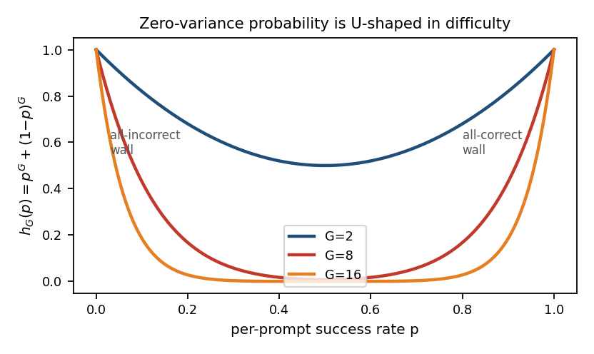
Result 1 — ZVF Sees What the Reward Curve Cannot (Claim 1)
 | late-run mean reward | late-run ZVF | gradient signal
G=2 × 160 steps | ≈ 0.9–1.0 (pool mastered) | 0.75–1.0 (all-correct wall) | effectively zero
G=16 × 20 steps | ≈ 0.3–0.5 (mid-learning) | 0.00–0.25 | sustained
• Same rollout budget (2,560/arm), seeds 123/456: reward alone declares G=2 the winner; the (reward, ZVF) pair shows its lead ended in zero-gradient compute.
• ZVF is a diagnostic, not a predictor: ZVF rose AFTER the reward plateau in every measured collapse — a cheap alarm, not a cause.
• Population form: the U-shaped kernel — starvation at both walls (too hard / mastered); larger G narrows both.
7
Notes:
(2 min) THE core result. Walk the table: late in training the G=2 arms read reward ~1.0 — by the reward axis, perfect. ZVF says 75-100% of groups are all-correct: zero gradient. Same budget, G=16 arms are mid-learning with ZVF under 0.25 and signal intact. Read as a pair, (reward, ZVF) separates 'policy is good' from 'training is still moving'. ZVF alone aliases mastery with incapacity — always read the pair.

Slide 9
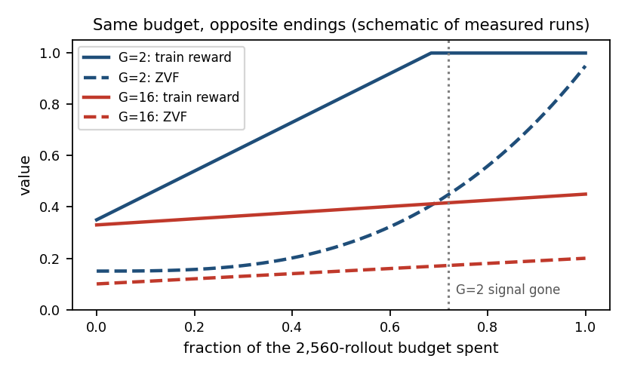
Result 2 — Group Size Is a Schedule Variable (Claim 2)
• Design: matched budget of 2,560 rollouts per arm — G=2×160 steps vs G=16×20 steps (batch 8, 512-token completions, LoRA rank 4, seeds 123/456).
• Finding: G=2 races to reward ≈1.0 on the sampled pool, then terminates inside the all-correct zero-variance wall; G=16 ends mid-learning with ZVF ≤ 0.25 and signal intact.
• Interpretation: small G buys early steps and starves the endgame; large G holds signal throughout. Group size selects WHICH END of training starves — a schedule variable.
• Honesty check: static fixed-step sweeps are confounded by what the budget is held in; controller efficacy is NOT claimed (pre-registered test is future work).
8
Notes:
(2 min) The decisive experiment design point: hold the ROLLOUT BUDGET fixed, not the step count. Small G converts the budget into more optimiser steps early — then exhausts its own signal as accuracy rises (the p->1 wall of the kernel). Large G pays for contrast it doesn't need early and retains signal late. So group size controls WHICH END of training starves — a schedule question, not a constant. The naive static sweep is confounded by what the budget is held in — I show both views. ANTICIPATED ATTACK: 'G=16 only avoids the wall because it has not learned the task yet.' Answer: exactly — and that is the claim. At a FIXED budget, G chooses which end starves: G=2 spends its final steps on dead groups while reading reward 1.0; G=16 keeps every update signal-bearing. No winner is declared; the pair tells you where the budget went.

Slide 10
Result 3 — The Estimator Is Calibrated, the Budget Is Exact
• T1 (calibration): ZVF_t is an unbiased binomial-proportion estimator; Wilson CI covers 0.95–0.98 in every tested setting (Wald marginal at m=32). Curriculum ordering is an estimand-labelling requirement, not an invalidation.
• T2 (reliability budget): rollouts-to-next-informative-group is geometric; N(ZVF)=G⌈ln δ/ln ZVF⌉ matched observed quantiles at ratio 1.00 across all six difficulty strata (hardest: ZVF=0.886 ⇒ 160 rollouts) — both quantiles are integer counts of G-rollout groups, so exact agreement is attainable, not a suspicious continuous fit. A budget, NOT an impossibility bound.
• T3 (honest negative): the signal-per-rollout objective satisfies J(2)=J(3) for EVERY difficulty prior — its argmax is universally {2,3}, so it cannot yield a data-adaptive G — per-rollout accounting ALWAYS favours tiny groups, which is exactly why Result 2 treats G as a schedule, not a static optimum. Found by adversarial review; reported as a result, not buried.
• Two earlier statement errors (a quantifier confusion in T2; a GU sign slip) were caught by external review, corrected, re-validated — and are documented in the thesis as part of the method.
9
Notes:
(1.5 min) Three theory results, each validated on real 512-prompt pools. T1: Wilson interval covers 0.95-0.98 in every tested setting — report which ZVF the interval covers under curriculum ordering. T2: geometric waiting-time budget N = G ln(delta)/ln(ZVF) matched observed quantiles at ratio 1.00 in all six difficulty strata — hardest stratum needs 160 rollouts for a 90%-guaranteed informative group. T3 is the honest one: our signal-per-rollout objective turns out to have a UNIVERSAL argmax G* in {2,3} for every prior — an algebraic identity, found by external review of our own theory. We report it as a negative result. ANTICIPATED ATTACK: Wilson assumes iid — answer: under curriculum ordering the interval stays calibrated for the LOCAL stage-level ZVF (0.944), and stratified batch composition restores global validity (0.996); the requirement is labelling WHICH estimand the interval covers.

Slide 11
Result 4 — GRPO vs Dr.GRPO: No Footprint at This Scale (+ the Incident)
• Six-arm uncapped panel (Qwen3-8B, 1,024-token cap, 3 seeds/loss): GRPO lengths 1004→905, 981→944, 996→900; Dr.GRPO 999→931, 972→902, 1000→878 — lengths SHRINK 3.8–12.2% in every arm; no length inflation, no late-ZVF separation between losses.
• Reading: at this scale the loss-form choice has no observable footprint on length or ZVF — evidence about reporting, not superiority. Comparisons between these losses measure stack noise unless controlled far more tightly than the labels suggest.
• The incident: the first panel ran with a documented --loss drgrpo flag that was never wired in — both "arms" silently trained identical GRPO. Caught only by reading OUR client-side runner script (the managed loss kernel stays closed — the flag died in our code before reaching it); artifacts preserved under .invalid_actually_grpo names; corrected rerun REVERSED one conclusion.
• Response became protocol: invalidate loudly → preserve → rerun → record. This failure is a first-class result feeding the reproducibility standard (Result 5).
10
Notes:
(2 min) Tests the base-paper critique directly. Six uncapped arms (1,024 tokens), 3 seeds per loss: completion lengths SHRINK 3.8-12.2% in all six arms — no verbosity trap at this scale — and no late-ZVF separation. Then own the incident proudly: the first panel was invalid because a documented --loss flag was never wired to the loss; no output-level trace revealed it — only reading the runner did. We invalidated loudly, preserved artifacts under .invalid names, reran same-day, and one conclusion REVERSED. That incident is now a case study and the seed of the reporting standard.

Slide 12
Result 5 — Setting the Standard: What Must Be Reported When Training
• Anchor: same algorithm, same task, different environment or different hands → wildly different results. The fix is not more compute — it is reporting the details of what actually ran. Three measured instances from our own data:
• Backend swap (undisclosed, bundled a base-checkpoint change): final training reward moved across a 17× span — 85.6% vs 5.0% — under the same label.
• Same "DAPO" label: mean ZVF 0.00 on an open trainer with true dynamic sampling vs 0.55–0.58 on a closed stack running an asymmetric-clip surrogate.
• Reward-parser sensitivity: micro-jitter ε~U(0,1e-4) below verifier resolution collapses batch ZVF 0.158 → 0.000 — reported ZVF must name its verifier.
• The contribution: MIN-REPORT-RL sets the standard for what details every RL training report must include — plus GRPO-Registry (machine-readable stack catalog, 20 seed entries) and stackdiff (pairwise flip-risk verdicts R0–R5) to enforce it mechanically.
• The 8 items: ① loss form (ratio/clip/mask/normalisation) ② reference policy & KL handling ③ sampler/backend/precision incl. base-checkpoint identity ④ per-step ZVF/GU trajectory ⑤ group-size schedule ⑥ held-out split disjoint from the reward environment ⑦ decontamination + parser-robustness probe ⑧ held-out pass@k curves, not just pass@1. Every item earned its place by flipping a result in our own corpus.
11
Notes:
(1.5 min) Three measured instances, each a lever that flipped a result: 17x reward span from an undisclosed backend swap that also bundled a checkpoint change; the same 'DAPO' label yielding ZVF 0.00 on an open trainer vs 0.55-0.58 on a closed stack; and reward micro-jitter below the verifier's resolution collapsing batch ZVF 0.158 to 0. Every item of the 8-item MIN-REPORT-RL standard exists because one of these levers moved a result in OUR OWN data — not from taste. Land the framing: this project SETS THE STANDARD for what to report when training - walk the 8 items fast, then say every one earned its place by flipping a result here.

Slide 13
Result 6 — Held-Out Evaluation: Gains, Transfer, and an Honest Boundary
• Baseline capability (deterministic first-200 test slice, n=32, clustered bootstrap): pass@1 30.4% [27.5, 33.1] but pass@32 91.0% — corroborated on the 512-prompt train pool (30.3%). GSM8K is nearly saturated at k=32; ~9 points of headroom bounds what training can claim here.
• Transfer: post-RL adapters show zero forgetting and mild positive transfer on MBPP (pass@32 within noise of or above base for all G); pass@1-only reporting would misread the G=2 arm as a regression (all pass@1 deltas −0.5 to +1.9pp, within single-seed noise).
• Hard-task boundary (MATH-500, partial): GSM8K-trained frontier gains do not carry — consistent with distribution sharpening rather than capability expansion. Stated as a non-claim in the thesis.
• Cross-scale observations (the 79-run cross-library corpus, 7 libraries, 0.6B–671B — frontier entries are single-seed LoRA case studies via the managed API): scale does not uniformly reduce ZVF; starvation is (difficulty × G × phase) geometry. Observations, never claims (scope slide).
12
Notes:
(1.25 min) RQ4. Base Qwen3-8B on GSM8K: pass@1 30.4% but pass@32 91% — the base model already solves almost everything at k=32, so GSM8K alone cannot demonstrate capability expansion; that scope discipline is itself a finding. Post-RL adapters: zero forgetting on MBPP and a +1.5-2.5 point pass@32 frontier improvement, within noise at single-seed — exactly why the standard mandates pass@k curves with CIs. MATH-500 partial: GSM8K-trained gains do NOT replicate on hard math — distribution sharpening, not capability expansion.

Slide 14
Implementation Scale & Evidence Trail (audited 12 Jul)
• 983 Tinker training runs enumerated via REST API — 26 base models, 0.6B → 1T; all 65 corrupted runs predate June 8; every thesis-supporting run is clean and checkpointed.
• External backends: Modal / Lightning AI / Colab pass@k panels (26 runs) + 4 cross-library H100 baselines; 1,034 W&B runs across 17 projects; 49 HuggingFace artifact repos.
• zvf-triage: 82/82 tests green; wheel + sdist built, twine-checked; PyPI publication staged.
• Traceability: 19 claim-critical runs highlighted in the audit workbook, each with W&B link + checkpoint + result artifact — embedded below (double-click to open).
tinker_runs_audit_2026-07-12.xlsx — embedded copy (983 runs · key_runs · external_runs · wandb_runs · hf_artifacts · insights). Canonical file: outputs/ in the repo.
13
Notes:
(45 s) Fast slide. 983 runs on the Tinker account — audited and classified this morning; the thesis claims rest on 19 identified claim-critical runs, each linked to W&B and its artifact. If asked about any number: the workbook key_runs sheet has the run id, checkpoint, W&B link, and result JSON.

Slide 15
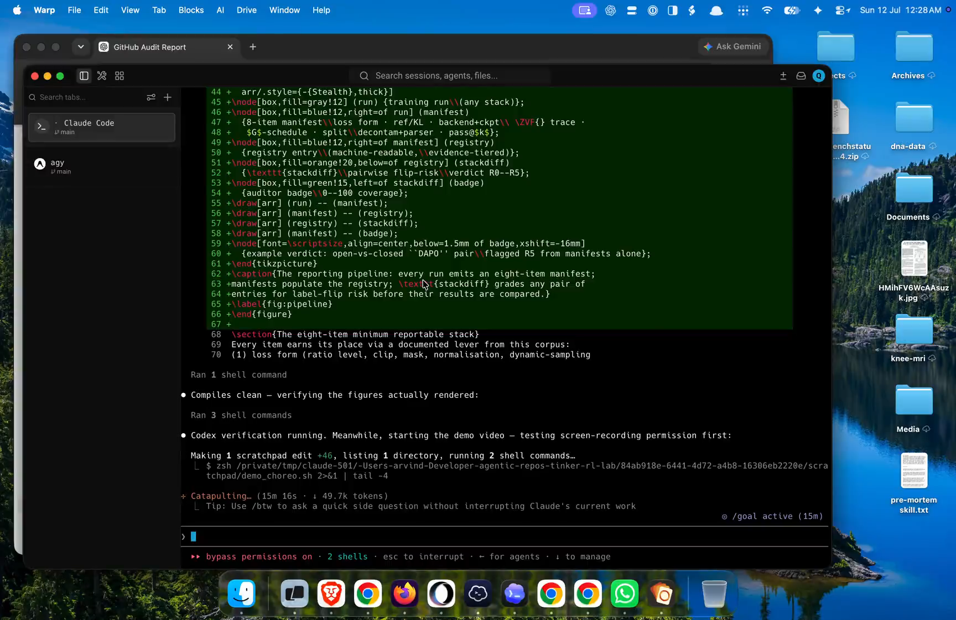
Demo (Live)
• One command, fully offline: ./submission/demo/demo.sh — mechanism fixture (4 groups → ZVF=0.500, GU=0.500), recorded artifact check (80 rewards, mean 0.6875, ZVF 0.3000), SHA-256 integrity, JSON + HTML dashboard. Status: PASS (re-verified today).
• Live artifact tour: W&B zvf-training — the (reward, ZVF) pair diverging on the real E-R2b arms; audit workbook key_runs sheet — every claim-critical run traceable in two clicks.
• zvf-triage quickstart: pip-installable package, examples/quickstart.py — the diagnostic as a reusable library, not a one-off script.
• Fallback if connectivity fails: the 86-second recorded walkthrough — embedded on this slide (right), plays offline.
embedded fallback: 86 s recorded walkthrough (click to play)
Click-to-open evidence (live):
↗ W&B: E-R2b G=2 arm — reward hits ~1.0 while ZVF climbs into the wall (er2b_g2_s123)
↗ W&B: E-R2b G=16 arm — mid-learning, ZVF low, signal intact (er2b_g16_s123)
↗ W&B: the invalidated P4 arm, preserved (p4uncap_drgrpo_s42.invalid_actually_grpo)
↗ W&B: full zvf-training project (45 runs)
↗ HuggingFace: published bench adapters (e.g. tinker-rl-bench-ppo_gsm8k_Qwen3-8B_s42)
↗ GitHub: arvindcr4/tinker-rl-lab (code, artifacts, audit workbook)
14
Notes:
(1 min + live demo) Run the one-command offline demo FIRST — it cannot fail on the network. ./submission/demo/demo.sh: mechanism fixture (4 groups, ZVF=0.5, GU=0.5), recorded artifact (80 rewards, mean 0.6875, ZVF 0.30), SHA-256 integrity check, HTML dashboard. Then if time and connectivity allow: the W&B zvf-training panel with live E-R2b curves, and the audit workbook key_runs sheet. Fallback: the 86-second recorded walkthrough. Verified PASS this morning.

Slide 16
Scope, Limitations & Roadmap
• Declared scope: Qwen3-8B, GSM8K-family binary rewards, Tinker managed API (LoRA rank 4), 1–3 seeds per result — claims are stated at the stack level and nowhere above it.
• No causal or predictive power is claimed for ZVF beyond diagnosis; controller efficacy is explicitly gated on a pre-registered, compute-matched comparison (≥3 seeds, held-out metrics).
• Roadmap (gated): bounded diagnostic paper (Claims 1–2) → controller paper (needs the win) → survival audit (needs an open stack). Thesis consolidates all 17 working documents.
• The transferable lesson: at this scale the binding constraint is not compute or novelty — it is certainty about what actually ran.
15
Notes:
(45 s) Close with the honesty that survives cross-examination: one model, one task family, one managed API, 1-3 seeds — the claims are stated at the stack level and nowhere above it. Roadmap is gated: diagnostic paper publishable now; controller paper gated on a pre-registered compute-matched win; survival audit gated on an open stack. Then stop talking and invite questions.

Slide 17
Thank you — Questions
github.com/arvindcr4/tinker-rl-lab · arvindcr4@gmail.com
Notes:
Thank the panel. Repo and email on screen. Offer the audit workbook or any W&B run on request.

