Slide 1
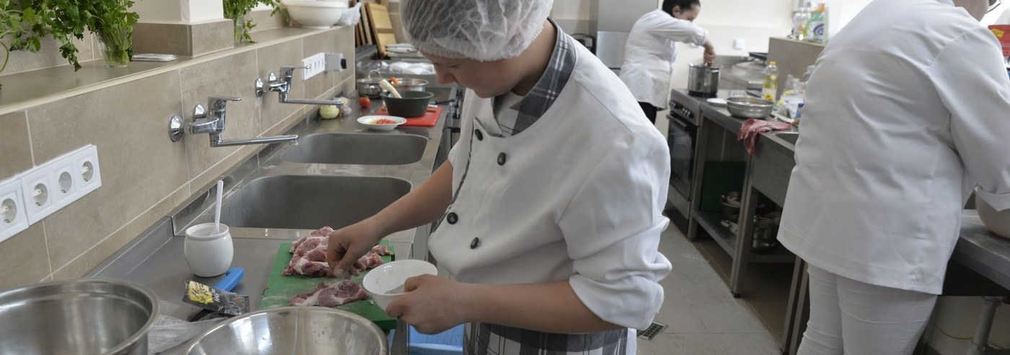

MTECH PROJECT · PHASE 1 DEFENSE
Diagnosing
Zero-Advantage Sampling
in Group-Relative RL
Arvind C R
SRN: PES2PGE24DS140
Department of Computer Science and Engineering
M.Tech Data Science and Machine Learning
PES University
Guide
Ramesh Prakash Guledgudd
July 2026
A measurement, intervention, and reproducibility study
Canonical artifact: reports/esa_phase1/Phase1_Project_Report_ZVF.tex
01

Slide 2
PROBLEM
A sampled group can consume compute
and still carry no reward-derived
policy-gradient signal.
GROUP-RELATIVE UPDATE
Aᵢ = rᵢ − r̄group
If every completion receives the same reward, then every Aᵢ is zero.
The project asks: how often does this happen, what does it waste, and can training avoid it?
The thesis contribution is diagnostic: quantify the phenomenon, test interventions, and ship reproducible evidence.
Definition and scope: thesis Ch. 1–2; KL/entropy terms are outside this reward-derived signal statement.
02

Slide 3
MECHANISM
Zero-variance fraction (ZVF) is the observable
Sample a group
Check reward variance
Count collapsed groups
G completions
per prompt
Var(r₁…rG) = 0 ?
ZVF = collapsed groups
÷ sampled groups
ZVF measures sampling efficiency, not total optimizer gradient.
The distinction prevents an overclaim when KL or entropy terms remain active.
Metric implementation: experiments/openings/p2_collapse_analysis.py; fixed schedule analysis in collapse_baseline_analysis.json.
03

Slide 4
RESEARCH QUESTIONS
Four questions define the Phase 1 boundary
01
Measure
02
Intervene
How frequently do sampled groups have zero reward variance?
Do curricula or group-size changes reduce wasted sampling?
03
Verify
04
Operationalize
Do toy findings persist under a real 3B model and multiple seeds?
Can telemetry expose the regime and reproduce the claim?
Phase 1 scope: measurement + exploratory interventions + verification + reproducibility.
04

Slide 5
SYSTEM AND PROVENANCE
One evaluation pipeline; two contribution boundaries
Task + model
Group sampling
Telemetry
Evidence
GSM8K
Qwen 2.5 / 3B
Methods × prompts
fixed schedule
Rewards · ZVF
length · advantage
JSON artifacts
figures · audits
INHERITED FOUNDATION
SEMESTER 4 PHASE 1 ADDITIONS
Semester 3 Group 6 baseline:
GRPO infrastructure and earlier experiment archive
ZVF framing, P1/P2/P3/P8 analyses,
claim audit, reproducibility demo, thesis synthesis
Semester boundary anchored to tag capstone-final-2026-04-25; attribution is explicit in the report.
05

Slide 6
METHOD
Evidence is layered by maturity and protocol
Study
Protocol
Artifact
Interpretation
P2
40 steps · GSM8K · 4 method traces · seed 0
collapse_baseline_analysis.json
Fixed-schedule diagnostic
Token budget
30k tokens · 3 seeds · baseline vs curriculum
token_budget/results.json
Matched-budget null result
P1
Qwen2.5-3B · 24 problems · 4 seeds
scaled_4seed_result.json
Scaled verification
P8
160 trace rows · 5 CV seeds
detector_reproduced.json
Proof-of-concept classifier
All headline values in this deck are linked to repository artifacts; disputed historical campaign aggregates are excluded.
06

Slide 7
HEADLINE RESULT · P2
About 71–77% of sampled groups were zero-advantage
100%
0.706–0.770
77.0%
75%
72.0%
70.6%
72.0%
mean ZVF across four method traces
50%
Interpretation
Sampling collapse was common under the shared seed-0 schedule. This diagnoses inefficiency; it does not establish a ranking between algorithms.
25%
0%
AERO
AREAL
GIFT
GRPO
Source: experiments/results/p2_openings/collapse_baseline_analysis.json; 40-step fixed schedule, seed 0.
07

Slide 8
INTERVENTIONS · P3 AND MATCHED-TOKEN CURRICULUM
The simple interventions did not produce a reliable advantage
Baseline
Curriculum
Group size
+0.028
+0.028
No universal
optimum
mean held-out gain
3 matched seeds
mean held-out gain
11–20 groups skipped
single-seed exploratory result
Negative result: reducing collapsed groups is not yet shown to improve learning under a fixed token budget.
Source: experiments/results/token_budget/results.json; P3 is explicitly scoped as exploratory.
08

Slide 9
VERIFICATION · P1
Scaling overturned the toy layer-freezing conclusion
1.000
0.083 ± 0.048
mean overlap across four seeds
Takeaway
Early layer importance was not stable enough to justify freezing from the first step.
0.083
Toy setup
Qwen2.5-3B
4 seeds
Source: experiments/results/p1_layerfreeze/scaled_4seed_result.json; Qwen/Qwen2.5-3B-Instruct.
09

Slide 10
OPERATIONAL TELEMETRY · P8
Telemetry separates method traces—but this is only a proof of concept
Full telemetry
Reward only
Scope boundary
0.838
0.426
160 rows
± 0.010 AUROC
5 CV seeds
± 0.027 AUROC
5 CV seeds
one trajectory per method
correlated row-wise CV
not integrity generalization
Use as a reproducible diagnostic prototype—not as a deployed detector claim.
Source: experiments/results/p8_openings/detector_reproduced.json and FINDINGS.md.
10

Slide 11
CONTRIBUTION MATURITY
The defensible contribution is a measured evidence stack
BUILT
PROTOTYPE
DESIGNED
Measurement + audits
Telemetry classifier
Phase 2 studies
ZVF definition
P2 fixed-schedule analysis
13-claim submission audit
Reproducible P8 pipeline
offline demo dashboard
bounded interpretation
cross-model replication
cluster-aware validation
token-efficient controller
Claim maturity is explicit: completed evidence, proof-of-concept artifacts, and future work are not conflated.
11

Slide 12
DEMO
The defense demo runs offline in one command
submission/demo
1 Run
stdlib-only checks
$ ./submission/demo/demo.sh
Mechanism fixture: PASS
4 groups · ZVF=0.500 · GU=0.500
Recorded artifact: PASS
80 rewards · mean=0.6875 · ZVF=0.3000
DEMO STATUS: PASS
2 Inspect
JSON + HTML dashboard
3 Explain
metric, artifact, scope
Runbook: submission/demo/DEFENSE_RUNBOOK.md; tests: python3 -m unittest discover -s submission/demo/tests -v.
12

Slide 13
CONCLUSION
PHASE 2
Zero-advantage sampling is
common, measurable, and not yet
solved by simple filtering.
Next tests
01 Multi-model replication
02 Cluster-aware detector validation
03 Adaptive sampling under matched compute
04 End-to-end learning impact
Phase 1 delivers a defensible diagnostic contribution:
measured collapse, negative intervention results,
scaled verification, and reproducible artifacts.
Thank you
Final position: diagnostic evidence is strong; causal and generalization claims remain Phase 2 work.
13

