Slide 1

Nearfield Communication
Secure Vehicle Electronic Control Unit (ECU) & Profile Management System Multi-Factor Authentication and Personalized Driver Environments using ESP32 & NFC
By : Arvind Chinni Ravi (22145673)
Sai Charith Sathyanarayana (13945724)
Under Guidance of :
Prof. Dr. –Ing. Raphael Ruf
Mr. Bernd Stehle

Slide 2
Problem statement & Objectives
The Problem : Modern vehicles lack seamless profile portability; most memory seat settings are tied to the car, not the driver. Furthermore, keyless entry systems are vulnerable to relay attacks and cloning. The Solution :
A secure, decentralized ECU that:
Stores driver profiles on the user’s card (Portability).
Uses AES-128 Encryption to prevent cloning (Security).
Provides a Web Dashboard for real-time personalization (UX).
2

Slide 3

System Architecture
Brain: ESP32 (Dual-core processor, built-in Wi-Fi for the web server).
The Key: PN532 NFC Module (Mifare Classic communication).
The Seat: Servo Motor (Simulates motorized physical adjustments).
Visual Interface: SSD1306 OLED (Status updates) & 4-Color LED System (User identification).
User Interface: Local Web Dashboard (Mobile/Web).
3

Slide 4
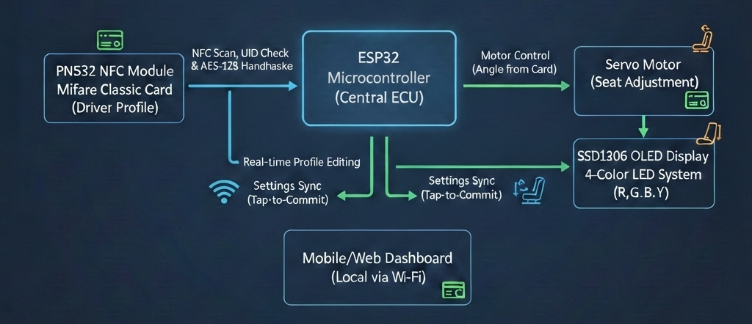
System Architecture
4

Slide 5
Security Layer: The Authentication Handshake
Three-Tier Verification:
1. UID Matching: Initial check to see if the card is in the authorized database.
2. AES-128 Handshake: The runAES() function simulates a cryptographic challenge. Even if a UID is spoofed, the encrypted payload prevents unauthorized access.
3. Physical Read: Settings are pulled directly from the NFC Data Blocks, ensuring that even if the car's database is wiped, the driver's settings remain intact.
5

Slide 6
The Tap-Tap-Adjust Workflow
Operational Phases: Phase 1 (The Initial Tap): Card detected > Security Handshake > Servo moves to stored angle. Phase 2 (The Double-Tap): Tapping again within 4 seconds unlocks the Web Dashboard (prevents accidental Wi-Fi activation). Phase 3 (The Sync): After adjusting settings on the phone, a third tap triggers the TAP TO COMMIT sequence, writing data back to the card.
6

Slide 7
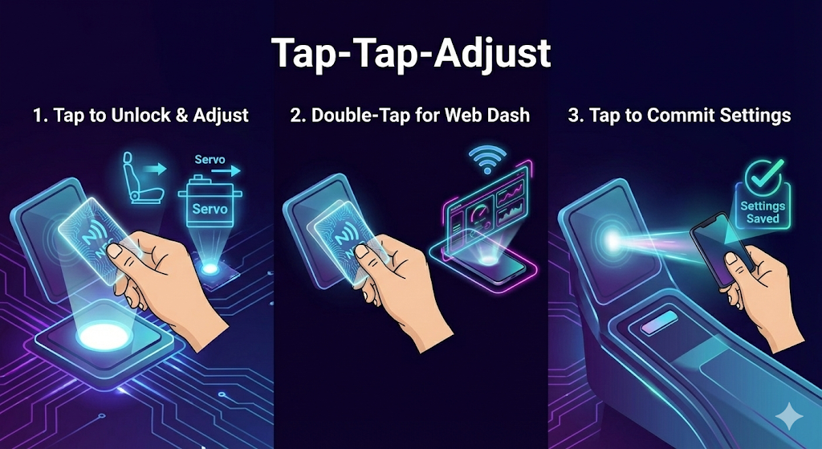
The Tap-Tap-Adjust Workflow
7

Slide 8
Web Dashboard & Local Connectivity
Asynchronous Web Server: Hosted directly on the ESP32.
Features:
Real-time Seat Angle adjustment slider.
Music Genre selection (Jazz, Rock, Pop, etc.).
Drive Mode toggle (Eco, Sport, Comfort).
By hosting the web server directly on the ESP32 inside the car, you have eliminated the internet as an entry point.
8

Slide 9
Guest Mode & Dynamic Enrollment
Future Scope & Scaling
Objective: Grant temporary access (e.g., Valet, Mechanic) without compromising admin data.
Workflow:
Enrollment: Admin activates Enroll Mode to temporarily whitelist the specific card.
Sandboxing: The Guest profile is restricted to Safe Defaults (Eco Mode, 90° Seat) and cannot overwrite Admin settings.
Security: The system uses Volatile Memory (RAM). Guest credentials are automatically wiped when the ignition turns off.
9

Slide 10
Future Scope & Scaling
Biometric Integration: Adding a fingerprint sensor for 3-Factor Authentication.
Cloud Sync: Syncing profiles to a secure cloud so settings can be pulled to any car globally.
Expanded Actuation: Controlling mirrors, steering column, and climate control via the same NFC trigger.
CAN-Bus Integration: Moving from a simulation (Servo) to actual vehicle CAN-Bus communication.
10

Slide 11
Conclusion & Q&A
This ECU prototype proves that vehicle personalization can be both highly secure (AES-128) and incredibly portable.
Demo Ready!
Questions?
11

Slide 12


T H ANK YOU!

