Slide 1
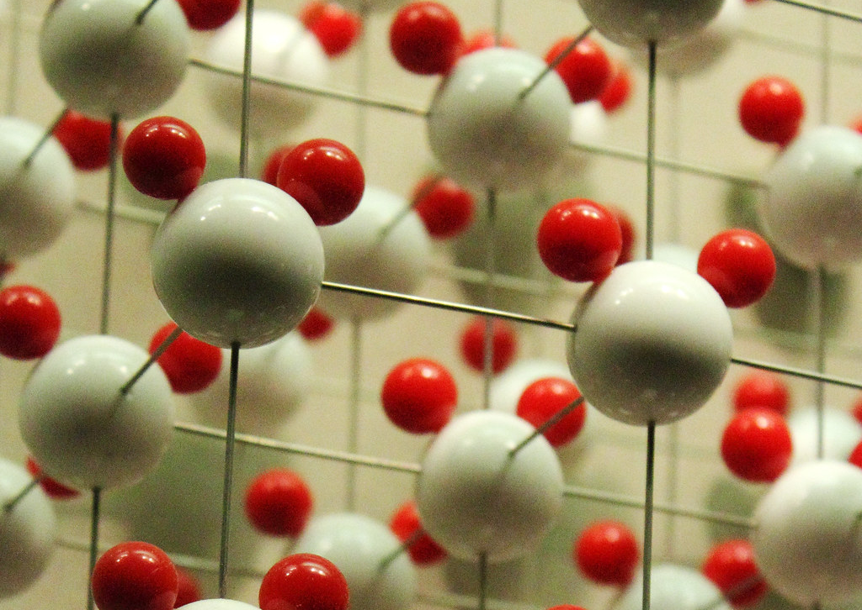
Shape memory alloy
This Photo by Unknown author is licensed under CC BY.

Slide 2
CONTENTS
Introduction about project
Aim of Project
Insights from given research paper
Shape memory alloy and Its Properties
Implementing Similar ML Model for Shape Memory Alloy

Slide 3
Introduction
Scientists struggle to find key details for making materials because there's so much scientific research.
Accessing this wealth of knowledge demands an exhaustive exploration of literature, which is an extremely time-consuming and labor-intensive task
Develop a Time saving efficient solution to read thousands of Research articles and Journals present on internet and extract important parameters useful for research of new material.
Develop a ML Model which automatically extracts details & important parameters from text, a comprehensive approach that utilizes natural language processing (NLP) techniques and machine learning algorithms.
These models will scan through vast amounts of scientific text , pinpoint relevant information, and extract key synthesis parameters, ultimately aiding scientists to accelerate materials discovery.

Slide 4
AIM
To find a systematic approach to develop machine learning model for the automated extraction of synthesis parameters specific to Shape Memory Alloys from extensive scientific texts.
Taking reference from the given Research Paper to develop a similar Model to help to extract information related to Shape Memory Alloy and then find important parameters used to determine a new material as a SMA.
Research Paper: Automated extraction of synthesis parameters of pulsed laser-deposited materials from scientific literature - Digital Discovery (RSC Publishing)

Slide 5
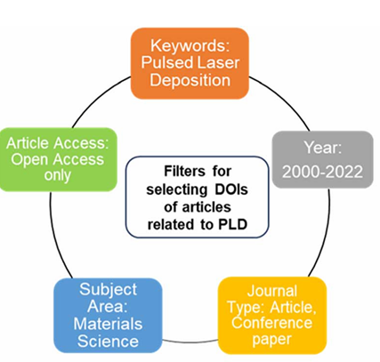
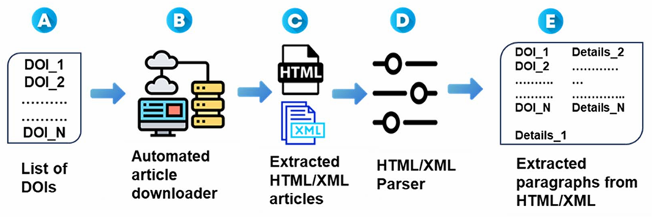
INSIGHTS FROM RESEARCH PAPER
Focus on the intersection of Natural Language Processing (NLP) and Materials Science.
Data acquisition from over 6000 research articles, followed by pre-processing, feature extraction, and model training.
Digital object identifier (DOI) acquisition was performed to procure research articles pertinent to PLD
DOIs were segregated based on the respective publishers
Automated Pipeline to download articles
Web-scraping was utilized to retrieve the research articles based on the DOI list
Research Paper: Automated extraction of synthesis parameters of pulsed laser-deposited materials from scientific literature - Digital Discovery (RSC Publishing)
Relevant information including article titles, authors, abstracts, publication dates, in addition to the raw-text files were downloaded in HTML/XML format

Slide 6
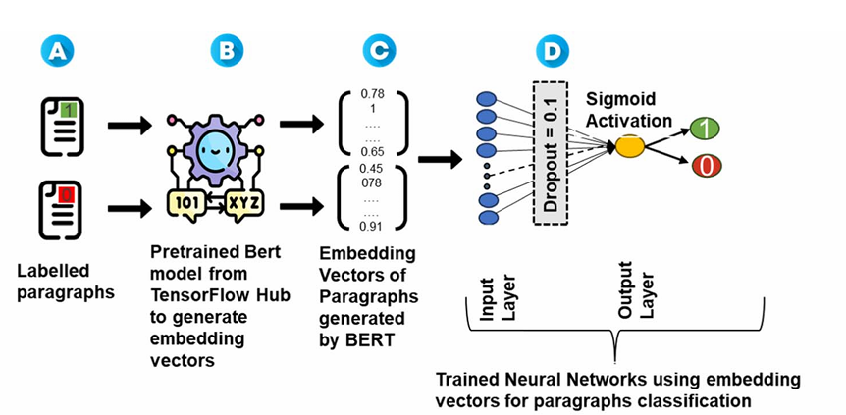
Pre-Processing and BERT Embeddings
Pre-processing of extracted data by data cleaning, normalization, and entity categorization
Paragraph embeddings using BERT ( Bidirectional Encoder Representations from Transformers), converting textual information into quantifiable features. The BERT model used for generating embedding was a general pre-trained model from the Tensor Flow hub
Paragraph classification model, built to categorize para graphs based on the presence or absence of processing parameters related to PLD using binary classification approach.
Research Paper: Automated extraction of synthesis parameters of pulsed laser-deposited materials from scientific literature - Digital Discovery (RSC Publishing)
Utilized the MatSciBERT (pre-trained on a massive corpus of materials science related text) based architecture to identify and categorize various PLD synthesis parameter.

Slide 7
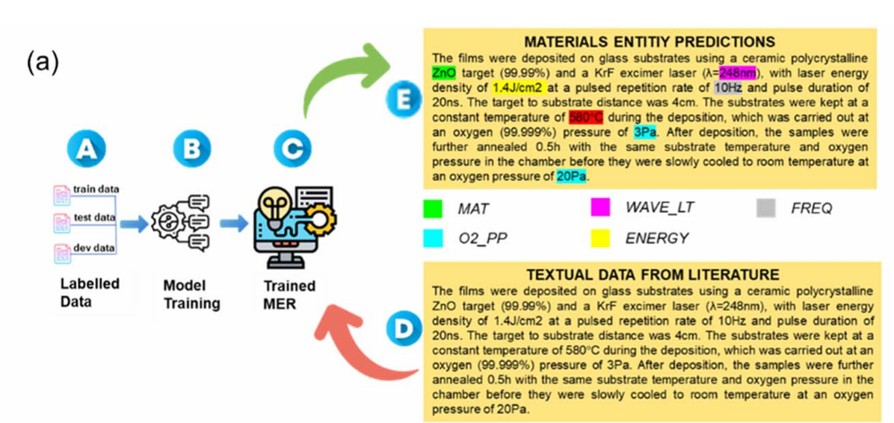
CATEGORIZATION USING MER
Materials entity recognition (MER) involved the recognition and categorization of specific elements from unstructured textual data
Material specific entities and their respective processing parameters were identified using a MER model. To facilitate the creation of a labeled dataset for training the MER model, a labeling tool was utilized. an open-source tool, NER Annotator by Tecoholic, was employed to label entities.
Research Paper: Automated extraction of synthesis parameters of pulsed laser-deposited materials from scientific literature - Digital Discovery (RSC Publishing)
Parameters such as deposition temperature, pressure, laser energy, wavelength, thin film material, and substrate, using a Named Entity Recognition (NER) model.
The training data for NER included domain-specific information related to PLD in materials science

Slide 8
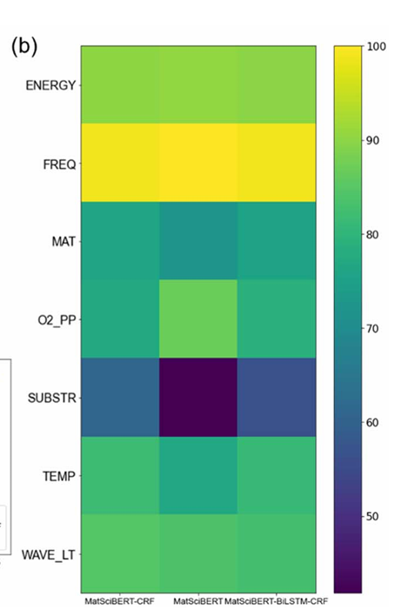
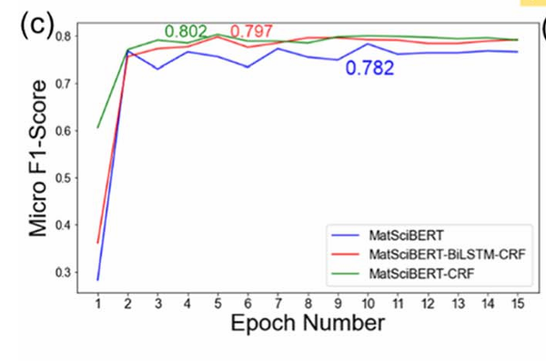
UNITs NORMALIZATION AND RESULTS
The extracted data often comprises diverse units and inconsistent representations. Normalization of units is pivotal step in standardizing the representation of extracted processing parameters.
Material normalization, Wavelength normalization, Frequency normalization, Energy normalization, Temperature normalization, Oxygen partial pressure normalization are some parameters that were normalized to find the most important parameter among them.
Results:
Trained MER Model's evaluation Typical metrics, including accuracy, precision, recall (sensitivity), and F1 Score, were calculated to evaluate the accuracy of the trained model.
Both micro and macro F1 scores were calculated to decide the model performance.
Research Paper: Automated extraction of synthesis parameters of pulsed laser-deposited materials from scientific literature - Digital Discovery (RSC Publishing)

Slide 9
SHAPE MEMORY ALLOY
Shape Memory Alloys (SMAs) are a unique class of materials that can return to a predetermined shape when subjected to a specific thermal process. This remarkable property is due to the material's ability to undergo a reversible phase transformation.
Properties :
Shape Memory Effect (SME) - This is the ability of the alloy to return to its original shape when heated after being deformed at a lower temperature.
Super elasticity - Also known as pseudo elasticity, this is the capacity of the material to undergo large deformations and return to its original shape without a temperature change, typically observed in a narrow temperature range.

Slide 10
SHAPE MEMORY ALLOY
MECHANISM:
Phase Transformation: The transformation between the martensitic (low temperature, easily deformed) and austenitic (high temperature, rigid) phases is central to the SMA’s behavior.
Thermomechanical Process: When the SMA is deformed in the martensitic state and then heated above the transformation temperature, it reverts to the austenitic state, recovering its original shape. Cooling it back transforms it again to the martensitic state.

Slide 11
SHAPE MEMORY ALLOY
Shape memory Alloys
NiTi back to same shape
Transformation can be done by temperature, stress
Computation/ Experimental
Stimulation
DSC Heat flow vs Temperature

Slide 12
SHAPE MEMORY ALLOY
Stress vs Strain curve
Critical stress
Maximum super elasticity
Maximum strain
Materials
Stimulation Method : Molecular Dynamics / DFT
Ab initio molecular Dynamics
MD force field , DFR

Slide 13
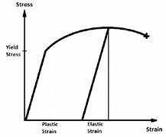
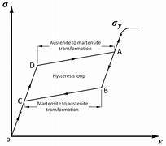
STRESS STRAIN CURVE OF SHAPE MEMEORY ALLOY
When an ordinary metal is extended, a stress-strain curve similar to that shown in Figure 1 is obtained.
When a large load exceeding the metal’s elastic limit is applied, inelastic deformation occurs. This deformation cannot be removed even when the load is removed. This means that the metal takes a permanent set. With shape memory alloys, necessary shapes can be memorized into them and the kind of high temperature, ultra-elastic, base phase performance illustrated in Figure 2 can be observed.
Even when they are deformed into a martensite condition at low temperatures, when they are reheated, they return to the base phase and the originally memorized shape.
FIGURE 1(NORMAL MATERIAL
that
FIGURE 2(SMA)

Slide 14
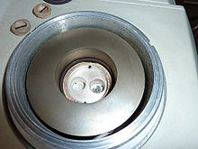
Differential scanning calorimetry
Differential scanning calorimetry (DSC) is a thermoanalytical technique in which the difference in the amount of heat required to increase the temperature of a sample and reference is measured as a function of temperature.
There are two main types of DSC: Heat-flux DSC which measures the difference in heat flux between the sample and a reference (which gives it the alternative name Multi-Cell DSC) and Power differential DSC which measures the difference in power supplied to the sample and a reference

Slide 15
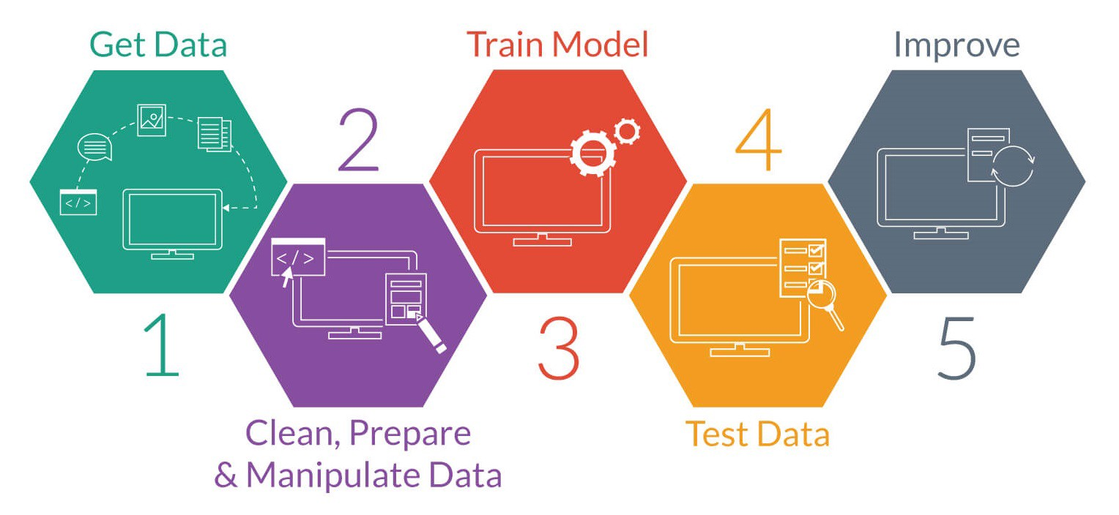
IMPLEMENTATION FOR SMA
Keywords and Entities
Data Collection
Preprocessing
Feature Extraction
Model Development
Training and Evaluation

Slide 16
Keywords and Entities
New Keywords (for SMAs):
Alloy composition (e.g., NiTi, CuAlNi)
Phase transformation temperatures (e.g., Martensite start/finish, Austenite start/finish)
Heat treatment parameters (e.g., annealing temperature, time)
Mechanical processing conditions (e.g., strain rates, cooling rates)
Environment conditions (e.g., oxidation, corrosion resistance)
Thermo-mechanical cycling
Grain size, microstructure
Dopants or alloying elements

Slide 17




Data Collection
Building a comprehensive SMA dataset involves gathering relevant papers from various sources like PubMed, IEEE Xplore, Web of Science, and Google Scholar. These papers should cover all aspects of SMA research, including synthesis, characterization, and applications.

Slide 18
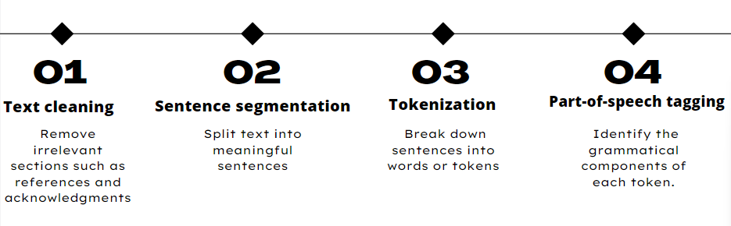
Preprocessing
The preprocessing steps remain largely the same but should now focus on identifying sections relevant to SMAs:
Text cleaning: Remove irrelevant sections such as references and acknowledgments.
Sentence segmentation: Split text into meaningful sentences.
Tokenization: Break down sentences into words or tokens.
Part-of-speech tagging: Identify the grammatical components of each token.

Slide 19
Feature Extraction
Named Entity Recognition (NER): Train the NER model to identify SMA-specific entities such as chemical compositions (e.g., NiTi, CuAlNi), phase transformation temperatures, heat treatment conditions, and mechanical properties.
Dependency Parsing: Adapt the dependency parsing model to understand the context and relationships specific to SMA synthesis and characterization.

Slide 20
Model Development
MatSciBERT Adaptation:
Fine-tune the MatSciBERT model on a dataset comprising SMA literature to improve its understanding of context-specific terminology.
Paragraph Classification:
Update the paragraph classification model to detect paragraphs describing SMA synthesis parameters. Use new SMA-related keywords and entities in training data.
Materials Entity Recognition (MER):
Adapt the three architectures (MatSciBERT, MatSciBERT-CRF, MatSciBERT-BiLSTM-CRF) to recognize and categorize SMA-specific synthesis parameters.
Fine-tune these models with a corpus annotated specifically for SMA research.

Slide 21
GROUP MEMBERS
THANK YOU
AMAN NIGAM
ARVIND DEVKATE
PRATHAMESH LADHE
DHEERAJ
220215
220811
220118
220356

