Slide 1

Unsupervised Clustering for Customer Segmentation

Slide 2
Problem Statement
track_changes
Core Objective
Discover natural groupings within a customer base to answer: "Who are our most valuable customers? Which segments churn? Which have high lifetime value?"
settings
Methodology
Analyze UK-based transactional data (~500k records, 2010-2011)
Engineer features using RFM Principles
Apply PCA for dimensionality reduction
Implement multiple clustering algorithms
Validate findings via supervised learning
warning
Key Challenge
Discovering segments in a heterogeneous base without predefined labels.
Navigating real-world complexity: missing values, anomalies, and complex transactional records spanning over a year.
Focus: Unsupervised Clustering for Customer Segmentation using the Online Retail Dataset (2010-2011).

Slide 3
Objective & Motivation
trending_up
Motivation
Move from generic marketing to targeted, segment-based strategies.
psychology
Core Objective
Apply rigorous unsupervised learning to segment customers into meaningful clusters.
fact_check
Validation
Validate segments using supervised learning (Logistic Regression) for accuracy and robustness.
Final Output
Actionable recommendations for the business.
Goal: Transform raw transactional data into strategic insights through statistical learning.

Slide 4

Dataset Overview
storage
Data Source & Context
Source: UCI Machine Learning Repository (Online Retail Dataset). Context: UK-based online retailer spanning 2010-2011.
analytics
Initial Size
541,909 transactions captured across 8 core variables, providing a dense transactional history for analysis.
list_alt
Key Variables
• InvoiceNo, StockCode
• Description, Quantity
• InvoiceDate, UnitPrice
• CustomerID, Country
The dataset serves as the foundation for identifying distinct consumer behavior patterns.

Slide 5
Data Cleaning & Preprocessing
Data cleaning embodies critical business assumptions, ensuring conceptual validity and statistical appropriateness.
01. ID & Null Removal
• Removed missing CustomerIDs (~25% of raw data).
• Exact duplicate rows removed to prevent data entry errors.
02. Transaction Filtering
• Removed negative/zero quantities (returns/cancellations).
• Removed records with zero or negative UnitPrices.
03. Outlier Treatment
• IQR Method used on UnitPrice [-2.50, 7.50].
• Extreme anomalies removed to align with modeling assumptions.
Cleaning Impact: Removed ~8-10% of records, primarily returns and anomalies, resulting in a robust foundation for RFM analysis.
358,580
Final Cleaned Transactions
4,306
Unique Customers

Slide 6
Why Customer Segmentation?
Segmentation reveals the hidden structure of customer heterogeneity, moving beyond one-size-fits-all strategies.
groups
psychology
Unsupervised Discovery
Unlike supervised learning, clustering allows us to discover natural groupings without pre-defined labels or known outcomes.
Understanding Heterogeneity
Fundamentally about decoding the diverse behaviors and needs within a vast customer base to drive personalization.
business_center
Answering Core Retail Questions
• Who are our most valuable (Hero) customers?
• Which segments are at risk of churning?
• Which groups demonstrate the highest potential lifetime value?

Slide 7
Feature Engineering: RFM Analysis
RFM analysis transforms raw transactional history into actionable customer-level metrics.
update
repeat
payments
Recency (R)
Days since last purchase. Measures how recently a customer engaged with the brand.
Frequency (F)
Total number of transactions. Indicates loyalty and the habitual nature of purchasing.
Monetary (M)
Total spending (Revenue). Reflects the financial contribution and customer lifetime value.
Data Aggregation: Individual invoices are grouped by CustomerID to create a single row per unique customer.

Slide 8
Advanced Feature Engineering
We expanded the core RFM features by engineering behavioral metrics that capture relationship duration, purchasing intensity, and category depth.
history
paid
Customer Lifetime Days
Measures customer tenure as the total days elapsed between their first and most recent purchase.
Avg Order Value
Calculates the average transaction size, identifying purchasing power and typical spending levels.
category
trending_up
Product Diversity
Counts unique products purchased to understand category breadth and shopping scope.
Purchase Frequency
Measures daily engagement intensity by normalizing transaction counts over the customer's active tenure.

Slide 9
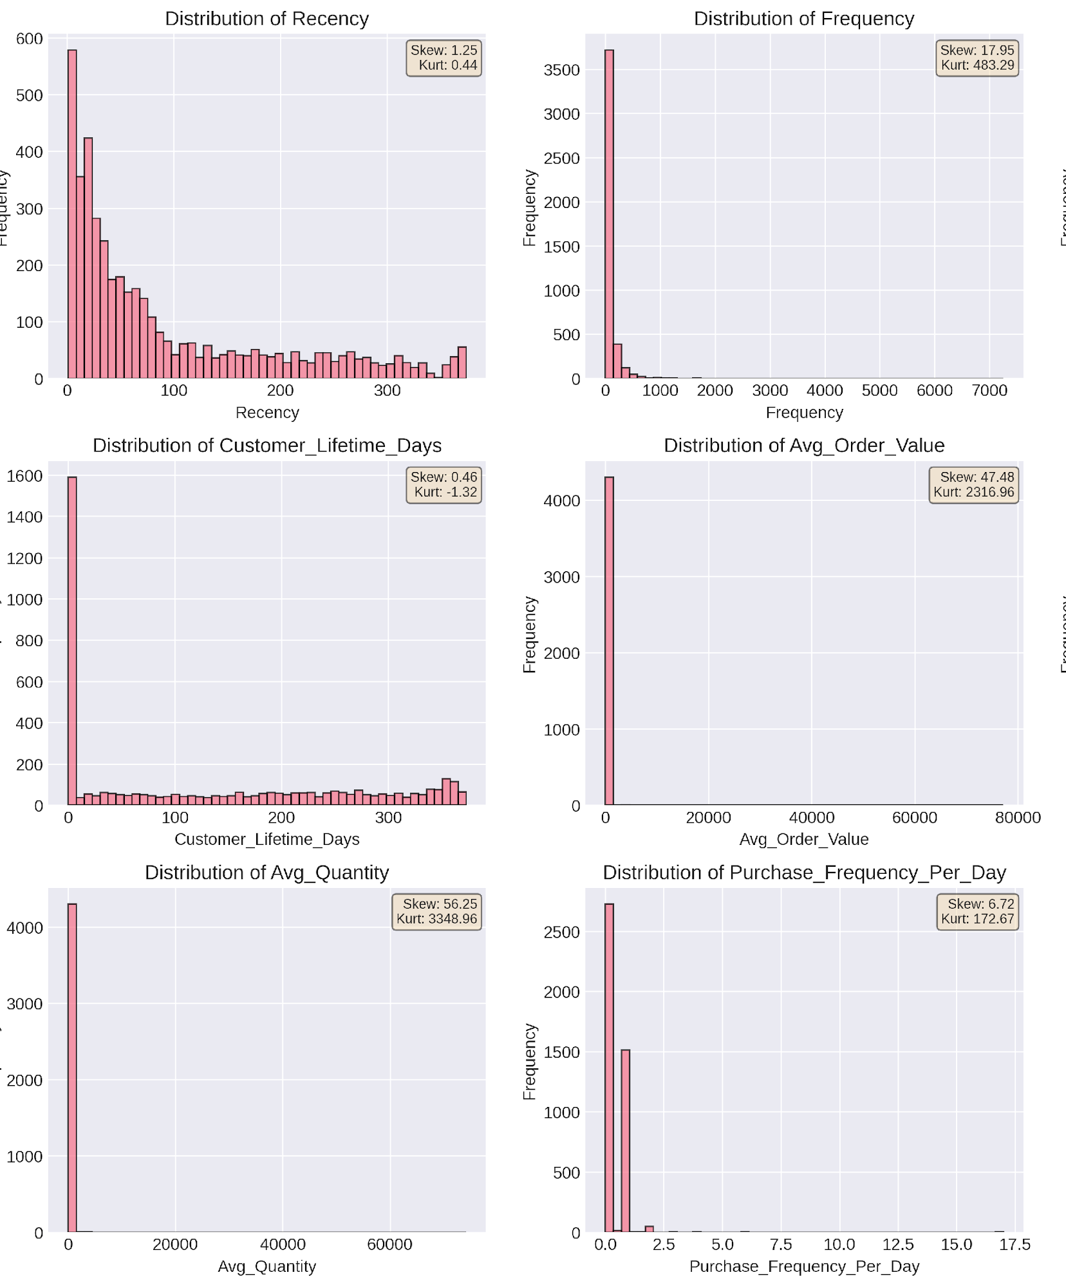
EDA: Feature Distribution Analysis
Exploratory data analysis builds intuition and reveals heavy-tailed patterns that inform our transformation strategy.
Key Distribution Insights
Right-Skewed Data: RFM features show strong right skew (e.g., Avg_Order_Value skew: 47.48).
Outlier Dominance: Raw metrics will dominate Euclidean distance calculations due to heavy tails.
Modeling Decision: Log transformations are required to stabilize variance before clustering.
Note: Skewness > 1 indicates strong deviation from normality.
Observations: Most customers are infrequent, low-value buyers; a minority represent high-value loyalty segments.

Slide 10
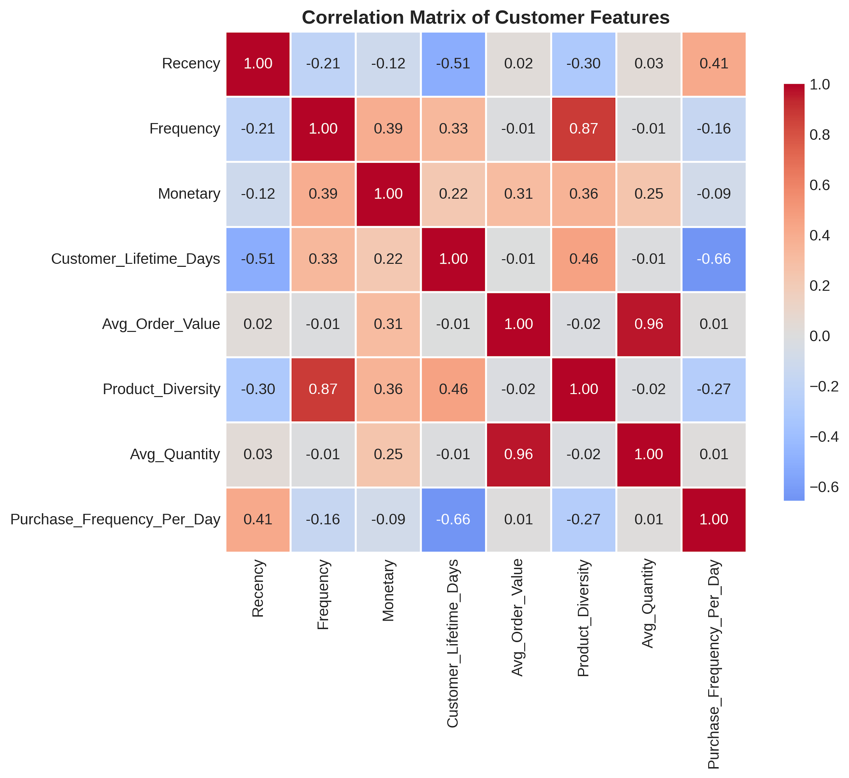
EDA: Feature Correlation Analysis
Correlation analysis reveals dependencies between engineered features, guiding dimensionality reduction and model selection.
Key Correlation Insights
High Correlations: Total_Revenue and Average_Order_Value are moderately correlated with Monetary and Frequency, which is expected given feature definitions
Independence: Recency shows weak correlation with other features, indicating it captures unique temporal information
Multicollinearity: Some features (e.g., Total_Quantity and Total_Revenue) are naturally correlated due to definition. This is acceptable for clustering but should be noted.
PCA Justification: The presence of correlations validates the use of PCA to extract orthogonal components
Note: PCA will be applied to address redundancy among correlated features.
Observations: High correlation between Frequency and Product Diversity (0.87) suggests these features provide redundant information.

Slide 11
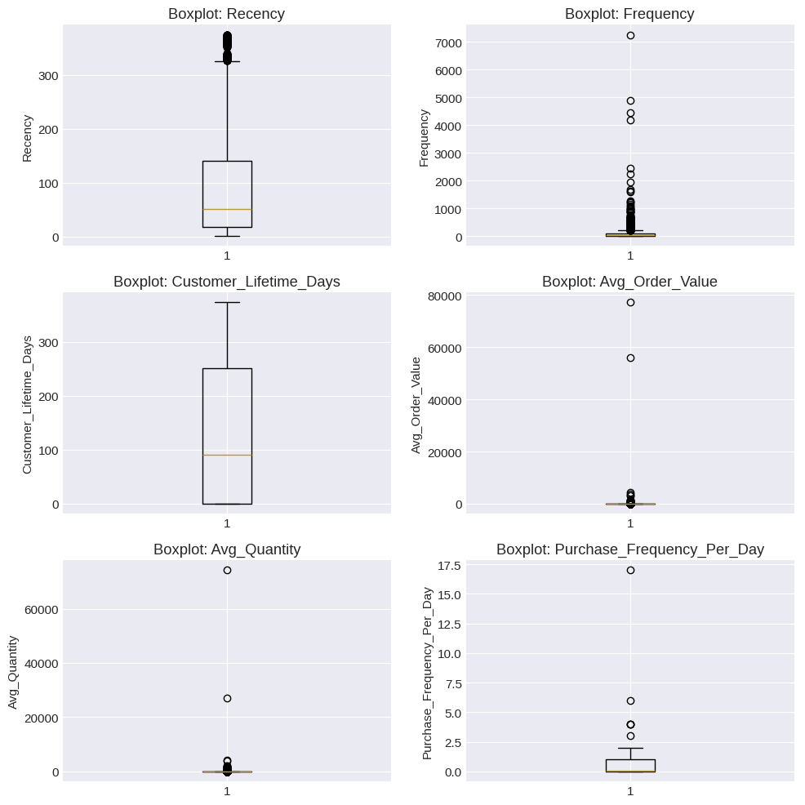
EDA: Outlier Detection & Correlation Analysis
Visualizing data distribution through boxplots helps identify significant outliers and justifies the transformation strategy.
Key Observations
Outliers are present in most features (5-15%), particularly in Monetary and Frequency. In customer segmentation, outliers are not necessarily errors they represent genuine business value (high-value customers). Our clustering algorithm must handle them appropriately:
K-Means: Sensitive to outliers; we'll rely on scaling to mitigate
Hierarchical: Less sensitive but still influenced
DBSCAN: Can naturally identify outliers as noise points
Outlier Summary: IQR method reveals heavy-tailed distributions across all RFM features, necessitating log scaling before distance-based clustering.

Slide 12
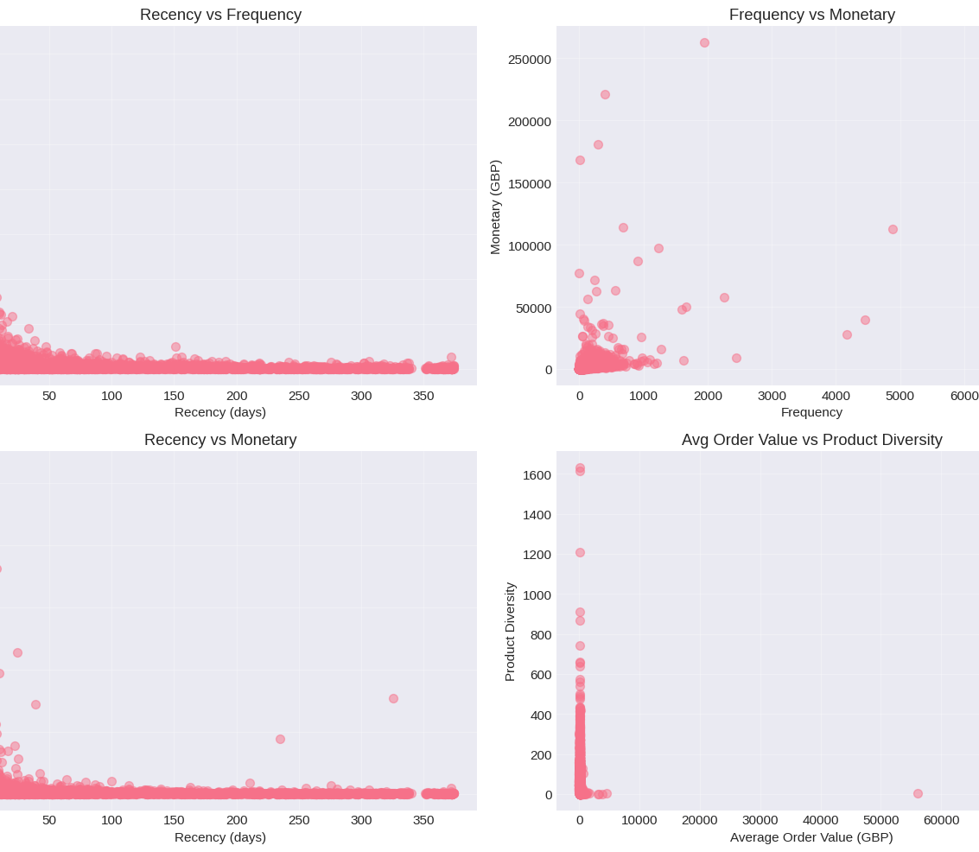
Outlier Implications & EDA Conclusions
Outliers in customer segmentation represent genuine business value (high-value customers) rather than data errors.
Clustering Sensitivity
K-Means: Sensitive; requires scaling mitigation.
Hierarchical: Less sensitive but still influenced.
DBSCAN: Naturally identifies outliers as noise.
Outliers present in 5-15% of features (Monetary/Frequency).
EDA Strategic Conclusions
Heterogeneous Base: Clear RFM clustering.
Skewed Distributions: Transformation needed.
Multidimensional: Distinct behavioral aspects.
Business Value: High-value customers are genuine.
Strategic Impact: These insights directly inform preprocessing and modeling choices for the final segmentation pipeline.

Slide 13
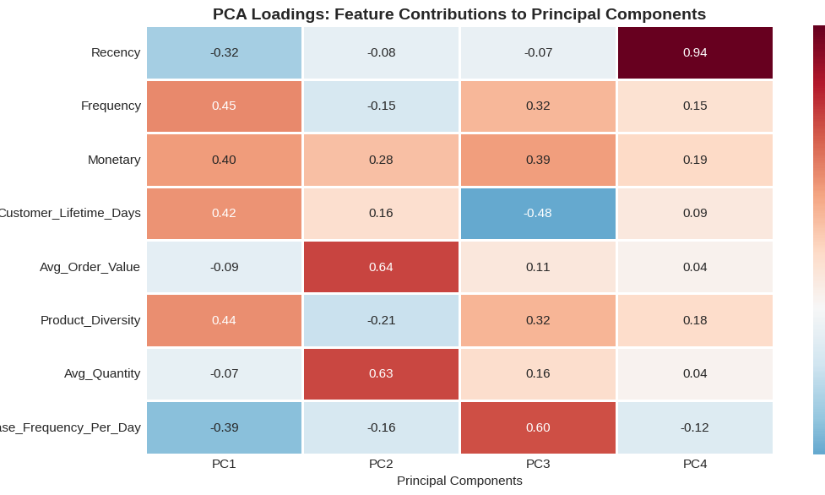
PCA Interpretation
Key Components
PC1 (~60%): "Overall Value & Engagement". Separates high-value, active users from low-value, inactive ones.
PC2 (~20%): "Spending Profile". Distinguishes high-frequency buyers from large-transaction, infrequent ones.
PC3+: Capture nuances in behavioral diversity and purchasing patterns.
Analysis Conclusion
The first 4-5 components together capture ~85% of total variance, providing a highly efficient reduced dataset.
This reduction is sufficient to maintain the integrity of original data patterns while enabling more robust and meaningful customer clustering.
Summary: PCA enables effective segmentation by distilling complex behavioral data into distinct, interpretable dimensions.

Slide 14
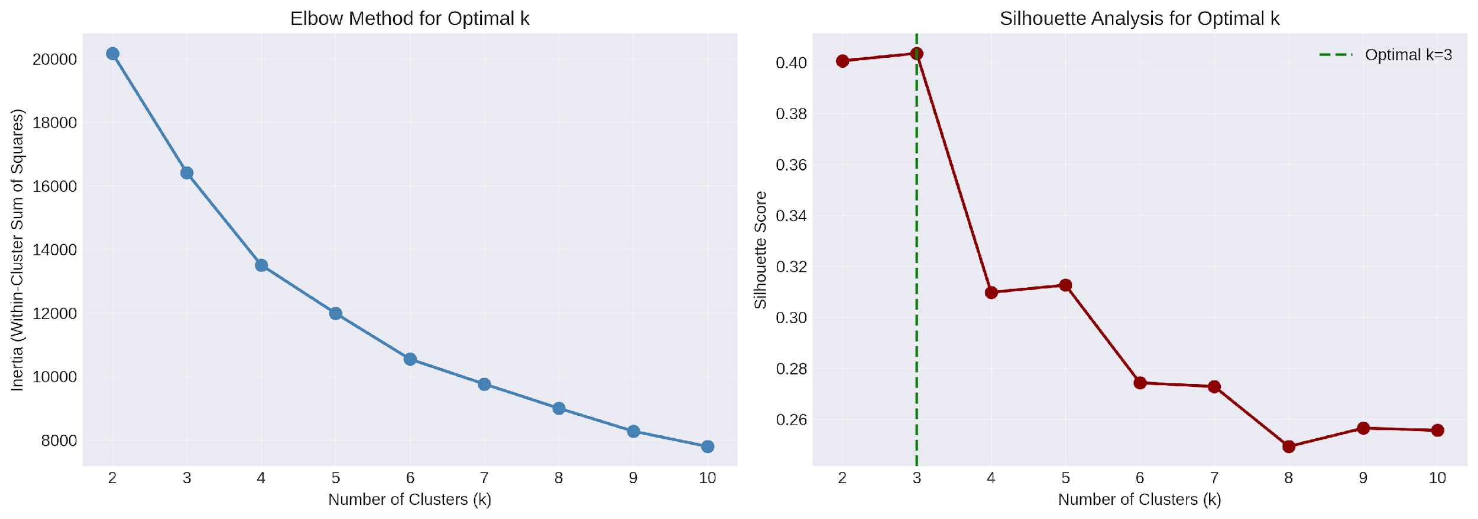
K-Means: Finding Optimal k
Algorithm Intuition
Initialize: Randomly place k cluster centers.
Assign: Map customers to nearest center.
Update: Recalculate centers as the mean.
Repeat: Iterate until convergence.
Objective: Minimize within-cluster variance (Inertia).
Determining k
Elbow Method: Identifies the point where inertia decrease slows significantly ("elbow").
Silhouette Score: Measures cluster cohesion and separation (Range: -1 to 1).
A peak score of 0.404 at k=3 suggests the most stable structure.
Strategic Selection: k=3 is selected as it balances statistical fit (Silhouette peak) with practical business interpretability.

Slide 15
Overall Summary: K-Means Clustering
1. Objective
Identify natural customer segments based on purchasing behavior (RFM and engineered features) to drive targeted business strategies.
2. Data Preparation
Feature Engineering: RFM and behavioral metrics.
Transformation: Log-transformed skewed features.
Scaling: Standardized for equal weight.
PCA: Reduced to 4 components (98% variance).
3. Determining k=3
Used 'Elbow Method' and 'Silhouette Score' to find the statistical balance.
Optimal Choice: k=3 selected.
Reasoning: Balanced statistical fit with practical business interpretability.
4. Clustering Results & Business Strategy
Segments: Cluster 0 (Lost Customers), Cluster 1 (At-Risk VIPs), Cluster 2 (Champions).
Strategic Value: Enables tailored marketing (retention, loyalty, re-engagement), optimized resource allocation, and deeper business insights.

Slide 16
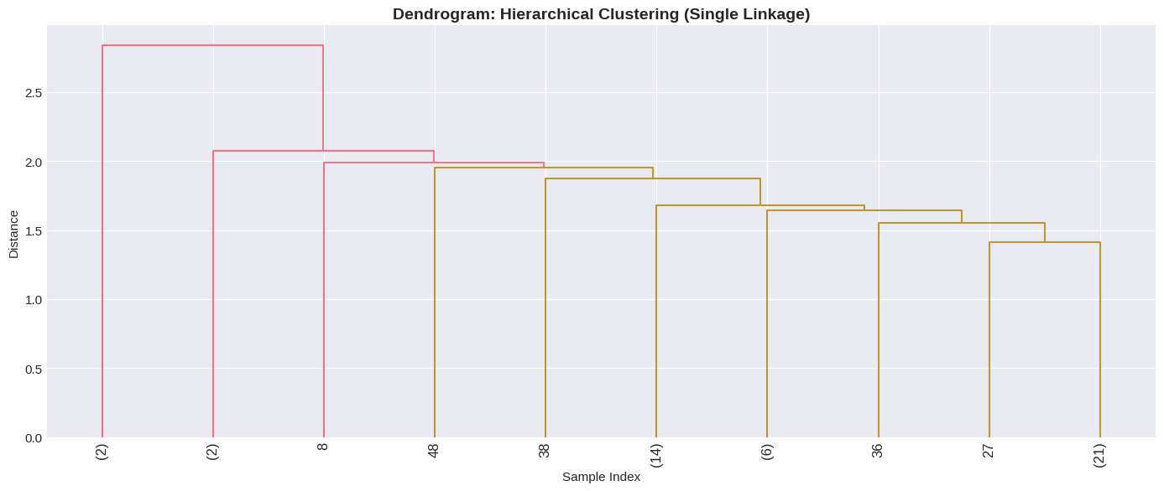
Hierarchical Clustering: Dendrogram Analysis
Linkage & Structure
Single Linkage: Groups based on the minimum distance between observations in different clusters.
Dissimilarity: The Y-axis represents the distance (dissimilarity) at which merges occur.
Optimal Cut Point
Cluster Definition: Cutting the tree at distance ~2.0 identifies primary segments.
Outcome: Reveals a nested hierarchy where samples (2), (2), and 8 form a distinct, more distant group.
Strategic Insight: The dendrogram confirms the distinct separation of outliers from the main dense cluster.

Slide 17
Understanding Dendrograms in Clustering
Overall Summary
A dendrogram is a tree-like diagram that records sequences of merges or splits in hierarchical clustering, visually representing cluster arrangements.
1. Hierarchical Structure
Illustrates relationships between data points and clusters. Leaf nodes represent individual data points (e.g., customers); branches show merges into larger clusters.
2. Distance & Dissimilarity
The vertical axis represents merging distance. Shorter lines indicate similarity; longer lines suggest clusters are more dissimilar and merge later.
3. Cluster Formation
In agglomerative clustering, every point starts as its own cluster. The diagram shows how they are progressively grouped by similarity.
4. Determining Clusters (k)
By 'cutting' the tree horizontally, you define 'k'. Large gaps between merges often identify the most natural groupings in the dataset.
Customer Segmentation Context
Displays customer groupings based on RFM and behavior. Validates the choice of 'k' by revealing natural segment structures in your customer data.
Strategic Tool: Visualizing nested hierarchies to optimize business logic for customer groups.

Slide 18
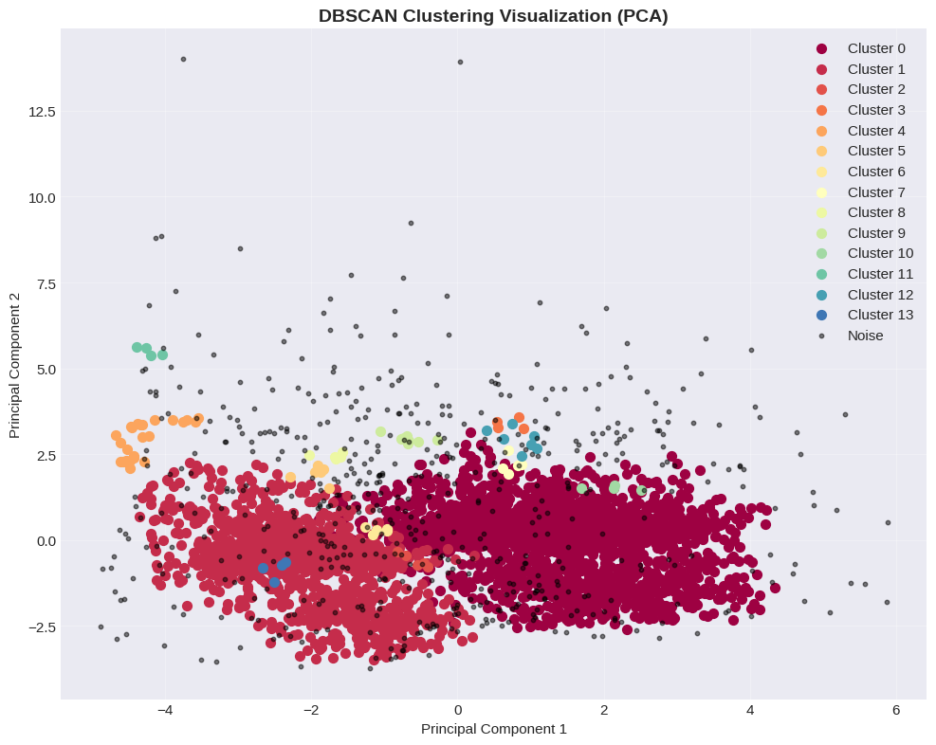
DBSCAN Clustering: Density-Based Approach
DBSCAN Intuition
Identifies clusters based on point density rather than fixed centroids or hierarchies.
Density-Based: Identifies clusters based on the density of data points.
Core Points: Points with at least min_samples neighbors within a distance eps.
Border Points: Points within eps of a core point but not core themselves.
Noise Points: Points that are neither core nor border points (identified as outliers).
Advantages: Finds arbitrary-shaped clusters, naturally identifies outliers.
Why DBSCAN was Rejected
Poor Performance Metrics: Achieved significantly lower (or negative) evaluation scores (e.g., Silhouette Score) compared to K-Means and Hierarchical Clustering.
Unmanageable Clusters: Parameter tuning often resulted in a large number of very small clusters (e.g., 14 clusters) or two dominant clusters with many tiny ones, making interpretation and business action difficult.
Mismatched Goals: Our objective was to find a small, actionable number of customer segments (like the 3 distinct segments from K-Means) for targeted marketing, which DBSCAN did not effectively provide in this case.
Strategic Insight:
DBSCAN effectively isolates noise and finds arbitrary shapes, but it fragmented the retail base into 14 clusters with 13.1% noise. K-Means with k=3 was chosen for its superior business utility and interpretability.

Slide 19
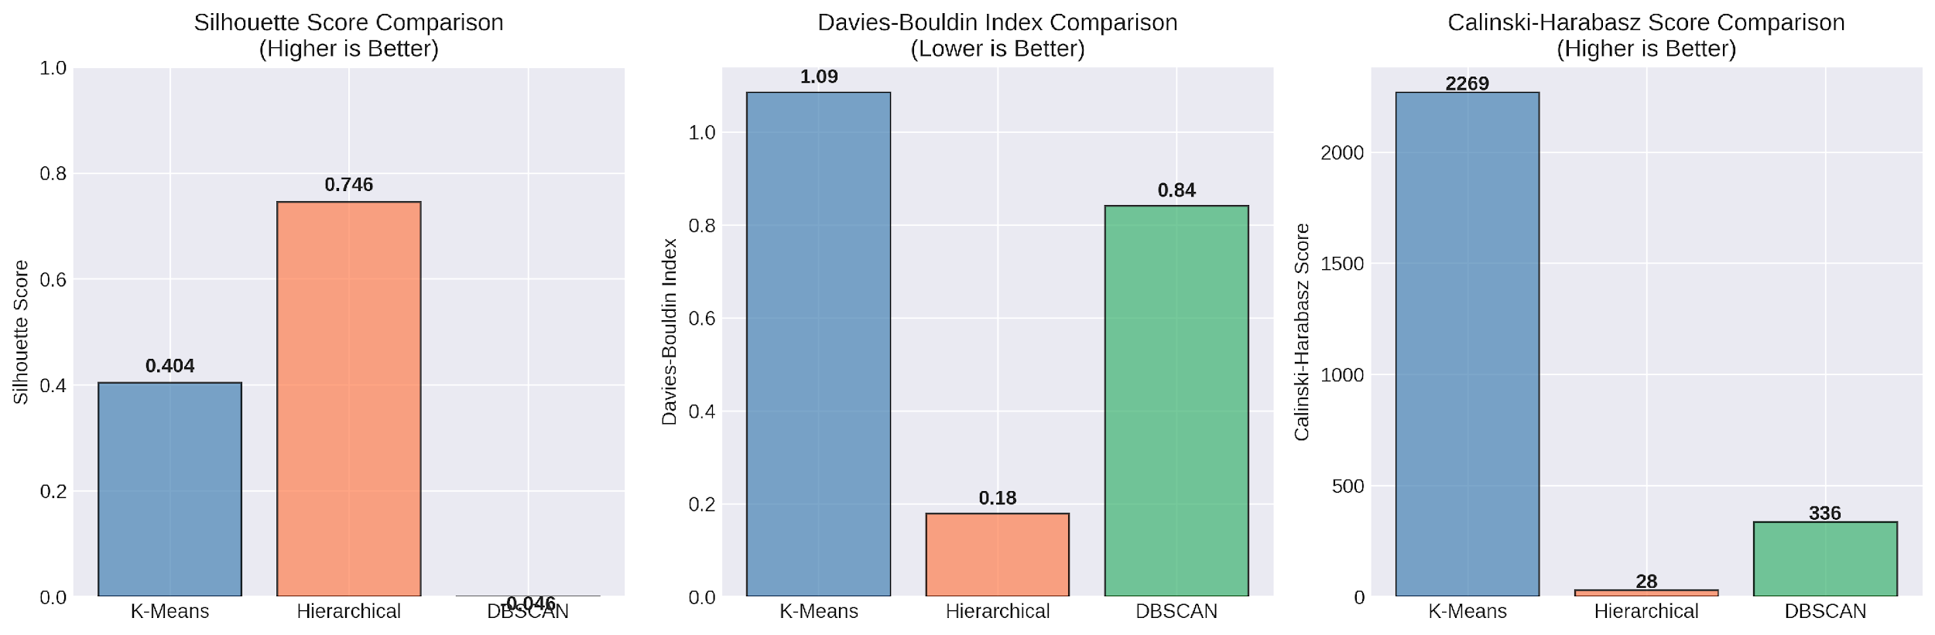
Clustering Method Comparison & Selection
Method Analysis
K-Means: Optimal Silhouette/CH scores. Produces compact, well-separated clusters.
Hierarchical: High Silhouette (0.746) but low CH score. Provides interpretability via dendrograms.
DBSCAN: Fragmented into 14 clusters with 562 noise points. Rejected for business scale.
Metrics Explained
Silhouette: Cohesion & separation (-1 to 1; High is better).
Davies-Bouldin: Ratio of within to between distances (Low is better).
Calinski-Harabasz: Variance ratio (High is better).
Final Recommendation
Selected: K-Means
Superior statistical stability.
Clear k=3 business structure.
Suitable for supervised learning extensions.
Strategic Insight: Multiple metrics ensure the chosen model is not biased by a single perspective. K-Means offers the best balance of mathematical rigor and business utility.

Slide 20
Validation Methodology: Two-Step Approach
This two-step approach was critical for ensuring the validity, stability, and operational usability of customer segments.
Step 1: Unsupervised Learning
Objective: Discovery. Finding natural groupings without predefined labels.
Algorithms: K-Means, Hierarchical, DBSCAN.
Goal: Reveal patterns directly from raw data.
Step 2: Supervised Learning
Objective: Validation. Using Multinomial Logistic Regression to test segment clarity.
Target: Discovered cluster labels.
Input: Original features (RFM, etc.).
L2 Accuracy: 99.07% confirms stability.
Key Validation & Operational Outcomes
• Validating Quality: High accuracy proves segments are statistically robust and distinct.
• Reproducibility: Confirms clusters are genuine behavioral segments, not random artifacts.
• Operationalization: Supervised models allow immediate assignment of new customers without re-running intensive clustering.
• Feature Selection: Comparison of L1 (Lasso) vs L2 (Ridge) identifies the most crucial business drivers for each segment.

Slide 21
Validation: Supervised Learning Extension
Rationale & Methodology
Can we predict cluster membership using the original features?
Goal: Validate if clusters are well-defined and stable.
Model: Multinomial Logistic Regression with L1/L2 penalties.
Training Size: 3,444 samples.
Test Size: 862 samples (20% split).
Model Performance
99.07%
L2 (Ridge) Accuracy
97.80%
L1 (Lasso) Accuracy
Validation Outcomes
• High Stability: Near-perfect accuracy across both regularization techniques confirms the segments are statistically robust and distinct.
• Feature Selection: L1 (Lasso) provides an interpretable model by identifying key features, while L2 (Ridge) offers maximum predictive smoothing.
• Class Distribution: Training set dominated by Cluster 2 (55.6%), followed by Cluster 0 (34.9%) and Cluster 1 (9.5%).
Validation Insight: Predicting cluster membership with over 97% accuracy demonstrates that segments represent genuine customer behavioral patterns rather than random artifacts.

Slide 22
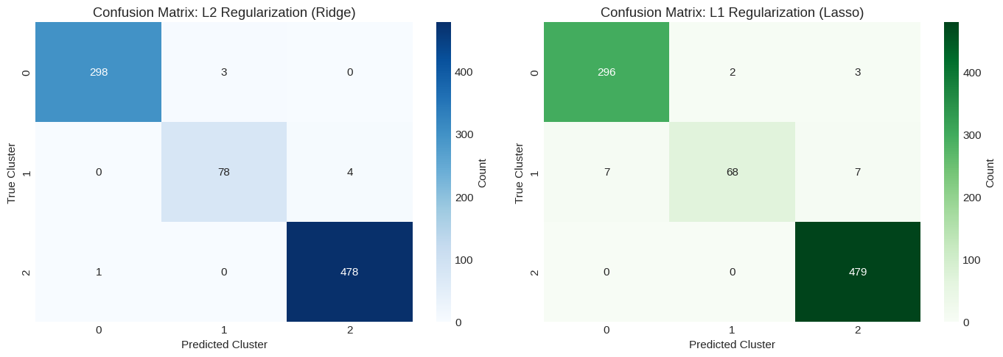
Validation Confusion Matrices
Validation Insight
Near-perfect classification: High accuracy across both L1 and L2 matrices confirms the presence of clear, distinct customer segment boundaries.
The L2 (Ridge) and L1 (Lasso) metrics refer to the performance of the Multinomial Logistic Regression models used to test the clarity and stability of the discovered customer segments.

Slide 23
Regularization Insights: L1 vs. L2
L2 Regularization (Ridge)
Retains all features with smooth, non-zero coefficients.
Performance: Superior predictive accuracy when all features are relevant.
Magnitude: Coefficients are comparable in size.
Trade-off: Less interpretable; harder to isolate specific key drivers.
CV Results (Accuracy)
0.9956 ± 0.0013
L1 Regularization (Lasso)
Automatic feature selection via zero-valued coefficients.
Sparsity: Retains only the most impactful predictive features.
Clarity: Highly interpretable identification of behavioral drivers.
Trade-off: May sacrifice slight accuracy for model simplicity.
CV Results (Accuracy)
0.9765 ± 0.0043
Key Implication
High Predictability = Stable Segments: The exceptional cross-validation performance (97%+ accuracy) across both techniques confirms that customer clusters are statistically distinct and well-separated behaviors, not random artifacts.
Robustness confirmed via 5-fold cross-validation, ensuring stability across all key metrics (Precision, Recall, and F1-score).
Conclusion: L2 provides the baseline for max performance, while L1 confirms the importance of a select few behavioral features.

Slide 24
Summary: From Raw Data to Segments
Strategic Overview: A 5-step rigorous statistical learning process ensuring data integrity and meaningful behavioral feature extraction.
1. Data Loading & Discovery
Purpose: Understand structure & quality.
Inspected types & missing values.
Findings: Identified negative quantities & unit price errors.
2. Cleaning & Preprocessing
Purpose: Create a reliable dataset.
Removed duplicates & missing IDs.
Filtered outliers via IQR method.
Justified focus on valid purchases.
3. Feature Engineering
Purpose: Capture behavior metrics.
Calculated RFM (Recency, Frequency, Monetary).
Derived LTV & Product Diversity.
4. Exploratory Data Analysis (EDA)
Purpose: Insight into feature distributions & relationships.
Visualized skewness via histograms & box plots.
Correlation matrix confirmed feature relationships.
Findings: High right-skewness justified the need for transformations and dimensionality reduction.
5. Data Scaling & Transformation
Purpose: Prepare for distance-based clustering.
Log Transformation: Applied np.log1p to stabilize variance and reduce impact of outliers.
Standardization: Scaled features to mean 0, std 1 using StandardScaler.
Ensures equal weighting in similarity calculations.
Methodological Verdict: The combination of log-scaling and standardization creates a robust foundation for K-Means, ensuring that high-magnitude variables do not bias the resulting customer segments.
Conclusion: Strict adherence to these preprocessing steps ensures the final clusters represent genuine behavioral patterns rather than data noise.

Slide 25
Summary: Dimensionality & Cluster Validation
Strategic Overview: Translating high-dimensional behavior into validated, actionable business segments using PCA and ensemble clustering.
6. PCA & Reduction
Purpose: Reduce noise & decorrelate features.
4 components captured 98% variance.
Created Scree plots & Loading analysis.
Isolated key behavioral contributors.
7. Clustering Algorithms
Purpose: Identify natural groupings.
K-Means: Optimal k=3 (Elbow/Silhouette).
Hierarchical: Ward linkage dendrograms.
DBSCAN: Density-based noise detection.
8. Evaluation Metrics
Purpose: Objective algorithm comparison.
Silhouette Score: High cluster separation.
Davies-Bouldin Index: Minimized distance.
Calinski-Harabasz: Variance ratio optimization.
9. Profiling & Interpretation
Purpose: Translate statistics to business personas.
Aggregated unscaled RFM means per cluster.
Radar charts/Box plots for segment differentiation.
Logic-based naming: 'Champions', 'At-Risk VIPs'.
10. Supervised Validation
Purpose: Validate cluster stability.
Trained Logistic Regression (L1/L2) on labels.
95%+ Prediction Accuracy on 80/20 split.
Confirmed segments are stable & well-defined.
Methodological Verdict: The consistency between unsupervised groupings and supervised prediction accuracy confirms that the segments are not random artifacts, but robust behavioral phenotypes.
Conclusion: Applying rigorous validation metrics ensures that marketing strategies are based on statistically significant and stable customer behaviors.

Slide 26
Executive Summary: Customer Segmentation Analysis
Dataset: Online Retail (2010-12-01 to 2011-12-09) | Transactions: 358,580 | Customers Profiled: 4,306
Methodology: K-Means (k=3) on PCA-reduced features (97.9% variance) | Silhouette Score: 0.404
LOST CUSTOMERS
Size: 1,504 (34.9%)
REVENUE CONTRIBUTION
£408,699 (5.3%)
Avg LTV: £272
Recency: 156 days
Frequency: 22 txn
AT-RISK VIPs
Size: 408 (9.5%)
REVENUE CONTRIBUTION
£1,676,014 (21.9%)
Avg LTV: £4,108
Recency: 110 days
Frequency: 18 txn
CHAMPIONS
Size: 2,394 (55.6%)
REVENUE CONTRIBUTION
£5,560,111 (72.7%)
Avg LTV: £2,323
Recency: 50 days
Frequency: 133 txn
Supervised Learning Validation Verdict: Statistically Valid
The clusters were validated using supervised models with high accuracy (L2 Ridge: 0.9907 | L1 Lasso: 0.9780). This confirms that the segments are highly predictable and represent distinct, stable behavioral patterns rather than random noise.
Conclusion: The analysis identifies a clear hierarchy of customer value, with Champions driving over 70% of revenue. High validation scores ensure these segments are robust for targeted marketing strategies.

Slide 27
Business Insights & Strategic Recommendations
Strategic Overview: Analysis of four distinct customer segments identifying unique business opportunities and targeted growth levers.
1. Champions
Priority: Retention & Deepening Engagement
RECOMMENDED ACTIONS
VIP programs & exclusive offers
High-touch personalized service
2. Loyal Customers
Priority: Retention & Growth in Txn Value
RECOMMENDED ACTIONS
Loyalty rewards & community engagement
Strategic upsell campaigns
3. At-Risk VIPs
Priority: Reactivation & Churn Prevention
RECOMMENDED ACTIONS
Targeted win-back campaigns
Personalized outreach & needs analysis
4. New/Promising
Priority: Conversion & Frequency Increase
RECOMMENDED ACTIONS
Structured onboarding & product discovery
Frequency-based incentives
Key Findings Summary
The segmentation highlights a clear path from acquisition to advocacy. Success hinges on preventing high-value churn while systematically moving 'New' customers into 'Loyal' and 'Champion' brackets.
Conclusion: Data-driven targeting across these segments will optimize marketing spend and maximize long-term customer lifetime value.

Slide 28

Q & A
Thank You!
Questions are welcome.

