Slide 1
Web Page Search Centre, Application and Data Flow
Date :- 15/12/2018
Version :- 1.0

Slide 2
Project Web Page Search Centre Contents
Web Page Search Centre -> Application Flow
Web Page Search Centre -> Data Flow (Data transformation and loading flow)

Slide 3
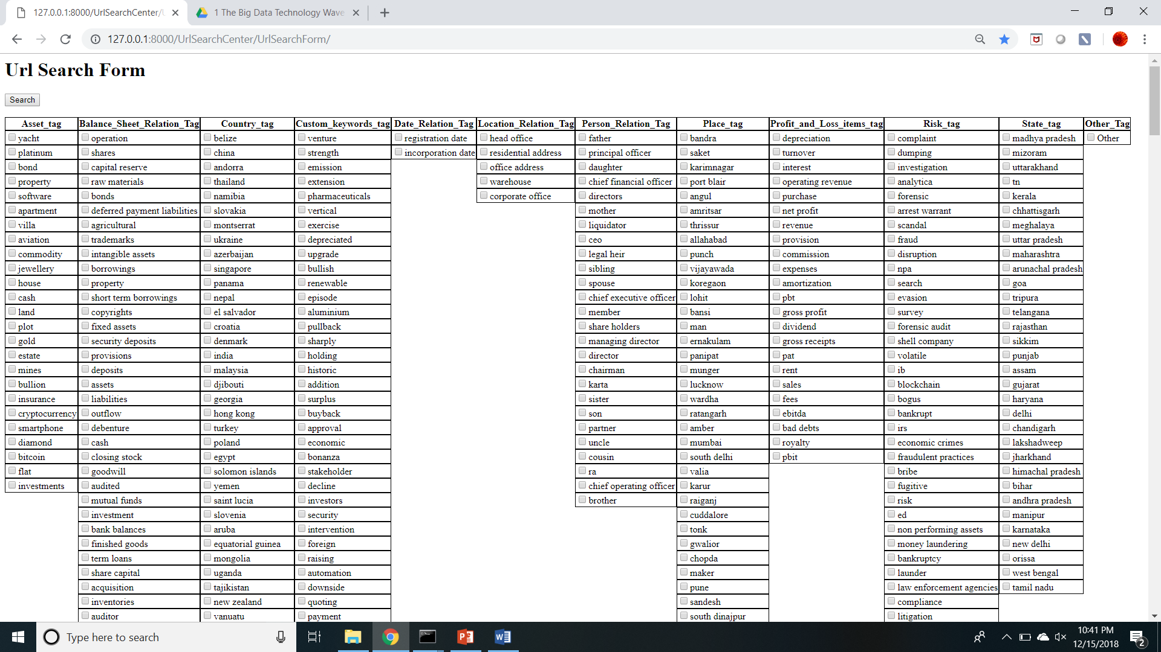
Web Pages Search Centre -> Application Flow
Step 1 :- Open Web Pages Search Centre Application URL. Below Search form will appear.

Slide 4

Web Pages Search Centre -> Application Flow
Step 2 :- Select Tag cash under Asset_tag.

Slide 5

Web Pages Search Centre -> Application Flow
Step 3 :- Select Tag singapore under Country_tag.

Slide 6

Web Pages Search Centre -> Application Flow
Step 4 :- Select Tag addition under Custom_keywords_tag.

Slide 7

Web Pages Search Centre -> Application Flow
Step 5 :- Select gross profit Tag under Profit_and_Loss_items_tag.

Slide 8

Web Pages Search Centre -> Application Flow
Step 6 :- Select scandal and volatile Tags under Risk_tag and click Search button at top left corner.

Slide 9
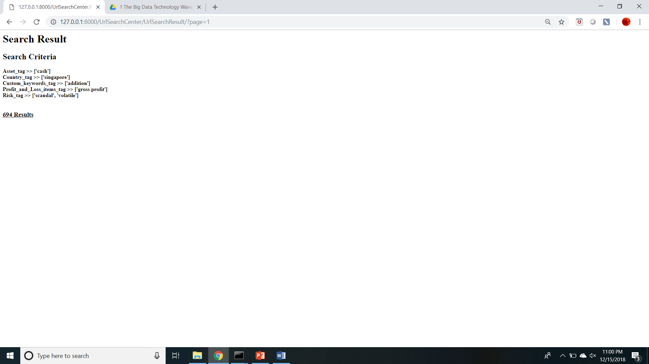
Web Pages Search Centre -> Application Flow
Step 7 :- After clicking Search button in step 6, user will be navigated to below Search Result page.
In this Page following information will be displayed.
Search Criteria :- It will tell what search criteria was selected by user in previous search form page.
Number of Results Link :- this link will show total number of results found based on search criteria and on clicking this link, list of source link search results along with short description will appear across different pages.

Slide 10
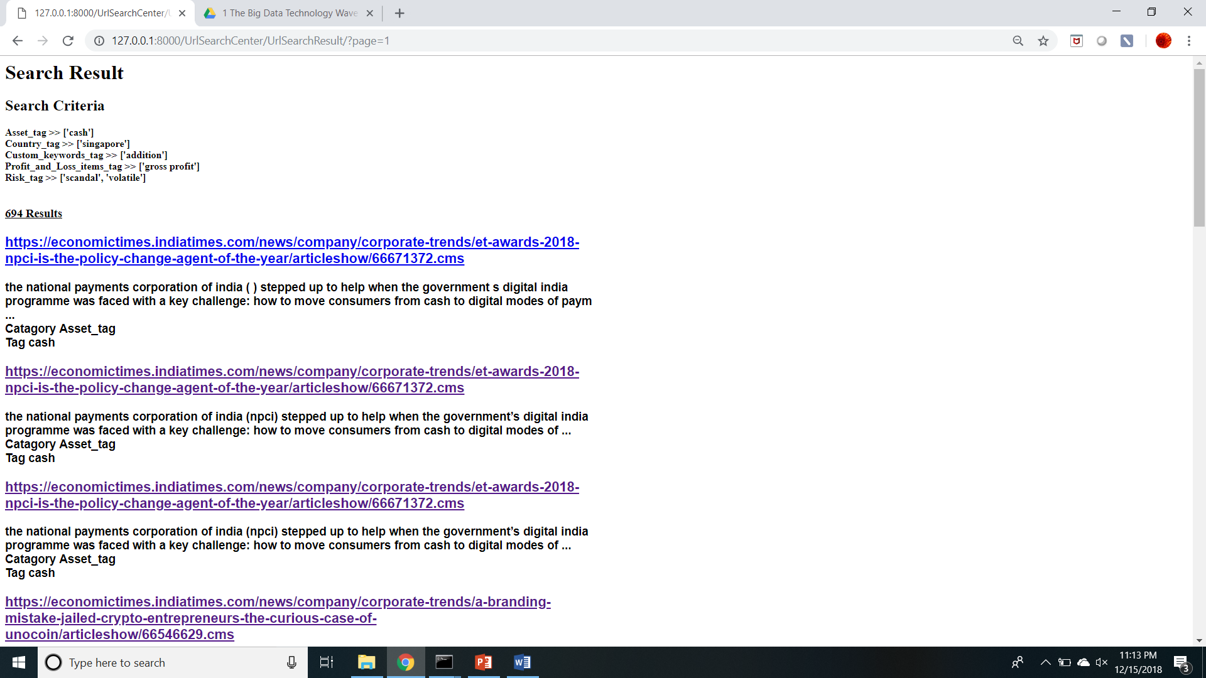
Web Pages Search Centre -> Application Flow
Step 8 :- Click on Number of Results link present in step 7, User will get the list of all the source_links search results along with short description.

Slide 11
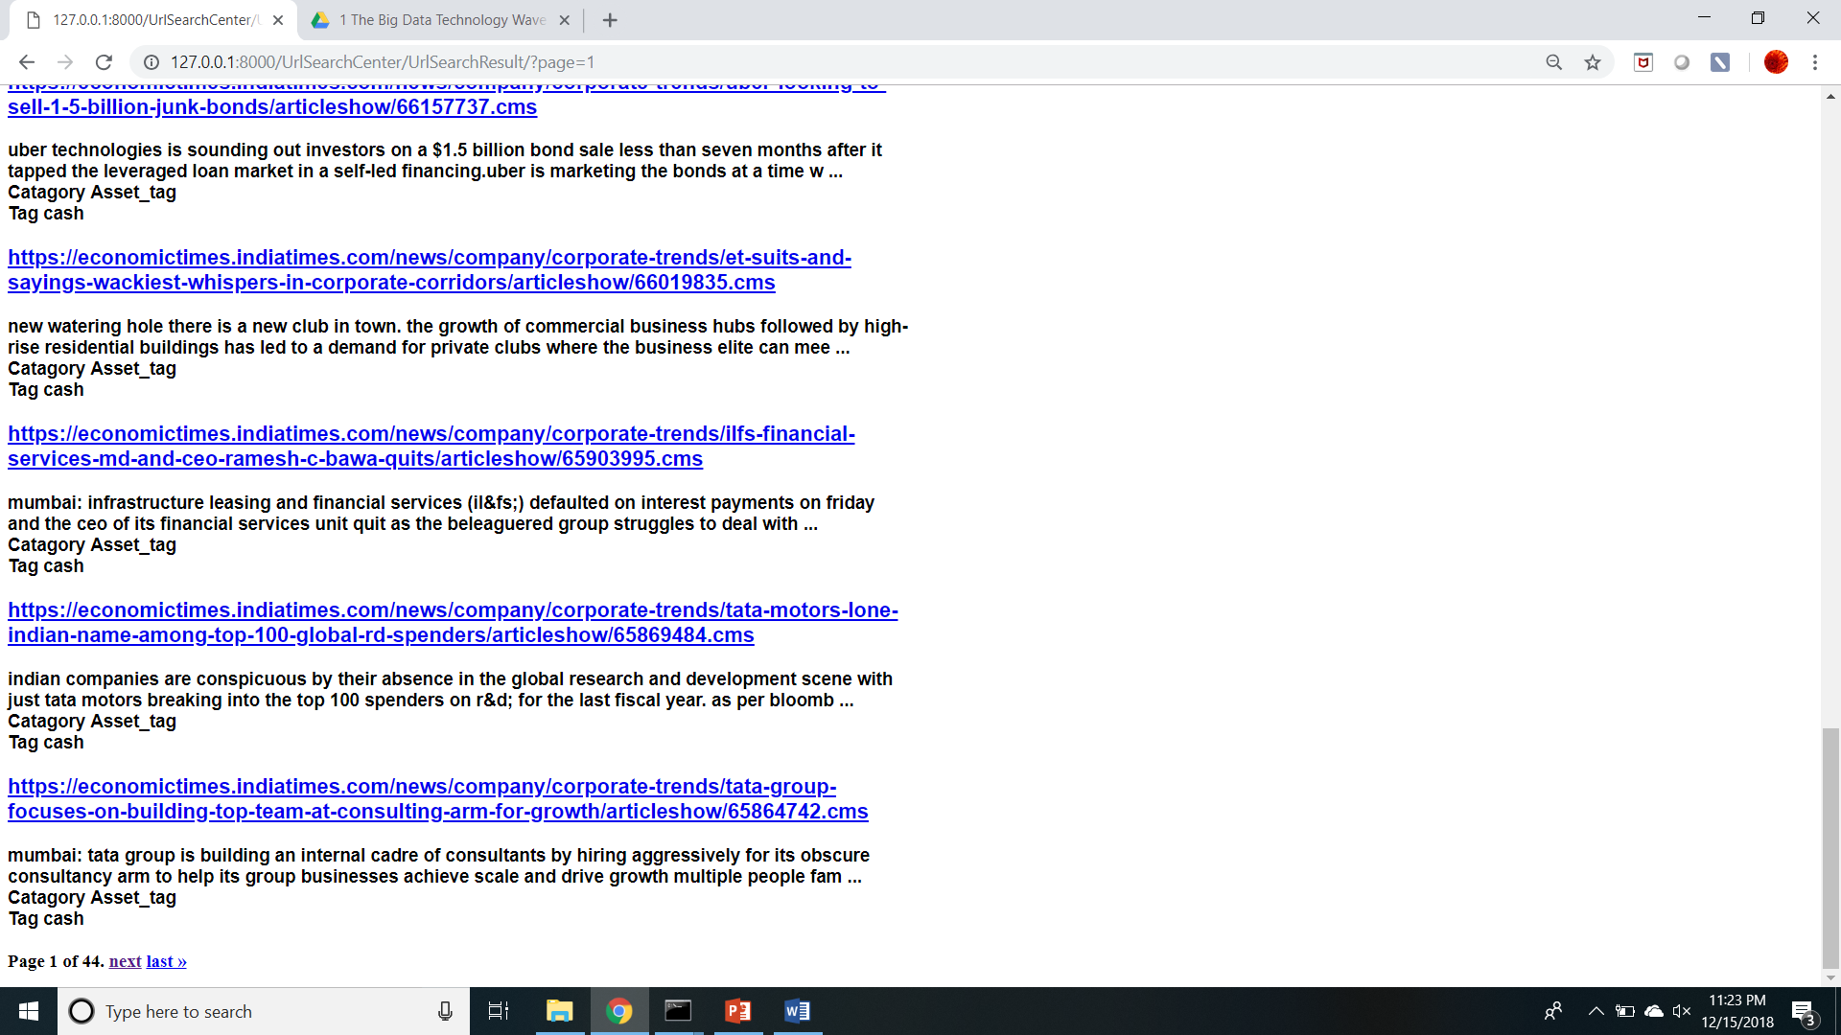
Web Pages Search Centre -> Application Flow
Step 9 :- Scroll to the bottom of page, User will be able to see page info and page navigation links (next, last ) at the bottom of page and will be able to navigate to next or last page using those links.

Slide 12
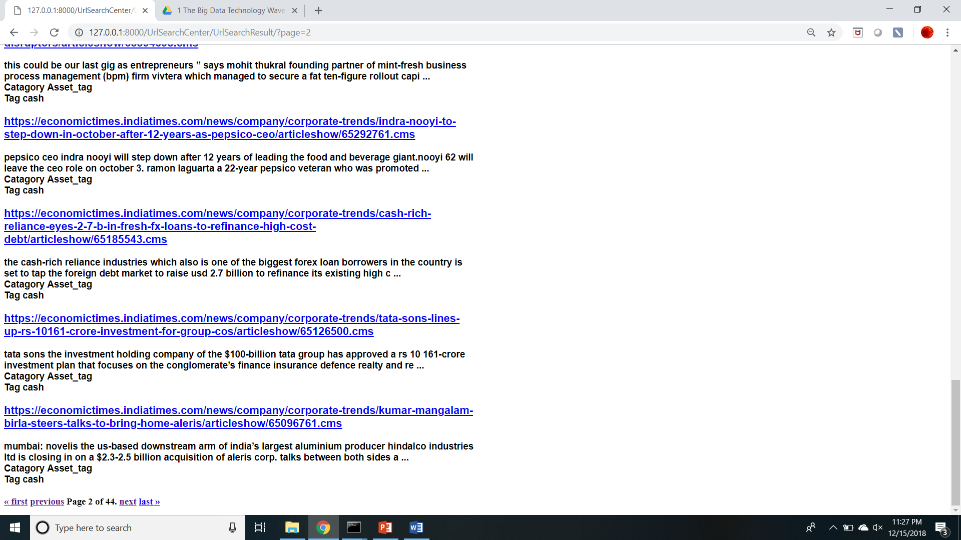
Web Pages Search Centre -> Application Flow
Step 10 :- Click on next page navigation link at the bottom of page, User will be navigated to next page containing search results in next page and page navigation links (first, previous, next, last) and updated page info at the bottom of next page.

Slide 13
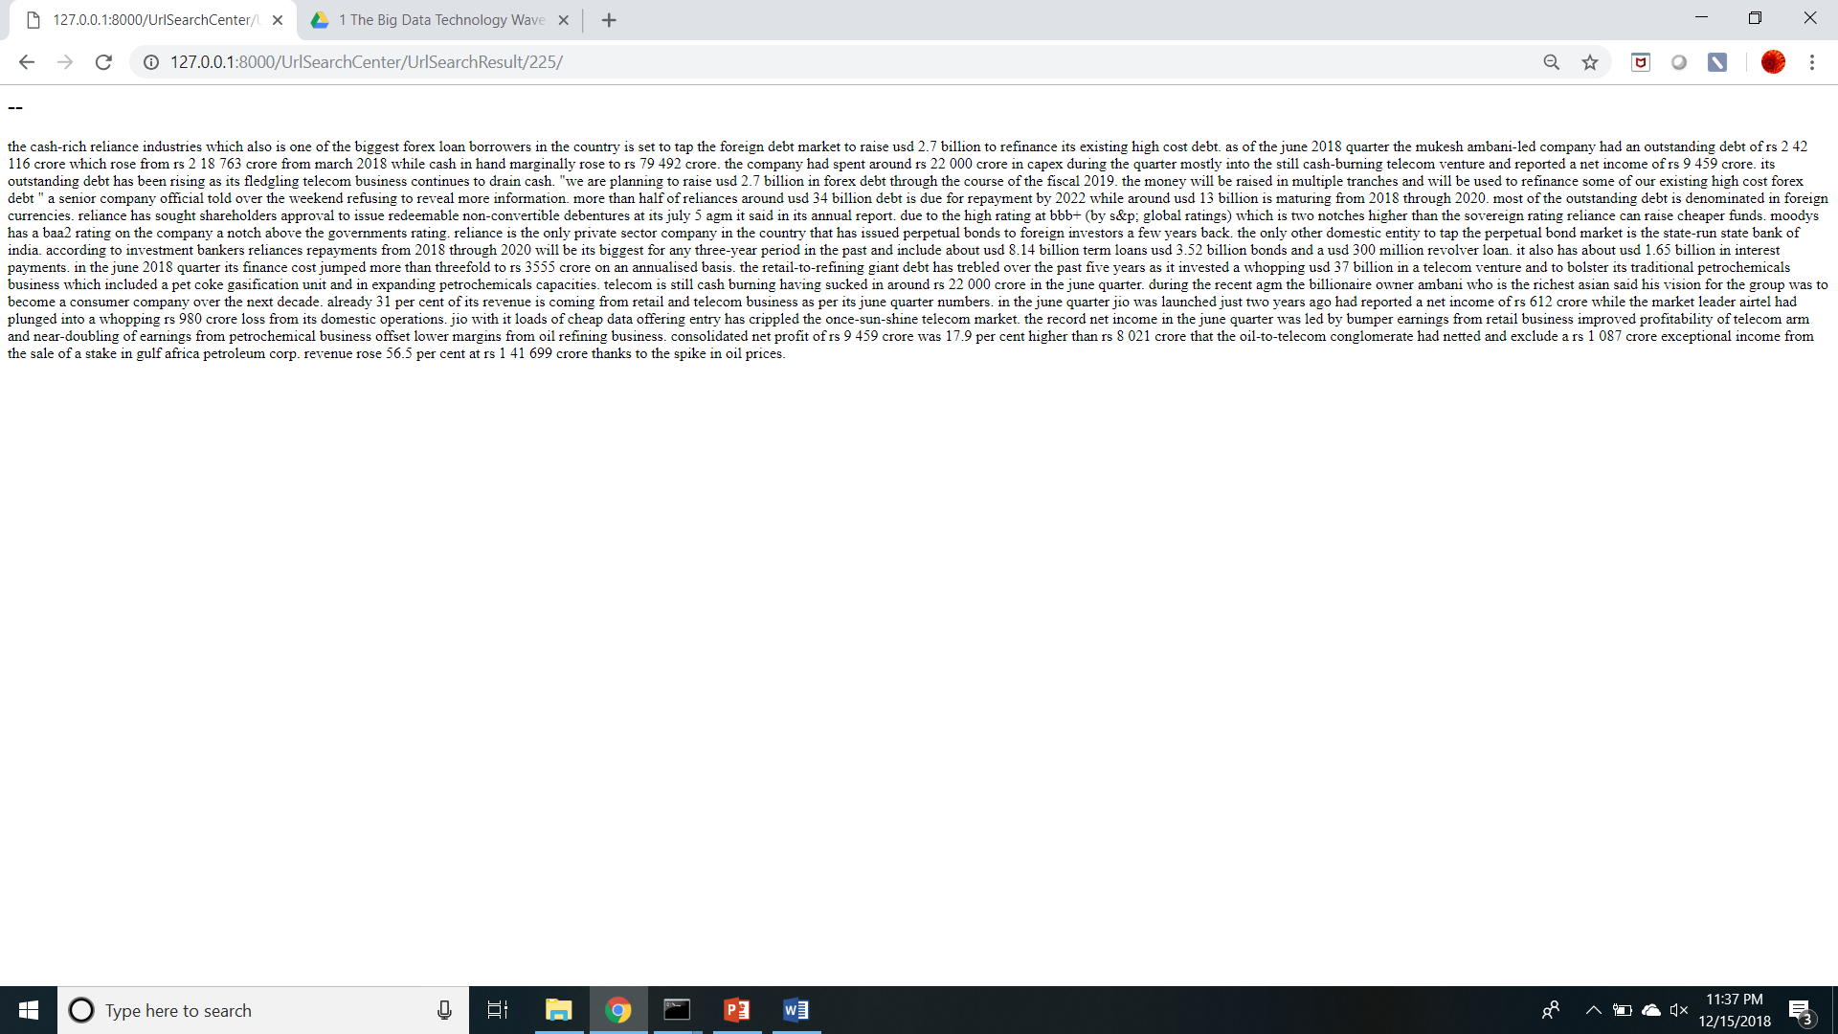
Web Pages Search Centre -> Application Flow
Step 11 :- Click on 3rd Search Result from the bottom of page, User will be navigated to web page corresponding to that Search Result.

Slide 14


Web Page Search Centre -> Data Flow (Data transformation and loading flow)
Transformation
Tagging data csv file is transformed into new csv file which can be utilized by an Web Page Search Centre application. This process is done using python programming.
Hadoop File System
The transformed csv file is placed into Hadoop file system by executing Hadoop specific commands from CLI.
Hive Database
An empty table is created in Hive by executing commands from Hive shell
finally Data from Hadoop file system is loaded into Hive table by executing commands from Hive shell.
Tagging data csv file.
Hive table containing data from Tagging data csv file.

