Slide 1
Time Trends Findings
Presentation 1
Julia, Sophia, and Varun

Slide 2
Recommendations
1a. Adjust website prompts to reduce calls at peak opening times and encourage calling later in the week
1b. Implement a system to record call success for analysis and improvement
2. Increase agent engagement to minimize customer departures when call volume is low.
3. Align staffing with seasonal demand can help legal aid serve more clients without raising costs

Slide 3
Call volumes peak in the morning, as well as towards the beginning of the week
Peak call time is typically between 8am - 10am depending on flow, EP, termination reason, duration, outcome etc.
Difficult to see when callers have time/want to call, since they are encouraged to call first thing in the morning
Call volumes tend to be higher at the beginning of the week compared to the end of the week
Afternoon calls are shorter and less active: average duration drops to ~5 minutes, with fewer menus/actions per call
Suggests lower engagement or effectiveness compared to mornings, but current data doesn’t clearly indicate impact on call quality or success
Recommendation 1

Slide 4
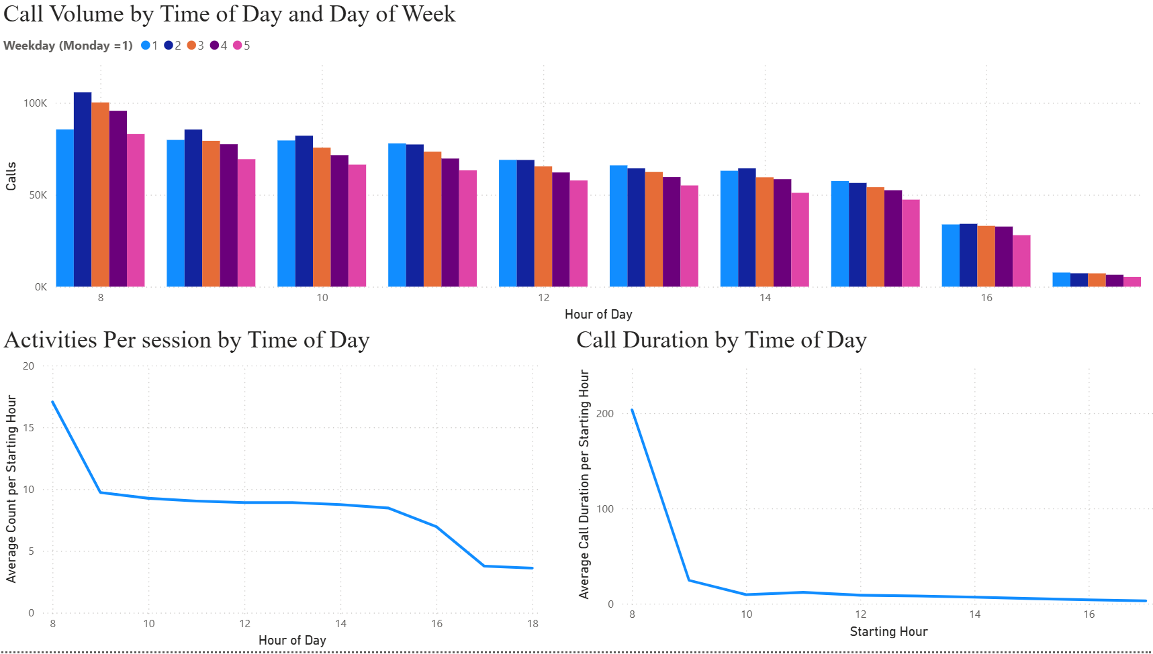
Call volumes, activities per call, and durations tend to be higher in the morning and lower in the afternoon
Recommendation 1

Slide 5
Instructing users to call at 8 a.m. may overwhelm system and diminish service quality
There is currently a note on the website which encourages people to call at 8am
Revise website messaging to distribute call volume more evenly throughout the week.
Remove prompts that encourage users to call immediately when phone lines open, and instead trial messaging that highlights Thursday and Friday as optimal times to reach support
May not be the perfect solution (exploring more options in next steps)
Develop a system to track and categorize call outcomes and resolution success.
This data will enable deeper analysis of call effectiveness, help identify when and why shorter calls are less successful, and guide future staffing and training decisions.
Recommendation 1

Slide 6
Note about Callbacks
Total number of callbacks was 72,426 and out of these, 44 were terminated because of the customer not answering.
Termination reason is only taken into account for calls post March 16, 2025 so I will be focusing on this group (11,916)
Beneficial because it gives us insight as to why these callbacks are not being completed.
Still, 44 customers is not enough to make my previous recommendation actionable so I looked into termination reasons that were of larger proportions of the data.

Slide 7
Customer leave rates remain steady despite lower call volume and consistent staffing.
Call volume declines after peak morning hours, but customer abandonment remains steady.
This suggests that agent availability is not translating into improved customer retention.
With the same number of agents handling fewer calls, we would expect fewer customers to leave.
The lack of decrease may indicate inefficiencies in how agents are being utilized during low-demand periods.
Recommendation 2
Notes:
Main point: Customers are less likely to pick up when called during certain business hours
Agents that answer customer calls back during peak work hours = less likely to be answered
maybe bc start of workday or after lunch / meeting times
customers are calling during short breaks or between tasks, making them less willing to wait on hold
Pick up rates improve later in the day so customers might be more responsive in afternoon (after 2pm)
Pattern could be due to underlying operational factors
Like agents might be picking up fewer customer calls later in the day instead of more customers picking up later in the day

Slide 8
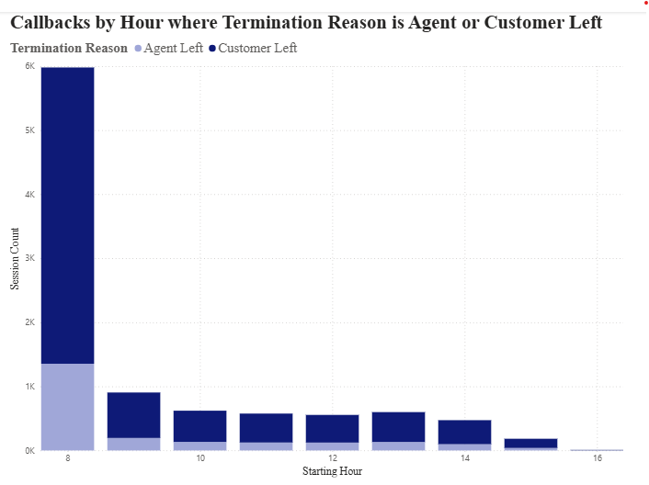
The agent-to-customer leave ratio remains consistent.
Recommendation 2
Notes:
Big picture: customer no-answer rate decreases after 9AM and 1PM
graph has starting hour on x-axis, limited from 8AM to 5PM so during business hours
Session counts on y-axis represents the number of calls where the termination reason for the call is “No Answer from Customer”
assuming this means that the agent answered the customer back and the call was not answered
significant drop towards the end of the day, after 2PM, lowest at 5PM

Slide 9
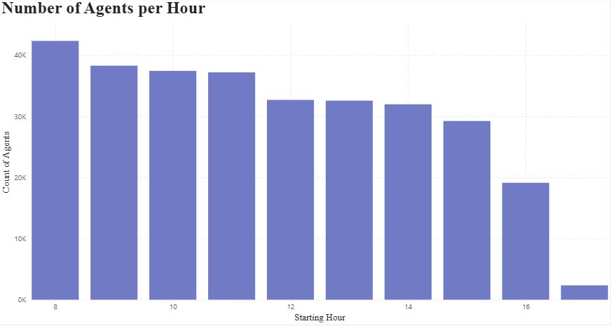
While the number of agents per hour remains consistent.
Recommendation 2
Notes:
The ratio of agents leaving to customers leaving remains stable, even as call volume declines and staffing levels stay constant.
This indicates that consistent staffing is not translating into improved customer retention when demand is lower.

Slide 10
Improve agent responsiveness to prevent customer drop-offs during low call volume.
Reinforce performance expectations and engagement strategies to maintain responsiveness.
Reinforce accountability by setting clear performance expectations for engagement during low-volume periods.
Could take form as minimum response times or target answer rates.
Offer performance feedback or quick refreshers to agents who show slower response patterns during off-peak hours.
Recommendation 2
Notes:
Recommendation: focus agent efforts on early morning and early afternoon where customers are less responsive
High rates of no answer from customers indicates call attempts are high as well + we know from cynthia telling us in class that most calls come at the beginning of the day
I recommend focusing efforts there but also at 1pm - 2pm
Allow for leaner coverage in late morning and late afternoon where pickup likelihood is naturally higher
assuming if people are waiting that long and still pick up, these are possibly some more dedicated customers so assuming the response rate won’t change in these time areas
Addressing the critical windows where there are high rates of customers not answering helps ensure that calls are answered more quickly.

Slide 11
Understanding Call Spikes Is Key to Doing More with Less
Legal aid already operates on thin budgets, and shifting policies and a volatile economy make grants and donations unpredictable
Call volumes often exceed capacity—many people seeking help can’t get through or face long wait times
Demand likely does not rise evenly; it likely spikes at specific times—certain days, weeks, or policy moments see surges while others stay quiet
By understanding and anticipating these spikes, resources can be allocated when they’re needed most—helping the organization serve more clients without increasing costs
Recommendation 3

Slide 12
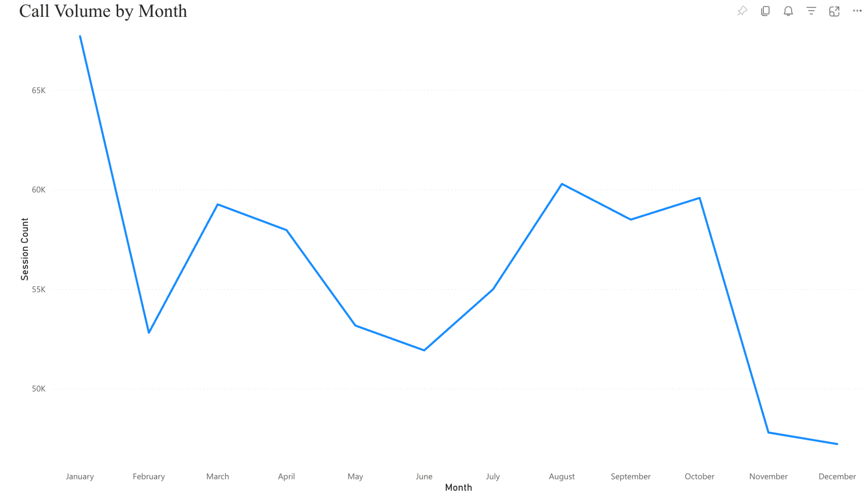
Call volumes spike in January, drop off in summer and December
Recommendation 3
Notes:
Big picture: call volumes spike late-spring into summer
graph has each month over the course of the last year on the x axis
Session counts on y-axis represents the number of calls
Steep rise in calls in April, slight drop in June/July when kids get out of school, summer starts, picks back up again in August, and then drops back down in September, before tapering off during the holidays

Slide 13
Smarter, seasonally aligned staffing can help legal aid meet demand without increasing costs
Adjust staffing to match seasonal demand:
Increase staff during new-year spikes using temporary hires or flexible schedules, and scale back during quieter summer and holiday periods.
Use AI and chatbots for routine calls:
Automate FAQs and triage during peak times so human staff can focus on complex cases.
Anticipate common issues before peak season:
Analyze frequent summer call topics to create self-help guides, FAQs, or short workshops that reduce call volume.
Recommendation 3

Slide 14
Next Steps
Explore some of the variability seen in peak call times and days by filtering (see appendix) and translate into recommendations.
Determine the best way to go about redistributing call times.
Drill down further to see if the call volume trend observed above is uniform across all menu types or if specific menu options follow unique trends and thus require different solutions/recommendations
Consider political trends.
Mapping trends onto past years to see if we can attribute increased volume to recent policy landscape.

Slide 15



New Metric Ideas
Potential Metric | What it Measures | Why it Matters
Time spent talking to agent | Within each call, how much time is spent actually talking to a person (agent) instead of going through menus or voicemails. | Can use this to determine the percent of a call that is spent talking to an agent vs. going through menus/voicemails (as a measure of call success) to plot against time or different user journeys.
Agent Performance | Measures how effectively customer service agents handle their responsibilities, including number of successful customer interactions. | High agent performance directly impacts operational efficiency. Monitoring this metric helps identify training needs and improve overall service quality and quantity.
Queue Wait Time | Measures the average amount of time a caller spends waiting in a queue before being connected to an agent. | Longer wait times indicate bottlenecks or staffing inefficiencies that directly impact customer satisfaction and overall system performance.

Slide 16
Appendix
Some interesting trends which we haven’t (yet) developed into findings/recommendations can be seen on the appendix page of the Power BI.

