Slide 1
Time Trends Findings
Presentation 1
Julia, Sophia, and Varun

Slide 2
Recommendations
1. Optimize the time windows during which customers are encouraged to call, based on observed trends
2. Avoid scheduling customer callbacks during low-response business hours to improve pickup rates
3. Align staffing with seasonal demand can help legal aid serve more clients without raising costs

Slide 3
Call volumes peak in the morning, as well as towards the beginning of the week
Peak call time is almost always 8am regardless of flow, EP, termination reason, duration, outcome etc.
Difficult to see when callers have time/want to call, since they are encouraged to call at 8am
A few exceptions → see Appendix
Call volumes tend to be higher at the beginning of the week compared to the end of the week
Making strategic changes to the timing of calls could allow agents to reach more people in need
Recommendation 1

Slide 4


Call volumes and activities per call tend to be higher in the morning, while call durations are lower
Recommendation 1

Slide 5
Instructing users to call at 8 a.m. overwhelms system and diminishes service quality
There is currently a note on the website which encourages people to call at 8am
Stop encouraging people to call immediately when the phones open, as the chaos may lead to a decline in quality of service
May not be the perfect solution (exploring more options in next steps)
Encourage people to call later in the week, so the phones aren’t flooded on Mondays
At least for a period of time, to see if the calls redistribute and ensure they don’t overload the end of the week
Recommendation 1

Slide 6
Customers are less likely to pick up when call is answered by agent during peak business hours.
Calls made during peak work hours (around 9Am and 1PM are less likely to be answered.
These times may coincide with the start of the workday or after lunch when customers are less available.
Pick up rates improve later in the day, suggesting customers are more responsive in the afternoon.
This pattern could possibly reflect operational factors.
Agents may be making fewer callback attempts later in the day, contributing to the observed trend (see next slide).
Recommendation 2

Slide 7
Customer no-answer rate decreases after 9 AM and 1 PM.
Recommendation 2

Slide 8
Focus agent efforts on early morning and early afternoon where customers are less responsive.
Schedule agent efforts toward lower response periods like 9AM - 10AM and 1PM - 2PM where call attempts are high but answer rates are low.
Allow for leaner coverage in the late morning and late afternoon when pick-up likelihood is naturally higher.
Addressing the critical windows where there are high rates of customers not answering helps ensure that calls are answered more quickly.
Recommendation 2

Slide 9
Understanding Call Spikes Is Key to Doing More with Less
Legal aid already operates on thin budgets, and shifting policies and a volatile economy make grants and donations unpredictable
Call volumes often exceed capacity—many people seeking help can’t get through or face long wait times
Demand likely does not rise evenly; it likely spikes at specific times—certain days, weeks, or policy moments see surges while others stay quiet
By understanding and anticipating these spikes, resources can be allocated when they’re needed most—helping the organization serve more clients without increasing costs
Recommendation 3

Slide 10
Call volumes spike from April to September
Recommendation 3

Slide 11
Smarter, seasonally aligned staffing can help legal aid meet demand without increasing costs
Since call volumes surge from April to September, increasing staffing during those months—through temporary hires, flexible scheduling, or part-time contracts—can ensure more callers receive timely help without overstaffing in quieter months
Lean more heavily on AI-powered agents or chatbots during the summer can handle routine inquiries, triage urgent cases, and free human staff to focus on complex legal issues
By analyzing common issues that drive summer call spikes, LegalAid can develop online self-help guides, FAQs, or pre-recorded workshops ahead of peak season, helping clients find answers before they call reduces the overall burden
Recommendation 3

Slide 12
Next Steps
Explore some of the variability seen in peak call times and days by filtering (see appendix) and translate into recommendations.
Determine the best way to go about redistributing call times.
Consider political trends.
Mapping trends onto past years to see if we can attribute increased volume to recent policy landscape.

Slide 13



New Metric Ideas
Potential Metric | What it Measures | Why it Matters
Time spent talking to agent | Within each call, how much time is spent actually talking to a person (agent) instead of going through menus or voicemails. | Can use this to determine the percent of a call that is spent talking to an agent vs. going through menus/voicemails (as a measure of call success) to plot against time or different user journeys.
Agent Performance | Measures how effectively customer service agents handle their responsibilities, including number of successful customer interactions. | High agent performance directly impacts operational efficiency. Monitoring this metric helps identify training needs and improve overall service quality and quantity.
Queue Wait Time | Measures the average amount of time a caller spends waiting in a queue before being connected to an agent. | Longer wait times indicate bottlenecks or staffing inefficiencies that directly impact customer satisfaction and overall system performance.

Slide 14
Appendix
Some interesting trends which we haven’t (yet) developed into findings/recommendations can be seen on the appendix page of the Power BI.
We also have slides with static versions of our visuals below in case the embedded Power BI has problems rendering during our presentation.

Slide 15
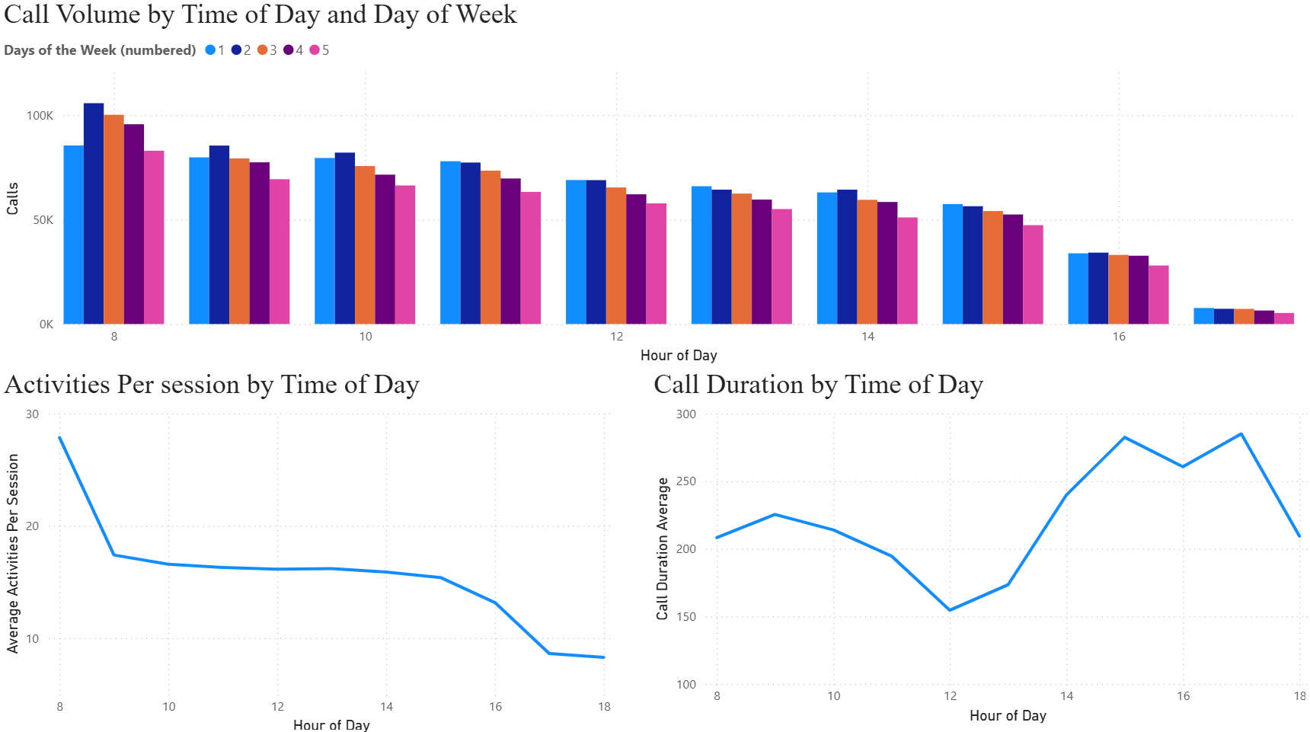
Call volumes and activities per call tend to be higher in the morning, while call durations are lower
Recommendation 1

Slide 16
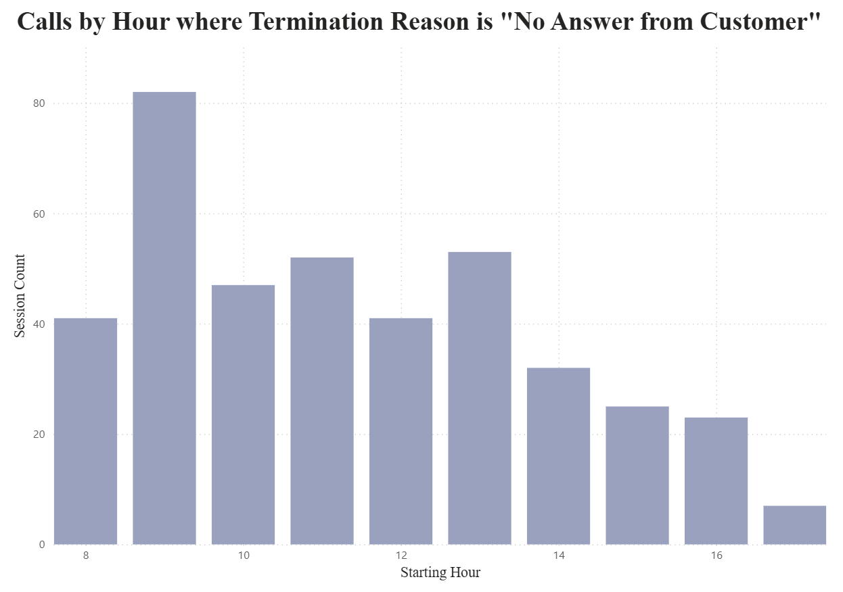
Customer no-answer rate decreases after 9 AM and 1 PM.
Recommendation 2

Slide 17
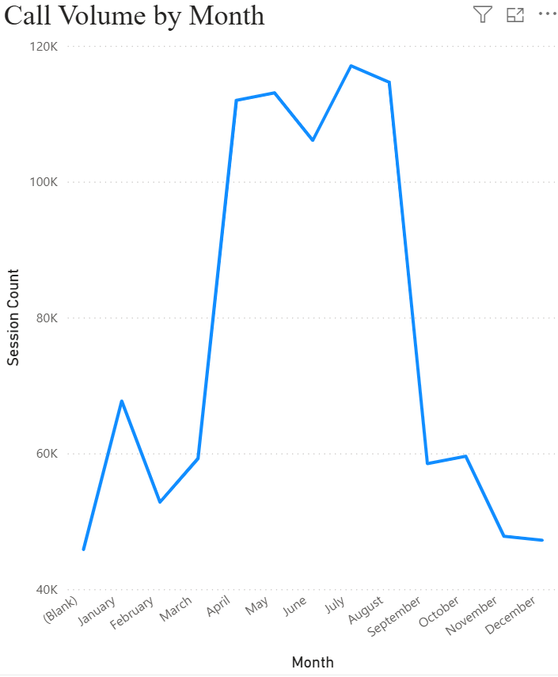
Call volumes spike from April to September
Recommendation 3

