Slide 1

STAT 390 • RESEARCH PROJECT
Presentation 1
Hierarchical Attention Multiple Instance Learning (MIL) Analysis

Slide 2
ANALYST
Dina, Maya, Haowen

Slide 3
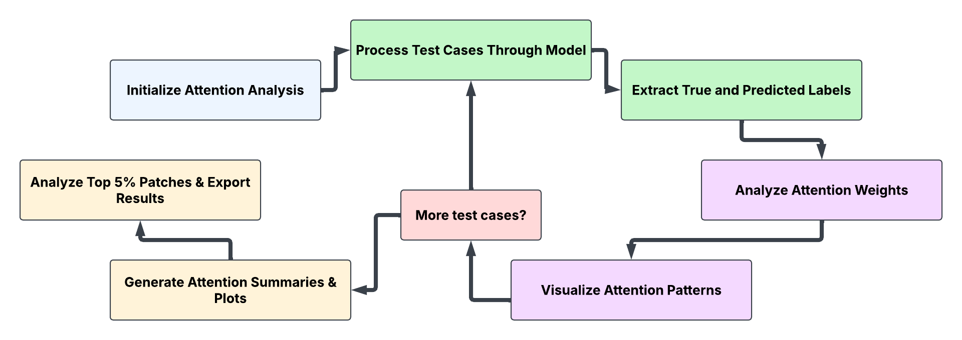
General Flowchart
Retrieve each case's prepared stain/slice data and run the model to obtain classification scores and attention weights
Set the Hierarchical Attention MIL model to evaluation mode, create output folders, and initialize result containers
Retrieve the actual diagnosis, determine the predicted diagnosis using model scores, and store both labels
Identify the top 5% highest-attention patches per case, analyze their distribution, and export CSV and text summaries
Yes
No
Identify the most attended stain and highest/lowest-attention slices; calculate effective attention for every patch
Save stain-level attention summaries and generate patch- and slice-level attention distribution plots for each case
Visualize high- and low-attention patches and collect slice-level attention records for the current case
Initialization
Inference & Classification
Analysis & Visualization
Decision
Output & Reporting

Slide 4
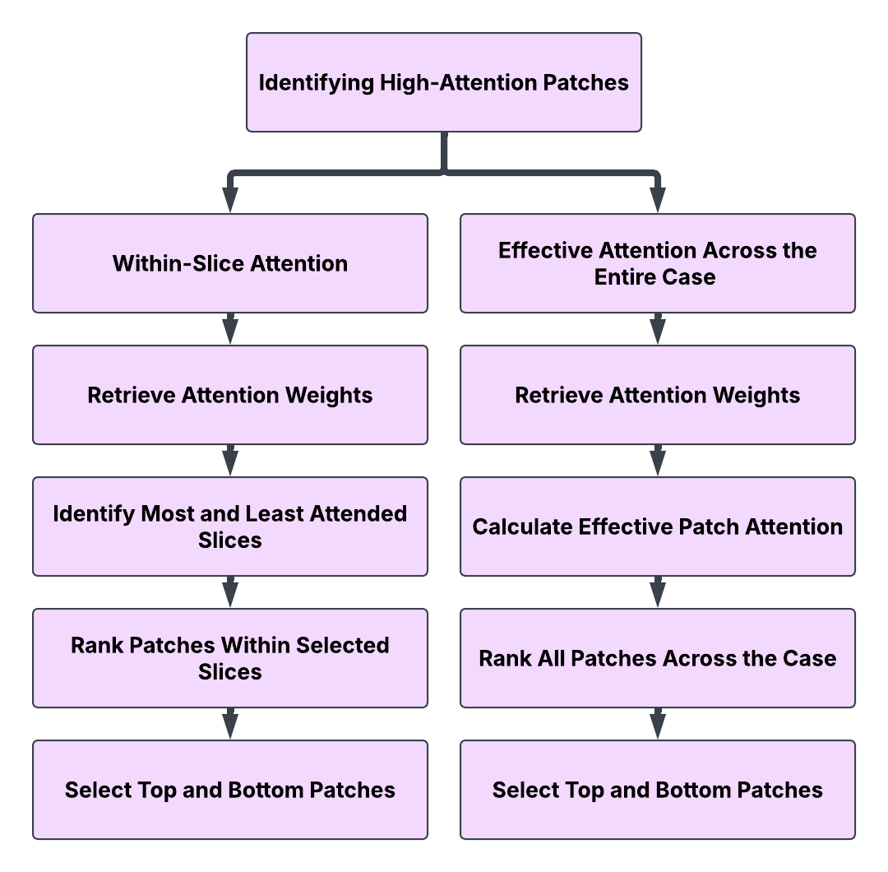
Analyze Attention Weights: Identifying High-Attention Patches
Obtain slice-level and patch-level attention weights for each stain from the MIL model
Obtain stain-level, slice-level, and patch-level attention weights from the MIL model
Use argmax() and argmin() to identify the slices with the highest and lowest attention weights within each stain
Multiply stain, slice, and patch attention weights to calculate each patch's overall attention
Sort patches by their individual attention weights within the selected slices
Sort all patches by their effective attention weights, regardless of stain or slice
Select the top 5 patches from the most attended slice and bottom 5 from the least attended slice of each stain
Select the 5 patches with the highest and lowest effective attention weights across the entire case

Slide 5
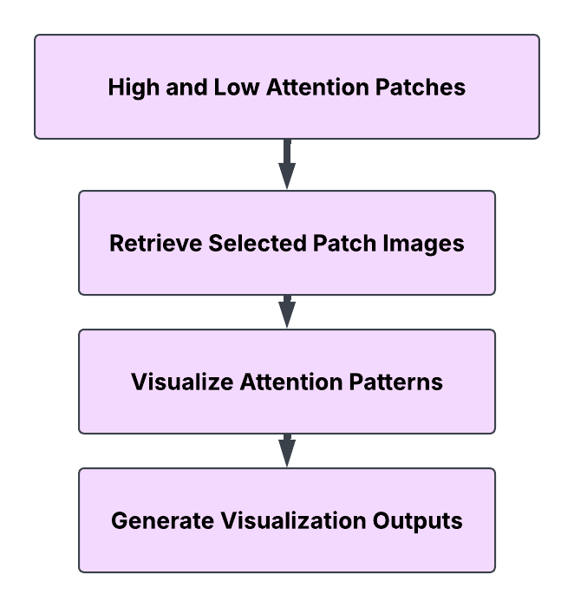
Visualize Attention Patterns
Use the selected patch indices to retrieve the corresponding image patches from their original slices
Display the high- and low-attention patches identified through within-slice and effective-attention analysis
Organize the selected patches and their attention information into visual outputs for interpretation

Slide 6
Patch position to image file
_lookup_png_for_patch
Build file index cached per case + stain (_build_pt_index_for_case_stain)
Glob .pt files
case_52_ and case_052_
_match_1_h&e_patch10.pt,
_match_1_melan_patch5.pt
Keep this stain only
_file_contains_stain
keeps _h&e_, drops _melan_
Group by slide ID
_parse_slice_id_from_filename
match_1, match_10, unmatched_2
Sort patches in each slice
_parse_patch_index_from_pt_filename
lookup: patch1, patch2, patch10, model: patch1, patch10, patch2
Sort the slice IDs
sorted()
match_1, match_10, match_2
Notes:
Overview: The previous coding steps essentially say “slice 0 patch 1 looks important” - this chart/process is how the code turns that counting into a filename. It rebuilds the sorted list of files and counts to the same position
Overarching function lookup_png: tries to find for what png image those numbers are associated with AFTER figuring out weights
Build pt index for case function: does 5 things in order to make ordered list of the case stain pair’s files
Glob .pt files: lists every patch file in the .pt folder whose name starts with this case’s id
_file_contains_stain: keeps only the files whose name contains the stain we’re looking at
_parse_slice_id_from_filename: groups those files into slices using the slice name in each filename (like match_1)
_parse_patch_index_from_pt_filename: sorts the patches inside each slice by the number after _patch in the filename
Sort the slice IDs: puts the slices in order, which becomes the order that slice_idx counts through
DIAGNOSIS OF INDEXING ISSUE:
In attention_analysis.py, _build_pt_index_for_case_stain rebuilds the file list for a case and stain. Inside it, there is a loop and lambda function that sorts each slice’s patch files by the integer after _patch, so the order is patch1, patch2, patch10, patch11
However, the model’s input in data_utils.py sorts the files by the full path as text, resulting in patch0, patch1, patch10, patch11, patch2
These inconsistencies come together in on the first step in the next slide (pt_path = files[patch_idx]) in which the position the model reported is read as that spot in the numeric list
EX: For a position like 2, the model meant patch10 and the lookup returns patch2.
Code References:
data_utils lines that sort alphabetically:
group_patches_by_slice: case_slices[k] = sorted(case_slices[k])
build_case_dict: stain_patches = sorted(stain_groups[stain])
_build_pt_index_from_pt_filename lines that sort numerically:
flist_sorted = sorted(
flist,
key=lambda x: (
_parse_patch_index_from_pt_filename(x) is None,
_parse_patch_index_from_pt_filename(x) or 10**18,
x,
),
)
For each file x it calls the lambda to get a key, a tuple of three values, and sorts by those keys. Tuples compare left to right: the first value decides the order, and the second matters only if the first values tie.
The three values are:
parse(x) is None is False if the filename has a patch number and True if not, so files without a number go last.
parse(x) or 10**18 is the patch number as a real integer. If there is no number it’s 10^18, a huge placeholder. (That or also turns a real 0 into 10^18, which is the patch0 quirk.)
x is the filename, used only to break ties.

Slide 7
Pick by position (in lookup)
slice_ids_sorted[slice_idx], files[patch_idx]
.pt name to .png path
_map_pt_to_png_path
PNG file exists?
os.path.exists
No
Fallback: index PNG folder
_build_png_index_for_case_stain
Yes
Return PNG path
Yes
File found?
slice and patch in range
No
Return None
Caller shows the result
PNG: tissue image, None: tensor heatmap
Notes:
Pick by position
Uses the model’s slice number to choose a slice from the sorted slice list, then its patch number to choose a file inside that slice, assuming the model counted in the same order. This is where the issue from the previous step shows up: the list being indexed was sorted numerically, but the model’s positions refer to a text-sorted list, so the wrong patch comes out.
_map_pt_to_png_path
Swaps .pt for .png in the chosen filename and points it at the image folder to get the picture’s path.
PNG exists?
If that PNG is on disk, it gets returned and the process is done.
Fallback (_build_png_index_for_case_stain)
If the PNG is missing or anything else failed, it repeats the same grouping, sorting, and position-picking directly on the PNG folder, and returns nothing if that fails too. It contains its own copy of the numeric patch sort, so it makes the same ordering mistake.
Show results
If a path comes back, the figure shows the tissue image, and if nothing comes back, it draws a heatmap of the raw numbers instead. With this bug the tissue image is real but is usually the wrong patch, so a normal-looking figure doesn’t prove the mapping is right.

Slide 8
Model Execution - Statistics
run_20261020_225948
18 Test Cases
94.4% Accuracy
11 correctly classified high-grade
6 correctly classified benign
0 incorrectly classified high-grade
1 incorrectly classified benign
Note: Use 8GB ram for splits and 32GB for running the model
https://github.com/arvindkrishna87/Team4_TheAnalysts/tree/main/Presentation1/Presentation1_base_code

Slide 9
Model Execution - Output
Case Level: Visualizes top 8 and bottom 8 patches across all stains and slices using effective attention weights
Slice Level: Visualizes the 8 highest-attention patches from the most important slice and the 8 lowest-attention patches from the least important slice for each stain
Stain Level: No dedicated top/bottom patch visualization across all slices within each stain
Additional Outputs:
  Effective Patch Attention Distribution: Histogram of effective attention weights across all patches within each case, highlighting concentration of attention
  Slice Attention Distribution by Stain: Ranked slice attention weights within each stain, showing which slices receive the most attention

Slide 10
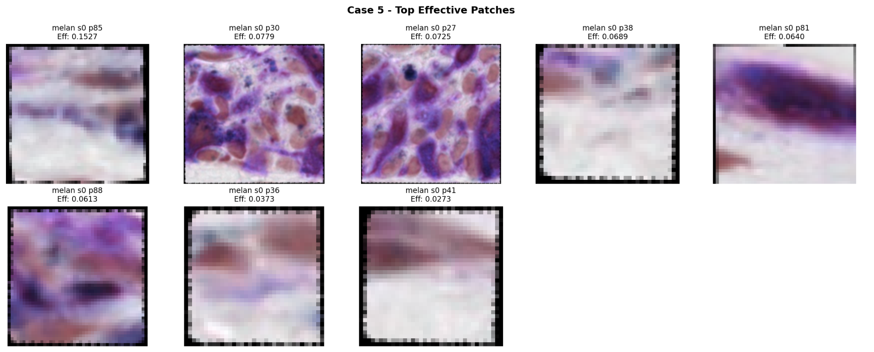
Case 5 - Correctly Classified High-Grade (Patch Level)

Slide 11
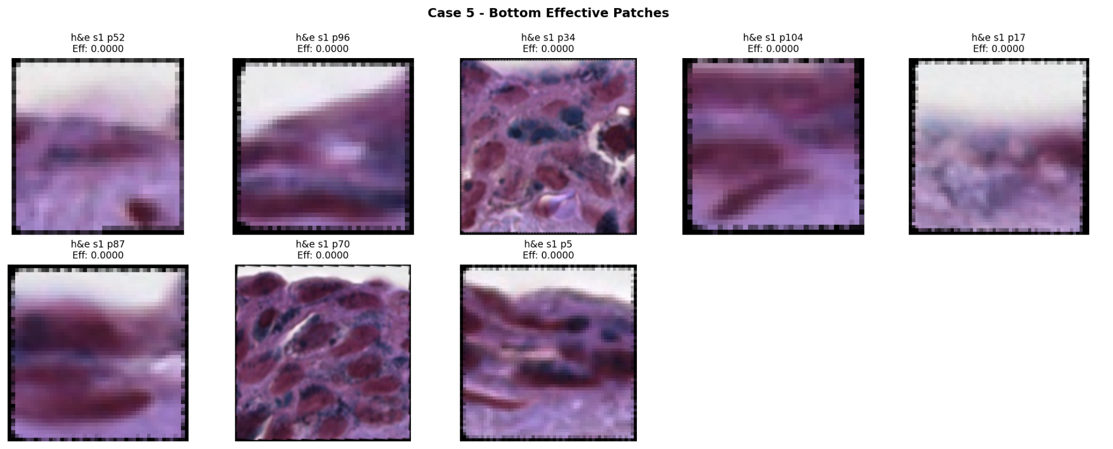
Case 5 - Correctly Classified High-Grade (Patch Level)

Slide 12
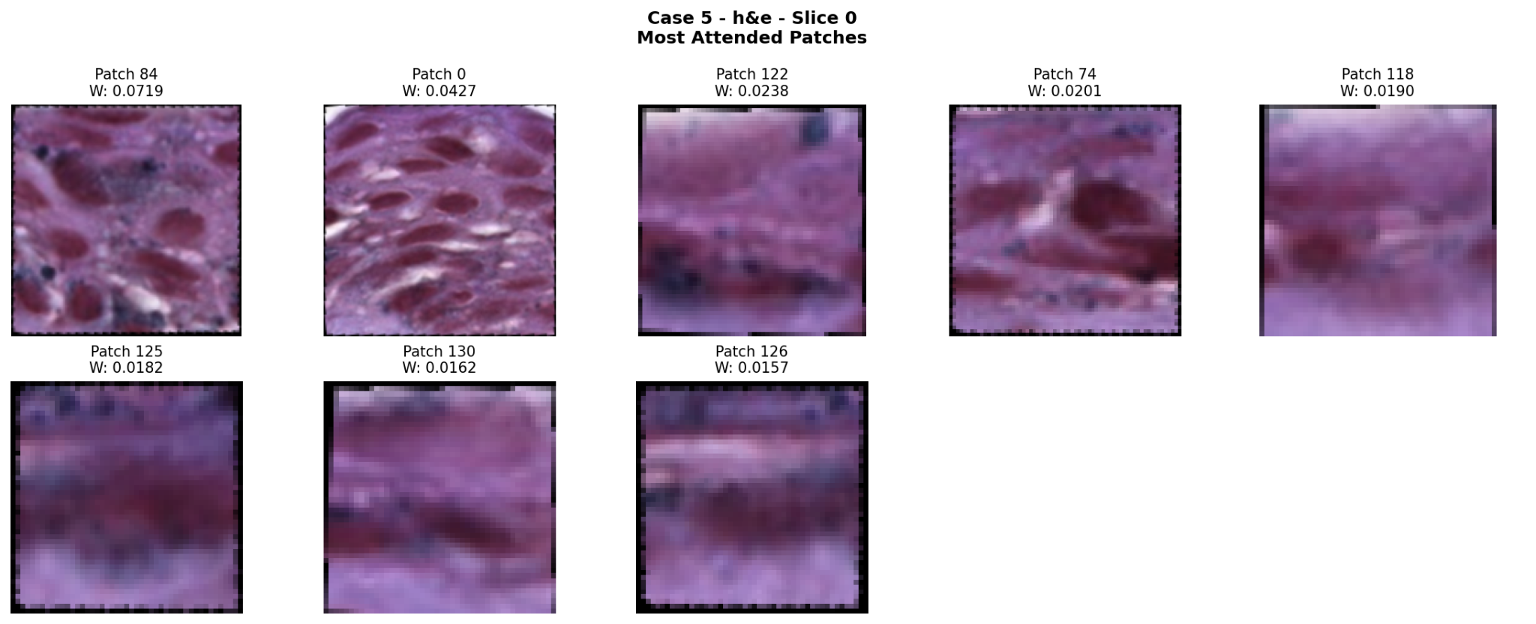
Case 5 - Correctly Classified High-Grade (Slice Level)

Slide 13
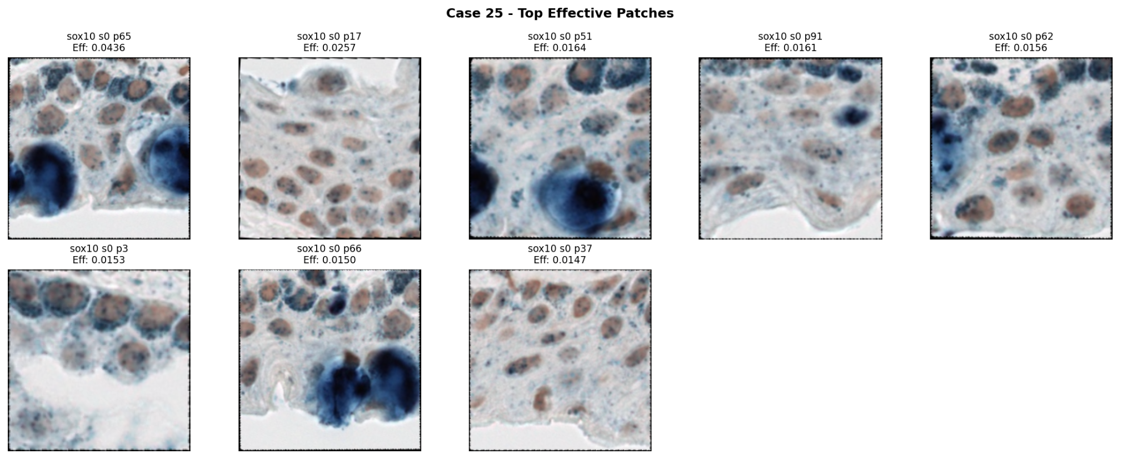
Case 25 - Correctly Classified Benign (Patch Level)

Slide 14
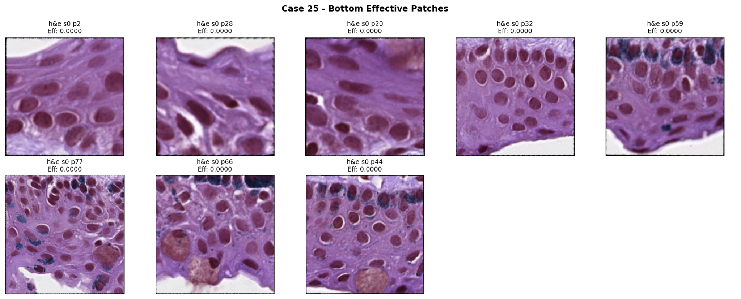
Case 25 - Correctly Classified Benign (Patch Level)

Slide 15
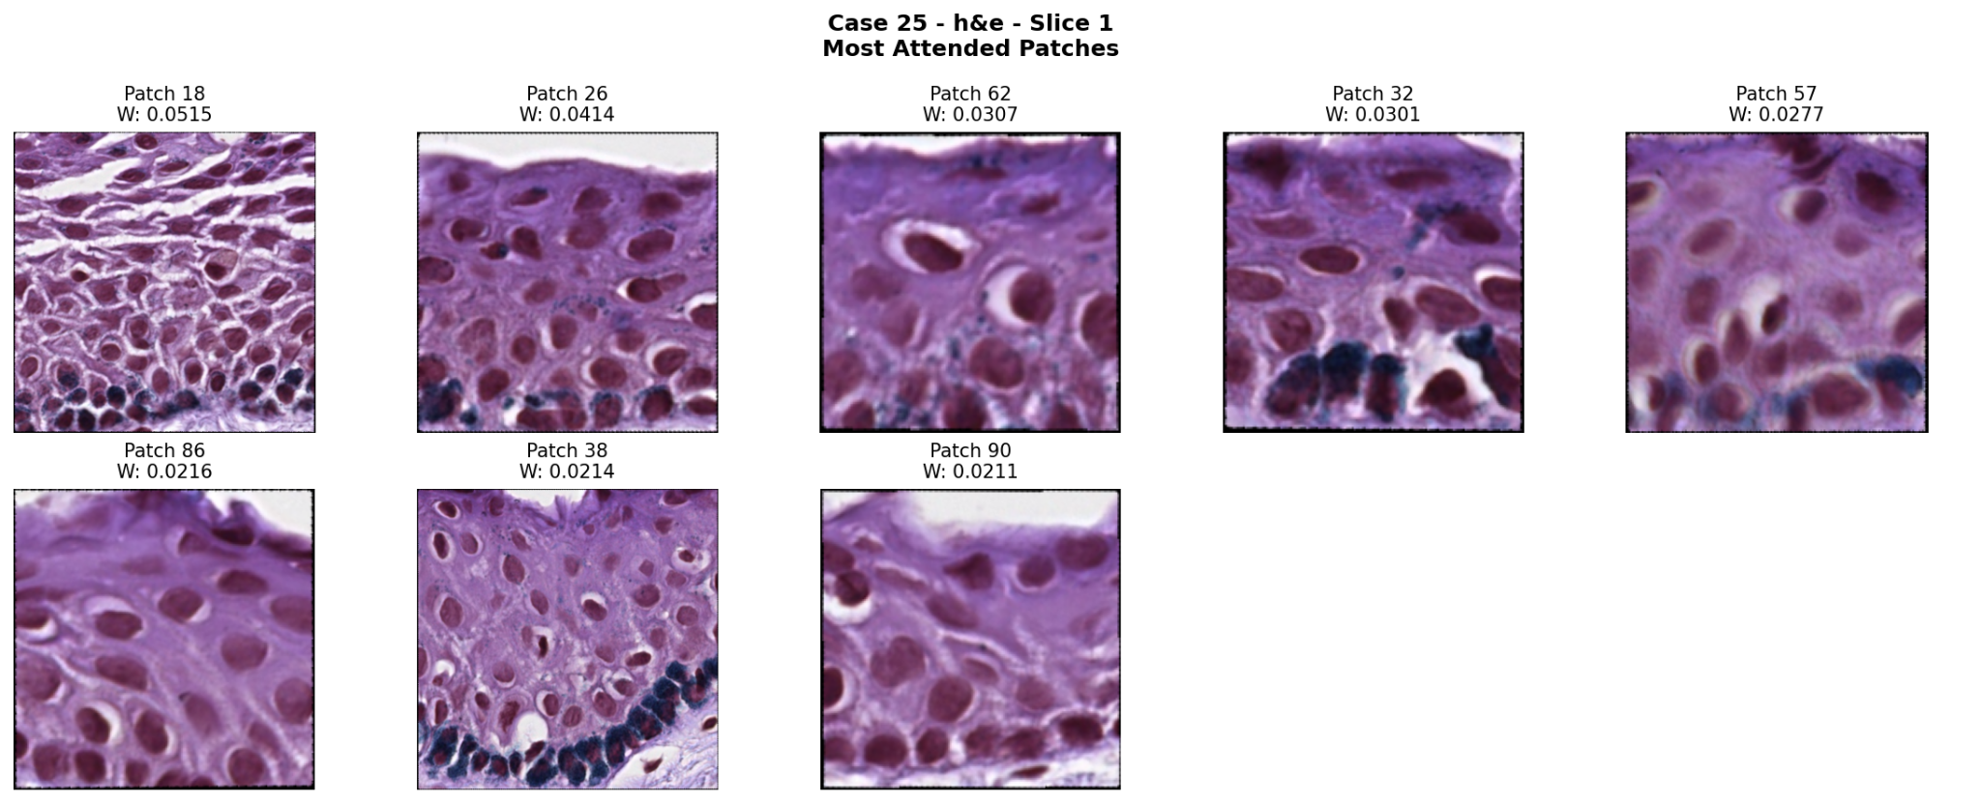
Case 25 - Correctly Classified Benign (Slice Level)

Slide 16
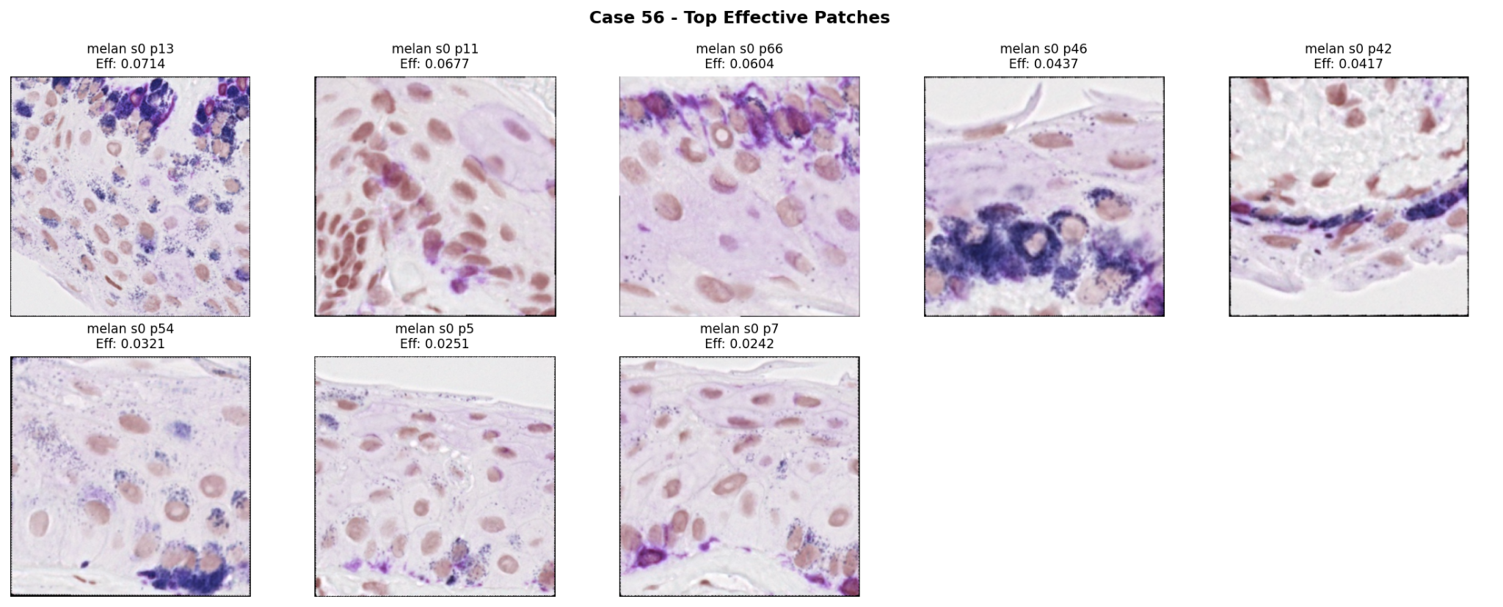
Case 56 - Incorrectly Classified Benign (Patch Level)

Slide 17
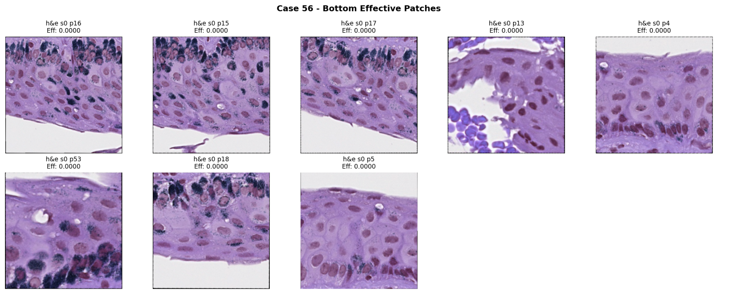
Case 56 - Incorrectly Classified Benign (Patch Level)

Slide 18
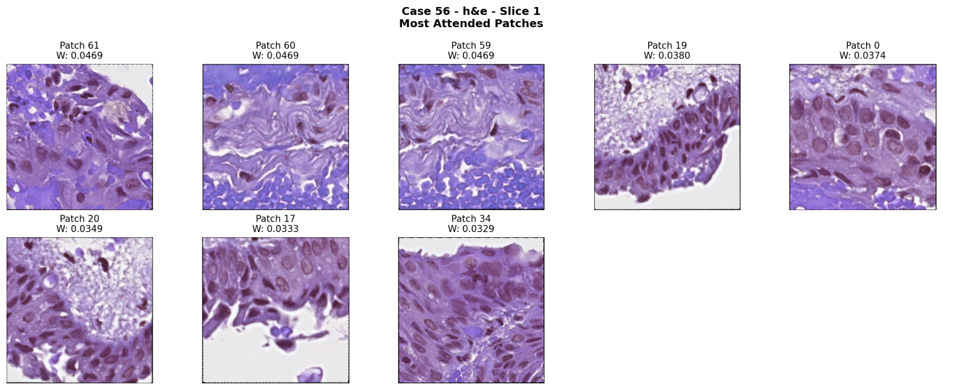
Case 56 - Incorrectly Classified Benign (Slice Level)

Slide 19
Observations and Recommendations
Normalized Attention Weights: Softmax ensures attention weights sum to 1, allowing relative importance to be compared across patches
Expand Stain-Level Visualization: Generate bar charts comparing normalized attention weights across H&E, Melan, and SOX10 to identify which stains receive the most attention in each case
Evaluate Attention Distribution: Examine whether attention is overly concentrated in a small number of patches, slices, or stains, potentially limiting the model's ability to capture broader information
Investigate Visualization Quality: Examine why some high-attention patches appear blurry while low-attention patches appear clearer, and assess whether this reflects meaningful diagnostic features

Slide 20

Consultant
Hortense Ineza Mutamba, Alzaharaa Alzaabi

Slide 21
Problem & Clinical Goal
01. Context & Task
Tissue Classification
Classify eye-tissue samples into benign (normal) or high-grade (abnormal, needs treatment) using microscope images of conjunctival tissue.
Specifically analyzes melanocytes (pigment cells) to check if they remain at the tissue base or have spread throughout.
02. The Challenge
Inconsistent Diagnosis
~39%
Expert agreement on borderline cases
Pathologists currently diagnose visually by eye, leading to significant subjectivity and variance between experts.
03. The Objective
ML Second Opinion
Build an automated machine-learning model to assist pathologists during clinical evaluation.
Key Benefits:
• Consistent diagnostic standard
• Reproducible decision support

Slide 22
Pipeline & Methodology (Non-Coder Overview)
01. VISUAL PIPELINE
The Big Picture
Microscope tissue images are sliced into small square patches, converted into numeric summaries, and combined across patches and stains to reach a final diagnosis: benign or high-grade.
02. EXPERIMENTAL DESIGN
5-Fold Cross-Validation
The 93 patient cases are split into 5 equal groups (“folds”). In 5 rotating runs, 4 groups teach the model while 1 is held back for testing, ensuring every case is tested once without overlap.
03. METHOD RATIONALE
Why Avoid Single Splits?
With a small dataset of 93 cases, a single train/test split could be unusually lucky or unlucky by chance. Testing across 5 rotations and averaging gives a far more trustworthy performance estimate.
04. LEAKAGE PREVENTION
Strict Patient Isolation
All tissue patches from a single patient strictly stay within the same fold. This prevents the model from memorizing individual patient identity rather than genuinely learning disease patterns.

Slide 23
Technical Pipeline & Methodology(For Coders)
01. STEP ONE
Patch Slicing
QuPath annotation + epithelium contour → square patches of variable size.
(Start with whole microscope slide images. Use QuPath to draw boundaries around the tissue region, then cut that region into many small square patches (patches vary in size).
)
patching_code_Fall2025.ipynb
02. STEP TWO
Feature Embedding
Each patch run once through frozen KimiaNet (CNN)
(Run each patch through KimiaNet, a pre-trained CNN that’s frozen (not re-trained), to convert it from an image into a 4096-number vector, a compressed numeric summary of what’s visually in that patch.)
precompute_pooled_features.py
03. STEP THREE
Case & Fold Splitting
93 cases → 5 rotating train / val / test folds (StratifiedGroupKFold, related patients grouped).
(Take all 93 cases and split them into 5 rotating train/val/test folds using StratifiedGroupKFold, which keeps all patches belonging to the same patient together in one fold (so no patient’s data leaks across train and test).)
make_splits.py
04. STEP FOUR
Attention Model
Patches → slice → stain → case embedding, with attention learned at every level.
(Feed everything into the model, which combines patches → slices → stains → one case-level prediction, using attention at every level. Output: benign or high-grade.)
main.py → benign / high-grade

Slide 24
Critical Review & Proposed Improvement
01. The Weakness
Unjustified Weight
+46%
Higher than data justifies(2.52 vs 1.73)
Class counts: 37 benign vs. 64 high-grade (≈1.73:1 ratio).
config.py uses [2.5285, 1.0], found by Optuna hyperparameter search.
Chosen for validation loss, not derived from actual class balance
[config.py , line 38].
02. Why This Matters
Model Over-Correction
2.53 : 1
Assumed vs. 1.73:1 Actual
The model over-corrects for an imbalance milder than the weight assumes.
Over-penalizes benign misclassifications beyond what the dataset's own distribution warrants.
03. The Proposed Fix
Data-Derived Value
[1.73, 1.0]
Exact Class Ratio Swap
Update TRAINING_CONFIG['class_weights'] in config.py.
Computed as n_high_grade / n_benign (64 / 37).
• Single value swap
• Grounded directly in data

Slide 25
Zooming In: Patches Entering KimiaNet
Slides + QuPath
Epithelium outlined
Variable-size patches
Kept if 32 px or more
KimiaNet (DenseNet)
Shrinks each image 32×
Average pooling
4,096-number summary
Attention MIL
Benign / high-grade
What a small patch becomes
40 px → 1 cell
Inside KimiaNet every image is shrunk 32×. A patch under 64 px ends up as a single 1 × 1 cell, so its 4,096 numbers come from almost no tissue, mostly edges and padding.
Drawn to scale: cells KimiaNet summarizes
Median patch
199 px = 36 cells
What KimiaNet was trained on
1000 px → 31 × 31 cells
More than 240,000 patches of 1000 × 1000 px at 20× (Riasatian et al., 2021, Medical Image Analysis). Each summary averages about 961 regions of tissue.
40 px patch
= 1 cell
1000 px training patch
31 × 31 = 961 cells

Slide 26
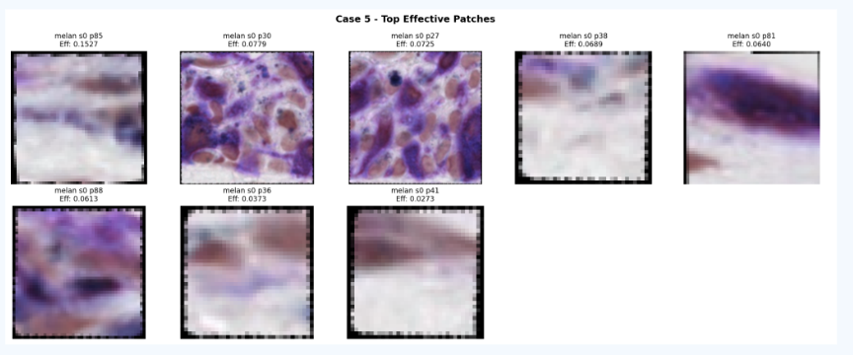
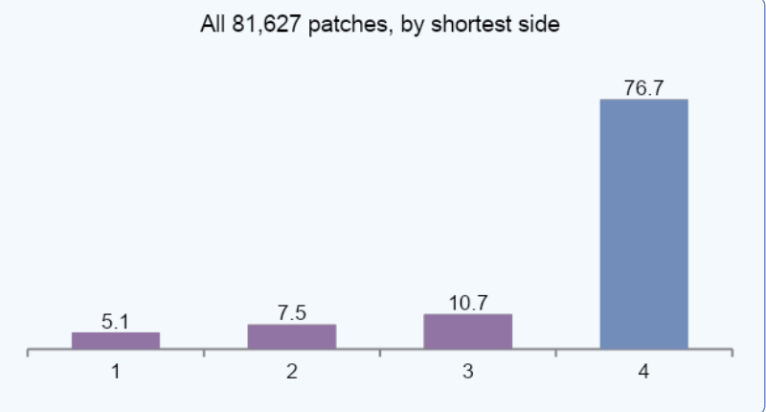
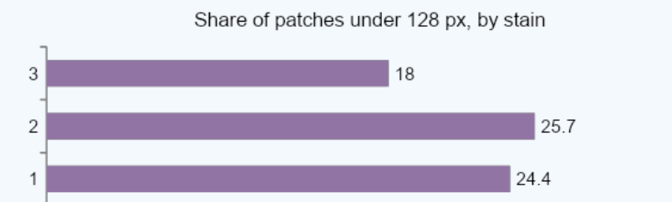
Evidence: How Common Are Small Patches?
Case 5, top 8 attention patches (team slide 11). 6 of 8 look pixelated because they are tiny and the plot enlarges them for display. All 8 come from one melan slice.
23.3%
of the 81,627 patches are under 128 px
36 vs 961
cells: median patch vs a training patch
4.8%
become a single 1 × 1 cell (about 3,900)

Slide 27
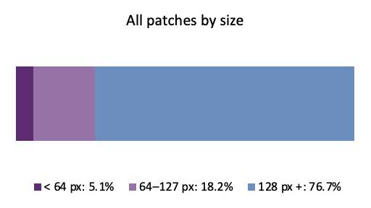
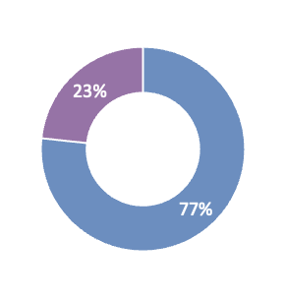
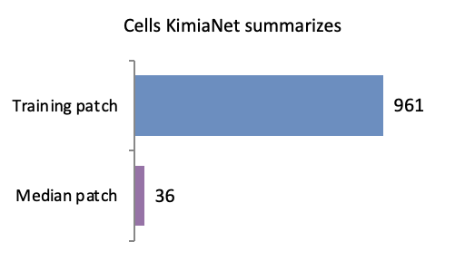
Patch Size: Weakness, Impact, and Fix
01. The Weakness
Loose Size Filter
32 px
current MIN_PATCH_SIZE (line 32)
Any patch of 32 px or more goes into KimiaNet at its own size.
4.8% of patches (about 3,900) become a single 1 × 1 cell, and 23% are under 128 px.
02. Why This Matters
Far Less to Summarize
36 vs 961
cells: median patch vs KimiaNet training patch
Even a typical patch gives KimiaNet far less tissue than it was trained on. Single-cell patches mostly reflect edges and padding.
Attention still weighs them like any other patch, and lands on tiny patches in Case 5.
03. The Proposed Fix
Raise the Minimum
128 px
at least a 4 × 4 grid inside KimiaNet
precompute_pooled_features.py, line 32: MIN_PATCH_SIZE = 128
Safeguard: if a slice has none ≥ 128 px, keep its 5 largest. Re-run the embeddings, then training.
76.7% kept
All 99 cases keep patches

Slide 28
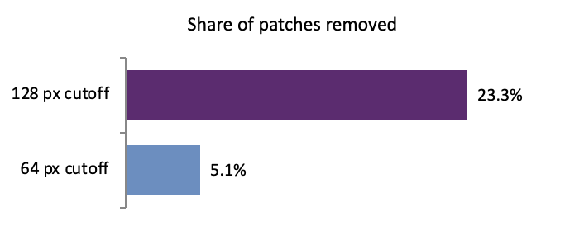
How to Test the Fix
Baseline
Current code, seed 390
Minimum patch side 32 px. Already run (job 4832248).
With the fix
Same seed, same split
Minimum patch side 128 px. Only one setting changes.
change one setting
Accuracy and recall per class
Benign recall must not drop
P(high-grade) on misclassified cases
Should move toward the right answer
Top 8 attention patches per case
Should be larger patches with visible cells
1
2
3
If benign recall drops: small patches may carry real signal (thin epithelium near the base). Fallback: a softer cutoff of 64 px, which removes only 5.1% of patches (the single-cell ones). Cost either way: one embedding re-run and one training run.

Slide 29
Thank You!

