Slide 1
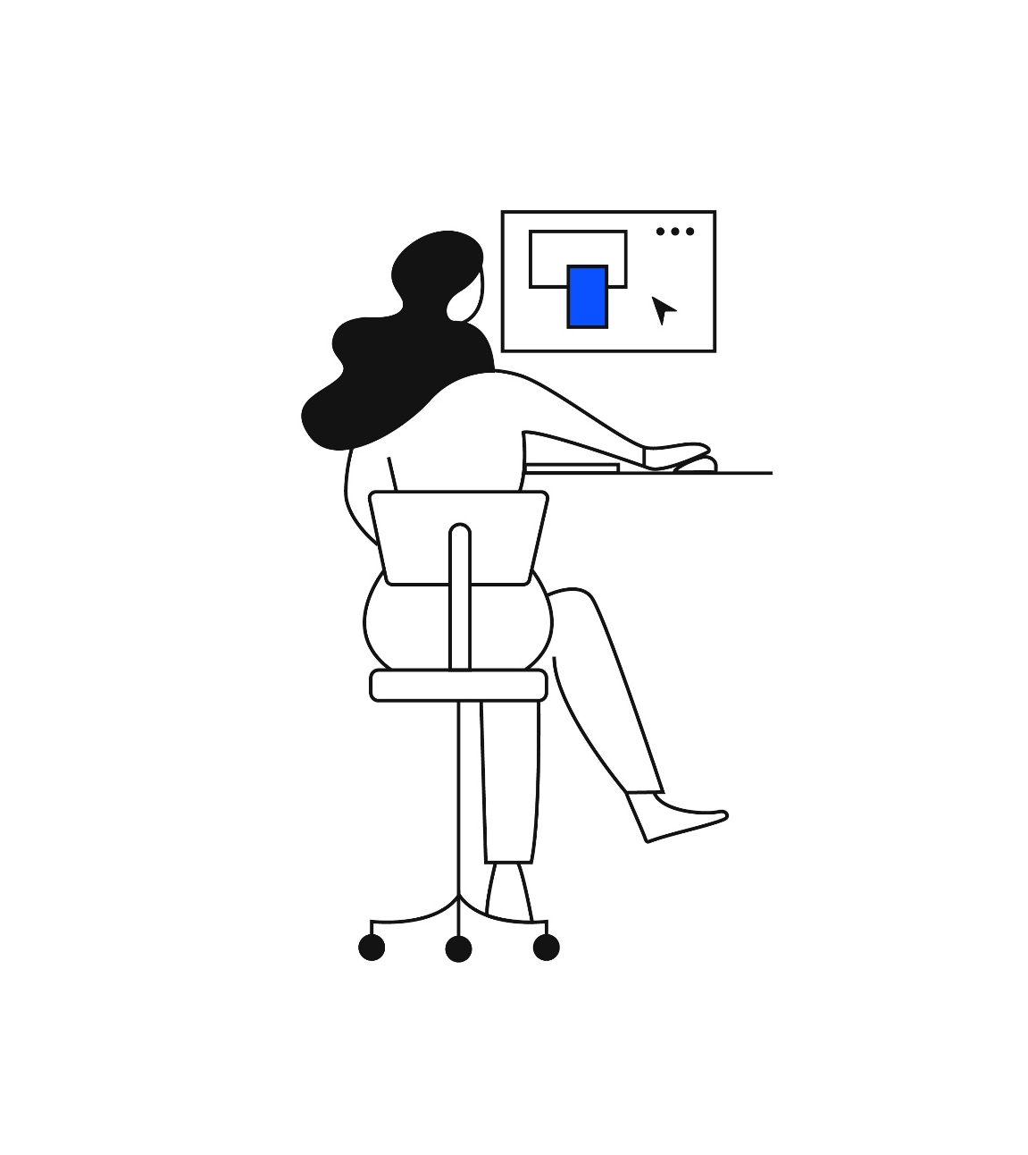
Guiding principles to using the KONE template
This PowerPoint template was taken into use in January 2023
For correct use and experience, we encourage you to familiarize yourself with the template and our BrandBook
You can find a quick user guide and instructions on the last slides
When adjusting slides from an old template to this one, copy the content instead of full slides
When presenting, we recommend using the PowerPoint Live functionality in Teams or the PowerPoint Desktop App
We do not recommend presenting through a web browser or Teams window, as some content might appear incorrectly
In case you experience technical difficulties when using the template, have questions or want to give feedback, please contact global.brand@kone.com
Guidelines and more information at KONE Brandbook
Images can be found from KONE MaterialBank

Slide 2


Slide 3
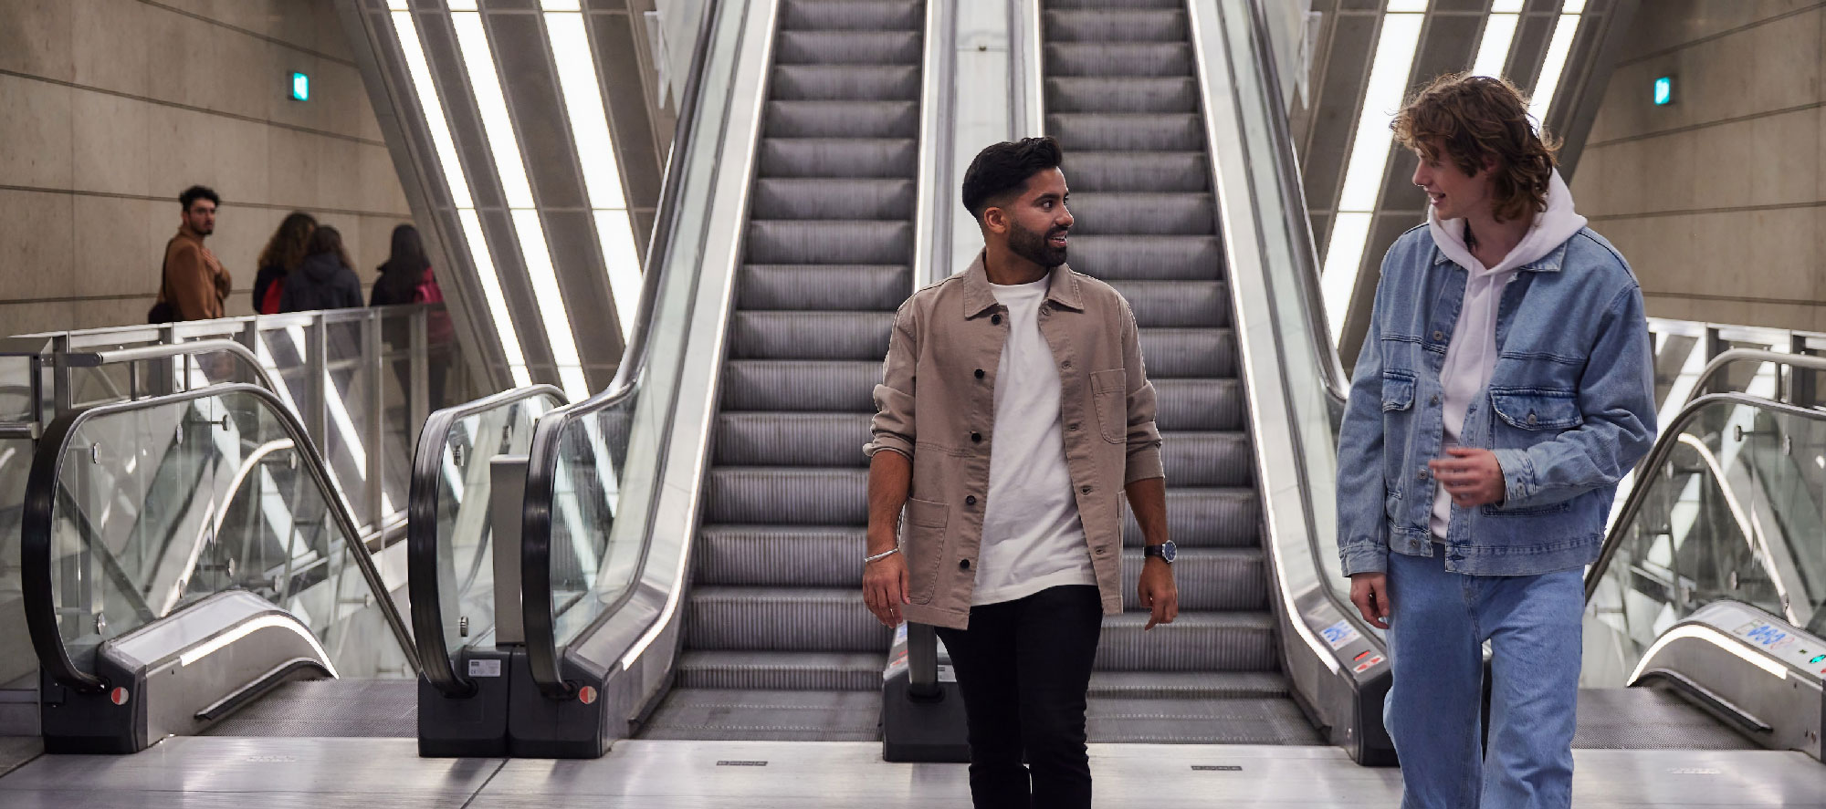

Slide 4
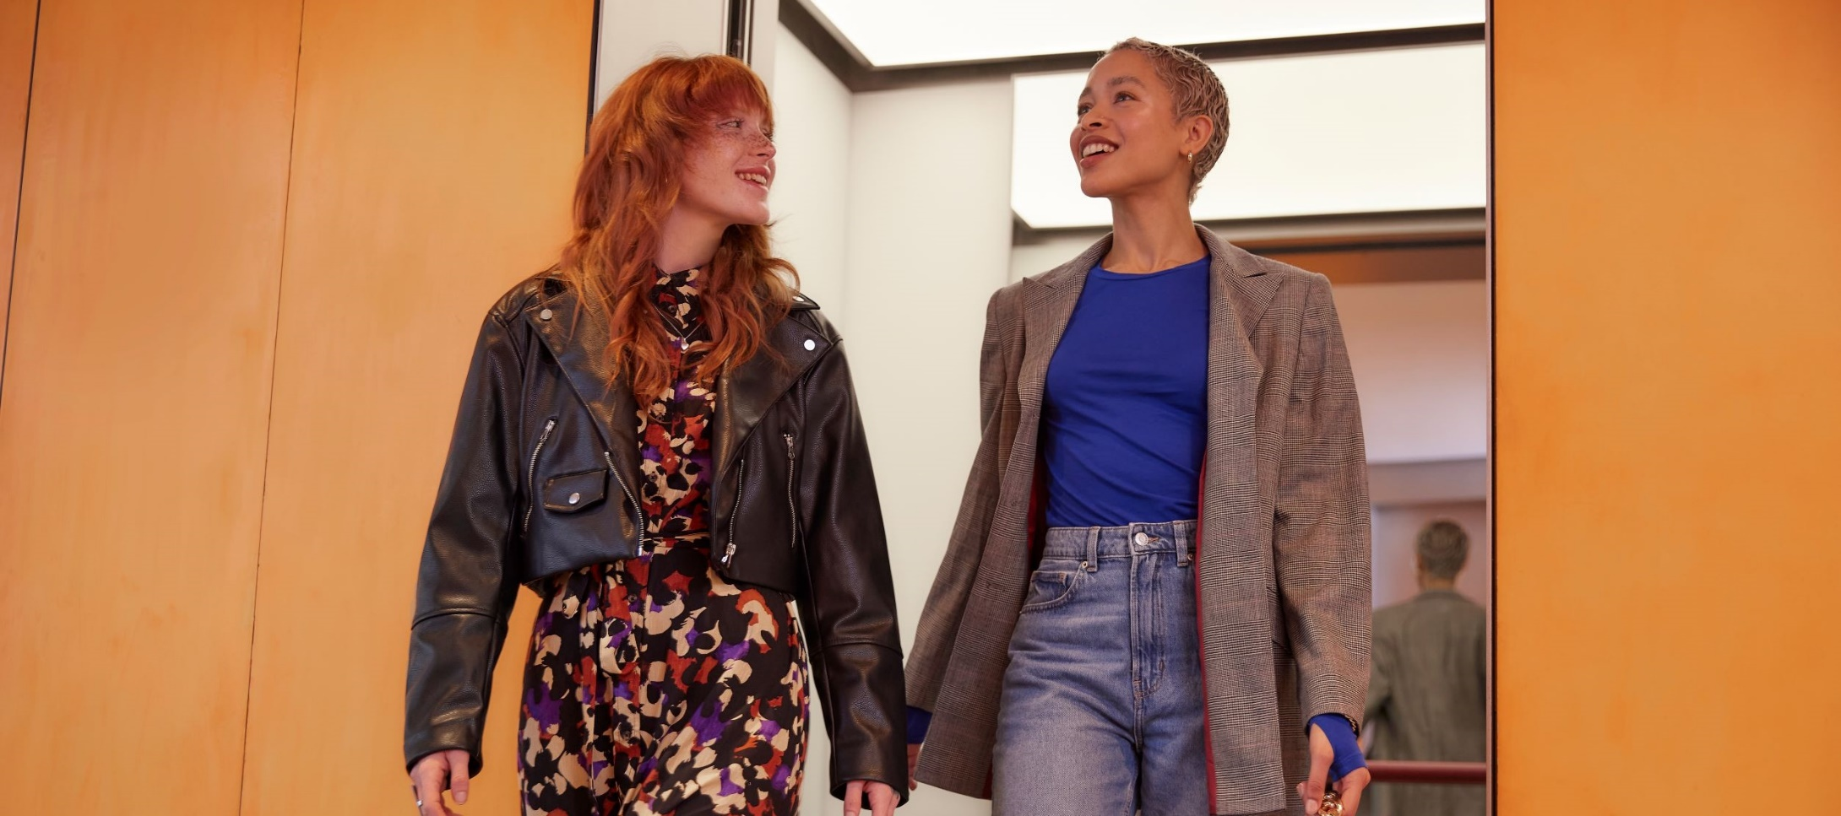

Slide 5


Slide 6
Subject | Resp. person | 0:00 | 0:00
Subject | Resp. person | 0:00 | 0:00
Subject | Resp. person | 0:00 | 0:00
Subject | Resp. person | 0:00 | 0:00
Subject | Resp. person | 0:00 | 0:00
Subject | Resp. person | 0:00 | 0:00
Subject | Resp. person | 0:00 | 0:00
Subject | Resp. person | 0:00 | 0:00

Slide 9


Slide 10


Slide 11

Thank you

Slide 12


Slide 13
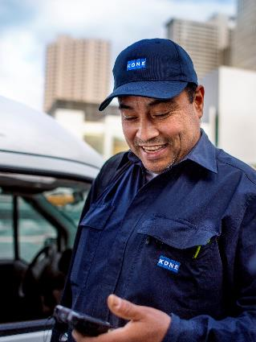
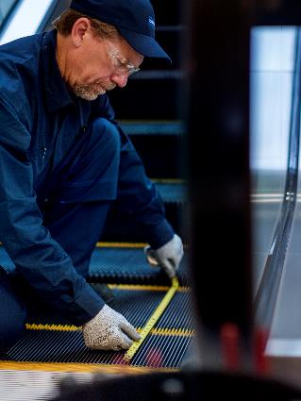
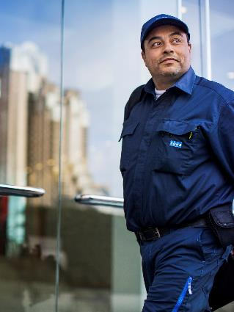
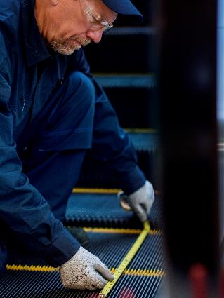
Timeline
2022
Integer ante magna, congue in augue eu, semper arcu.
2023
Integer ante magna, congue in augue eu, semper arcu.
2024
Integer ante magna, congue in augue eu, semper arcu.
2025
Integer ante magna, congue in augue eu, semper arcu.

Slide 14
Timeline
2022
Aliquam viverra mattis ultrices.
Sed vulputate pulvinar bibendum.
Praesent scelerisque tincidunt mauris, eget imperdiet felis vulputate sit amet.
2023
Aliquam viverra mattis ultrices.
Sed vulputate pulvinar bibendum.
Praesent scelerisque tincidunt mauris, eget imperdiet felis vulputate sit amet.
2024
Aliquam viverra mattis ultrices.
Sed vulputate pulvinar bibendum.
Praesent scelerisque tincidunt mauris, eget imperdiet felis vulputate sit amet.
2025
Aliquam viverra mattis ultrices.
Sed vulputate pulvinar bibendum.
Praesent scelerisque tincidunt mauris, eget imperdiet felis vulputate sit amet.

Slide 15
Roadmap
 | Jan | Feb | Mar | Apr | May | Jun | Jul | Aug | Sep | Oct | Nov | Dec
 | Q1 | Text | Text | Q2 |  |  | Q3 |  |  | Q4
Text |  | Text with background color 20% KONE Blue
 |  |  |  | Text
 |  |  |  |  | Text |  |  | Text
Text |  | Text |  |  |  | Text
 |  |  |  | Text |  |  | Text
 |  |  | Text |  | Text |  |  | Text
Text |  | Text
 | Text
 |  |  | Text
Text | Text |  |  |  | Text
 |  | Text |  |  |  |  | Text
 |  |  | Text
Text | Text |  |  |  |  | Text
 |  | Text
 |  |  | Text |  |  | Text
Text | Text
 |  | Text |  |  | Text
 |  | Text

Slide 16
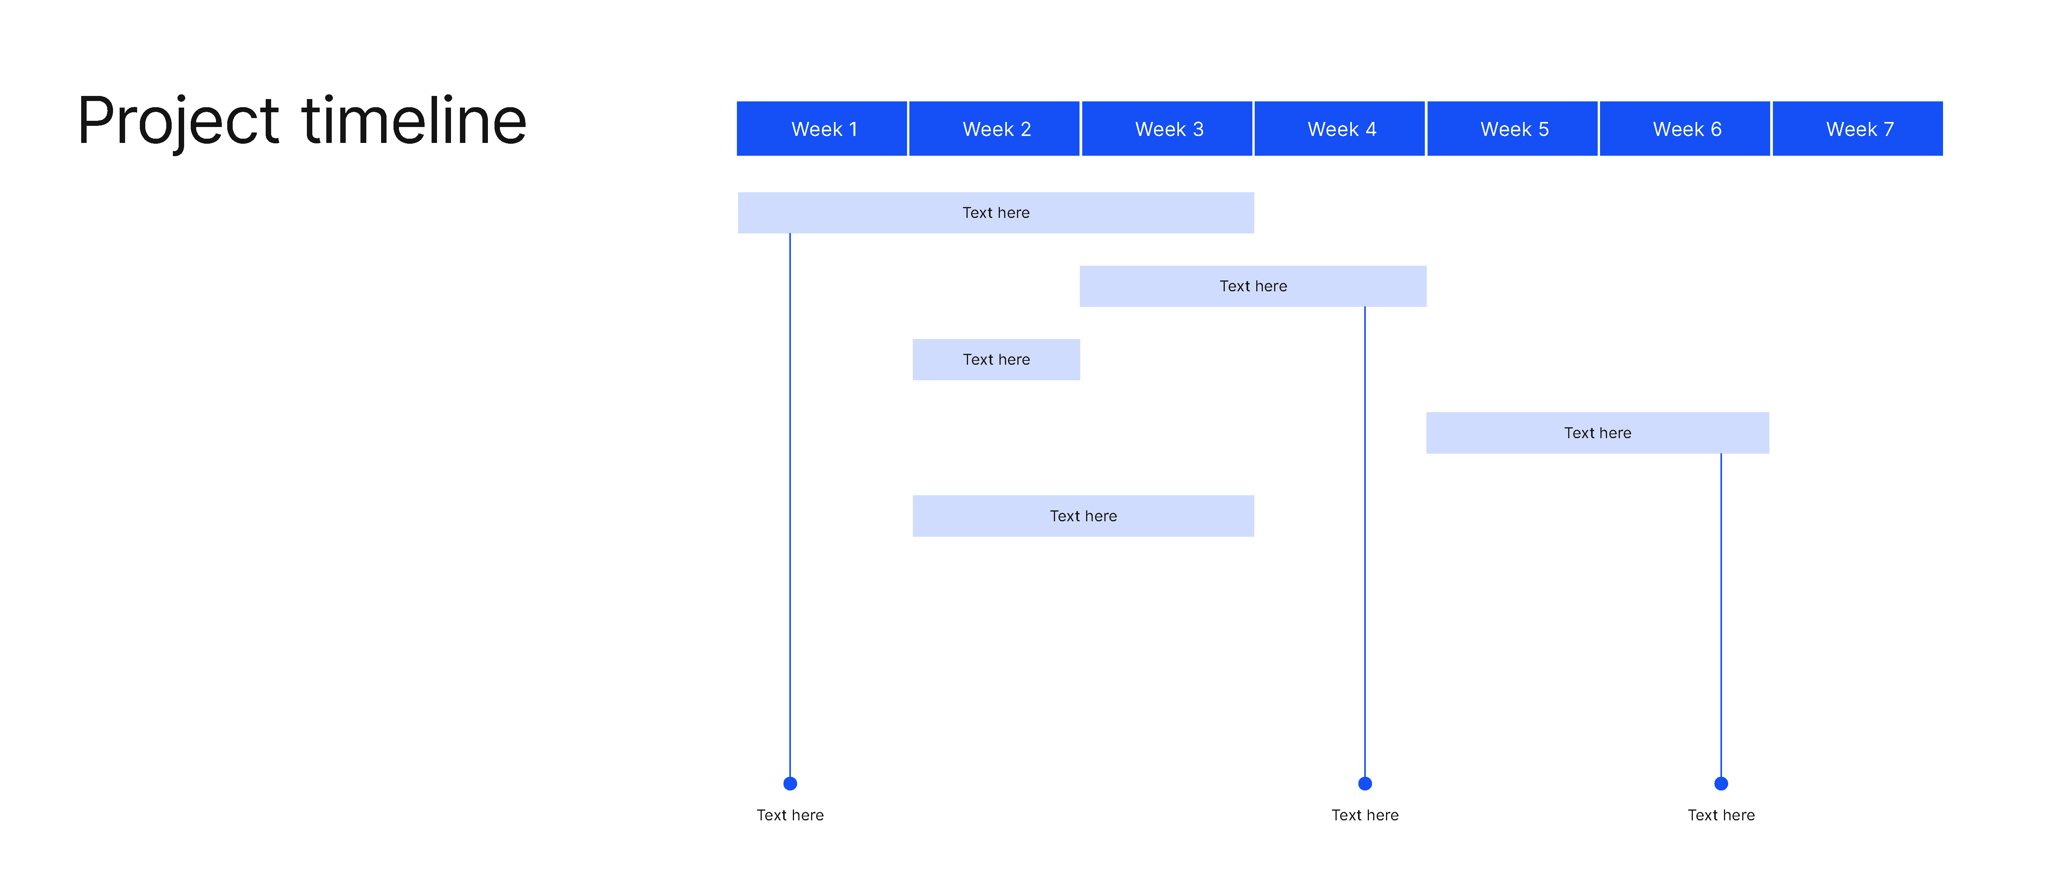
Project timeline
Week 1 | Week 2 | Week 3 | Week 4 | Week 5 | Week 6 | Week 7
Text here |  |  | Text here | Text here
 |  | Text here
 | Text here |  |  |  |  | Text here
 |  |  |  | Text here
 | Text here
Text here
Text here
Text here
Text here
Text here

Slide 17
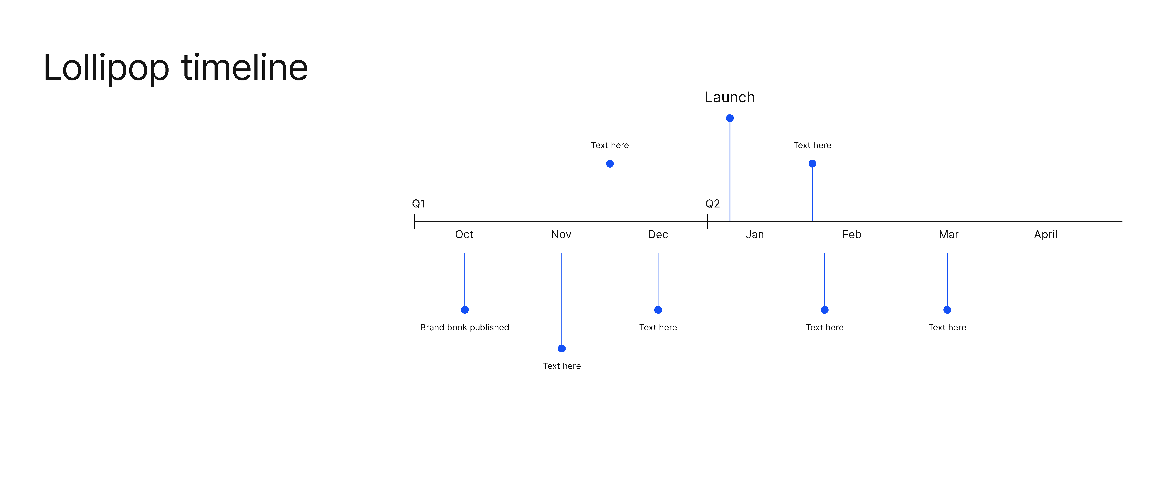
Timeline
Text here
Text here
Text here
Q4 |  |  | Q1 |  |  | Q2
Oct | Nov | Dec | Jan | Feb | Mar | Apr
Text here
Text here
Text here
Text here
Text here
Text here
Text here

Slide 18
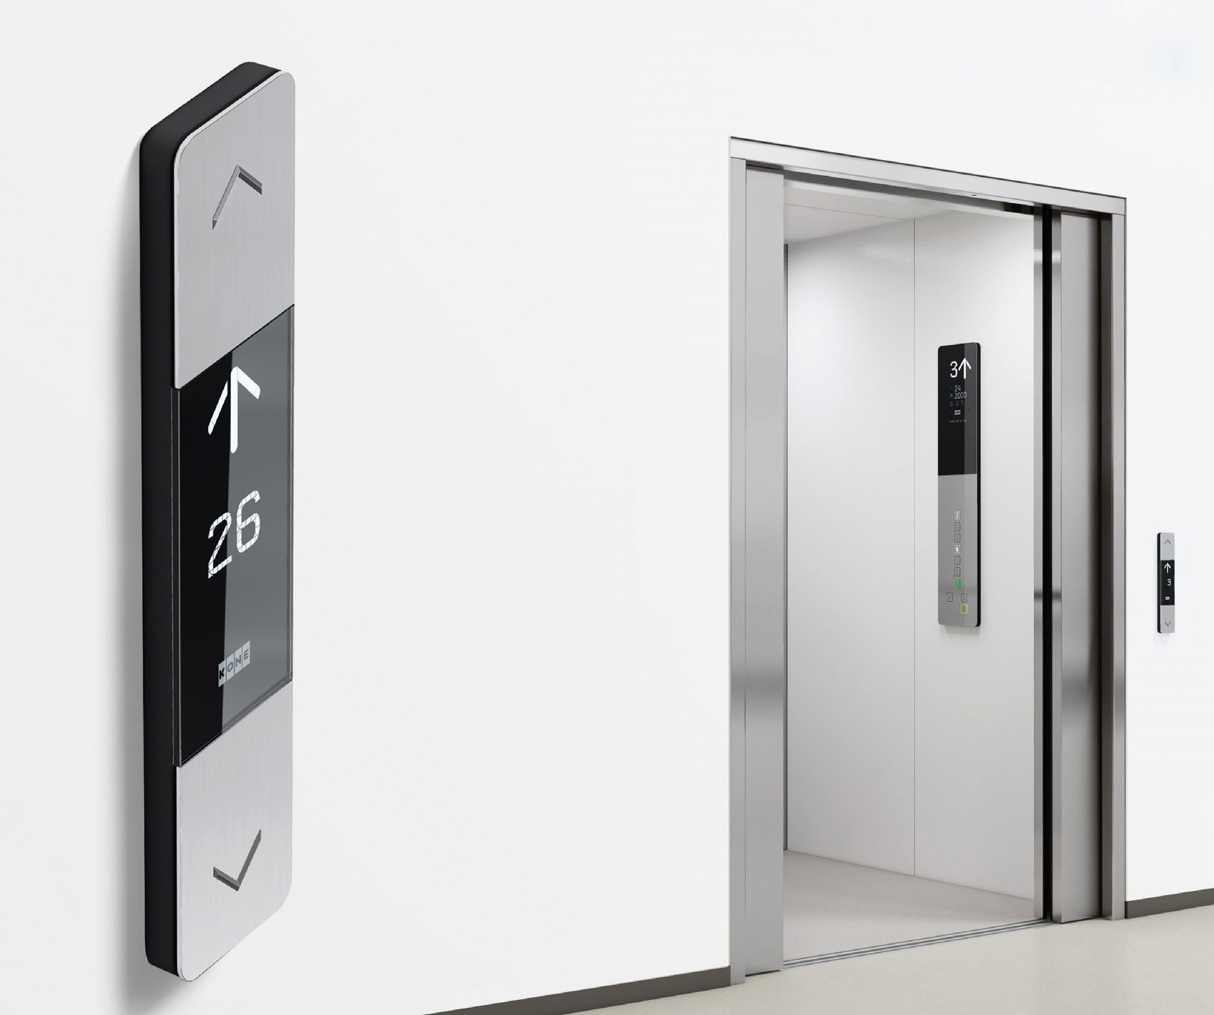
Value proposition
PRODUCT NAME
Aliquam viverra mattis ultrices. Sed vulputate pulvinar bibendum. Praesent tincidunt mauris, eget imperdiet felis vulputate sit amet.
3
Vestibulum
Dignissim nec
Lacus ac suscipit
1
Vestibulum
Praesent scelerisque tincidunt mauris
4
Donec ut orci
Lobortis
Curabitur faucibus pretium ex.
2
Vestibulum
Praesent scelerisque tincidunt mauris

Slide 19








KONE icons For more information and material: brandbook.kone.com

Slide 20





























KONE numbers

Slide 21


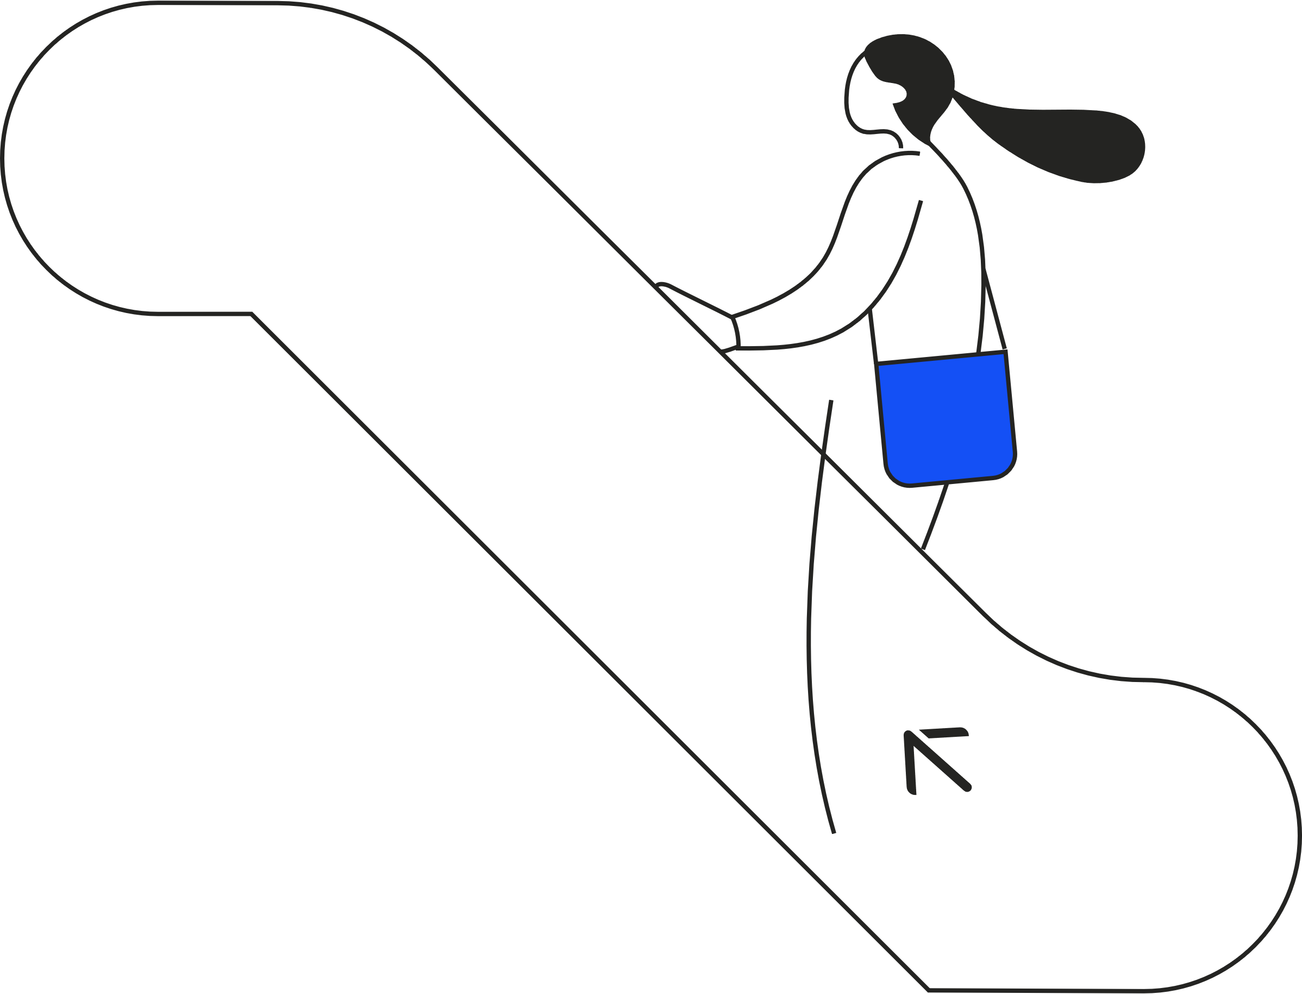
KONE illustrations For more information and material: brandbook.kone.com

Slide 22
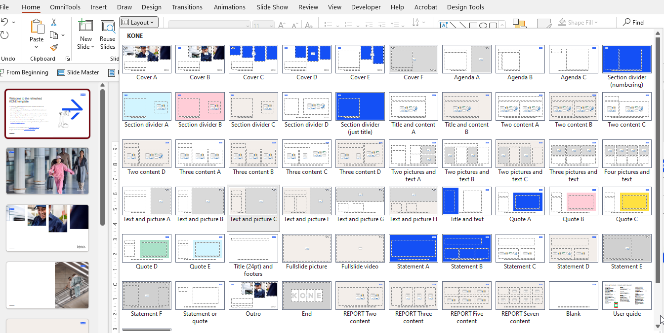
TIP:
Find more slide styles in the layouts:

Slide 23
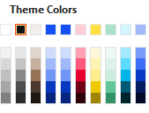
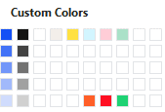


KONE colors
Please only use KONE colors highlighted in green
Theme Colors on top row
Custom Colors
Tints of blue and black
Accent colors used in UI and illustrations
Please do not use Standard Colors
#1450F5
RGB 20/80/245
#FFCDD7
RGB 255/205/215
#FFE141
RGB 255/225/65
AAE1C8
RGB 170/225/200
#D2F5FF
RGB 210/245/255
#A1B9FB
RGB 161/185/251
40% blue

Slide 24
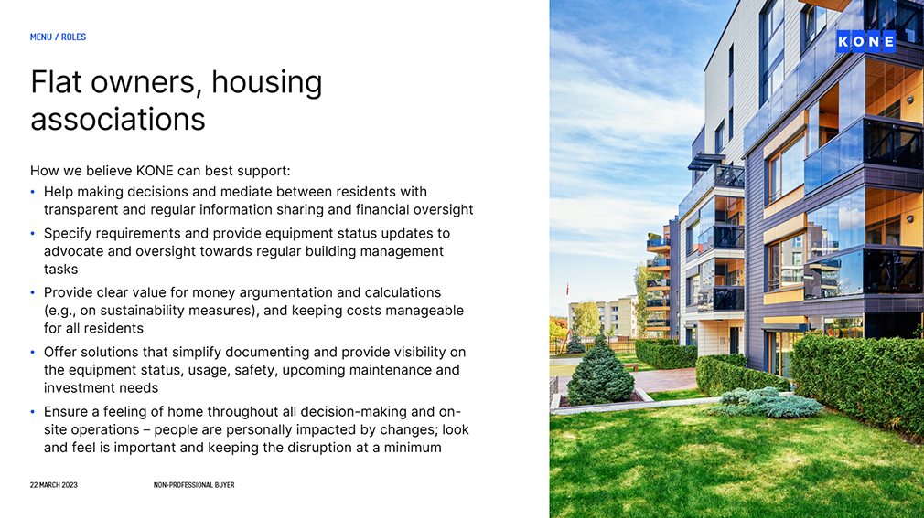
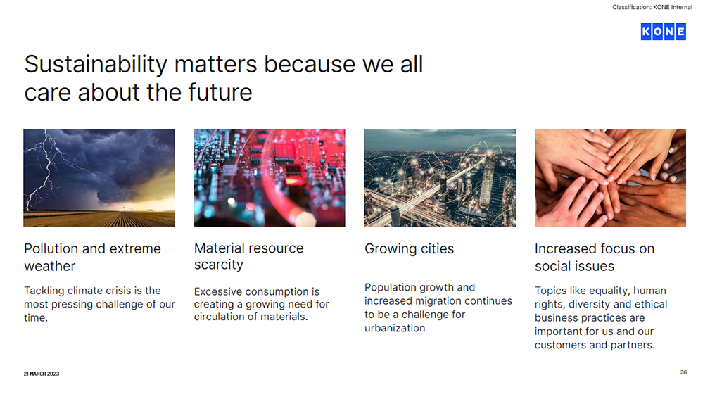
Text & typography
All text is left aligned with a few exceptions such as pagination, navigation text and footnotes
We have two fonts: Inter and KONE Information
Inter is our primary font and it is the default font for main headlines and body text in this template
Text in Inter font should always be written in either black (light backgrounds) or white (dark backgrounds) – never in blue
Text in Inter font should always be written in sentence case, never with all caps
KONE Information is our secondary font. In this template it is used for navigation text, page numbers, small section titles, technical descriptions, product names etc.
Text in KONE Information font should be written in either blue, black (light backgrounds) or white (dark backgrounds)
Text in KONE Information font should always be all caps

