Slide 1



I would like to share our plan of ONE Week MOD deployment with you reg

Slide 2
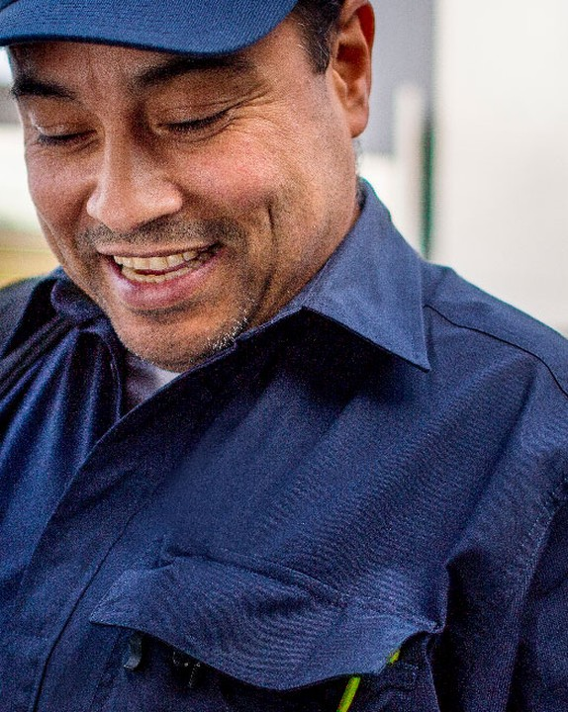

ONE WEEK MOD
Our plan for paid media deployment
Go-live for six EUR frontlines and India is September 21 and is non-negotiable.
Jira tickets are raised by Ajith and assigned to Aino for deployment, as usual.
Media plans are already done, so no new plan will be requested in the tickets.
21 AUGUST 2026
02

Slide 3
Today
01
Timing and go-live dates
02
Channels in scope for campaign set-up
A short walk through timing, scope and the way we will work together on this deployment.
03
What sits outside HUB and Omnicom
04
Who does what
05
Practicalities and assets
21 AUGUST 2026
03

Slide 4
01
TIMING
When we go live

Slide 5
GO-LIVE DATE
21
September 21 for the six EUR frontlines and India
The date is non-negotiable. AME (US and CA) may follow later; timing will be confirmed as soon as it is known.
21 AUGUST 2026
05

Slide 6
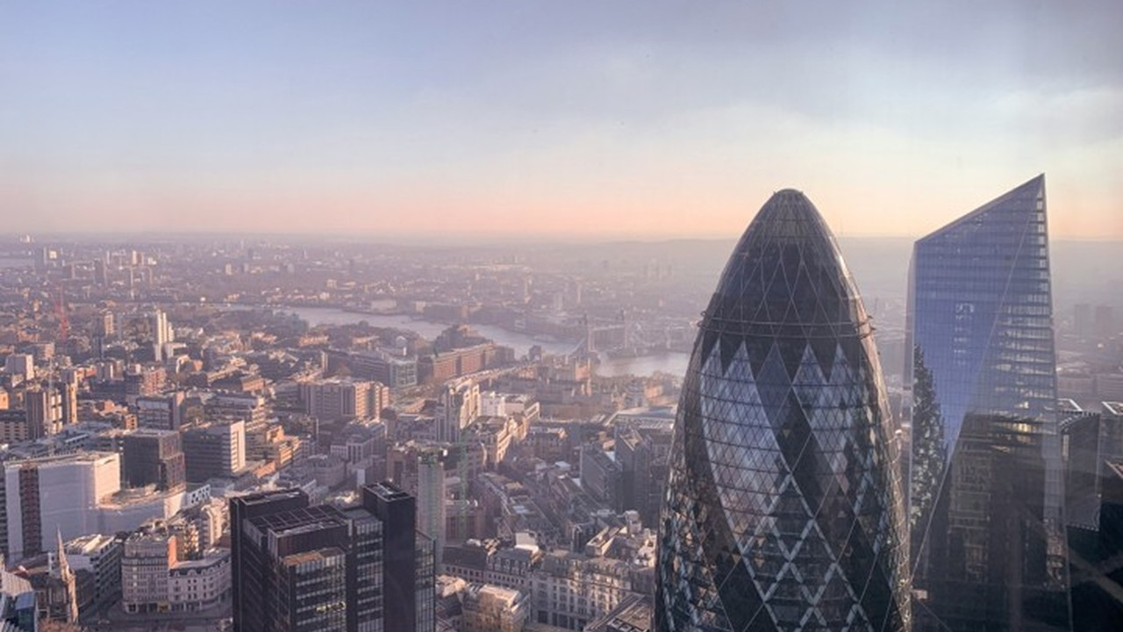
PART TWO
What is in scope, and what is not

Slide 7
Channels we need you to set up
01
02
03
04
05
06
Meta campaigns
LinkedIn campaigns
YouTube on local channels: DACH, Nordics, GIN
YouTube on global channel: EEM, I&I, FBL, AME if used
Spotify ads: Nordics only so far
Pmax and Search on Google Ads: all FLs except DACH
21 AUGUST 2026
07

Slide 8
OUT OF SCOPE
Handled outside HUB and Omnicom
Three activities are managed directly by the frontlines with their own partners, so no tickets will come your way for them.
Outdoor displays: EUR works directly with Dwise.
Account based advertising: EUR works directly with Dun & Bradstreet.
Geofencing: Nordics handles this with a local agency.
21 AUGUST 2026
08

Slide 9
How we will work together

Slide 10
Who does what
Ajith: raises the Jira tickets
Aino: takes the tickets and deploys the campaigns
Omnicom: sets up campaigns on Meta, LinkedIn, YouTube, Spotify and Google Ads
Frontlines and Global Comms: upload videos to local and global YouTube channels
DACH: handles Pmax and Search locally
21 AUGUST 2026
10

Slide 11

Practicalities: how the work reaches you
01
02
03
Ajith raises the ticket in Jira and assigns it to Aino. Media plans are ready, so no new plan is requested.
Assets come in the localized content Excel files, with URLs carrying UTM parameters and DAM links to localized assets.
Campaigns are built from those files and set live for September 21. There is no preview tool for this deployment.
21 AUGUST 2026
11

Slide 12

Thank you

