Slide 1
Anthropic Education Labs · Take-home submission
Learn mode
Claude does the work. You learn from it while it happens.
Arvind · Option B: Learning through collaboration with Claude
Notes:
Hi, I'm Arvind. This is Learn mode, my take on Option B. In one line: Claude does the work, and you learn from it while it happens.

Slide 2
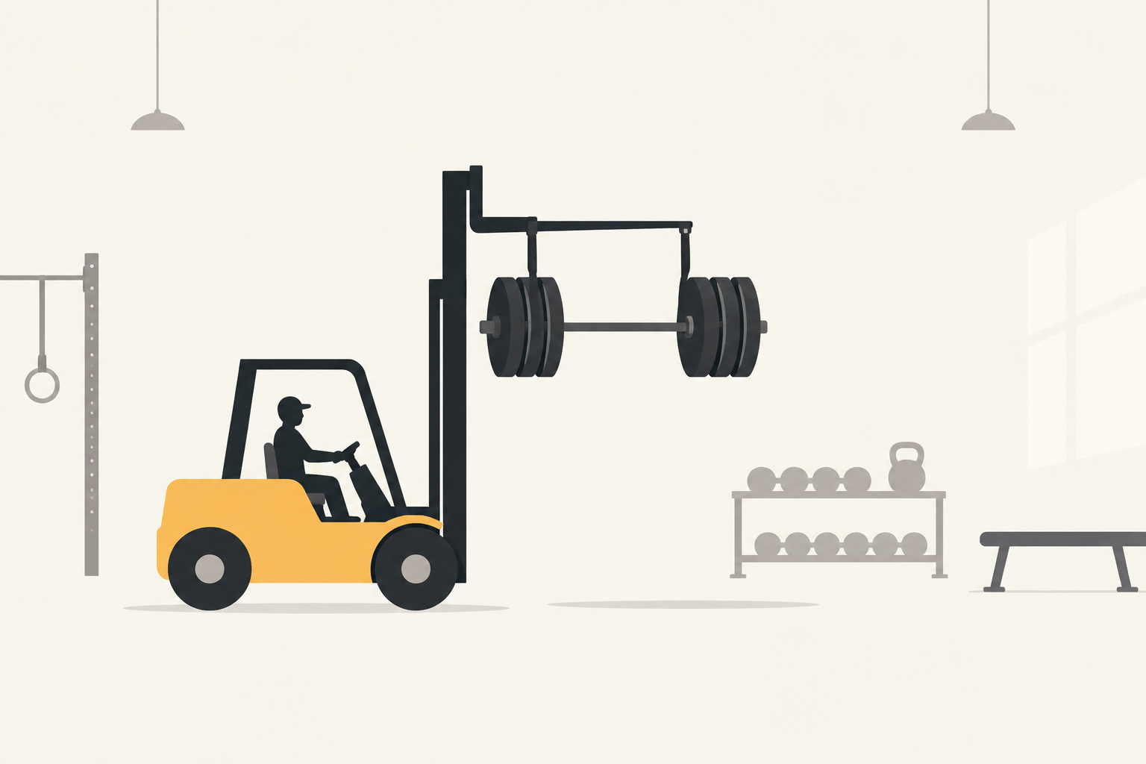
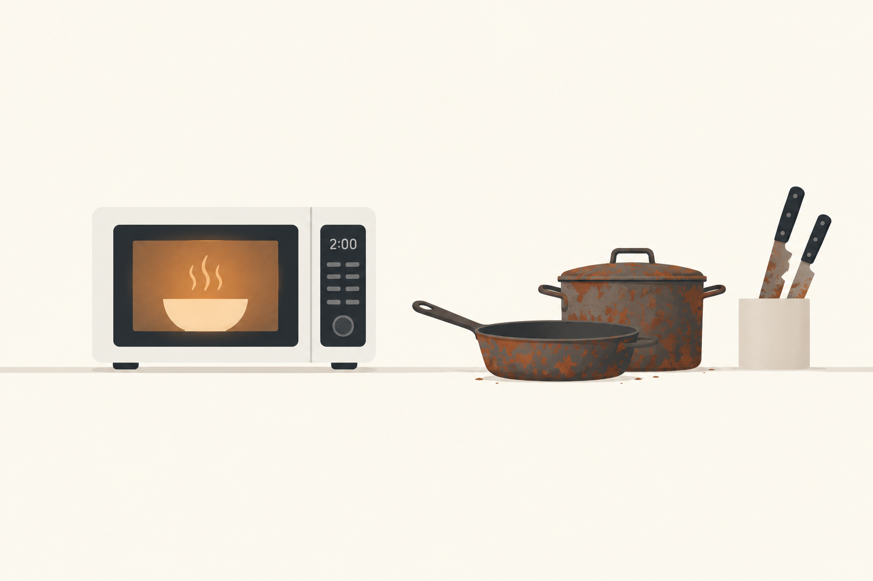
The problem
“When AI agents handle complex tasks autonomously, humans can become passive observers rather than active learners, missing opportunities to develop their own skills and understanding.”
Education Labs brief · Challenge 2: Cognitive engagement
Notes:
The brief puts it well: when agents do complex work on their own, people become passive observers. Agents are a forklift in the gym and a microwave in the kitchen. The work gets done, but the muscle doesn't grow and the knives go dull.

Slide 3
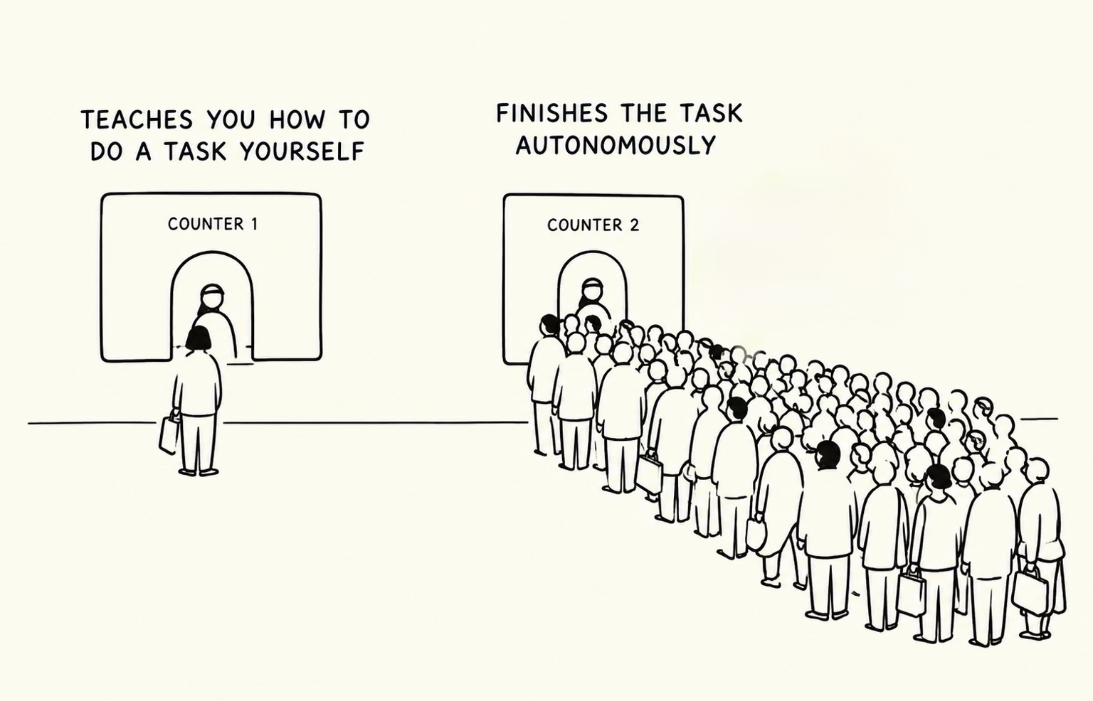
People go to the counter that finishes the task
Notes:
When something needs doing, people go to the counter that finishes the task. Many good learning products get little use; I've built some. So I put the learning inside Claude, where people already are, and it never makes the task wait.

