Slide 1
DATA MINING PROJECT
Student Academic
Performance Analysis
PASS RATE
90%
ATTENDANCE
87%
From student records to actionable academic insight
PYTHON · STREAMLIT · SCIKIT-LEARN
STUDENTS
480
Descriptive analytics + predictive modeling + student segmentation
Synthetic sample data · 480 student records
STUDENT ACADEMIC PERFORMANCE ANALYSIS · DATA MINING
01

Slide 2
01 · PROJECT OVERVIEW
One dashboard. Three ways to understand performance.
A practical education analytics workflow designed for exploration and early support.
01 Explore outcomes
02 Identify risk
03 Find segments
Track pass rate, GPA estimate, attendance, score distributions, school and grade patterns.
Compare interpretable baseline classification models using engagement and prior-performance signals.
Use unsupervised clustering to group students by learning and engagement patterns.
PASS RATE
AVERAGE GPA
ATTENDANCE
AT-RISK
90%
3.00
87%
55
Score of 60 or above
Score mapped to 4.0 scale
Mean attendance rate
Score <60 or attendance <70%
Purpose
Surface patterns that help educators investigate and support students—not automate decisions about them.
STUDENT ACADEMIC PERFORMANCE ANALYSIS · DATA MINING
02

Slide 3
02 · DATASET
A small, reproducible dataset with meaningful learning signals.
Synthetic records let the full pipeline run out of the box; replace them with validated data for further study.
STUDENT RECORDS
INPUT FIELDS
GRADE RANGE
ACADEMIC YEAR
480
13
9–12
2024
Generated sample rows
Required CSV columns
High-school sample
Assessment records
Academic history
Engagement
Learning context
Previous and final scores
Grade level
Assessment date
Enrollment year
Attendance percentage
Assignment completion
Study hours per week
School
Parent / guardian education
Internet access
Gender category
Derived outcome labels
Pass = final score ≥ 60 · At-risk = final score < 60 OR attendance < 70%
STUDENT ACADEMIC PERFORMANCE ANALYSIS · DATA MINING
03

Slide 4
03 · METHOD
A transparent pipeline from raw CSV to useful views.
Validation, descriptive analysis, supervised prediction, and unsupervised segmentation.
1
2
3
4
5
Validate
Explore
Predict
Segment
Review
Required fields
Ranges · dates
Score · attendance
School · grade
Logistic regression
Random forest
Scaled features
K-means
Metrics · profiles
Educator context
Leakage guard
Risk classification excludes final score and the derived risk label from model inputs. A stratified 75/25 split keeps test examples separate from training.
STUDENT ACADEMIC PERFORMANCE ANALYSIS · DATA MINING
04

Slide 5
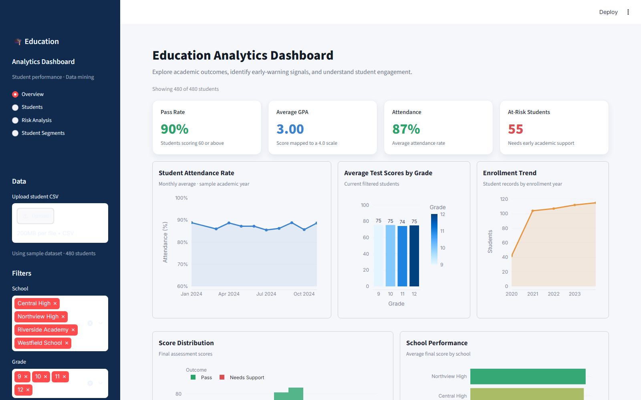
PRODUCT SCREENSHOT · STREAMLIT OVERVIEW
The dashboard at a glance
STUDENT ACADEMIC PERFORMANCE ANALYSIS · DATA MINING
05

Slide 6
04 · PREDICTIVE ANALYSIS
Early-warning classification: measure more than accuracy.
Two baseline classifiers, one stratified holdout, and clear performance trade-offs.
BEST MODEL
ACCURACY
PRECISION
RECALL
Random Forest
89.2%
53.8%
50.0%
Selected by F1
Correct overall
Risk flags that were correct
At-risk cases identified
Holdout comparison
Top random-forest drivers
Accuracy
73%
89%
Enrollment Year
Precision
29%
54%
Assignment Completion
86%
50%
Previous Score
Recall
Attendance Rate
F1
43%
52%
Study Hours
Logistic regression
Random forest
Interpretation
Good accuracy can coexist with missed at-risk students; review recall, subgroup behavior, and context before use.
STUDENT ACADEMIC PERFORMANCE ANALYSIS · DATA MINING
06

Slide 7
05 · UNSUPERVISED ANALYSIS
Student segments reveal different engagement patterns.
K-means groups students using standardized attendance, assignment completion, study time, and prior score.
SEGMENTS
SILHOUETTE
FEATURES
RISK FLAG
4
0.18
4
Derived
K-means groups
Modest separation in this sample
Standardized engagement inputs
Score and attendance rules
Segment profile
What stands out
Segment
Students
Attend.
Assignments
Study hrs
At-risk
Segment 4 has the highest observed risk rate (26%).
Segment 1
116
90%
67%
8.1
7%
Segment 2
131
91%
88%
6.1
15%
Clusters are exploratory—not fixed student types or diagnoses.
Segment 3
136
90%
88%
10.8
2%
Segment 4
97
76%
83%
8.3
26%
Silhouette is modest: consider other features and cluster counts before interpreting groups.
STUDENT ACADEMIC PERFORMANCE ANALYSIS · DATA MINING
07

Slide 8
06 · IMPLEMENTATION
A lightweight Python project that is easy to run and extend.
Streamlit UI · pandas data preparation · scikit-learn models · Plotly visualizations.
PROJECT STRUCTURE
RUN LOCALLY · WINDOWS POWERSHELL
student_analysis/
├── app.py
py -3 -m venv .venv
├── student_analytics/
│ ├── data.py
.\.venv\Scripts\Activate.ps1
│ └── analysis.py
├── data/student_performance.csv
pip install -r requirements.txt
├── scripts/
│ ├── generate_sample_data.py
streamlit run app.py
│ └── create_project_presentation.py
├── tests/test_analysis.py
└── requirements.txt · README.md
Dashboard: http://localhost:8501
Upload a CSV with the documented 13 required fields; filters and exports update with the selection.
STUDENT ACADEMIC PERFORMANCE ANALYSIS · DATA MINING
08

Slide 9
07 · VALIDATION & RESPONSIBLE USE
Useful analysis starts with honest limits.
QUALITY CHECKS
RESPONSIBLE DEPLOYMENT
5 unit tests pass: reproducibility, validation, classification, and clustering.
Sample data is synthetic; performance does not establish real-world validity.
CSV schema, score ranges, numeric fields, and assessment dates are checked.
Use as a support signal only; educators review context and make decisions.
Risk inputs exclude final score and the derived target label.
Protect student privacy; obtain authorization and assess fairness on representative data.
Next steps
Evaluate on consented school data → measure subgroup outcomes → calibrate thresholds → review with educators
STUDENT ACADEMIC PERFORMANCE ANALYSIS · DATA MINING
09

