Slide 1


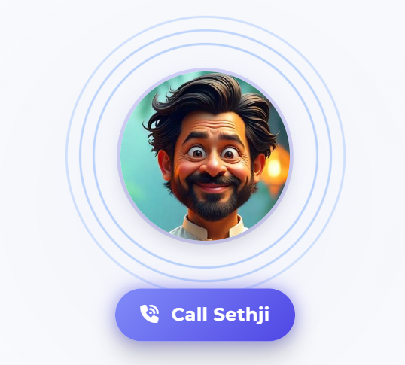










Sethji Grocery Store
An AI powered solution catering to various markets …
Ania, Polska
Thomas, Deutschland
Su Lee, China
Manuel , Brazil
Jim, Texas
Munshilal, India
Roger , Australia
Ivy, Jamica
Inventory Management Solutions at Scale

Slide 2
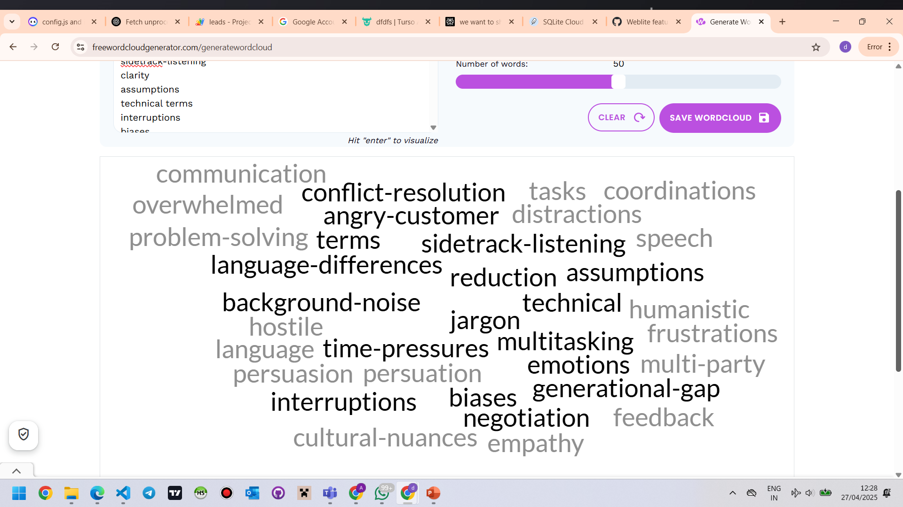
Market Size
Market Potential: Targets a $7 billion serviceable market with an achievable 5-10% market share, translating to $280M-$710M revenue potential by 2030 for LTIMindtree.
Target Customer - Core Markets (retail) - Grocery, Apparel, Electronics, and Pharmacy stores
Target Customer - Adjacencies - Automotive, Education, Consumer electronics. Food Services, Construction, E-Commerce, Warehouses
Simplified communications – via telegram + WhatsApp
Language Support – Support 80+ Languages including Hindi , Polish, and German, Bengali, etc
Visual Planograms – Support for visual planograms
Our products is “Industry FIRST”
1. Seasonal Forecast - Blending A2A + with AI (Gen AI + AI)
2. Voice AI supporting humanstic intent , multi-language context switching
3. LLM powered Telegram + Whatsapp communication which talks, responds, takes orders remotely freeing shop owner bandwidth

Slide 3
Market Size
(Ref: The business research company and IMARC group)

Slide 4

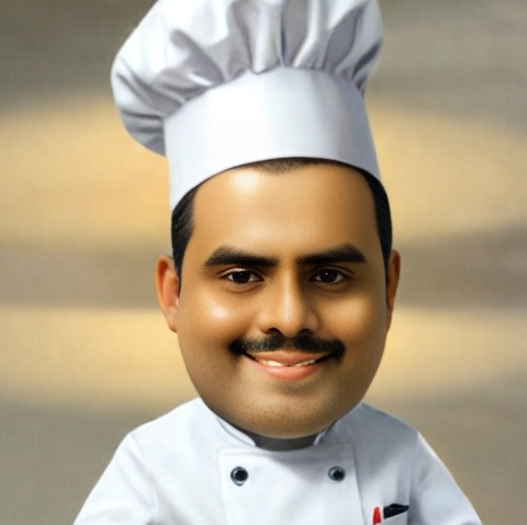


Team & Challenge Construct
Team Name
Baby GENius
Sethji Grocery Store
Nikita
10672405
Grand Fromage
Challenge Statement
Optimizing Inventory Management for a Small Retail Store
Arvind
10696594
Digital Dishwasher
Srini M
61041192
Maître d' Mayhem
The more inventory a company has, the less likely they will have what they need
Taiichi Ohno

Slide 5


Problems we are solving … at a global scale…
“
“
“
“
“
“
During Eid, no more halwa or good dates left, wallah, business goes down! (stockouts during peak season)
Ai-yah, the Spring Festival rush, my nian gao and red lanterns all wrong! Seasonal demand prediction is so difficult
Crikey, tryin' to beat those blokes' prices is a fair dinkum battle! (price optimization)
Roger , Australia
Salman , Oman
Su Lee, China
“
“
“
“
“
“
My kielbasa, sernik, even Wedel chocolate spoiling! How to prevent stock wastage ?
Well, these slowpokes are just hoggin' my cash and takin' up prime real estate, (slow moving inventory)
Nossa, without a good system, all these pão de queijo and açaí going bad is a big problema! (expiry issues)
Ania, Polska
Jim, Texas
Manuel , Brazil
“
“
“
“
“
“
Ach, this hand-counting gives only Kopfschmerzen and wrong numbers! I want a system to automate inventory reconciliation
It's tough to know if mithai boxes or jalebi’s fly off the shelves fastest, ya know? (difficulty identifying best sellers)
Man, this whole hand-written reorderin' for mi ackee and saltfish is takin' forever! (blaming her manual reordering process)
Thomas, Deutschland
Munshilal, India
Ivy,
Jamica
5

Slide 6
Problems we are solving … at a global scale…
Slow Movers
Compliance issues
Inventory processing
Error Prone
Data model expansion
Best Sellers
FIFO
Time consuming
Seasonal Demand
LIFO
Just-In-Time
Demand Forecasting
Sales Trends
Blue Sheets (Physical inventory reconciliation)
Carrying Cost
Stock Audits
WAC
Supplier Delays
Real time inventory
Manual Tracking
Loss prevention
Economic Order Quantity
Order fulfilment
Replenishment
Backflushing
Simplification
Markets
Vendor Managed Inventory
Multi Channel
Order Fulfillment
Poor Reordering
Consumption
Safety Stock
Inventory Visibility
Main Overground Line
Reporting Delays
Cross Docking
Space Constraints
Competition
Pricing Errors
Product Lifecycle Mgmt
Obsolescence
Reorder Point
Stockouts
Overstocking
Inventory Mismatch
Customer Returns
Batch Tracking
SKU Management
Cycle Counting
Underground Line
Wastage
Inadequate structure
Expiry tracking
Stock management
Discrepancies
Stock levels
Carrying Cost
Inventory control
Inventory Valuation
Decision Delays
Inventory Aging
Supply Chain
Product Rotation
Inventory Shrinkages
Lifecycle Management

Slide 7
Technical approach to solving various inventory challenges
Technical Solution
Leverage Python-flask + KAPPA architecture using Pandas, keras, Numpy to predict demand using advanced algorithms.
LLM for handling queries, processing orders (Gemini 2.5 Flash + ADK + Audio understanding + Image scanning/vision AI)
Integrate with Telegram, support automated order handling, Send instant reorder notifications via Reporting portal with smart quantity suggestions.
Implement Humanistic AI to bring a human like feel using POCA templates
Handle data via JSON rules engine - headless data architecture using Gen AI for creating custom content through advanced prompt engineering
Internationalization support (i18n) – context adaption to 4 languages (Deutsch, Polski, Hindi, English)
Model Context Protocol (MCP) to establish bidirectional data pipelines between inventory systems and AI agents.
Inventory
Tracking
Demand Forecasting
Reordering Alerts
Expiry Management
Sales Analytics
Real-Time Updates
AI-Driven Insights
Instant Notifications
Waste Reduction
Performance Tracking
01
02
03
04
05
Capture and update stock status instantly, ensuring retailers are always informed about inventory levels with seamless scanning integration.(audio, text, image)
Utilize advanced algorithms to analyze sales data and trends, providing accurate demand predictions tailored to business needs.
Receive immediate reordering alerts via Portal, with smart suggestions for quantities based on historical data and demand forecasts.
Monitor product expiration dates with automated alerts, prioritizing older stock to minimize waste and optimize inventory rotation.
Analyze top-performing products and receive notifications for underperforming stock, allowing for informed decision-making and markdown strategies.

Slide 8
We have covered the following personas :
Stage | Scenario | Actions | AI/Tech Involvement | Emotional Impact
1. Awareness | Sethji hears about Sethji.ai from LTIMindtree vendor and sees demo videos. | • Attends local demo • Talks to peers | - | Curious but skeptical
2. Product Upload | Uploads of Product information via customer chat (WhatsApp/Telegram integrated), product csv files | • Installs app • Links to POS • Uploads product catalog | 🧠 Initial data ingestion, catalog mapping, and model configuration | Hopeful, optimistic
3. Daily Use – Inventory Tracking | Uses Sethji co-pilot interface to track daily inventory and perform updates | • Scans new stock • Gets real-time alerts | 👁️ LLM Image recognition tracks on-shelf stock 📡 Data streamed to SQLite & processed | Empowered, confident
4. Demand Forecasting | Notices an AI-generated forecast showing potential spike in flour demand during festival. | • Adjusts order plan proactively | 📈 ML model forecasts demand using past sales + external factors | Impressed, prepared
5. Automated Reordering | Receives alert: "You’re running low on biscuits. Auto-reorder placed." | • Approves or edits order via Telegram | 🔁 AI Rules engine + reorder thresholds 🔔 Alert via voice or bot | Relieved, less stress
6. Insights & Reports | Reviews weekly report on expired goods and top 5 SKUs. | • Uses mobile dashboard | 📊 Analytics engine summarizes shelf life, wastage, high-margin items | Strategic, proud
7. Voice Assistant Queries | Asks, “How many Parle-G packets sold last week?” | • Speaks to inbuilt voice bot | 🎤 ADK + Diarization + voice recognition integrated with AI model | Delighted by convenience
8. Growth Phase | Opens a second store. Uses same dashboard and forecast engine. | • Adds store node to Sethji.ai | 🧠 Scalable headless architecture supports multi-store setup | Ambitious, in control

Slide 9

Technical Solution Expanded
Requirement | Solution Considerations | AI | Gen AI | Voice | Telegram | Dashboard
Real-Time Inventory Tracking | Backend solution to capture realtime-orders (supplier + customer) instant updates on stock status, ensuring retailers are always informed about their inventory levels. Seamless Image detection/product detection for products by scanning integration for quick and accurate stock updates. Color-coded inventory status indicators provide at-a-glance understanding of current stock levels. Alerts will notify users when stock is low, allowing for timely action to replenish items.
AI-Driven Demand Forecasting / Replenishments | The system analyzes past sales data and seasonal trends to predict future demand accurately Advanced pattern recognition algorithms identify trends in your sales history for accurate predictions. Automatic detection and adjustment recommendations based on seasonal buying patterns. Integration with event data and weather forecasts to anticipate demand fluctuations Tailor forecasting models to your specific business needs with accuracy reporting metrics.
Reordering Alerts | Instant reordering notifications sent directly to your Telegram for immediate action Smart suggestions for purchase quantities based on historical data and predicted demand. Streamlined process with vendor management integration for efficient purchasing. Set specific reorder points with priority categorization options for different product types.

Slide 10
Technical Solution Expanded
Requirement | Solution Considerations | AI | Gen AI | Voice | Telegram | Dashboard
Expiry Tracking | Complete system for monitoring product expiration dates and prioritizing older stock. Automated alerts for items approaching their expiration dates to reduce waste. First-In-First-Out inventory organization system to ensure proper stock rotation. Detailed reports with actionable suggestions to minimize product loss and optimize inventory
Sales Analytics | Track top-performing products with detailed historical performance analytics. Receive notifications for underperforming stock with markdown recommendations. Year-over-year comparisons to identify and prepare for seasonal demand patterns. Create and export detailed reports in multiple formats for further analysis
Structural Management | Flexible inventory methods with automated guidance based on product types. Powerful tools for organizing products with custom taxonomy options for your store. Comprehensive reporting with support for multiple accounting methods. Seamless inventory synchronization across locations with transfer management tools. Handle brand substitutions and replacements across same category

Slide 11
Solution Architecture
1. Data Input Layer (Capture & Ingest)
2. Processing & Intelligence Layer (AI Core)
Retail Store Data
Computer Vision
Voice Interface
External Sources
Demand Forecasting
AI + Gen Layer
Inventory Optimizer
Reorder Alert Engine & Sales Analyzer
💡 Audio/image/text ingestion using Cross-Sensory Modeling (CSM), Diarization models, Image recognition via LLM scanning tools
💡 KAPPA (pub-sub architecture), JSON rules engine (headless), AI agents via Model Context Protocol (MCP)
5. Analytics & Monitoring layer
4. Communication & Automation
3. Storage & Date Management
Dashboard: Real-time stock levels, sales analytics, expiry alerts
Reports: Historical trends, missed sales, overstock insights
Telegram Bot
DeepGram / Virtual Avatar
Auto Order Flow
SQLite3 (Light weight embedded DB)
Vector DB
CDC Layer
💡For ease of use given small stores might have Technically Challenged people
💡 Enables local-store operations even with intermittent connectivity
💡Built-in intelligence to recommend markdowns and promotions

Slide 12





Technical Architecture
System structure, key components, and their interactions
Reports
Primary Persona
Business Facade
LLM
Agents
Security
🧔‍♂️ Small Retailer
🧕 Store Assistant
👨‍👩‍👧‍👦 Customer
👨‍🔧 Supplier
Channels
Demand Forecast Agent (scikit-learn)
API Gateway
Gemini AI
✅ Data Encryption (at rest + transit)
🟢 Telegram Bot
🟣 Voice AI
🌐 Web UI (Bootstrap)
📞 Phone Call Bot (Optional)
Flask
Ultravox – Voice AI
Spoilage Detector Agent (Pandas + shelf life logic)
✅ SQLite DB security (local passphrase, Google Drive backup optional)
B2B Persona
Voice AI
Telegram
🏪 Franchise Manager
📦 Wholesalers
🏛️ 3rd Party Aggregators
UI Interface
Store
Inventory Reorder Agent (based on sales trends + min/max rules)
Pandas/Numpy
Underpins
Sales Insight Agent (Dash + NumPy)
✅ API Tokens (rotating keys for agents)
Underpinning Services
Database (SQLite + CDC Metadata)
Seaborn/MatPlot
3rd Party
Billing
Telegram Order Agent (parses customer messages, logs orders)
Business Rules Engine (JSON)
Vector DB
✅ Privacy Presets: Obfuscate customer data
External
🏪 PoS
📦 Shipping
📦 Tommorow.ai
🏛️ FMCG
📣 eDI B2B (Ariba)
SQL Alchemy
CSV/POS Files
Files / Data Shares
UPI
Stripe integration
Country Policy
Local regulatory rules
Price display compliance
Expiry tracking audits
REST API / Services
API Access
Model Context Protocol Manager
Prompt Perfect + JSON Enforcement
POCA templates
Hardcoded functionality

Slide 13
Selling Models
$2 BN
Adjacencies
Products
Incremental Product
$3 BN
$3 BN
Derivative
Product
We see a 5-10 BN ancillary business by building more solutions across our product lines
Offering provided as a Sethji in a box – pricing models in next slide
Opportunity to expand to adjacencies including Automotive, Education, Consumer electronics. Food Services, Construction, E-Commerce, Warehouses

Slide 14
Pricing Models
Regional Pricing Solutions
Region | Recommended Models | Localization Tips & Example Price Ranges
India | Tiered Subscription, Usage-Based, Freemium | Lower entry pricing. Basic: ₹499–₹1,499/month; Usage-based: ₹4–₹8/minute. Freemium for adoption.
Europe | Tiered Subscription, Per-User, Usage-Based | Price in Euros, include VAT. Basic: €29–€69/month; Mid: €99–€199; Premium: €299+. Usage: €0.10–€0.25/min. GDPR focus.
Other Regions | Hybrid (Tiered + Usage), Outcome-Based | Local currency. Basic: $29–$59/month; Usage: $0.10–$0.20/minute. Custom enterprise and multi-currency.
Tiered Pricing
Plan | Features (Examples) | Target Customer | India Price | Europe Price | US/Other Price
Basic | Voice commands, simple queries, limited integrations | Small businesses | ₹499/mo | €29/mo | $29/mo
Pro | Advanced analytics, multi-language, CRM integration, reports | Growing orgs | ₹1,499/mo | €99/mo | $99/mo
Enterprise | Custom AI workflows, compliance, API, premium support | Large enterprises | ₹4,999+/mo | €299+/mo | $299+/mo
Voice AI-Specific Pricing Table
Model | India Price | Europe Price | US/Other Price | Notes
Pay-Per-Minute | ₹4–₹8/min | €0.10–€0.25/min | $0.10–$0.20/min | For high-volume or flexible users
Feature Add-Ons | Custom | Custom | Custom | Advanced analytics, compliance, etc.
Volume Discounts | Available | Available | Available | For large contracts or multi-year deals

Slide 15
Sethji Solution – Software Requirements
01
Infrastructure
Minimal instructure designed to run on a t3.micro infrastructure (considering store owners may
04
Major Packages Req
Major Python packages leveraged:
‘langgraph’, ‘crewai’, 'python-dotenv’, 'langchain’, 'langchain-community', 'langchain-text-splitters’, 'langchain-chroma', 'langchain-openai’, 'langchain-core’

Slide 16
Requirements – Tools & Softwares
Open-Source Software: Python, Flask, AngularJS, SQLAlchemy, Scikit-learn, and Plotly Dash for building the application.
Responsive UI / PWA App capable of being rendered across devices (Deviceless architecture)
Vercel Cloud:
Storage Size: data volume (e.g., Database size).
Compute Resources: CPU and memory need for running ML models and APIs (Scikit-learn, incorporating models like ARIMA and RandomForest for SKU-level demand forecasting.)
Web URL access
Telegram API access (blocked by LTIMINDTREE)
UltraVox API access (blocked by LTIMINDTREE)
Elevenlabs access (blocked by LTIMINDTREE)
Voice Interface Support: Integrate Ultravox for multilingual voice input/output, enhancing accessibility for semi-literate users.
Telegram Bot + Audio + Image extraction : Develop a bot to manage supplier purchase orders and customer requests, utilizing NER for SKU extraction and transaction logging. (Gemini API)
Data Visualization: Use Plotly Dash for analytics dashboards, presenting insights like slow-moving stock and sales trends, accessible via a mobile-optimized Bootstrap interface
ALL Team members + Laptops are using LTIMindtree laptop with the above restrictions only

Slide 17
48 Hours WINDOW - MVP Scope and Deliverables
PPT + Video showing the solution
Implement a SQLite3 Database for lightweight embedded data storage.
Enable Change Data Capture (CDC) for tracking data changes and integrity.
Integrate basic Computer Vision capabilities for product identification and inventory tracking.
Develop a Voice UI using Diarization and Humanistic AI for intuitive user interactions.
Allow voice commands for actions such as inventory checks and reorder requests.
Utilize AI + Gen Layer with KAPPA architecture for demand prediction using Pandas, Keras, and NumPy.
Implement a demand pattern design using tomorrow.io weather data.
Create an Inventory Optimizer to suggest optimal stock levels and manage inventory efficiently.
Develop a Reorder Alert Engine to trigger alerts for low stock levels.
Build a Real-Time Dashboard displaying stock levels, sales analytics, and expiry alerts.
Generate reports on historical trends, missed sales, and overstock insights.
Integrate a Telegram Bot for automated order handling and instant reorder notifications with smart quantity suggestions.

Slide 18
Sethji Grocery Store
Thank You

