Slide 1
User Trust Aided Recommender System
Presented by :
Vachik Dave
Arvind Nair
Hitendra Rathod
Guided by :
Prof. Xia Ning

Slide 2
Outline
Introduction
Collaborative Filtering & Matrix Factorization
Motivation
Proposed Work
Formulization
Dataset
Results
Conclusion

Slide 3
Introduction
Problem definition:
Try to predict user’s rating for new unrated item and use that information to recommend unrated items by the user.
In this project, we compare the user trust based recommendation with the two base line methods:
1- Item-Item Collaborative Filtering and
2- Matrix Factorization method.
We aim to show that User Trust aided recommendation outperforms the baseline recommendation methods.

Slide 4
Overview Of Item-Item Collaborative Filtering
The cosine similarity of the items is considered.
This is done by looking at the users who co-rated those items.
The most similar items are stored in descending order of their calculated cosine similarity values.
From the table we consider Top K unpurchased items most similar to those items purchased by a particular user.
We then find the candidate set for that particular user.
We finally generate Top-N recommended items.

Slide 5
Item-Item Collaborative Filtering
Results:
K (Unpurchased Items) | N (Candidate Set) | Hit Rate (HR) | Average Reciprocal Hit Rate(ARHR)
10 | 10 | 0.001518 | 3.2368XE-4
20 | 15 | 0.002016 | 2.7388XE-4
20 | 20 | 0.002589 | 2.7388XE-4
25 | 15 | 0.002166 | 2.9878XE-4
25 | 25 | 0.003087 | 2.9878XE-4
30 | 15 | 0.001892 | 2.7388XE-4
30 | 20 | 0.002390 | 2.7388XE-4
30 | 30 | 0.003311 | 2.7388XE-4

Slide 6
Overview Of Matrix Factorization Method
In this method, we optimize the objective function using Alternating Least Squares (ALS).
For this we first fix Item factor matrix Q and we solve for User factor matrix P.
Then we fix P and solve for Q.
f(P,Q) = ∑(r_{ui} – p_{u} q_{i} )² +λ(||P||²_{F} +||Q||²_{F} )
This is the objective function which has to be minimized.
The User-Item rating matrix is used after optimization to calculate HR and ARHR.
We calculate the top K item for recommendations.

Slide 7
Matrix Factorization Method
Results:
K (Latent Dimension) | Control Parameter (lamda) | Mean Square Error (MSE) | Root Mean Square error (RMSE) | Hit Rate (HR) | Average Reciprocal Hit Rate (ARHR)
1 | 3 | 1.5960 | 1.2633 | 8.4655XE-4 | 2.4898XE-5
1 | 5 | 1.5544 | 1.2467 | 0.001269 | 2.4898XE-5
3 | 3 | 1.6234 | 1.2741 | 8.7144XE-4 | 4.9797XE-5
3 | 5 | 1.5546 | 1.2468 | 0.001518 | 4.9797XE-5
5 | 7 | 1.5209 | 1.2332 | 0.002589 | 4.9797XE-5
6 | 10 | 1.4811 | 1.2170 | 0.005726 | 1.9918XE-4

Slide 8
Motivation:
Traditional methods: only use historical information
in real world - many other influences
friends and other known users reviews
A user → set of other users

Slide 9
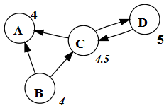
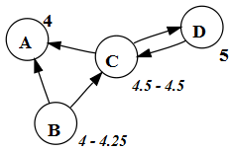
Proposed Method:
Matrix Factorization(MF) : basic but powerful technique
incorporate the trust information into MF:
Add the trust information in loss function.
Add the trust information as regularization term.
Sanjog Ray et. al.[3]: good improvement by trust propagation
Trust Propagation: if a trustworthy person rated item good then highly probable that the user will also rate the item good.
→

Slide 10
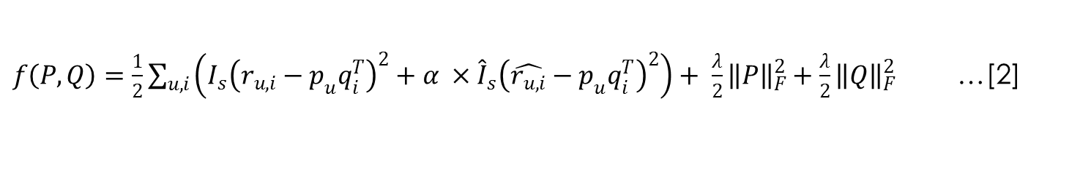
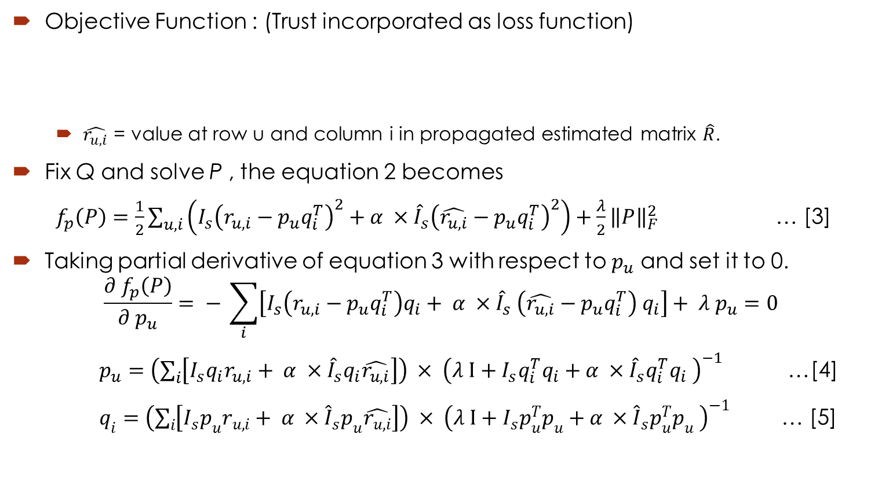
Formulization:
Objective Function : (Trust incorporated as loss function)
$\hat{r_{u,i}}$ = value at row u and column i in propagated estimated matrix $\hat{R}$.
Fix Q and solve P , the equation 2 becomes
$f_{p}\left(P\right)=\frac{1}{2}\sum_{u,i}{\left(I_{s}{\left(r_{u,i}−p_{u}q_{i}^{T}\right)}^{2}+α ×{\hat{I}}_{s}{\left(\hat{r_{u,i}}−p_{u}q_{i}^{T}\right)}^{2}\right)}+\frac{λ}{2}{\left\|P\right\|}_{F}^{2}$ … [3]
Taking partial derivative of equation 3 with respect to $p_{u}$ and set it to 0.
$$\frac{{∂ f}_{p}\left(P\right)}{∂ p_{u}}= − \sum_{i}{\left[{I_{s}\left(r_{u,i}−p_{u}q_{i}^{T}\right)q}_{i}+ α ×{\hat{I}}_{s} \left(\hat{r_{u,i}}−p_{u}q_{i}^{T}\right) q_{i}\right]}+ λ p_{u}=0$$
$p_{u}=\left(\sum_{i}{\left[I_{s}q_{i}r_{u,i}+ α ×{\hat{I}}_{s}q_{i}\hat{r_{u,i}}\right]}\right) × {\left(λ I+I_{s}{q_{i}^{T}q}_{i}+α ×{\hat{I}}_{s}{q_{i}^{T}q}_{i} \right)}^{−1}$ …[4]
$q_{i}=\left(\sum_{i}{\left[I_{s}p_{u}r_{u,i}+ α ×{\hat{I}}_{s}p_{u}\hat{r_{u,i}}\right]}\right) × {\left(λ I+I_{s}p_{u}^{T}p_{u}+α ×{\hat{I}}_{s}p_{u}^{T}p_{u} \right)}^{−1}$ … [5]
$f\left(P,Q\right)=\frac{1}{2}\sum_{u,i}{\left(I_{s}{\left(r_{u,i}−p_{u}q_{i}^{T}\right)}^{2}+α ×{\hat{I}}_{s}{\left(\hat{r_{u,i}}−p_{u}q_{i}^{T}\right)}^{2}\right)}+ \frac{λ}{2}{\left\|P\right\|}_{F}^{2}+\frac{λ}{2}{\left\|Q\right\|}_{F}^{2}$ …[2]

Slide 11
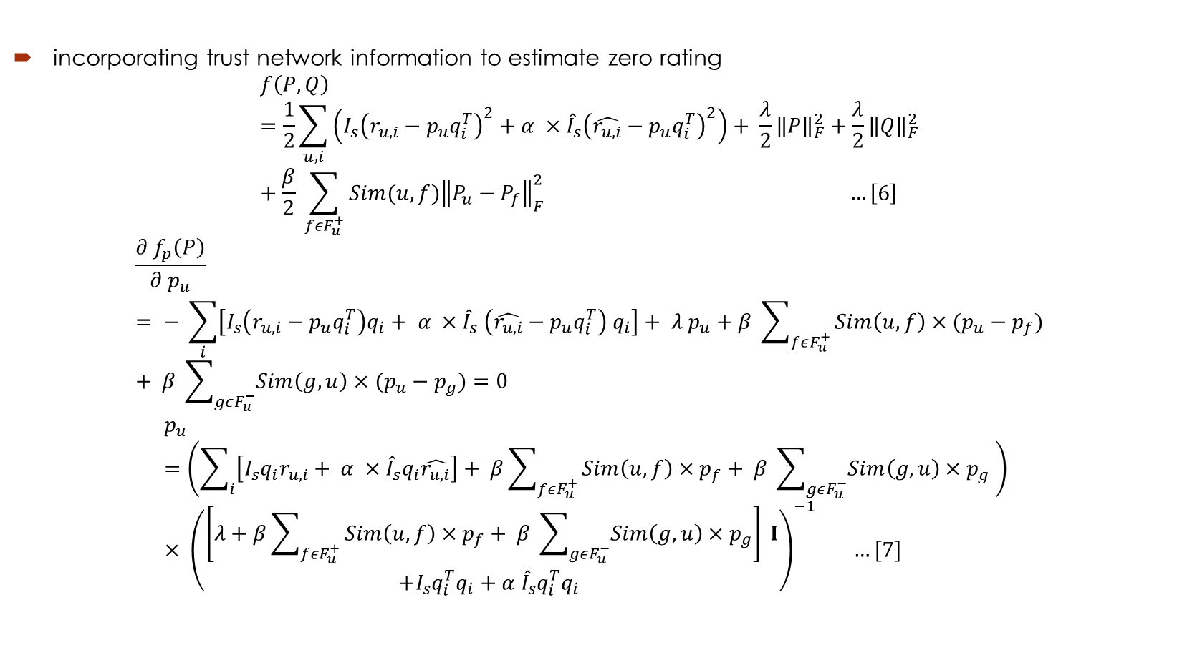
Second Version:
incorporating trust network information to estimate zero rating
$$f\left(P,Q\right)=\frac{1}{2}\sum_{u,i}{\left(I_{s}{\left(r_{u,i}−p_{u}q_{i}^{T}\right)}^{2}+α ×{\hat{I}}_{s}{\left(\hat{r_{u,i}}−p_{u}q_{i}^{T}\right)}^{2}\right)}+ \frac{λ}{2}{\left\|P\right\|}_{F}^{2}+\frac{λ}{2}{\left\|Q\right\|}_{F}^{2}+\frac{β}{2} \sum_{fεF_{u}^{+}}{Sim(u,f){\left\|P_{u}−P_{f}\right\|}_{F}^{2}} …\left[6\right]$$
$$\frac{{∂ f}_{p}\left(P\right)}{∂ p_{u}}= − \sum_{i}{\left[{I_{s}\left(r_{u,i}−p_{u}q_{i}^{T}\right)q}_{i}+ α ×{\hat{I}}_{s} \left(\hat{r_{u,i}}−p_{u}q_{i}^{T}\right) q_{i}\right]}+ λ p_{u}+β \sum_{fεF_{u}^{+}}{Sim\left(u,f\right)×{(p_{u}−p}_{f})}+ β \sum_{gεF_{u}^{−}}{Sim\left(g,u\right)×{(p_{u}−p}_{g})}=0$$
$$p_{u}=\left(\sum_{i}{\left[I_{s}q_{i}r_{u,i}+ α ×{\hat{I}}_{s}q_{i}\hat{r_{u,i}}\right]}+ β\sum_{fεF_{u}^{+}}{Sim\left(u,f\right)×p_{f}}+ β \sum_{gεF_{u}^{−}}{Sim\left(g,u\right)×p_{g}} \right) × {\left(\begin{aligned}\left[λ+β\sum_{fεF_{u}^{+}}{Sim\left(u,f\right)×p_{f}}+ β \sum_{gεF_{u}^{−}}{Sim\left(g,u\right)×p_{g}}\right] I \\ +I_{s}{q_{i}^{T}q}_{i}+α {\hat{I}}_{s}{q_{i}^{T}q}_{i} \end{aligned}\right)}^{−1} …[7]$$

Slide 12
Dataset:
Epinion dataset [4]:
User – Item rating values
User –User trust network
Statistics:
# users = 49,290 → 40,163 (active)
# items = 139,738
# rating = 664,824 very very sparse (0.00965% dense)
Avg. degree = 11.0252 (active users)
Max out degree = 1723
Max in degree = 2500
Training data 70% = 465376 ratings
Validation / Testing 15% (both) = 99723 ratings

Slide 13
Results:

Slide 14
validation and testing:

Slide 15
Hit Rate:

Slide 16
Conclusion :
Conclusion:
Definitely better method than basic MF
Significant improvement
Small HR & ARHR : items = 139,738 & sparse rating (testing set is selected from that)
Future Work:
Second version can perform better than proposed method

Slide 17
Referencese
Massa. P. and Avesani, P. (2004). Trust-Aware Collaborative filtering for Recommender Systems, Lecture notes in Computer Science, Vol. 3290, pp. 492-508.
Ma, H., Zhou, D. et. al. (2011). Recommender Systems with Social Regularization, ACM international conference on web search and Data-mining, pp. 287-296.
Ray, S. and Mahanti, A. (2010). Improving Prediction Accuracy in Trust-Aware Recommender System, Hawaii International conference on System Sciences, pp. 1-9.
Epinions Dataset: http://www.trustlet.org/wiki/Epinion_dataset.
Massa. P. and Avesani, P. (2007). Trust-Aware Recommender Systems, ACM conference on Recommender systems, pp. 17-24.
Ray, S. (2012). Identifying Influential Taggers in Trust-Aware Recommender Systems, International Conference on Advances in Social Network Analysis and Mining.
Jamali, M. and Ester, M. (2010) A matrix factorization technique with trust propagation for recommendation in social networks, ACM conference on Recommender systems, pp. 135-142.

Slide 18
Thank You!!!

