Slide 1

Converting to Short-Term Rental Properties
Watershed Real-Estate

Slide 2
SCOPE
BACKGROUND
RECOMMENDATION
JUSTIFICATION
CONCLUSION

Slide 3
BACKGROUND
PROS
Large market for short-term rentals
Much higher rates per night
CONS
Higher operating costs
Evaluation of Short-Term Rental Performance
Location
Property Type
$500,000 seed
>$6000 profit

Slide 4
RECOMMENDATION
Press-on with the conversion in a multi-stage process
10 most profitable properties first
Seed money: $500,000
$30,000 per conversion = $300,000
$200,000 float
Resilient against unexpected increases in cost

Slide 5
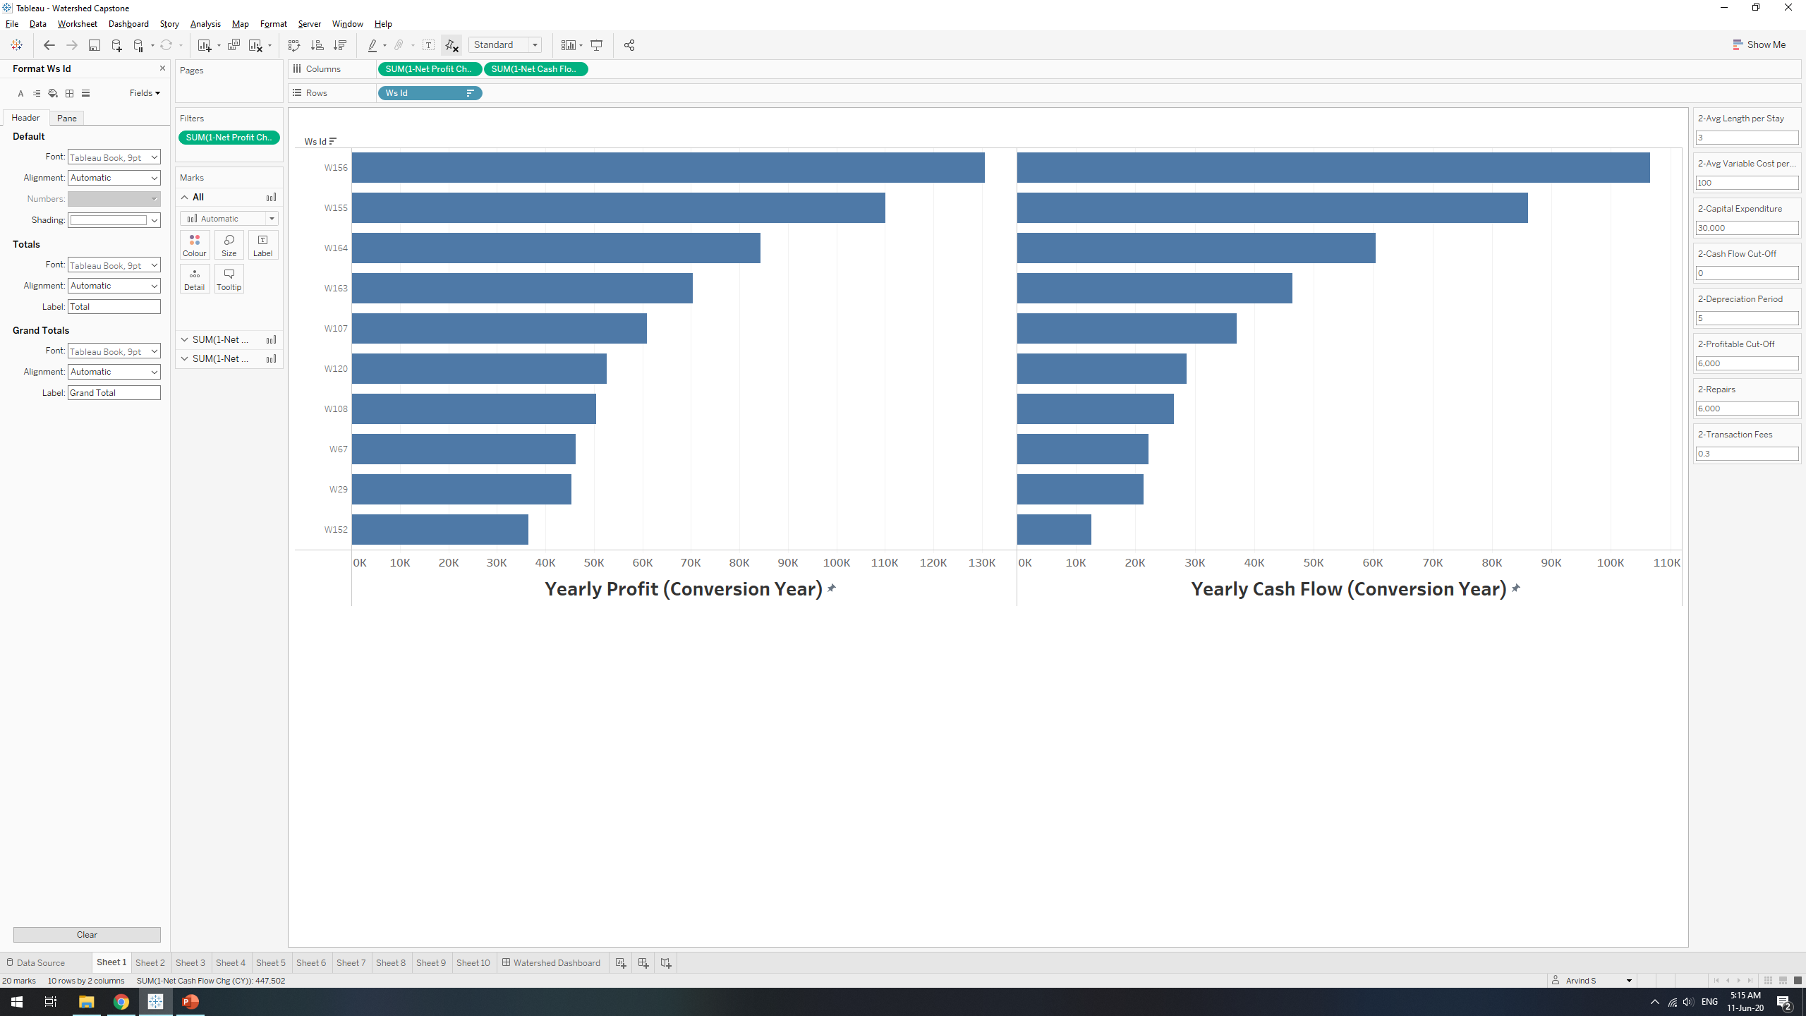
Profit:
$687,000 in first year
$596,000 thereafter
NO negative cash flows, even in conversion year
Refer to Dashboard

Slide 6
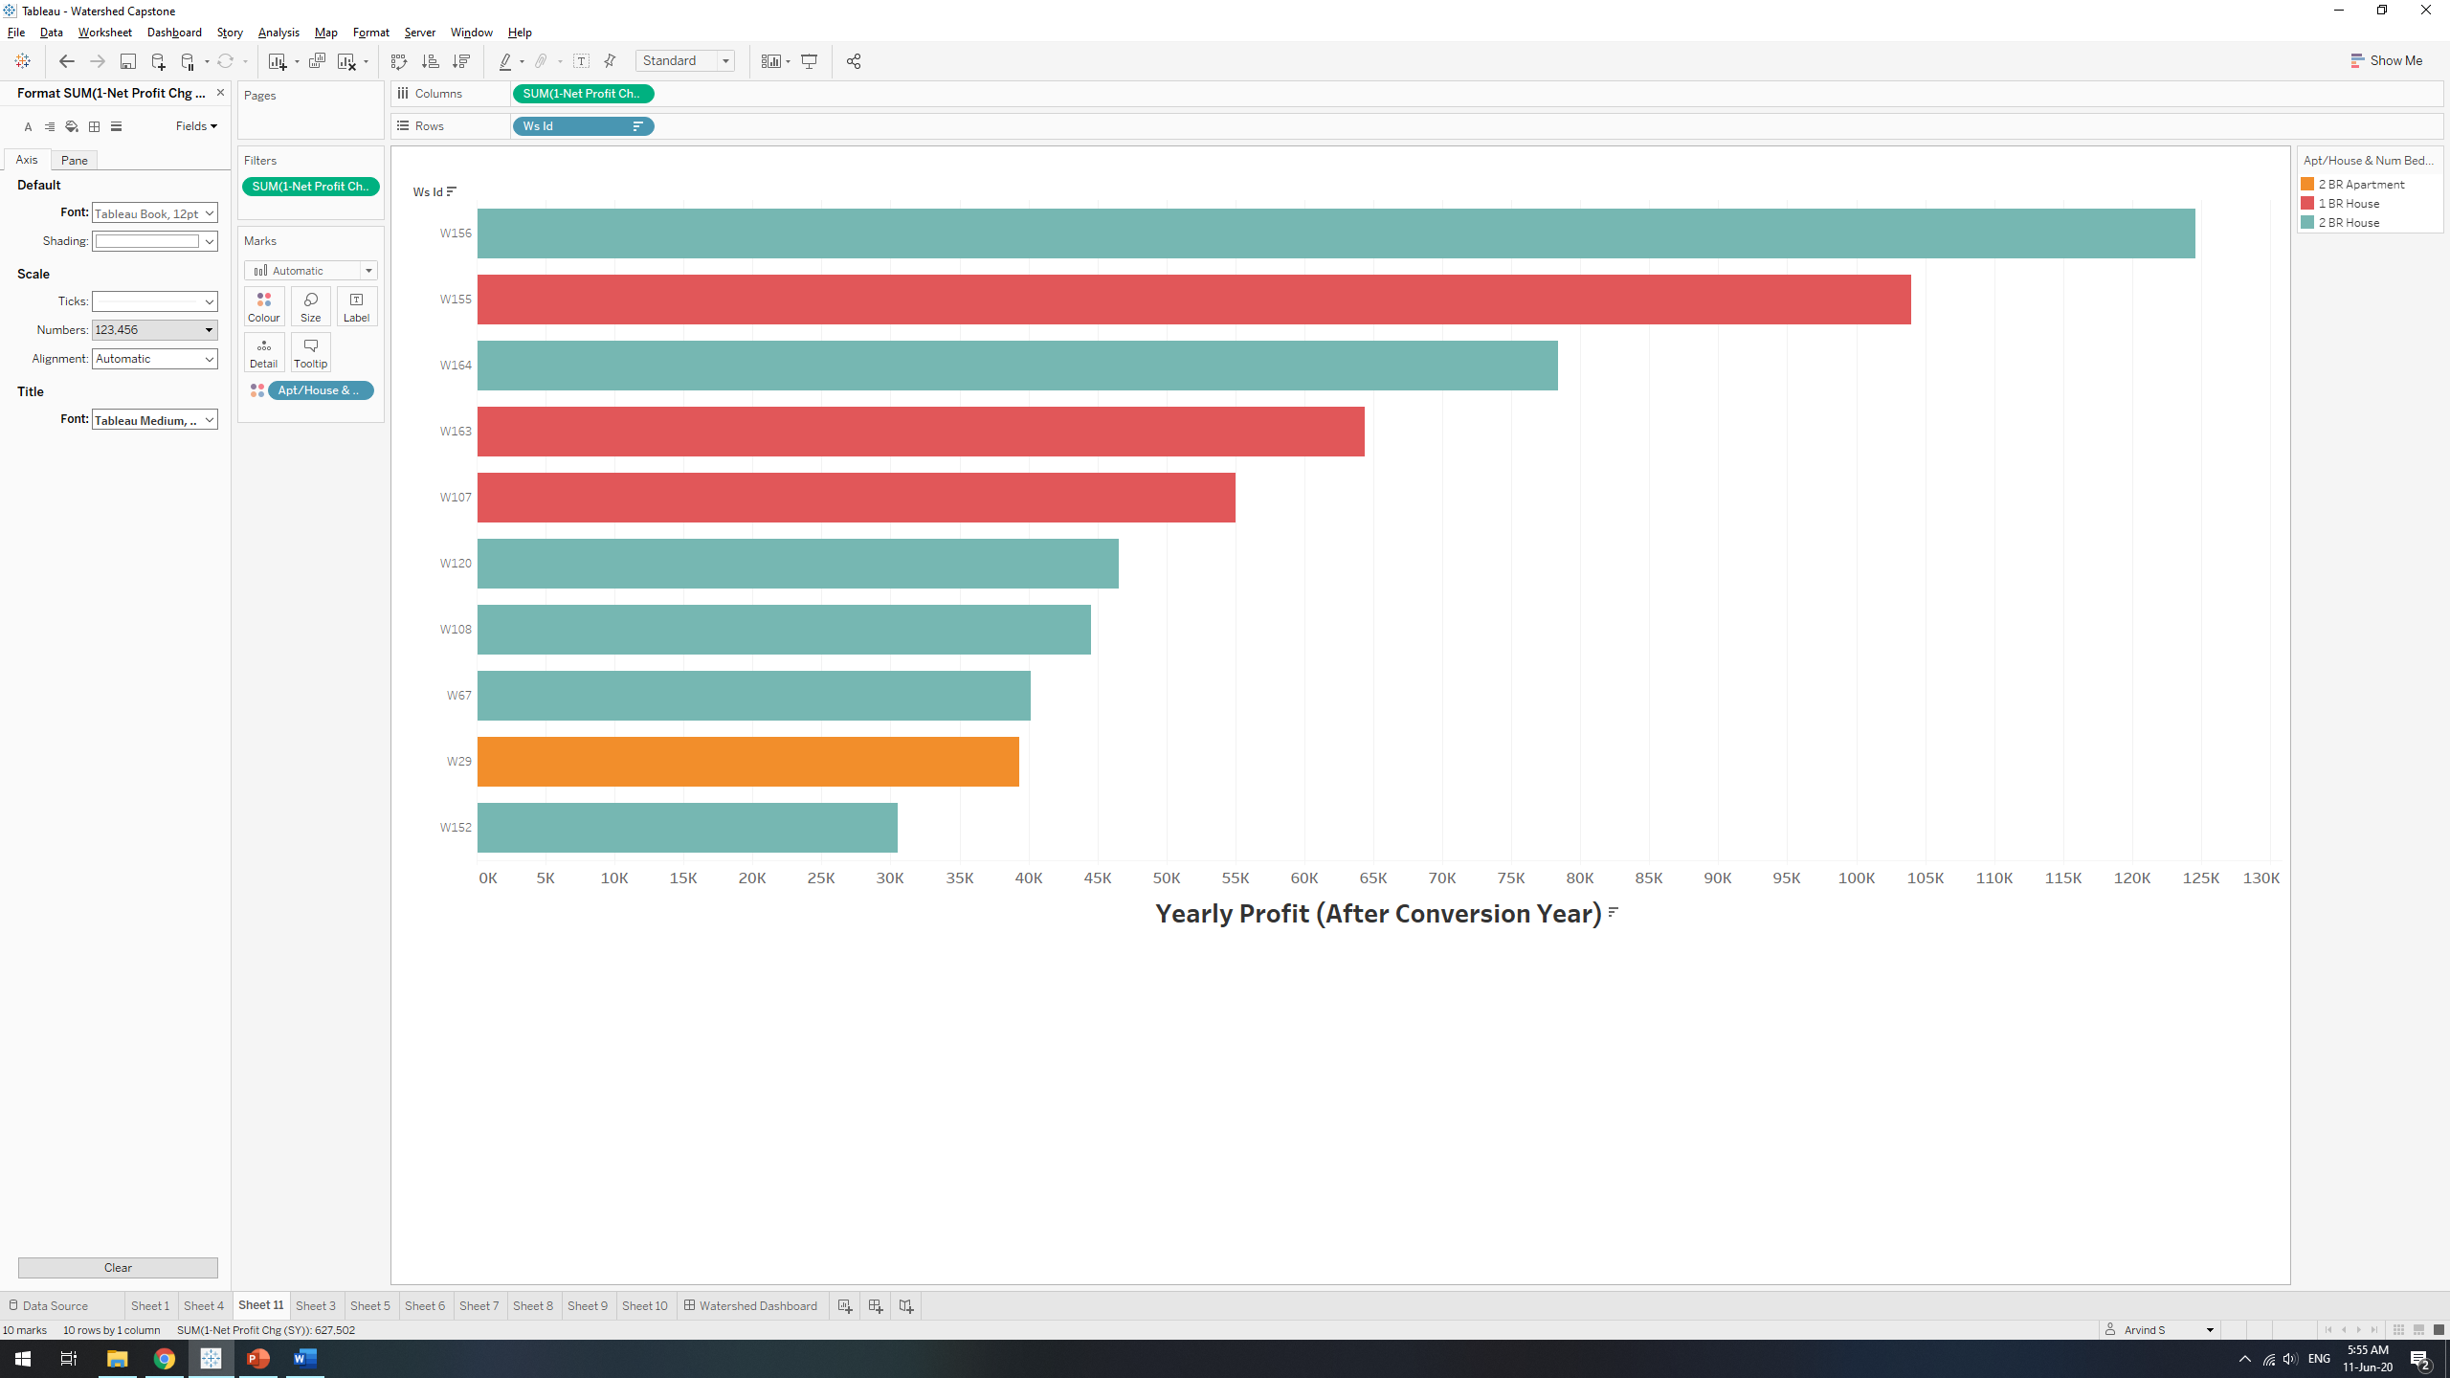
Client’s houses likely to be more profitable
Higher conversion and maintenance costs
Use upper end of sensitivity range

Slide 7
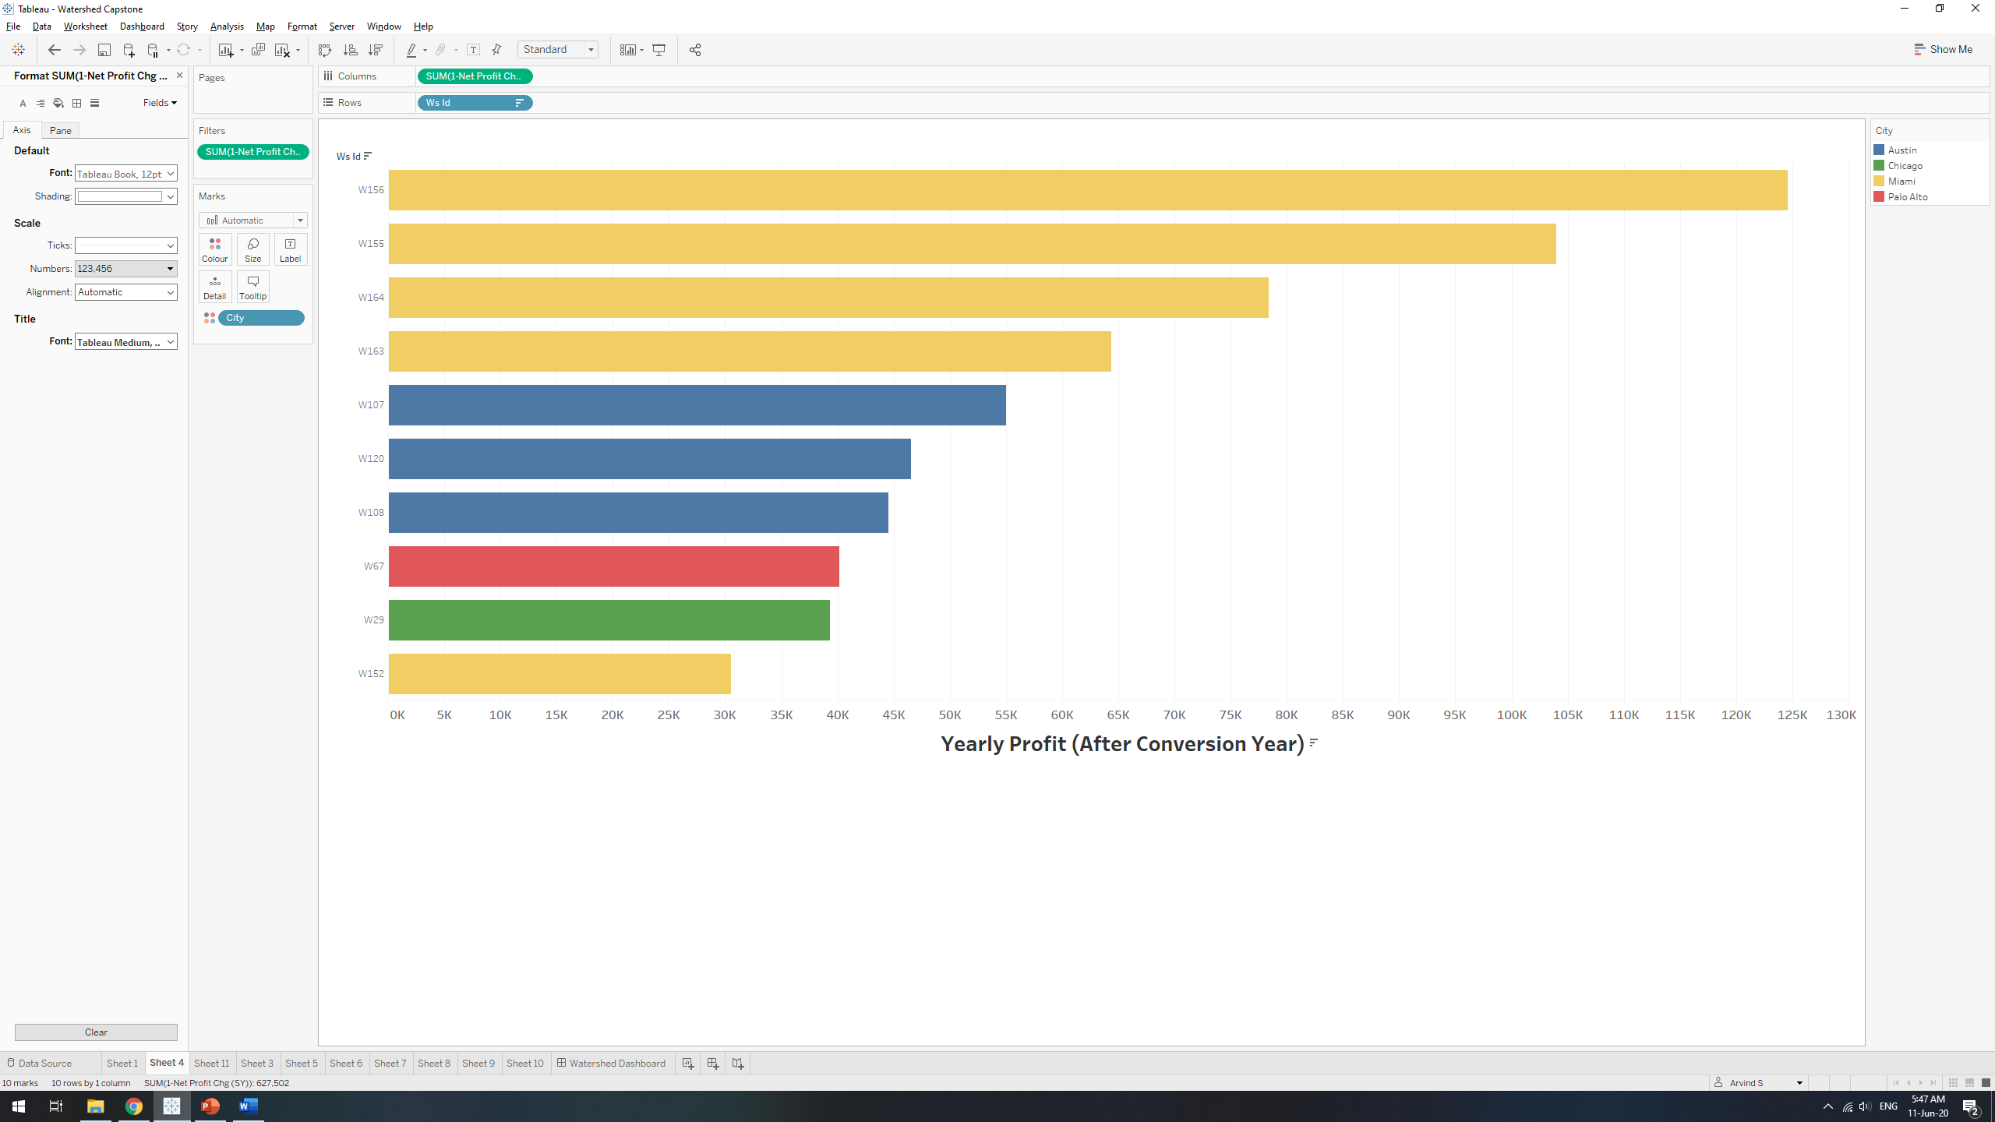
Miami and Austin: Higher tourism value?
Shorter stays?
Study seasonal effects: Discriminative Pricing

Slide 8
Justification
REVISED CASH FLOW
Phase 1
10 properties converted at $40,000: $100,000 float
Revised Profit Projection: $523,000 in the conversion year
$623,000 in cash reserves
Phase 2 and Beyond
Convert next 10 most profitable properties
$223,000 float >> Sustainable Growth
Repeat annually: cap at 55 (based on min. profitability of $6000)

Slide 9
Conclusion
Part of client’s property is viable for conversion
Higher operating costs are offset by strong revenue
Explore discriminative pricing to further boost profits
High chance of sustainable growth with ZERO debt

Slide 10
The end
Questions?

