Slide 1
ANAPLAN – Migration Strategy to Cloud
EDT and Finance Technology Data Transformation Team

Slide 2
Project Summary
DATA -→ INSIGHTS -→ ACTIONS
The strategic direction for enterprise reporting involves transitioning all Anaplan data and historical financial data from Essbase into the Azure Data Lake.
This initiative aims to preserve the integrity and accessibility of current financial dashboard reporting, ensuring that the Finance department retains the ability to query data once the legacy tools are phased out in December 2024.
To facilitate the development and integration of Anaplan data into Azure, additional engineering resources may need to be mobilized from May to October of 2024.
This augmentation of the team is essential to ensure a seamless transition and the ongoing availability of critical financial data within the new platform.

Slide 3












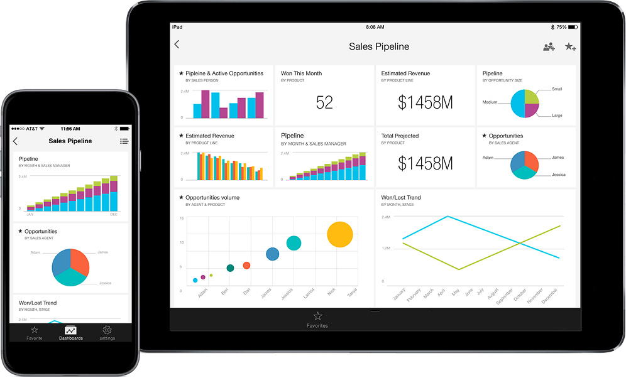







Finance – Temporary Pipeline
Data Sources
Ingestion
Azure Data Lake
Serve
Data Lake (Analytics)
Target State
Bronze
Raw
Layer
Silver
Curated Layer
Gold
Serving
Layer
Power BI Dataset
ADLS Gen 2
ADLS Gen 2
ADLS Gen 2
Azure SQL Consumption layer
Driver Data: Clorox Businesses
Databricks – Gold Consumption layer
Power BI
Bronze State : Where the data will be stored in its Raw Format
Silver State : Where data will be curated, cleaned including history
Gold State :
Where data will be served and ready for BI serve
Desktop and Mobile
Azure Databricks Spark-SQL / PySpark
Clorox Private Network
Security & Compliance
Networking
Operations
Monitor
Azure
Active Directory
VNET
Express Route
Agile Framework
Business Users
Azure Firewall
Key Vault
Domain
Controllers
DevOps
Notes:
Based on ADLS Gen 2 as Storage and Databricks for Processing following Medallion architecture

Slide 4




Anaplan - Detailed Solution Architecture
The proposed architecture brings the necessary capabilities while being robust and scalable to meet leading standards and emerging needs.
Data Sources
Ingestion
Azure Data Lake
Serve
Data Lake (Analytics)
Target State
Bronze
Raw
Layer
Silver
Curated Layer
Gold
Serving
Layer
Copy Data activity
API Calls
Power BI Dataset
ADLS Gen 2
ADLS Gen 2
ADLS Gen 2
Azure SQL Consumption layer
Azure Data
Factory
Databricks – Gold Consumption layer
Power BI
Bronze State : Where the data will be stored in its Raw Format
Silver State : Where data will be curated, cleaned including history
Gold State :
Where data will be served and ready for BI serve
Self-Hosted Integration Runtime (SHIR)
VMs on Private VNET to access mulesoft
Desktop and Mobile
Azure Databricks Spark-SQL / PySpark
Historical Data
Clorox Private Network
Security & Compliance
Networking
Operations
Monitor
Azure
Active Directory
VNET
Express Route
Agile Framework
Business Users
Azure Firewall
Key Vault
Domain
Controllers
DevOps
Notes:
Based on ADLS Gen 2 as Storage and Databricks for Processing following Medallion architecture

Slide 5
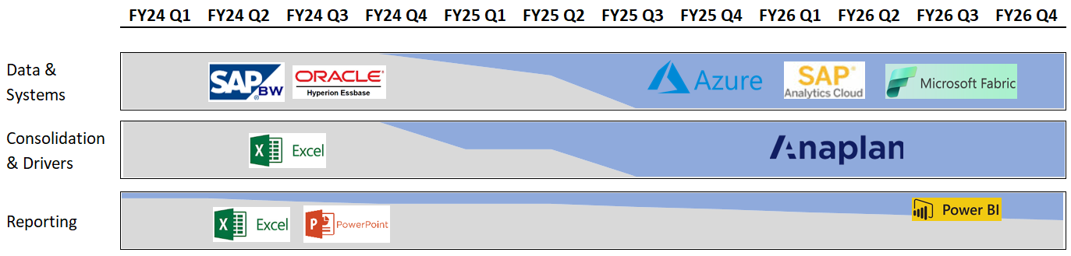
Timing of Critical Resource Support
Source: Anaplan project presentation
Anaplan testing period begins July-Dec 2024 and goes live Jan 2025. Then Legacy financial systems used to query current and historical financial data will be sunset.
Anaplan Data will become available in May/June to begin building pipelines
Seek to complete refined data engineering by October/November
Finance Data team will build custom reports in fabric for Q2 FY25 release
Shadow Period

