Slide 1
Analyzing H1B Data Using Hadoop Ecosystem
Presented by:
Name: Arvind Pednekar
Student ID: S171107500112
Center: Pune Deccan

Slide 2
Objective
To provide analysed report to H1B Sponsers to help them to make plans for future visa applicants. It will help them to get a skilled workers for their respective work.

Slide 3
Analyzing Factors
We will be performing analysis on the H1B visa applicants between the years 2011-2016. After analysing the data, we can derive the following facts.
1 a) Is the number of petitions with Data Engineer job title increasing over
time?
b) Find top 5 job titles who are having highest growth in applications.
2 a) Which part of the US has the most Data Engineer jobs for each year?
b) find top 5 locations in the US who have got certified visa for each year.
3)Which industry has the most number of Data Scientist positions?
4)Which top 5 employers file the most petitions each year?

Slide 4
Analyzing Factors
5) Find the most popular top 10 job positions for H1B visa applications for each year?
6) Find the percentage and the count of each case status on total applications for each year. Create a graph depicting the pattern of All the cases over the period of time.
7) Create a bar graph to depict the number of applications for each year
8) Find the average Prevailing Wage for each Job for each Year (take part time and full time separate)
9) Which are top ten employers who have the highest success rate in petitions?
10) Which are the top 10 job positions which have the highest success rate in petitions?
11) Export result for question no 10 to MySql database.

Slide 5
Technology used
MapReducer : a parallel processing software framework. It is comprised of two steps. Map step is a master node that takes input and partitions them into smaller sub-problems and then distributes them to worker nodes. After the map step has taken place, the master node takes the answer to all of the sub-problems and combines them to produce output.
Hive : a data warehousing and SQL like query language that presents the data in the form of tables. Hive programming is similar to data Warehousing.
Pig : a platform for manipulating data stored in HDFS and that includes a compiler for map reduce programs and high level language called Pig Latin.it provides a way to perform data extractions, transformation and loading and basic analysis without having to write Map Reduce programs.
Sqoop : a connection and transfer mechanism that moves the data between hadoop and relational databases

Slide 6
Big Data
Big Data is a collection of large datasets that cannot be processed using traditional computing techniques.
Which is made up of commodity hardware.
Which contains both structured(Relational), semi structured(XML,JSON) and structured data(Word, PDF, Text and media logs ).
When “Big Data” emerged as a problem, Apache Hadoop evolved as a solution to it.

Slide 7
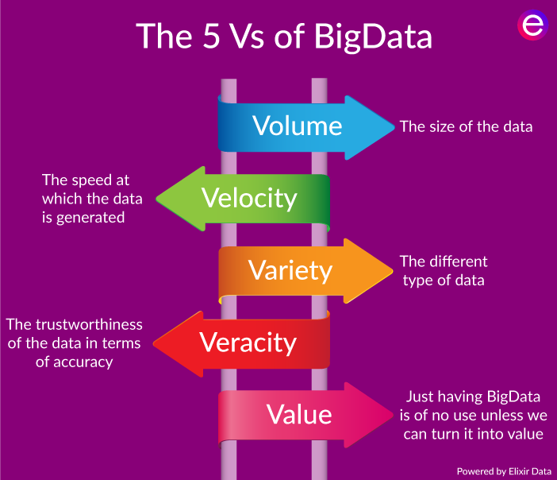
5 V’s of bigdata

Slide 8
Advantages of bigdata
Ability to store and process huge amounts of any kind of data, quickly. With data volumes and varieties constantly increasing, especially from social media and the Internet of Things (IoT), that's a key consideration.
Computing power. Hadoop's distributed computing model processes big data fast. The more computing nodes you use, the more processing power you have.
Fault tolerance. Data and application processing are protected against hardware failure. If a node goes down, jobs are automatically redirected to other nodes to make sure the distributed computing does not fail. Multiple copies of all data are stored automatically.
Flexibility. Unlike traditional relational databases, you don’t have to pre-process data before storing it. You can store as much data as you want and decide how to use it later. That includes unstructured data like text, images and videos.
Low cost. The open-source framework is free and uses commodity hardware to store large quantities of data.
Scalability. You can easily grow your system to handle more data simply by adding nodes. Little administration is required.

Slide 9
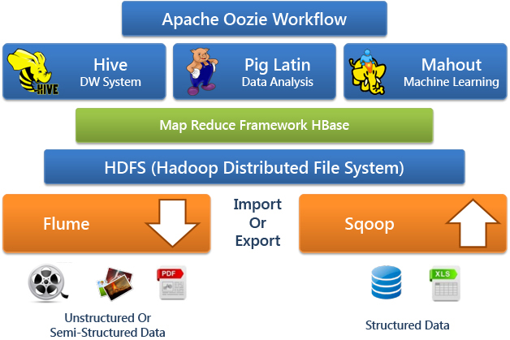
Hadoop Ecosystem

Slide 10
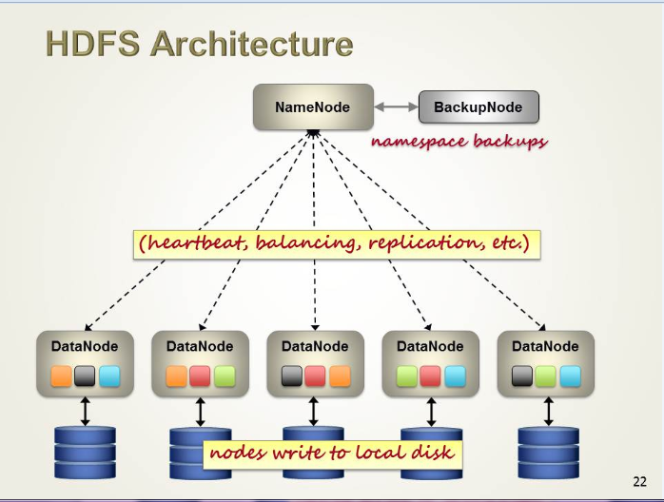
HDFS Architecture

Slide 11
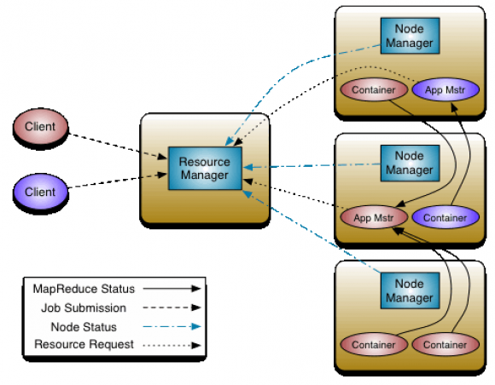
YARN

Slide 12
1 a) Is the number of petitions with Data Engineer job title increasing over
time?
Technology used: MapReduce
Solution: Average growth 68.81

Slide 13
b) Find top 5 job titles who are having highest growth in applications.
Technology Used: MapReduce
Solution:
JobTitle cnt11 cnt12 cnt13 cnt14 cnt15 cnt16 avg_growth
BUSINESS ANALYST 2 1 0 2 2 1 249 4930.00
SENIOR SYSTEMS ANALYST JC60 2 425 393 515 606 1128 4255.46
PROGRAMMER/ DEVELOPER 0 0 0 0 1 209 4160.00
BUSINESS SYSTEMS ANALYST 2 0 0 3 9 3 594 3966.67
SOFTWARE DEVELOPER 2 5 1 177 29 26 20 3480.59

Slide 14
2 a) Which part of the US has the most Data Engineer jobs for each year?
for year 2011:-- SEATTLE, WASHINGTON 20
for year 2012:--SEATTLE, WASHINGTON 30
for year 2013:--SEATTLE, WASHINGTON 46
for year 2014:-- SEATTLE, WASHINGTON 45
for year 2015:--SEATTLE, WASHINGTON 61
for year 2016:--SEATTLE, WASHINGTON 128

Slide 15
2 b) find top 5 locations in the US who have got certified visa for each year.
Technology used: pig
Solution: sample output:
for year 2011:--
NEW YORK, NEW YORK 23172
HOUSTON, TEXAS 8184
CHICAGO, ILLINOIS 5188
SAN JOSE, CALIFORNIA 4713
SAN FRANCISCO, CALIFORNIA 4711

Slide 16
3)Which industry has the most number of Data Scientist positions?
Technology used : Hive
Solution:
STATISTICIANS 649
COMPUTER AND INFORMATION RESEARCH SCIENTISTS 500
OPERATIONS RESEARCH ANALYSTS 426

Slide 17
4)Which top 5 employers file the most petitions each year?
Technology used: Hive
Solution:
2011 TATA CONSULTANCY SERVICES LIMITED 5416 1
2011 MICROSOFT CORPORATION 4253 2
2011 DELOITTE CONSULTING LLP 3621 3
2011 WIPRO LIMITED 3028 4
2011 COGNIZANT TECHNOLOGY SOLUTIONS U.S. CORPORATION 2721 5
2012 INFOSYS LIMITED 15818 1
2012 WIPRO LIMITED 7182 2
2012 TATA CONSULTANCY SERVICES LIMITED 6735 3
2012 DELOITTE CONSULTING LLP 4727 4
2012 IBM INDIA PRIVATE LIMITED 4074 5
2013 INFOSYS LIMITED 32223 1
2013 TATA CONSULTANCY SERVICES LIMITED 8790 2
2013 WIPRO LIMITED 6734 3
2013 DELOITTE CONSULTING LLP 6124 4
2013 ACCENTURE LLP 4994 5

Slide 18
5) Find the most popular top 10 job positions for H1B visa applications for each year?
Technology Used: Hive
Solution:
YEAR JOB_TITLE COUNT RANK
2011 PROGRAMMER ANALYST 31799 1
2011 SOFTWARE ENGINEER 12763 2
2011 COMPUTER PROGRAMMER 8998 3
2011 SYSTEMS ANALYST 8644 4
2011 BUSINESS ANALYST 3891 5
2011 COMPUTER SYSTEMS ANALYST 3698 6
2011 ASSISTANT PROFESSOR 3467 7
2011 PHYSICAL THERAPIST 3377 8
2011 SENIOR SOFTWARE ENGINEER 2935 9
2011 SENIOR CONSULTANT 2798 10

Slide 19
6) Find the percentage and the count of each case status on total applications for each year. Create a graph depicting the pattern of All the cases over the period of time.
Technology Used: MapReduce
Solution:

Slide 20
7) Create a bar graph to depict the number of applications for each year
Technology Used: Hive
Solution:

Slide 21
8) Find the average Prevailing Wage for each Job for each Year (take part time and full time separate)
Technology Used: Pig
Solution:
(ASSOCIATE SQA ENGINEER,Y) 9853122.909090908
(TEACHER (MATHEMATICS),Y) 9491354.0
(SENIOR AUDIT ASSOCIATE,Y) 9422870.636363637
(ELEMENTARY SCHOOL SPANISH TEACHER,Y) 9078950.0
(DATA ADMINISTRATOR,N) 8976796.8
(SENIOR FINANCE MANAGER,Y) 8831672.0625
(PRINCIPAL ARCHITECT,Y) 8453338.3
(AUDIT SUPERVISOR,Y) 8175795.071428572
(SR. VICEPRESIDENT, WORLD WIDE BUSINESS DEVELOPMEN,Y) 7991400.0
(TECHNOLOGY CONSULTANT III,Y) 7570872.04

Slide 22
9) Which are top ten employers who have the highest success rate in petitions?
Technology Used : Pig
Solution:
Employer Name applications percentage of applications (%)
INFOSYS LIMITED 130592 99.5405537858368
ACCENTURE LLP 33447 99.393069632553
TECH MAHINDRA (AMERICAS),INC. 10732 99.33842713380544
TATA CONSULTANCY SERVICES LIMITED 64726 99.33720606865866
HCL AMERICA, INC. 22678 99.26801305229738
DELOITTE CONSULTING LLP 36742 98.32888792118013
WIPRO LIMITED 48117 98.28958580127606
MICROSOFT CORPORATION 25576 98.09196121363779
ERNST & YOUNG U.S. LLP 18232 98.0528740675735
CAPGEMINI AMERICA INC 16725 97.95515695067265

Slide 23
10) Which are the top 10 job positions which have the highest success rate in petitions?
Technology Used: MapReduce
Solution:
job_title petitions success_rate
SYSTEMS ENGINEER - US 10036 99.84
TECHNOLOGY LEAD - US 28350 99.75
TECHNOLOGY ANALYST - US 26055 99.73
DEVELOPER 12909 95.67
COMPUTER SYSTEMS ENGINEER 11090 94.95
CONSULTANT 23081 92.97
SENIOR CONSULTANT 24904 92.33
LEAD ENGINEER 11157 91.37
COMPUTER PROGRAMMER 70570 90.72
SYSTEMS ANALYST 61965 89.96

Slide 24
11) Export result for question no 10 to MySql database
Technoly Used : Sqoop and Mysql
Solution:
1.mysql –u root –p
Password$:cloudera
2.create database h1b;
3.use h1b;
4.create table problem10 (job_title varchar(200) NOT NULL,applications bigint NOT NULL,success_rate float NOT NULL) ;
5. mysql> describe problem10;
+--------------+--------------+------+-----+---------+-------+
| Field | Type | Null | Key | Default | Extra |
+--------------+--------------+------+-----+---------+-------+
| job_title | varchar(200) | NO | | NULL | |
| applications | bigint(20) | NO | | NULL | |
| success_rate | float | NO | | NULL | |
+--------------+--------------+------+-----+---------+-------+
6. sqoop export --connect jdbc:mysql://localhost/h1b --username root --password cloudera --table problem10 --export-dir /project/prob10 --input-fields-terminated-by '\t' --mysql-delimiters -m 1;

Slide 25
Thank you

