Slide 1

DATA ACQUISITION AND VISUALIZATION ANALYSIS
ARVIND SUBHASH BABU

Slide 2


BUSINESS CASE
BUSINESS PROBLEM

Slide 3
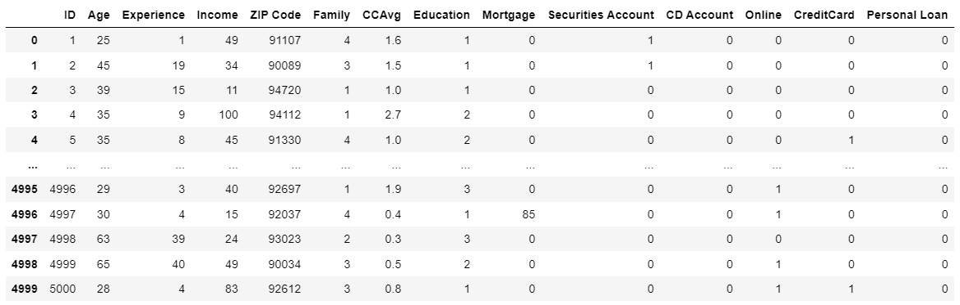
ABOUT THE DATA

Slide 4
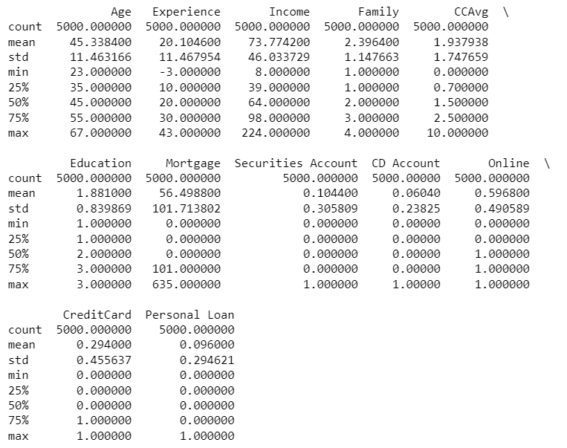
DESCRIPTIVE STATISTICS

Slide 5
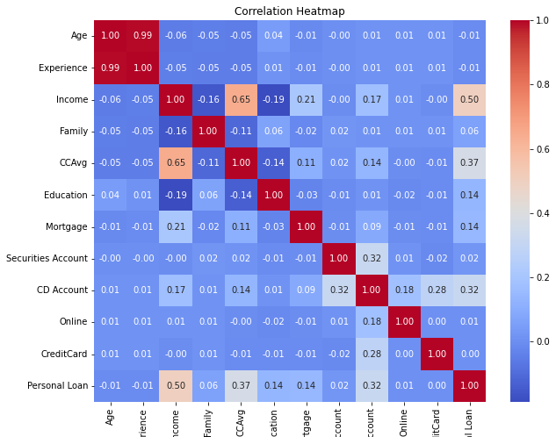
VISUALIZATION - HEATMAP
This heatmap shows the correlation between 'personal loan' and other independent variables.
Income has the highest correlation with 'personal loan’.
It has a correlation of 0.32 between 'CD Account' and 'Personal Loan' and a correlation of 0.37 with 'CCAvg’.
There exists a correlation of 0.14 between 'education' and 'personal loan'. Same for 'mortgage and 'personal loan'.

Slide 6
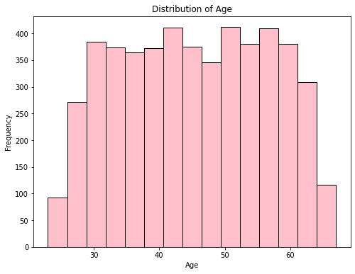
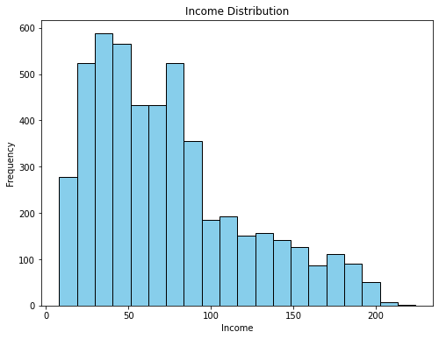
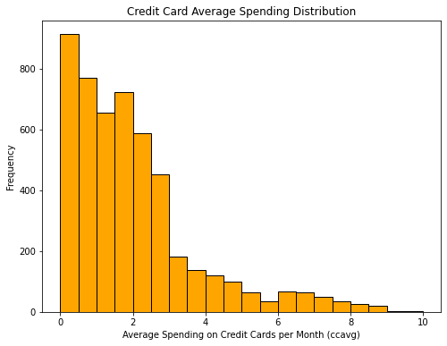
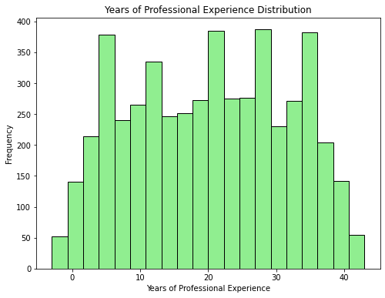
VISUALIZATION - HISTOGRAM
The distribution of ‘Credit Card’ is skewed to right.
The distribution of income is skewed to right.
The distribution of age is almost normally distributed but shows some characteristics of uniform distribution
The distribution of years of personal experience is almost normally distributed.

Slide 7
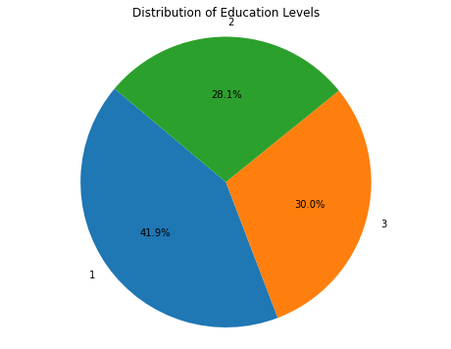
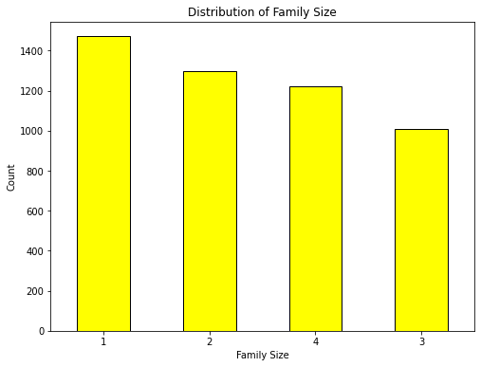
VISUALIZATION – PIE & BAR CHART

Slide 8
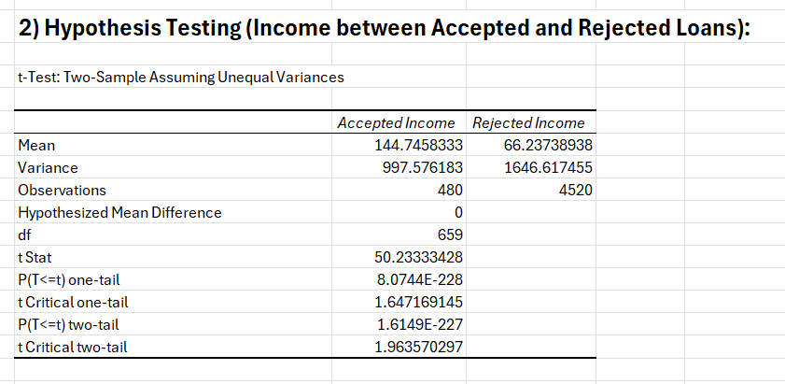
Hypothesis Testing (Income between Accepted and Not Accepted Loans):
Null Hypothesis : There is no significant difference between the mean income of people who accepted the loan and people who didn’t.
Alternate Hypothesis: There is a significant difference between the mean income of people who accepted the loan and people who don't.

Slide 9

Interpretation and Conclusion
Interpretation:
Since the p-values are much smaller than 0.05 (our chosen significance level), we reject the null hypothesis.
Conclusion:
There is strong evidence to suggest that the mean income of customers who accepted loans is significantly different from the mean income of customers who did not accept loans.

Slide 10
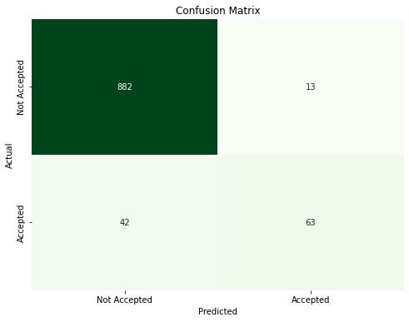
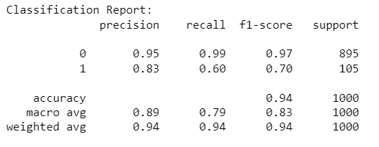
MODEL BUILDING – LOGISTIC REGRESSION
Logistic regression is a statistical technique used to model the probability of a binary outcome based on one or more predictor variables.
The variables are selected by stepwise selection method.
The variables used are 'Income’, 'Family’, 'CD Account’, 'Mortgage’, 'Online',’ Education’ and 'CCAvg’.
The model showed an accuracy of 0.945 or 94.5%

Slide 11
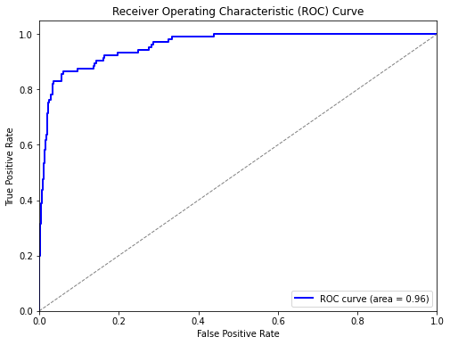
LOGISTIC REGRESSION – ROC CURVE

Slide 12
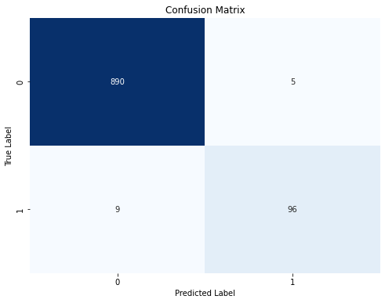
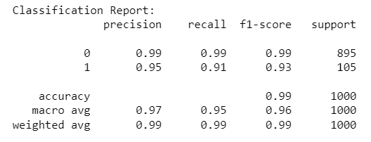
MODEL BUILDING – DECISION TREE ANALYSIS
Decision tree analysis is a method used in machine learning where decisions are made based on conditions or rules that branch out like a tree, helping to classify or predict outcomes.
The variables are selected by stepwise selection method.
The variables used are 'Income’, 'Family’, 'CD Account’, 'Mortgage’, 'Online',’ Education’ and 'CCAvg’.
The model showed an accuracy of 0.986 or 98.6%

Slide 13
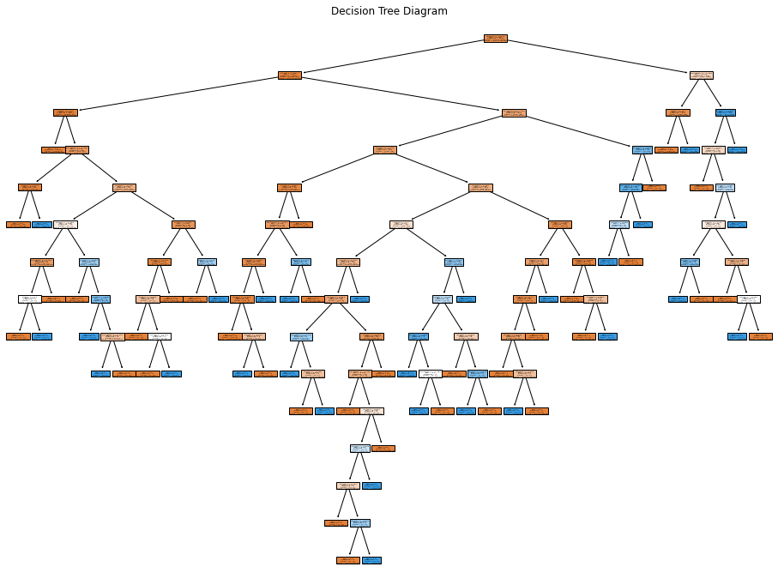
DECISION TREE – GRAPHICAL REPRESENTATION

Slide 14
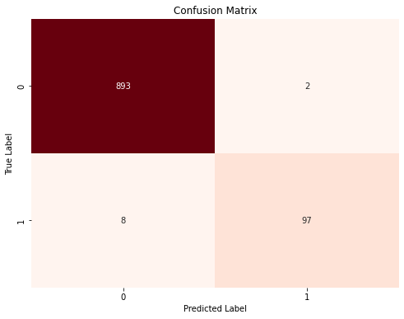
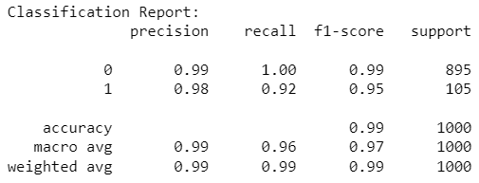
MODEL BUILDING – RANDOM FOREST
Random Forest is an ensemble learning technique in machine learning that constructs multiple decision trees and combines their predictions to improve accuracy and robustness.
The variables are selected by stepwise selection method.
The variables used are 'Income’, 'Family’, 'CD Account’, 'Mortgage’, 'Online',’ Education’ and 'CCAvg’.
The model showed an accuracy of 0.99 or 99%

Slide 15
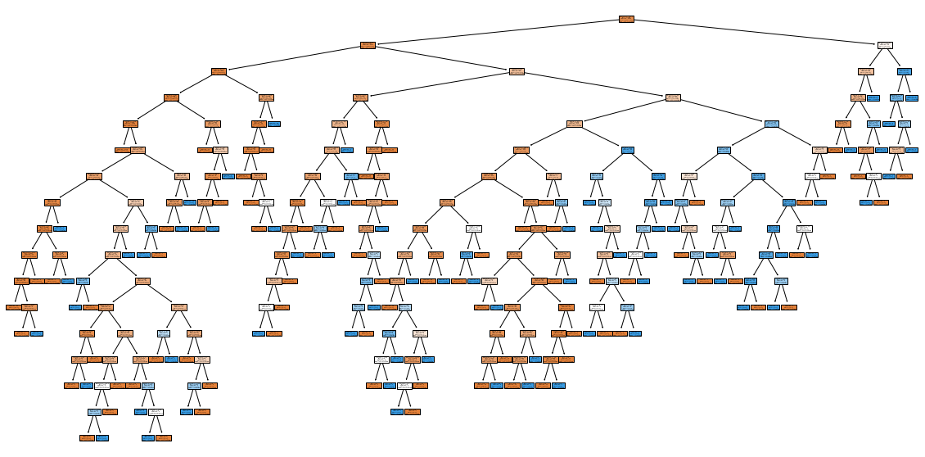
RANDOM FOREST – GRAPHICAL REPRESENTATION

Slide 16
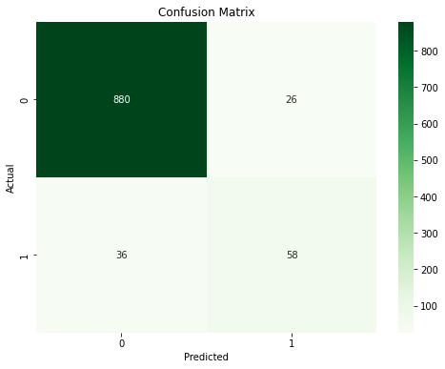
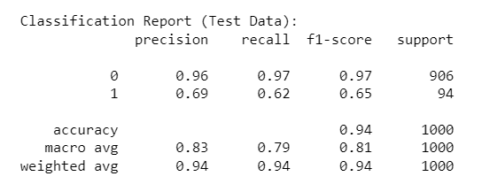
MODEL BUILDING – KNN CLASSIFICATION MODEL
K-Nearest Neighbors (KNN) classification is a simple algorithm that makes predictions by finding the majority class among the K nearest data points in a feature space.
The variables are selected by stepwise selection method.
The variables used are 'Income’, 'Family’, 'CD Account’, 'Mortgage’, 'Online',’ Education’ and 'CCAvg’.
The accuracy of the model is 0.938 0r 93.8%

Slide 17
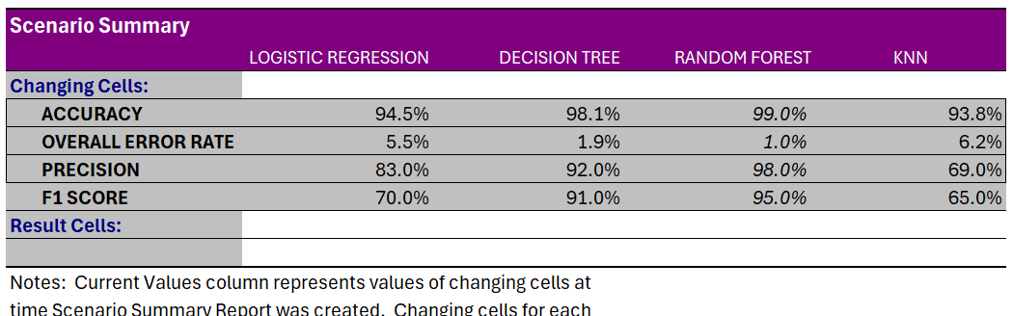
DECIDING THE BEST MODEL
By comparing the performance measures such as accuracy, overall error rate, precision and f1 score, it is clear that ‘Random Forest’ model shows the highest performance.

Slide 18
THANK YOU

