Slide 2
Operationalization using Microsoft R Server on single node machines and Spark clusters
Vanja Paunić, Data Scientist
Debraj GuhaThakurta, Senior Data Scientist
Yuzhou Song, Data Scientist
Siddharth Choudhary, Software Engineer
Syed Fahad Allam Shah, Data Scientist
John-Mark Agosta, Principal Data Scientist Manager
Material available at:
aka.ms/mlads2017-mrsdeploy

Slide 3
Session Goals
Tutorial participants will learn:
How to set up and access the operationalization service on a Microsoft R Server.
How to create and test R functions and models for operationalization. Examples will use multiple ML libraries, such as, CRAN, RevoScaleR, and SparkR.
How to operationalize R functions and models as web-services on Azure VMs and Spark clusters.
How to consume web-services from client applications.

Slide 4
Agenda
Introduction [15 minutes]
Overview of deployment options for R
MRS deployment service in mrsdeploy package
Hands-on exercises [1 hour, 15 minutes]
Setup and configuration of the MRS operationalization services on Linux VM
Short mrsdeploy demo
Remote execution and object movement
Creating, testing, deploying and consuming services in production
Operationalization on Azure VMs
Talk: Operationalization on Spark HDInsight clusters
Demo: Building swagger-based API client libraries [15 minutes]
Postman – browser swagger testing
AutoRest – auto client code generation from swagger file
Q & A [15 mins]

Slide 5
Introduction

Slide 6
Deployment / Operationalization
Operationalization refers to the process of publishing R models and code to a server in the form of web services and the consumption of these services within client applications.
Today, more and more businesses are adopting advanced analytics for mission critical decision making in areas such as fraud detection, healthcare and manufacturing.
Typically, data scientists first build the predictive models, and businesses then deploy those models in a production environment and consume them for predictive actions.

Slide 7
Predictive Analytics Process
Prepare: Assemble, cleanse, profile and transform diverse data relevant to the subject.
Model: Use of statistical and machine learning algorithms to build classifiers and predictions
Operationalize: Apply predictions and visualizations to support business applications
Prepare
Model
Operationalize

Slide 8
Challenges with long deployment lifecycle
Model
Re-Code
Validate
Deploy
Conversion in months
Results:
Slow innovation rates
Stale models
Errors
Extended testing & validation cycles
Notes:
Talk about traditional deployment process: after the model is built, it took a long time to convert it and integration with business apps in production.

Slide 9
R is a great modeling tool, but How do we deploy R code?
Notes:
Talk about R’s greatness in modeling, and its weakness in operationalization.

Slide 10
Mrsdeploy supplants existing deployment options for R
AzureML | Shiny (Rstudio) | OpenCPU
AzureML package provides an interface to publish web services on Microsoft Azure Machine Learnig (AML) from your local R environment. AzureML is open source (but a subscription to AML is paid) The main functions in the package cover: Workspace: connect to and manage AzureML workspaces Datasets: upload and download datasets to and from AzureML workspaces Publish: define a custom function or train a model and publish it as an Azure Web Service Consume: use available web services from R in a variety of convenient formats | Open source R package from Rstudio that creates interactive web applications around your R analyses and visualizations. No HTML/CSS/Javascript knowledge required to implement, but fully customizable with HTML/CSS/JavaScript Deploying Shiny Apps can happen in diﬀerent ways: Shiny Server Shiny Server ”Pro” (commercial) Shiny hosting on rstudio.com http://www.shinyapps.io (Free and Paid Version) | OpenCPU is an open source solution for embedded R computing. The software can be freely used, modified and redistributed for both open source and proprietary projects in academia or industry. All parts of OpenCPU are released under the Apache2 license. The free OpenCPU framework provides a reliable and interoperable HTTP API for R data analysis. You can either call the public servers or download and install OpenCPU’s code on your own servers.
Other commercial REST API-based deployment options:
Yhat
Domino
Sense.io

Slide 11
mrsdeploy

Slide 12
mrsdeploy Microsoft R Server deployment feature
Instant deployment
Turn R analytics to web services in one line of code
Swagger-based REST APIs, easy to consume with any programming language
Deploy to anywhere
Deploying web service server to any platform: Windows, SQL, Linux/Hadoop
On-premises or in cloud
Fast and scalable
Fast scoring, real time and batch
Scaling to a grid for powerful computing with load balancing
Diagnostic and capacity evaluation tools

Slide 13


Deployment Experience
Easy Consumption
Explore and consume services in R directly
Data Scientist
Easy Deployment
Turn R into web services in one line of code
Microsoft R Client
(mrsdeploy package)
Data Scientist
Services / Sessions
getService
Microsoft R Client
(mrsdeploy package)
publishService
Microsoft R Server
configured for
operationalizing R analytics
REST API calls
Easy Setup
In-cloud or on-prem
Adding nodes to scale
High availability & load balancing
Remote execution server
Apps
Easy Integration
Swagger-based APIs: easy to consume with any programming language
Developer

Slide 14
Deployment Experience
Easy Consumption
Explore and consume services in R directly
1
Data Scientist
Easy Deployment
Turn R into web services in one line of code
Microsoft R Client
(mrsdeploy package)
Data Scientist
Services / Sessions
getService
Microsoft R Client
(mrsdeploy package)
publishService
Microsoft R Server
configured for
operationalizing R analytics
REST API calls
Easy Setup
In-cloud or on-prem
Adding nodes to scale
High availability & load balancing
Remote execution server
Apps
Easy Integration
Swagger-based APIs: easy to consume with any programming language
Developer

Slide 15
Deployment Experience
Easy Consumption
Explore and consume services in R directly
2
Data Scientist
Easy Deployment
Turn R into web services in one line of code
Microsoft R Client
(mrsdeploy package)
Data Scientist
Services / Sessions
getService
Microsoft R Client
(mrsdeploy package)
publishService
Microsoft R Server
configured for
operationalizing R analytics
REST API calls
Easy Setup
In-cloud or on-prem
Adding nodes to scale
High availability & load balancing
Remote execution server
Apps
Easy Integration
Swagger-based APIs: easy to consume with any programming language
Developer

Slide 16
Deployment Experience
3
Easy Consumption
Explore and consume services in R directly
Data Scientist
Easy Deployment
Turn R into web services in one line of code
Microsoft R Client
(mrsdeploy package)
Data Scientist
Services / Sessions
getService
Microsoft R Client
(mrsdeploy package)
publishService
Microsoft R Server
configured for
operationalizing R analytics
REST API calls
Easy Setup
In-cloud or on-prem
Adding nodes to scale
High availability & load balancing
Remote execution server
Apps
Easy Integration
Swagger-based APIs: easy to consume with any programming language
Developer

Slide 17
Deployment Experience
Easy Consumption
Explore and consume services in R directly
Data Scientist
Easy Deployment
Turn R into web services in one line of code
Microsoft R Client
(mrsdeploy package)
Data Scientist
Services / Sessions
getService
Microsoft R Client
(mrsdeploy package)
publishService
Microsoft R Server
configured for
operationalizing R analytics
4
REST API calls
Easy Setup
In-cloud or on-prem
Adding nodes to scale
High availability & load balancing
Remote execution server
Apps
Easy Integration
Swagger-based APIs: easy to consume with any programming language
Developer

Slide 18
Hands-on Setup and configuration Remote exaction and object movement
John-Mark Agosta

Slide 19
Remote execution of R scripts
Built-in remote execute functions in R Client/R Server
Generate diff report to reconcile local and remote
Execute .R script or interactive R commands
Results come back to local
Generate working snapshots for resume and reuse
IDE agnostic
Login remote server
Generate Diff report
Reconcile Environment
R Sessions
R Client
(mrsdeploy package)
R Server
configured to
Remote Execute R Scripts
(Support Window Server, Linux Server, Hadoop )
Execute R Scripts
Snapshot remote env.
Logout remote server
“I can offload the function execution for heavy processing to a chunky server”
“I can validate my scripts against production environment before deployment”

Slide 20
Remote Execution Cheat Sheet
Remote Connection
remoteLogin | Remote login to the R Server with AD or admin credentials
remoteLoginAAD | Remote login to R Server server using Azure AD
remoteLogout | Logout of the remote session on the DeployR Server.
Remote Objects Management
listRemoteFiles | Get a list of files in the working directory of the remote session
deleteRemoteFile | Delete a file from the working directory of the remote R session
getRemoteFile | Copy a file from the working directory of the remote R session
putLocalFile | Copy a file from the local machine to the working directory of the remote R session
getRemoteObject | Get an object from the remote R session
putLocalObject | Put an object from the local R session and load it into the remote R session
getRemoteWorkspace | Take all objects from the remote R session and load them into the local R session
putLocalWorkspace | Take all objects from the local R session and load them into the remote R session
Remote Execution
remoteExecute | Remote execution of either R code or an R script
remoteScript | Wrapper function for remote script execution
diffLocalRemote | Generate a 'diff' report between local and remote
pause | Pause remote connection and back to local
resume | Return the user to the 'REMOTE >' command prompt
Snapshot Functions
createSnapshot | Create a snapshot of the remote session (workspace and working directory)
loadSnapshot | Load a snapshot from the server into the remote session (workspace and working directory)
listSnapshots | Get a list of snapshots for the current user
downloadSnapshot | Download a snapshot from the server
deleteSnapshot | Delete a snapshot from the server
Notes:
Snapshot functions are very useful for remote execution scenarios. It can save the whole workspace and working directory so that you can pick up from exactly where you left last time. Thank about saving and loading a game.
It can also be used when publish a web service to help you handle the environment dependencies. But it might impact the performance of the Request-Response time. For optimal performance, consider the size of the snapshot carefully. Before creating a snapshot, ensure that keep only those workspace objects you need and purge the rest. And, in the event that you only need a single object, consider passing that object alone itself instead of using a snapshot.

Slide 21
Hands-on Operationalization on Azure VMs
Vanja Paunić

Slide 22
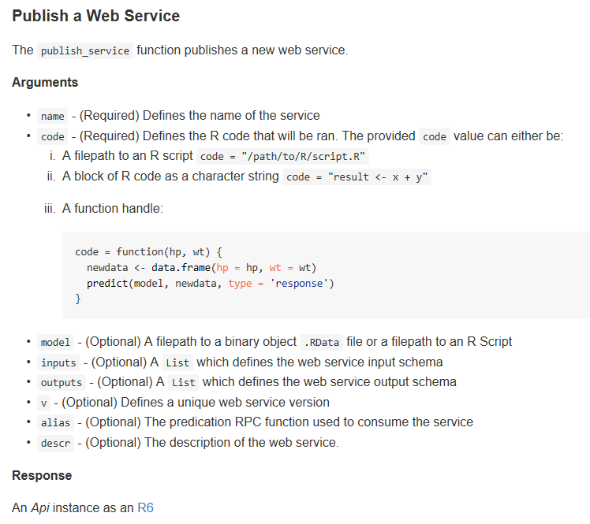
mrsdeploy web service functions
Function | Description
publishService | Publishes an R code block as a new web service running on R Server.
updateService | Updates an existing web service on an R Server instance.
listServices | Lists the different published web services on the R Server instance.
getService | Gets a web service for consumption.
deleteService | Deletes a web service on an R Server instance.

Slide 23

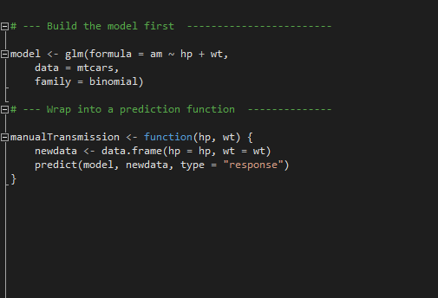
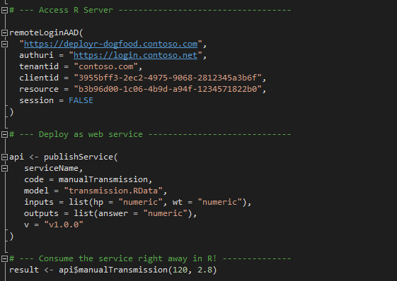
Easy Deployment
Build the model first
Deploy as a web service instantly
Notes:
If a version is not specified, a temp guid endpoint is created – this is mainly for development phase and sharing among team members privately.

Slide 24
Presentation Operationalization on Spark HDInsight cluster
Debraj GuhaThakurta

Slide 25
Scaling out MRS Operationalization work-loads
For larger work-loads, use MRS Operationalization services on HDInsight Spark clusters
Use workers as compute nodes to distribute work-load

Slide 26


Microsoft R Server Hadoop Architecture
1. R Server Local Processing:
Data in Distributed Storage
R process on Edge Node
Data Scientists
Edge Node
Worker Nodes
R
R
R
R
R
Head Nodes
2. R Server Distributed Processing:
Master R process on Edge Node
Apache Spark
Worker R processes on Worker Nodes
R
R
R
R
R
R Server

Slide 27
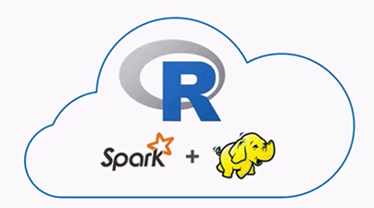
MRSDeploy scale up in HDI clusters
Edge
Workers
R Client
Web Node
API/Authentication
Compute Node
MRSdeploy is available on HDInsight clusters running Spark
Edge node serves as web node
Worker nodes can be used as compute nodes
Deploy
Auth.
REST API
Apps
Compute Node

Slide 28
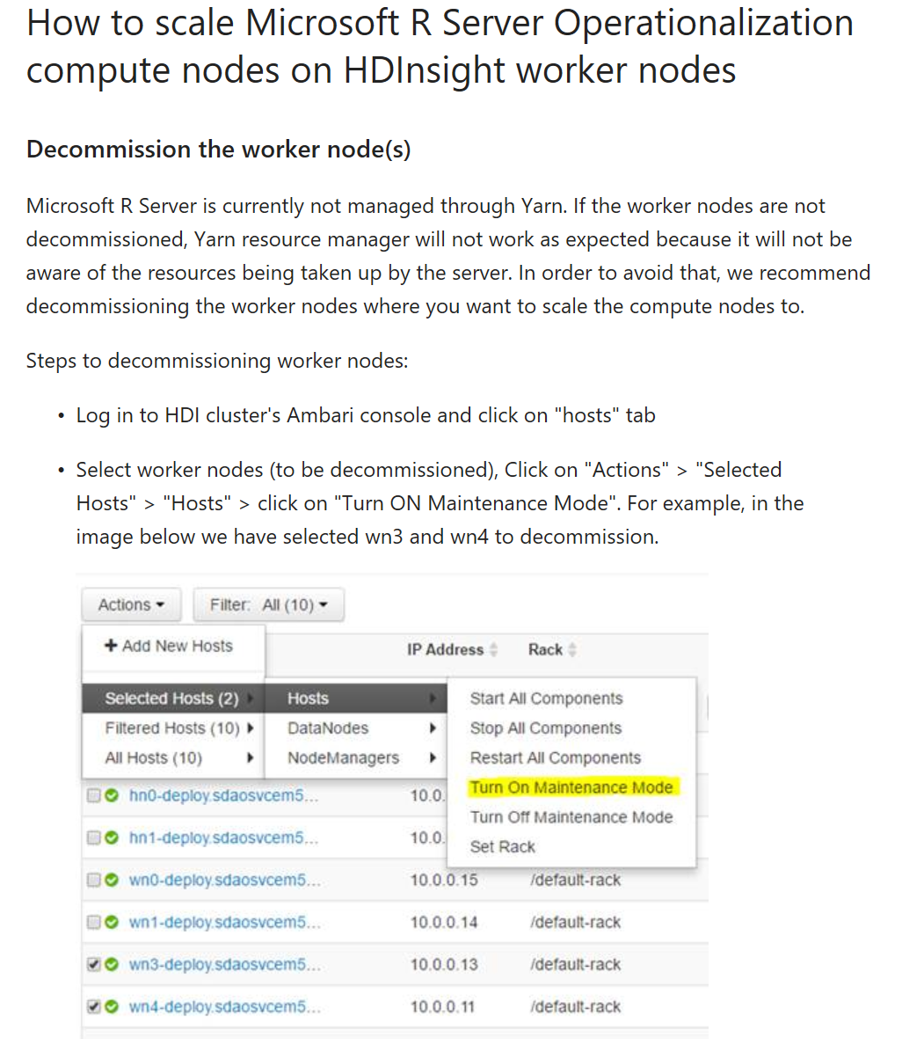
Configuring the HDInsight cluster worker nodes
To run only on edge node: Use same setup steps as DSVM
To use worker nodes: Have to setup worker nodes separately
https://docs.microsoft.com/en-us/azure/hdinsight/hdinsight-hadoop-r-server-get-started#how-to-scale-microsoft-r-server-operationalization-compute-nodes-on-hdinsight-worker-nodes

Slide 29
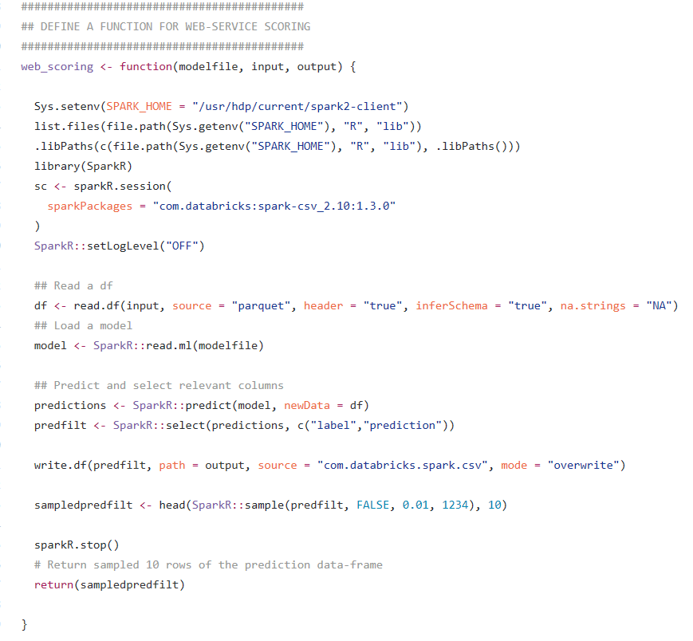
Define a scoring function: example
1. Create spark session
2. Load test data from HDFS
3. Load a Spark model from HDFS
4. Score (predict) on test
5. Save scores in HDFS
6. Stop spark session
1
2
3
4
5
6
http://tinyurl.com/Strata2017R

Slide 30
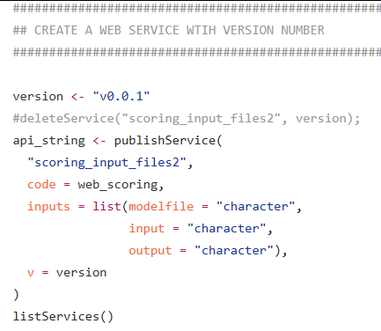
Creating the web-service using scoring function
1. Code: Scoring function
2. Inputs:
Model file location in HDFS
Test (scoring) data file location in HDFS
Output file location on HDFS [Where predictions are to be saved]
3. Version
1
2
3

Slide 31
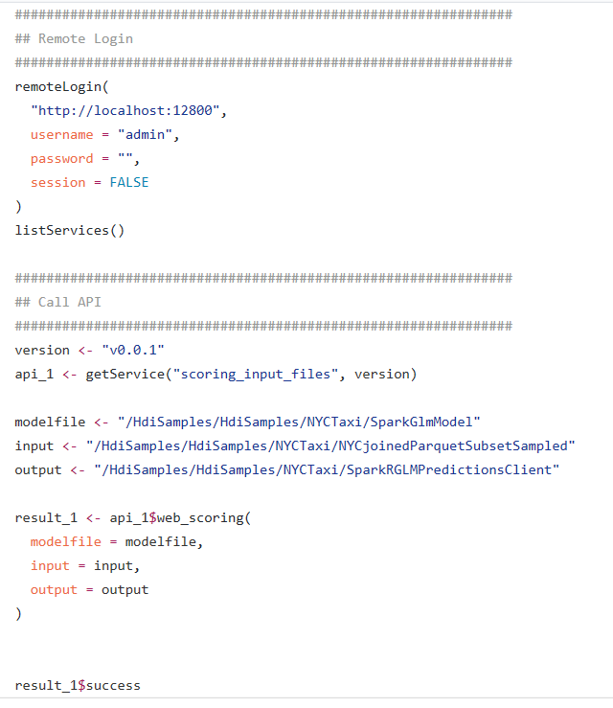
Calling web-service from a client
1
1. Remote login
2. Specify the inputs for web-service
3. Call web-service
2
3

Slide 32
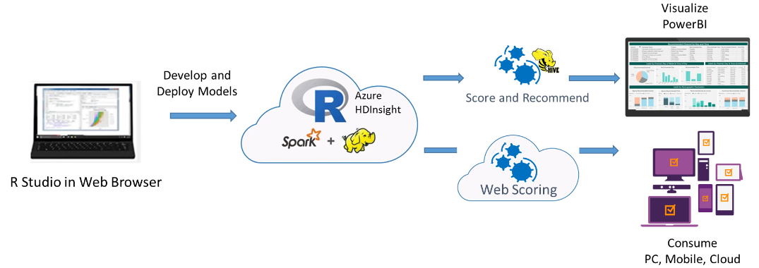
Business use case: Campaign optimization - Predicting how and when to contact leads
Yuzhou Song
Uses predictors such as demographics, historical campaign performance and product details → predict the probability of a lead conversion from each channel, at various times of the day and days of the week
https://microsoft.github.io/r-server-campaign-optimization/
Notes:
The solution uses simulated data, which can easily be configured to use your own organization’s data, to model the acquisition campaign response. The model uses predictors such as demographics, historical campaign performance and product details. The solution predicts the probability of a lead conversion from each channel, at various times of the day and days of the week, for every lead in the database.

Slide 33
Demo Building swagger-based API client libraries
Siddharth Choudhary

Slide 34
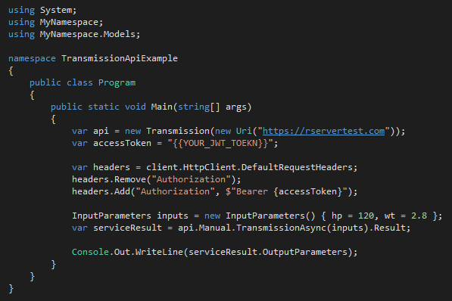
Consuming webservices Swagger based APIs, easy to consume, with any programming language
Data Scientist
Developer
Developer
Generate Swagger Docs for Web Services
Run Swagger tools to generate code
Write a few code to consume the service
Popular Swagger Tools: AutoRest or Code Generator
# Run the following code in R
swagger <- api$swagger()
cat(swagger, file = "swagger.json", append = FALSE)
AutoRest.exe -CodeGenerator CSharp -Modeler Swagger -Input swagger.json -Namespace Mynamespace
Notes:
The last experience I am going to demo is how to easily integrate this web service with a C# app. We leverage Swagger to achieve this goal. Swagger is the most popular open source API framework. It greatly simplifies the consumption of RESTful web services. By adding the Swagger description to our RESTful web services, developers can generate the codes easily.
It took 3 very easy steps to integrate the web service to an application.
First, data scientist generates the swagger doc, with 2 line of code.
Second, developer uses open source tools such as AutoRest to generate the sample code for the web services.
Last step, developer writes a few line of C# codes to consume the service. They will use the autogenerated code. You can see that during the whole process the developers don’t need to see R code at all.
That’s all for today’s demo. Easy deployment, easy consumption from R and easy integration with Apps. Thank you!

Slide 35
REST Calls using PostMan for R server O16N
https://blogs.msdn.microsoft.com/microsoftrservertigerteam/2017/02/22/rest-calls-using-postman-for-r-server-o16n/

Slide 36
Q & A
To learn more, check out tomorrow’s session:
Tutorial
Building Application Ready R Web Services with R Server Operationalization and R Tools for Visual Studio
Raj Krishnan.
June 9, 10:30am – 12:00pm
Quinault (34/2615)

