Slide 1
Pattern Matching in Biological Data
Domain : Machine Learning
Members:
Vinay Kumar Reddy K(2014503560)
Arvind Srinath K(2014503507)
Elavarasan A J(2014503514)
Guide:
Dr P Jayashree
Associate Professor
Department of Computer Technology

Slide 2
INTRODUCTION
whole genome sequencing is completed to analyse the genome due its vast requirement of memory for storing the genome while processing the genome to exploit the various properties of DNA
Deoxyribonucleic acid is molecule that contains the genetic instructions used in the growth, development, functioning and reproduction of all known living organisms and many viruses
Tandem repeats occur in DNA when one or more nucleotides are repeated and the repetitions are adjacent to each other.
VNTR is a location in an genome where a small nucleotide is organised as a tandem repeat. They often show variations in length among each individual

Slide 3
Continuation…
Quality Scores
The FASTQ format provides a simple extension to the FASTA format
Stores a simple numeric quality score with each base position.
FastQ has a number of variants, deriving from different ways of calculating the probability that a base has been called in error.
PHRED scores
Quality scores were originally derived from the PHRED program which was used to read DNA sequence trace files
Linked various sequencing metrics such as peak resolution and shape to known sequence accuracy.
The PHRED program assigned quality scores to each base, according to the following formula:
Q_PHRED=-10log10(pe)

Slide 4
Continuation…
Solexa scores
The Solexa quality scores, which were used in the earlier Illumina pipelines, are calculated differently from the PHRED scores:
Q-SOLEXA=-10log10(pe/1-pe)

Slide 5
CLASSIFICATION
Instead of processing the genome sequence which is made of millions of base pairs it would be better if it is processed once the repetitive parts are removed which would increase efficiency in both time and cost.

Slide 6
PROBLEM STATEMENT
Though human genome is more than 99 percent common in all humans the current available methods of processing biological data reprocess the complete sequence (on average of 3 million base pairs) each time.
Human analysis of the genome is more error prone.

Slide 7
OBJECTIVE
When processing the data it is enough to consider only the parts of genome that has changes when compared to reference genome.
Integration of intelligence in order to analyse the genome in order to find any abnormalities.

Slide 8
PROPOSED WORK
Design and Implementation of an algorithm to remove the tandem repeats that make the most part of the genome which inturn reduces the memory and time while analysing the genome for abnormalities.
To find the count of tandem repeats in a genome by using an opensource tool.
Design and Implementation of an algorithm to detect whether there are abnormalities.
Design and Implementation of a Deap Neural Network(DNN) to find the type of abnormality and the stage of abnormality (if any).

Slide 9
TOOLS USED
Galaxy
RepeatExplorer

Slide 10
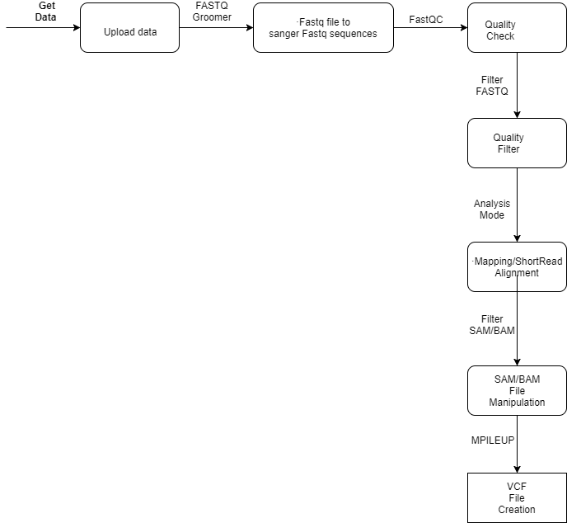
Galaxy Flow

Slide 11
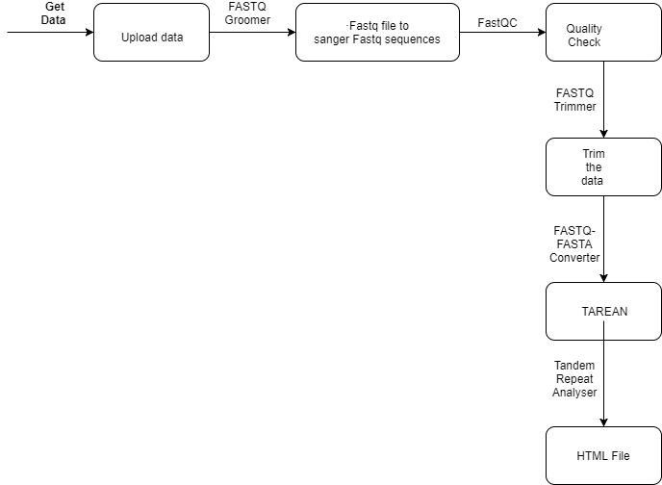
RepeatExplorer Flow

Slide 12
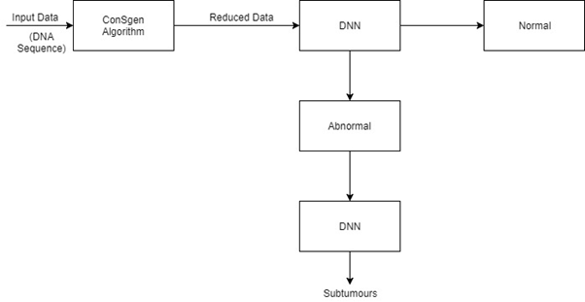
ARCHITECTURE DIAGRAM

Slide 13
References
Zhang, Jingsong, Yinglin Wang, Chao Zhang, and Yongyong Shi. "Mining contiguous sequential generators in biological sequences." IEEE/ACM Transactions on Computational Biology and Bioinformatics 13, no. 5 (2016): 855-867.
Zhou, Hongxia, Liping Du, and Hong Yan. "Detection of tandem repeats in DNA sequences based on parametric spectral estimation." IEEE transactions on information technology in biomedicine 13, no. 5 (2009): 747-755.
Deng, Yue, Zhiquan Ren, Youyong Kong, Feng Bao, and Qionghai Dai. "A hierarchical fused fuzzy deep neural network for data classification." IEEE Transactions on Fuzzy Systems 25, no. 4 (2017): 1006-1012.
Gosztolya, Gábor, and László Tóth. "DNN-based Feature Extraction for Conflict Intensity Estimation from Speech." IEEE Signal Processing Letters (2017).
Ramakrishnan, Nithya, and Ranjan Bose. "Analysis of healthy and tumour DNA methylation distributions in kidney-renal-clear-cell-carcinoma using Kullback–Leibler and Jensen–Shannon distance measures." IET Systems Biology 11, no. 3 (2017): 99-104.

Slide 14
Continuation…
Voges, Jan, Marco Munderloh, and Jörn Ostermann. "Predictive coding of aligned next-generation sequencing data." In Data Compression Conference (DCC), 2016, pp. 241-250. IEEE, 2016.
Deng, Yue, Zhiquan Ren, Youyong Kong, Feng Bao, and Qionghai Dai. "A hierarchical fused fuzzy deep neural network for data classification." IEEE Transactions on Fuzzy Systems 25, no. 4 (2017): 1006-1012.
Azim, Md Aashikur Rahman, Costas S. Iliopoulos, M. Sohel Rahman, and M. Samiruzzaman. "A Simple, Fast, Filter-Based Algorithm for Approximate Circular Pattern Matching." IEEE transactions on nanobioscience 15, no. 2 (2016): 93-100.
Pérez, Sandino Vargas, and Fahad Saeed. "A parallel algorithm for compression of big next-generation sequencing datasets." In Trustcom/BigDataSE/ISPA, 2015 IEEE, vol. 3, pp. 196-201. IEEE, 2015.
Ku, Chee Seng, En Yun Loy, Agus Salim, Yudi Pawitan, and Kee Seng Chia. "The discovery of human genetic variations and their use as disease markers: past, present and future." Journal of human genetics 55, no. 7 (2010).

