Slide 1
De novo assembly of short reads using Velvet
Adapted from Nick Loman
University of Birmingham
Notes:
Ok, this morning we are going to start out with a program called velvet. This was the first widely used short read assembler.

Slide 2
Velvet
One of the first short read assemblers
Developed by Daniel Zerbino of EBI
A de Bruijn graph assembler, like:
SPAdes
SOAPdenovo
ABYSS
ALLPATHS
Etc.
Notes:
This is a de bruijn graph assembler, much like a lot of other assemblers
In this course, we’ll start out with velvet, and you will also try your hands at spades.

Slide 3
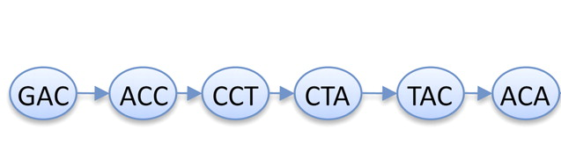
K-mers again
Read
GACCTACA
GAC
ACC
CCT
CTA
TAC
ACA
de Bruijn graph
K-mers (K=3)
K-1 bases overlap
Notes:
Velvet is based on k-mers.
Now, K-mers can also be used for other things than assembly
One fo the smarter things we can do is to count them.

Slide 4
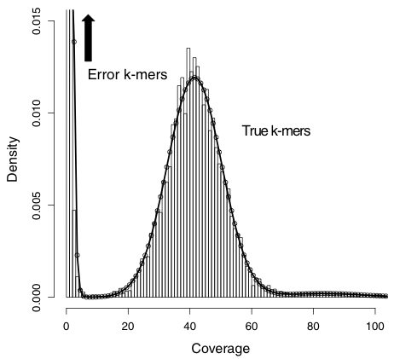
Idealised k-mer plot
Notes:
Now, this is what this plot would look like.
To the left is where we have unique and low freq k-mers. More likely than not, these are k-mers with errors in them.
Over here are the true ones.
Can you guys guess how much coverage we have on this genome?
Have them think
Show on black board

Slide 5
Counting k-mers
Plotting k-mer frequencies is a quick and easy way of:
Estimating genome size
Seeing copy number variation in genome
Estimating sequence read error
Planning a short-read assembly
Notes:
If we count k-mers and plot their counts, we can figure out quite a few things
Estimate genome size
# of k-mers will approximate length of genome
Duplications:
Bump in kmer graph
Sequence read error
Amounts of low coverage&singleton reads
Short read assembly
Figure out parameters for assembly algorithms

Slide 6
K-mers and K
no magical value of k
Depends on
read length
sequencing error
rate of polymorphism
coverage
Notes:
So, as you saw, for making k-mer graphs, we need to settle on a k to use.
This is not magic, and depends on many things

Slide 7
K-mers and K
Some rules:
k must be less than the read length
k can't be an even number (can produce palindromes)
Notes:
Rules for picking Ks

Slide 8
K-mers and K
Bigger k
Solves more repeats
fewer overlaps
lower k-mer coverage
Lower k
more overlaps
higher k-mer coverage
Notes:
Size of K does have effects
Have to weigh solving repeats (aka bigger k) vs losing overlap regions between reads (solved with smaller ks)
Both repeats and lack of overlap give fragmented assemblies, so we need to balance that.,

Slide 9
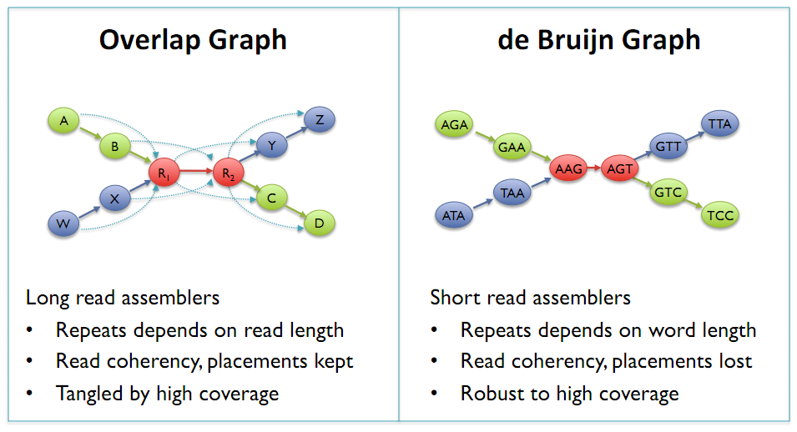
de Bruijn Graphs
Mike Schatz

Slide 10
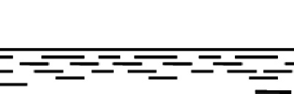
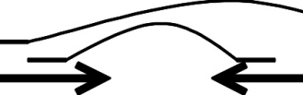
What do you get?
reads
contigs
scaffolds

Slide 11
Metrics
contigs
how many
total bases
N50
scaffolds
how many
total bases
N50
how many gaps
total gap bases
Notes:
So, we are going to be making some assemblies, and then we’ll evaluate them
These are the kinds of metrics that we will get when we do the evaluation.

Slide 12
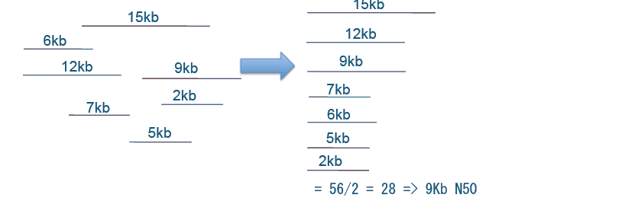
N50
Size of contig such that 50% of total bases are in contigs of this length or more
Sum of lengths: 56 kb
Thomas Keane and Jan Aerts, Wellcome Trust Sanger
Notes:
One of the more central measures is the N50
Size of contig such that 50% of total bases are in contigs of this length or more
How to get the N50
Add all lengths up, and divide by 2
Sort the contigs on length
Start with the longest, and add contig lengths together until you reach that number
N50 is then the length of the contigs which cause you to tip over the halfway number

Slide 13
N50
Size of contig such that 50% of total bases are in contigs of this length or more
OR
Shortest of the longest contigs that together make up 50% of the assembly
Notes:
N50 can be phrased in two different ways
Both are effectively the same

Slide 14
N50
Size of contig such that 50% of total bases are in contigs of this length or more
longer N50 is better
N50 count:
number of contigs of at least N50 size
Notes:
The clue is that we want to have N50 be large
We also want the number of contigs to be above N50 to be small, that indicates good continuity

Slide 15
N50 – NG50
N50:
Size of contig such that 50% of total bases are in contigs of this length or more
NG50:
Replace 'total bases' with 'genome length'
Notes:
We also have a measure called NG50
In this case instead of adding the contigs lengths together to get to the midway point, we use the genome length
Quite useful when we know approximately how long the genome should be

Slide 16
N50
Minimum contig length influences N50
Take away shorter contigs → N50 goes up
Notes:
Please note, sometimes a program lets you choose the shortest contig length that it will give out.
Now, if you do that, your N50 will go up. Cannot compare N50s unless you have the same criteria

Slide 17
N50
High N50 → better assembly
BUT
says nothing of quality
Notes:
But note, a higher N50 might tell you if an assembly is more contigous than another, but it will not tell you if your assembly is correct.
Might have a lot of misassemblies
Best N50 is achieved by simply stitching all contigs tougher, N50 becomes brilliant
So, right now, you are going to go onto your computers, and do an exercise conserning velvet.
You will create some assemblies, and you will figure out more about how velvet works.

Slide 18
Insert size
Experimental evidence
Allow Velvet to guess
Map reads and calculate
Notes:
So, back to velvet

Slide 19
Mate-pair data
Orientation different
Read contamination
PE => insert <=
mate-pair <= insert =>

