Slide 1
The CoRT Thinking Programme

Slide 2
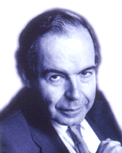







Edward de Bono
Edward de Bono has written 64 books with translations in 37 languages. He has been invited to work in 52 countries. He was born in Malta and graduated from the University of Malta. He proceeded as a Rhodes Scholar to Oxford and has held appointments at the Universities of Oxford, Cambridge, London and Harvard.
Dr de Bono is the originator of the term 'lateral thinking' which now has an official entry in the Oxford English Dictionary. He is regarded as the leading international authority in conceptual and creative thinking, and also the direct teaching of thinking as a skill.

Slide 3

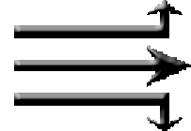

CoRT Thinking Programme
CoRT = Cognitive Research Trust
Thinking is a skill that can be developed
Most practical thinking takes place in the perception stage.
The tools method is used to teach thinking.

Slide 4
CoRT Thinking Programme
    PMI = Plus, Minus, Interesting
    CAF = Consider All Factors
    OPV = Other People’s Views
    FIP = First Important Priorities
    C&S = Consequences & Sequels
    AGO = Aims, Goals, Objectives
    APC = Alternatives, Possibilities, Choices

Slide 5
PMI
PLUS
MINUS
INTERESTING
Notes:
The interesting points are those which arc neither good nor bad but are worth noticing. The PMI is a way of treating ideas, suggestions and proposals. The natural reaction to an idea is to like or dislike it, to approve or disapprove. If you like an idea, it is very unnatural to look for the negative or minus aspects If you dislike an idea it is very unnatural to look for the positive or plus aspects. It is equally unnatural to pick out the merely interesting aspects of an idea.
Using the PMI as a deliberate operation gives students a means of by-passing the natural emotional reaction to an idea. Their objectives change from emotional reactions to carrying out with skill a formal operation.
The PMI is never intended to prevent decision or commitment but to ensure that this happens after both sides of the matter have been considered and not before.
In simple terms the PMI operation enlarges the view of a situation; without it, emotional reaction to an idea narrows the way we look at it.

Slide 6
PMI
Normally when presented with an idea, people support it or are against it
Once they have decided to take a position they will use all of their logic and emotion to defend that position
Using the PMI says “Let’s be fair to an idea and look at it from a few different sides before making up our minds”
Like Pros-and-Cons or SWOT analysis

Slide 7
PMI
P = Plus
  The good things about an idea
  Why you like it
  What are the benefits of it

Slide 8
PMI
M = Minus
  The bad things about an idea
  why you don't like it
  What are the potential problems

Slide 9
PMI
I = Interesting
  What you find interesting about an idea
  What are the future implications of the idea
  What does it tell us about the status quo

Slide 10

PMI: How to do it

Slide 11
PMI: How to do it

Slide 12

PMI: How to do it
P
M
I

Slide 13
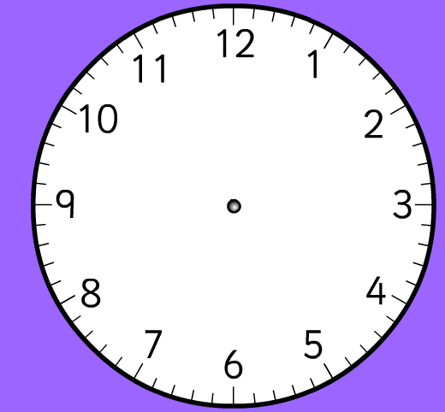
PMI: How to do it
P
M
I

Slide 14
PMI: How to do it
P
M
I
Faskmdf wkmfwef
Rfa qrrtyj tu eyw
weewtwrtjwryjyj
wj3446j46j46j46je
Sad.f/mr kiwmr r

Slide 15
PMI: How to do it
P
M
I
Faskmdf wkmfwef
Rfa qrrtyj tu eyw
weewtwrtjwryjyj
wj3446j46j46j46je
Sad.f/mr kiwmr r
Salkmvskfvmaslfkv
Fvkl’amfapwwrvm
We weew;vws;vwp
Fsvwmwwefwe;l,
Efwe,fwopropmgrt

Slide 16
PMI: How to do it
P
M
I
Faskmdf wkmfwef
Rfa qrrtyj tu eyw
weewtwrtjwryjyj
wj3446j46j46j46je
Sad.f/mr kiwmr r
Salkmvskfvmaslfkv
Fvkl’amfapwwrvm
We weew;vws;vwp
Fsvwmwwefwe;l,
Efwe,fwopropmgrt
Sadfmewpmfeow
Wefwe;lfmsdom
Efw[p,pwefwew
Wef;ewsefsd[ee
Weflwef,we;,efl

Slide 17
PMI
Order is significant, most people find “M” easy, so putting “P” first forces new directions
“directed thinking” only considering one direction at a time
Short timescales to encourage quickthinking creativity

Slide 18
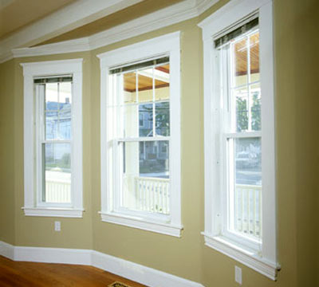
PMI: Example
Scenario: “Windows should be made of transparent plastic instead of glass”

Slide 19
PMI: Example
PLUS
  They wouldn’t break as easily
  They would not be as dangerous when broken
  Easier to transport in bulk because of resilience

Slide 20
PMI: Example
MINUS
  Plastic would be more expensive than glass
  Plastic would get scratched very easily
  Plastic could be melted easily

Slide 21
PMI: Example
INTERESTING
  Perhaps windows could be of all colours if plastic
  Perhaps we take it for granted that glass is best since we are used to it
  Maybe the windows could be coated with anti-scratch coating

Slide 22
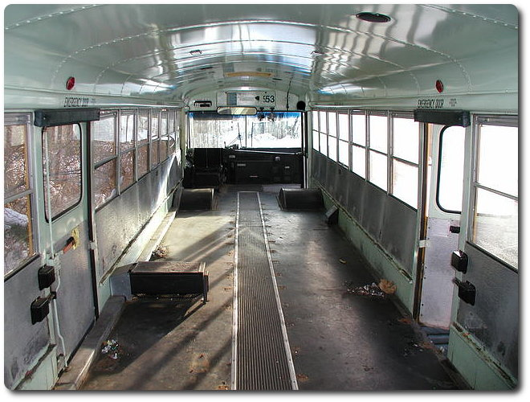
PMI: Exercise
Scenario:
“All seats should be taken out of buses”

Slide 23
PMI: Exercise
POSSIBLE SOLUTIONS
PLUS
  More people would be able to get into buses
  It would be easier to get in and out
  Buses would be cheaper to make and to repair
MINUS
  Passengers would fall over if sudden stops
  Old people and the disabled might not be able to use buses
  It would be harder to carry shopping bags and babies
INTERESTING
  Might be two types of bus; one with seats, one without
  The same bus might do more work
  Comfort is less important on a bus ??

Slide 24
CAF
CONSIDER
ALL
FACTORS
Notes:
People naturally assume that they have considered all the factors, but usually their consideration is limited to the obvious ones. Turning CAF into a deliberate operation switches attention from the importance of the factors to looking around for all the factors. Clearly it is difficult to consider all the factors, so in the teaching situation consideration can be limited to the ten most important factors (or any other number), or the lesson can be taught in terms of:
The emphasis of the lesson is on the factors that have been left out in a decision, plan, etc. In doing a CAF, students try to ensure that all important factors are listed in looking at each other's thinking, students try to spot which factors have been neglected. The CAF may be applied to one's own thinking as well as to the thinking of others: "What factors have I left out here?"

Slide 25
CAF
Unlike the PMI this is not a timed exercise, it takes as long as it takes
Decide on a specific number of factors, e.g. 10 factors
Continue working on list until that number of factors are achieved
May uncover hitherto unconsidered factors

Slide 26
CAF
Related to
  Action
  Decision
  Planning
  Judgement
  Conclusion

Slide 27
CAF
Consider All Factors

Slide 28
CAF
Consider All Factors
1.
2.
3.
4.
5.
6.
7.
8.
9.
10.

Slide 29
CAF
Consider All Factors
1. sfakwpaefmwaop
2.
3.
4.
5.
6.
7.
8.
9.
10.

Slide 30
CAF
Consider All Factors
1. sfakwpaefmwaop
2. sdfrva;,r;rropawe
3.
4.
5.
6.
7.
8.
9.
10.

Slide 31
CAF
Consider All Factors
1. sfakwpaefmwaop
2. sdfrva;,r;rropawe
3. lawooeridmcwnw
4.
5.
6.
7.
8.
9.
10.

Slide 32
CAF
Consider All Factors
1. sfakwpaefmwaop
2. sdfrva;,r;rropawe
3. lawooeridmcwnw
4. lskedjedosmwapc
5.
6.
7.
8.
9.
10.

Slide 33
CAF
Consider All Factors
1. sfakwpaefmwaop
2. sdfrva;,r;rropawe
3. lawooeridmcwnw
4. lskedjedosmwapc
5. xoowwmkfkovms
6.
7.
8.
9.
10.

Slide 34
CAF
Consider All Factors
1. sfakwpaefmwaop
2. sdfrva;,r;rropawe
3. lawooeridmcwnw
4. lskedjedosmwapc
5. xoowwmkfkovms
6. xwspaweofmefm
7. zkdoekrirjwwopac
8. lslwiwirjfkcmqas
9. cdale;aefiemfefm
10. kmxppaowedope

Slide 35
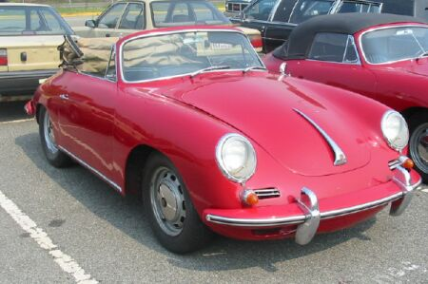
CAF: Example
Scenario “A husband and wife go to buy a used car for their family”
  10 factors

Slide 36
CAF: Example
  The person selling it actually owns it
  The price of the car
  The type of car and colour
  The engine power and speed of the car
  All the mechanical parts are working well
  The car is big enough for a family
  Has the car been in a crash?
  It will be easy to get replacement parts
  It has tax and NCT certificates
  What is the potential resell value?

Slide 37
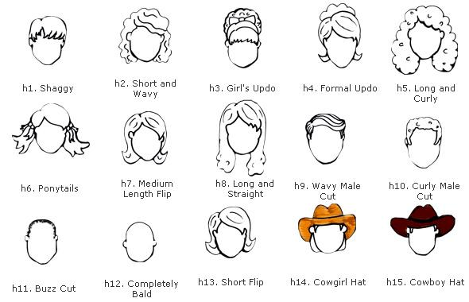
CAF: Exercise
Scenario “Factors involved in choosing your hairstyle”
  10 factors

Slide 38
OPV
OTHER
PEOPLE’S
VIEWS
Notes:
In the preceding nine lessons the enlargement of the situation - the broadening of perception - has always been from the point of view of the thinker. But many thinking situations involve other people as well. The point of view of these other people is also an essential part of the enlargement of the situation which is the basic theme of these first ten lessons. Thus another person may have different objectives, different priorities, different alternatives, etc. In fact, when another person does a PMI, CAF, C&S, AGO, FIP, or APC he or she may come up with different ideas because he or she is in a different position.

Slide 39
OPV
The process of looking at other people’s viewpoints so that the process can be used consciously and deliberately
Consider the views of all stakeholders
Can be employed in conjunction with other techniques
Notes:
In the preceding nine lessons the enlargement of the situation - the broadening of perception - has always been from the point of view of the thinker. But many thinking situations involve other people as well. The point of view of these other people is also an essential part of the enlargement of the situation which is the basic theme of these first ten lessons. Thus another person may have different objectives, different priorities, different alternatives, etc. In fact, when another person does a PMI, CAF, C&S, AGO, FIP, or APC he or she may come up with different ideas because he or she is in a different position.

Slide 40
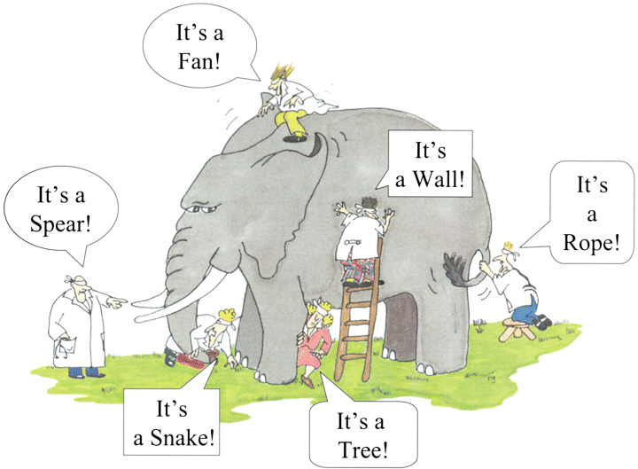
OPV

Slide 41
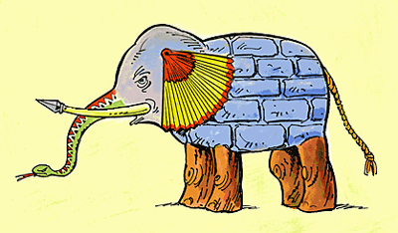
OPV

Slide 42

OPV: Example
Different people seeing a chicken in a field
Notes:
In the preceding nine lessons the enlargement of the situation - the broadening of perception - has always been from the point of view of the thinker. But many thinking situations involve other people as well. The point of view of these other people is also an essential part of the enlargement of the situation which is the basic theme of these first ten lessons. Thus another person may have different objectives, different priorities, different alternatives, etc. In fact, when another person does a PMI, CAF, C&S, AGO, FIP, or APC he or she may come up with different ideas because he or she is in a different position.

Slide 43
OPV: Example
Different people seeing a chicken in a field
STAKEHOLDERS
Hungry Person
Farmer
Chef
Child
Vegetarian
Another Chicken
Notes:
In the preceding nine lessons the enlargement of the situation - the broadening of perception - has always been from the point of view of the thinker. But many thinking situations involve other people as well. The point of view of these other people is also an essential part of the enlargement of the situation which is the basic theme of these first ten lessons. Thus another person may have different objectives, different priorities, different alternatives, etc. In fact, when another person does a PMI, CAF, C&S, AGO, FIP, or APC he or she may come up with different ideas because he or she is in a different position.

Slide 44
OPV: Example
Hungry Person
  “Goodie, it’s dinner”
Farmer
  “Livestock needs feeding”
Chef
  “This could make a good meal”
Child
  “This is my pet”
Vegetarian
  “It is wrong to eat anything with a face”
Another Chicken
  “Cluck”
Notes:
In the preceding nine lessons the enlargement of the situation - the broadening of perception - has always been from the point of view of the thinker. But many thinking situations involve other people as well. The point of view of these other people is also an essential part of the enlargement of the situation which is the basic theme of these first ten lessons. Thus another person may have different objectives, different priorities, different alternatives, etc. In fact, when another person does a PMI, CAF, C&S, AGO, FIP, or APC he or she may come up with different ideas because he or she is in a different position.

Slide 45
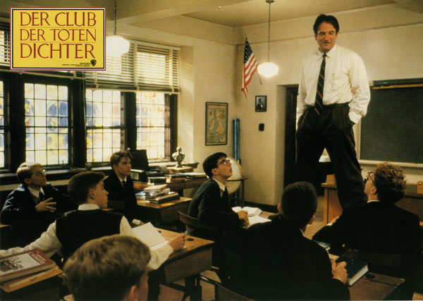
OPV: Exercise
A boy refuses to obey his teacher in class. The teacher sends the boy to the principal who suspends him. The boy’s parents object.
Notes:
In the preceding nine lessons the enlargement of the situation - the broadening of perception - has always been from the point of view of the thinker. But many thinking situations involve other people as well. The point of view of these other people is also an essential part of the enlargement of the situation which is the basic theme of these first ten lessons. Thus another person may have different objectives, different priorities, different alternatives, etc. In fact, when another person does a PMI, CAF, C&S, AGO, FIP, or APC he or she may come up with different ideas because he or she is in a different position.

Slide 46
OPV: Exercise
A boy refuses to obey his teacher in class. The teacher sends the boy to the principal who suspends him. The boy’s parents object.
What is the view of;
  The boy
  The teacher
  The principal
  The parents
  The classmates
Notes:
In the preceding nine lessons the enlargement of the situation - the broadening of perception - has always been from the point of view of the thinker. But many thinking situations involve other people as well. The point of view of these other people is also an essential part of the enlargement of the situation which is the basic theme of these first ten lessons. Thus another person may have different objectives, different priorities, different alternatives, etc. In fact, when another person does a PMI, CAF, C&S, AGO, FIP, or APC he or she may come up with different ideas because he or she is in a different position.

Slide 47
FIP
FIRST
IMPORTANT
PRIORITIES
Notes:
If you try to pick out only the most important points from the start, you will be able to see only a small part of the picture. But if you start by trying to see as large a picture as possible, then your eventual assessment of importance will be much more valid.
FIP is a judgement situation and there are no absolute answers. What one person believes to be most important another person may place far down the list of priorities. The intention of the lesson is to focus attention directly onto this assessment of importance. Once you can do a FIP, then you are free to generate as many ideas as you like. If you cannot do a FIP, then you are only able to consider ideas that have an obvious importance at first sight - and you may well never get to consider any other ideas at all.

Slide 48
FIP
The process of picking out the most important ideas, factors, objectives, consequences
To be used in conjunction with other techniques (e.g. CAF, APC )
Purpose is to restore the balance in a deliberate manner.
FIP is a judgement situation and there are no absolute answers.

Slide 49
FIP: Example
FIP on scenario “A husband and wife go to buy a used car for their family”

Slide 50
FIP: Example
  The person selling it actually owns it
  The price of the car
  The type of car and colour
  The engine power and speed of the car
  All the mechanical parts are working well
  The car is big enough for a family
  Has the car been in a crash?
  It will be easy to get replacement parts
  It has tax and NCT certificates
  What is the potential resell value?

Slide 51
FIP: Example
  The person selling it actually owns it
  The price of the car
  The type of car and colour
  The engine power and speed of the car
  All the mechanical parts are working well
  The car is big enough for a family
  Has the car been in a crash?
  It will be easy to get replacement parts
  It has tax and NCT certificates
  What is the potential resell value?
4 Votes
3 Votes
10 Votes
3 Votes
4 Votes
12 Votes
4 Votes
11 Votes
3 Votes
5 Votes

Slide 52
FIP: Example
  The person selling it actually owns it
  The price of the car
  The type of car and colour
  The engine power and speed of the car
  All the mechanical parts are working well
  The car is big enough for a family
  Has the car been in a crash?
  It will be easy to get replacement parts
  It has tax and NCT certificates
  What is the potential resell value?
4 Votes
3 Votes
3
10 Votes
3 Votes
4 Votes
1
12 Votes
4 Votes
2
11 Votes
3 Votes
5 Votes

Slide 53
FIP: Exercise
FIP on choosing hairstyle.

Slide 54
C&S
CONSEQUENCES
& SEQUELS
Notes:
C&S is concerned with action of some sort, either the action that one intends to take oneself or the action that others are taking. The intention is to enlarge the view beyond the immediate effect of that action. An action may seem worthwhile if the immediate effect is good but if one makes a deliberate effort to look at longer term consequences, the action may not he worthwhile at all. Conversely, an action that has good long-term consequences may not seem very enticing at the moment.
If CAF is thinking about a situation at the moment, then C&S is thinking ahead. Obviously, consequences also can turn up as part of a PMI, but the important point about a deliberate C&S is that attention is focused directly on the future.

Slide 55
C&S
The process of looking ahead to see the consequences of some action, plan, decision, rule, invention.
C&S deals with what may happen after the decision has been made.
  Short-term (1-2 years)
  Medium-term (2-5 years)
  Long-term consequences (over 5 years).

Slide 56
C&S: How to do it

Slide 57
C&S: How to do it

Slide 58
C&S: How to do it
ST
MT
LT

Slide 59
C&S: How to do it
ST
MT
LT

Slide 60
C&S: How to do it
ST
MT
LT
Faskmdf wkmfwef
Rfa qrrtyj tu eyw
weewtwrtjwryjyj
wj3446j46j46j46je
Sad.f/mr kiwmr r

Slide 61
C&S: How to do it
ST
MT
LT
Faskmdf wkmfwef
Rfa qrrtyj tu eyw
weewtwrtjwryjyj
wj3446j46j46j46je
Sad.f/mr kiwmr r
Salkmvskfvmaslfkv
Fvkl’amfapwwrvm
We weew;vws;vwp
Fsvwmwwefwe;l,
Efwe,fwopropmgrt

Slide 62
C&S: How to do it
ST
MT
LT
Faskmdf wkmfwef
Rfa qrrtyj tu eyw
weewtwrtjwryjyj
wj3446j46j46j46je
Sad.f/mr kiwmr r
Salkmvskfvmaslfkv
Fvkl’amfapwwrvm
We weew;vws;vwp
Fsvwmwwefwe;l,
Efwe,fwopropmgrt
Sadfmewpmfeow
Wefwe;lfmsdom
Efw[p,pwefwew
Wef;ewsefsd[ee
Weflwef,we;,efl

Slide 63
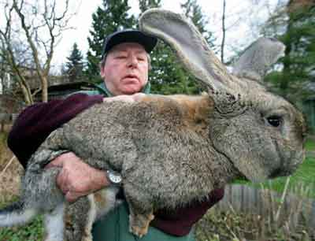
C&S: Example
An Australian man introduces rabbits into the country to provide hunting for his friends.

Slide 64
C&S: Example
Short-Term consequences
  friends have plenty to shoot at,
  rabbit is alternative source of food,
  lots of fun had,
  lots of guns sold

Slide 65
C&S: Example
Medium-Term consequences
  rabbits have multiplied,
  they have become a pest

Slide 66
C&S: Example
Long-Term consequences
  rabbits have spread all over Australia
  do a lot of damage to crops

Slide 67
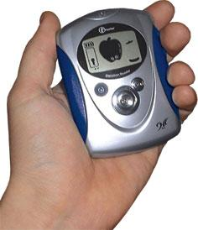
C&S: Exercise
“A new device has been created to immediately tell if someone is telling lies”

Slide 68
AGO
AIMS, GOALS
& OBJECTIVES
Notes:
You can do something out of habit, because everyone else is doing it, or as a reaction to a situation. These are all 'because' reasons. But there are times when you do something 'in order to' achieve some purpose of objective. It can help your thinking if you know exactly what you are trying to achieve. It can also help you to understand other people's thinking if you can see their objectives. In certain situations the words 'aims' and 'goals' are more appropriate than objectives, but the meaning is the same.

Slide 69
AGO
To introduce and emphasise the idea of purpose
Focus directly and deliberately on the intention behind actions.
  Aim is the general direction
  Goal is an ultimate destination
  Objectives are recognisable points of achievement along the way

Slide 70
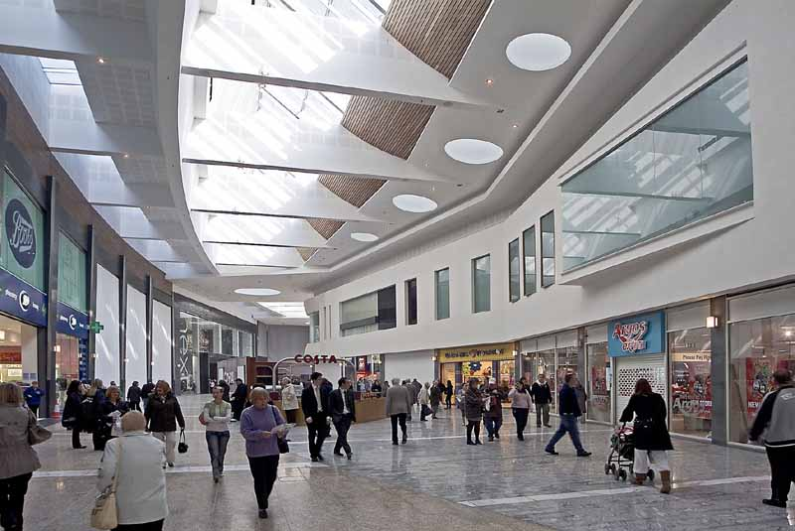
AGO: Example
“A developer is building a new shopping centre”

Slide 71
AGO: Example
Aim
  Make all arrangements for building
Goal
  Complete the shopping centre
Objectives
  to make a profit,
  build a successful shopping centre,
  pleasing potential shoppers,
  fitting in with planning authorities,
  work well in time and in budget

Slide 72
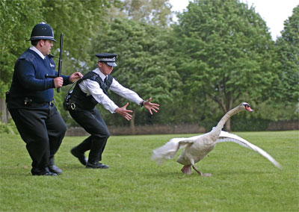
AGO: Exercise
Develop an AGO for the police and put them in order of priority

Slide 73
APC
ALTERNATIVES, POSSIBILITIES
& CHOICES
Notes:
When an obvious explanation presents itself it is very unnatural to look beyond it to try and find other possible explanations. That is why it is useful to have a device which can take one beyond natural inclinations
The APC is an antidote to emotional reaction. Whenever a student seems to be looking at something in a rigid way he/she can be asked to do an APC. If the student can do this then the result is either a change in view or an adherence to the original view now, however, due to preference. APC can be applied to other subjects.
When you have to make a decision or take action, you may at first think that you do not have all the choices at you disposal. But if you look for them, you may find that there are more alternatives than you thought. Similarly in looking at a situation there are always obvious explanations. But if you look for them, you may find that there are possible explanations that you had not thought of.

Slide 74
APC
The process of deliberately trying to find alternatives.
An attempt to focus attention directly on exploring all the alternatives or choices or possibilities - beyond the obvious ones
Applies not only to action but also to explanations.

Slide 75
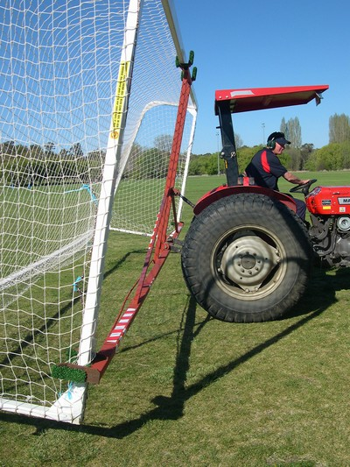
APC: Example
You arrive at school on Monday morning and see the goal posts have been removed. What could have happened?

Slide 76
APC: Example
Vandals cut them down
A car backed into a post badly splintering it and for safety sake it had to be removed.
The PE teacher had taken them down because they were not regulation size
The local football team borrowed them for a match
A pole vaulter needed to some quick practice
A Jousting contest had been held over the weekend and no one wanted to use real lances
A new school building is going to be built on the field

Slide 77
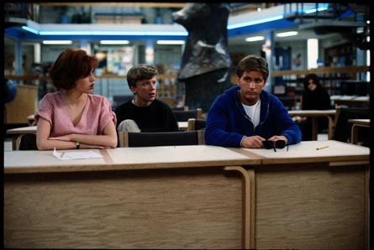
APC: Exercise
The brightest girl in class starts making mistakes in her work on purpose, what are the possible explanations ?

Slide 78
Summary
    PMI = Plus, Minus, Interesting
    CAF = Consider All Factors
    OPV = Other People’s Views
    FIP = First Important Priorities
    C&S = Consequences & Sequels
    AGO = Aims, Goals, Objectives
    APC = Alternatives, Possibilities, Choices

