Slide 1
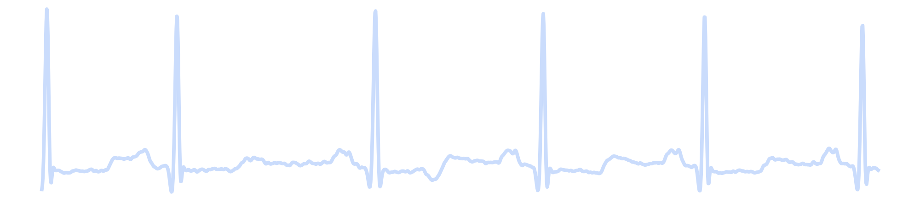
ECE 569A | Artificial Intelligence | Summer 2026
Automated Cardiac Arrhythmia Detection
using 1D Convolutional Neural Networks
Abhishek Kumar Singh (V01095409) • Arvind Sharma (V01098252) • Kuldeep Kumar (V01096893)
University of Victoria | Department of Electrical and Computer Engineering
Notes:
Kuldeep opens (9-min version): introduce the team (Abhishek Kumar Singh, Arvind Sharma, Kuldeep Kumar) and the project title. ~20s.

Slide 2
Motivation: Why Automate Arrhythmia Detection?
WHO
17.9 million deaths per year
from cardiovascular disease worldwide (World Health Organisation, 2021)
24h
100,000+ heartbeats
in a single 24-hour Holter recording, far more than a cardiologist can review by hand
AI
Our goal
automate first-pass beat screening with a compact, real-time capable 1D-CNN
2
Notes:
Kuldeep: WHO stat (17.9M deaths/year), 100,000+ beats per 24h Holter recording, our goal is a compact real-time capable model, safety net for wearable users. ~35s.

Slide 3
Related Work
'04
de Chazal et al.
Hand-crafted ECG morphology and RR-interval features with a linear classifier, evaluated under the AAMI inter-patient protocol.
'16
Kiranyaz et al. (our primary baseline)
Patient-specific 1D-CNN: a common population model fine-tuned per patient, evaluated on the strict inter-patient DS1/DS2 split.
'17
Acharya et al.
CNNs trained directly on raw ECG segments without hand-crafted features, competitive accuracy on the same 5-class AAMI scheme.
'19
Hannun et al.
Large-scale deep network on single-lead ambulatory ECG; reported performance exceeding the average cardiologist.
3
Notes:
Kuldeep: de Chazal 2004 (hand-crafted features), Kiranyaz 2016 (our baseline, patient-specific 1D-CNN), Acharya 2017 (raw CNN), Hannun 2019 (beats average cardiologist). We train one generic model, no per-patient fine-tuning. ~40s.

Slide 4
Problem Formulation
Supervised 5-class classification of a 180-sample (500 ms) ECG segment centered on the R-peak, sampled at 360 Hz.
Class | Meaning
N | Normal beat
S | Supraventricular ectopic beat
V | Ventricular ectopic beat
F | Fusion of normal and ventricular beat
Q | Unclassifiable beat
Objective: categorical cross-entropy
L = − Σ yc log(pc), optimized with Adam over ~114K weights
Search space: ~114,000 learnable weights and biases across all convolutional and dense layers
4
Notes:
Kuldeep: 5-class classification, 180-sample window at 360Hz centered on R-peak, AAMI classes N/S/V/F/Q, categorical cross-entropy with Adam over ~114K weights. ~40s.

Slide 5
Methodology: Data Pipeline
Raw ECG
(48 MIT-BIH records)
→
Butterworth
bandpass filter
(0.5–45 Hz)
→
Pan-Tompkins
R-peak detector
(from scratch)
→
Beat segmentation
+ AAMI labeling
→
109,468 labeled beats
70/15/15 split
92.85%
99.42%
5
R-peak sensitivity
R-peak precision (PPV)
AAMI beat classes
R-peak detector validated against expert cardiologist annotations (±50 ms tolerance). Class distribution is severely imbalanced: N 82.8%, Q 7.3%, V 6.6%, S 2.5%, F 0.7%.
5
Notes:
Kuldeep: 48 MIT-BIH records, Butterworth filter, from-scratch Pan-Tompkins detector validated at 92.85% sensitivity / 99.42% PPV, 109,468 labeled beats, 70/15/15 split, severe class imbalance (82.8% Normal). Hand off to Abhishek. ~45s.

Slide 6
Methodology: Model and Training
Layer | Output | Params
Conv1D 16, k=7 + Pool + Drop | (90, 16) | 128
Conv1D 32, k=11 + Pool + Drop | (45, 32) | 5,664
Conv1D 32, k=21 + Pool + Drop | (22, 32) | 21,536
Conv1D 64, k=31 + Pool + Drop | (11, 64) | 63,552
Dense 32 → Dense 16 → Softmax 5 | – | 23,173
Adam optimizer, initial LR 1e-3, halved on plateau
Class-weighted cross-entropy (N: 0.24× … F: 26.93×)
Batch size 128, 60 epochs, early stopping (patience 8)
Best epoch selected by validation loss: epoch 54
114,053
total trainable parameters (target: 50K to 200K)
6
Notes:
Abhishek opens his half (9-min version): 4 conv layers (kernel 7 to 31, receptive field grows with depth), 2 dense layers, 114,053 params. Class-weighted cross-entropy (Fusion ~112x Normal). Adam, 60 epochs, best epoch 54. ~45s.

Slide 7
Results: Overall Performance
96.80%
0.842
92.3–99.9%
Overall test accuracy
Macro-averaged F1 score
Sensitivity across all classes
Class | Sensitivity | Specificity | Precision | F1 | AUC
N | 96.70% | 98.55% | 99.69% | 0.982 | 0.998
S | 92.27% | 98.74% | 66.11% | 0.770 | 0.994
V | 96.76% | 99.71% | 95.87% | 0.963 | 1.000
F | 94.26% | 98.65% | 34.33% | 0.503 | 0.994
Q | 99.92% | 99.89% | 98.61% | 0.993 | 1.000
Accuracy alone is misleading: 82.8% of beats are Normal, so a trivial always-predict-N classifier already scores 82.8%.
7
Notes:
Abhishek: 96.80% accuracy, macro F1 0.842. Note accuracy alone is misleading (82.8% baseline). Sensitivity above 92% for every class. ~40s.

Slide 8
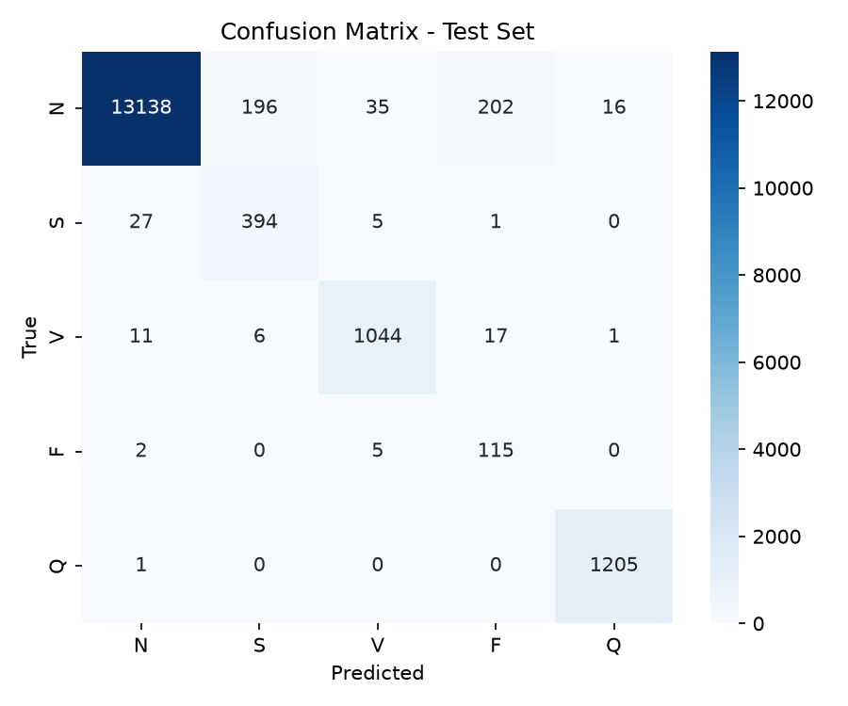
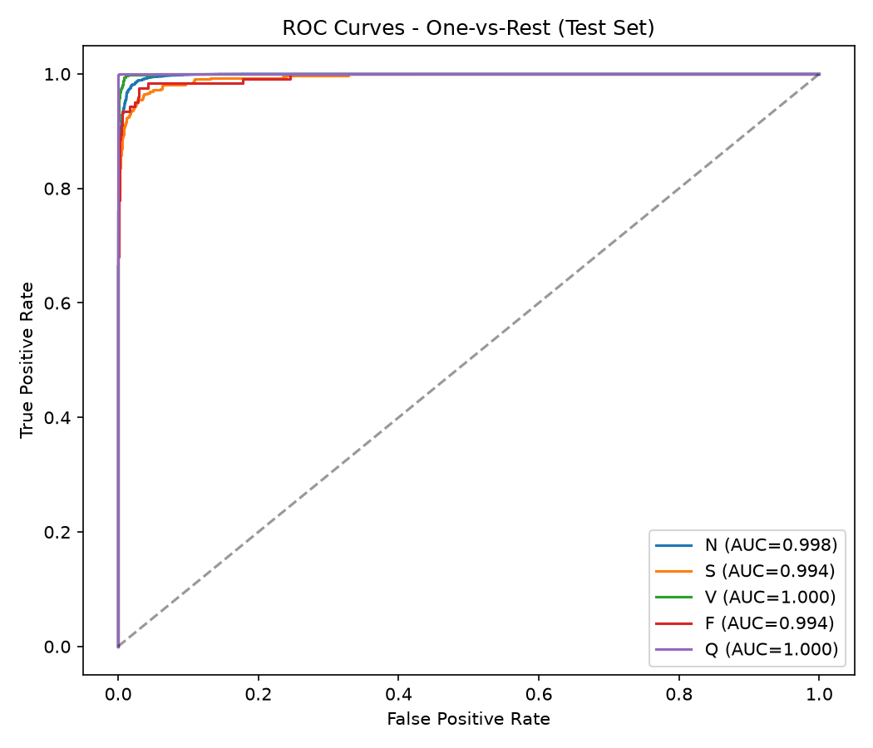
Results: Confusion Matrix and ROC Curves
Errors concentrate where classes look alike: Normal beats occasionally predicted as F or S. AUC stays 0.994–1.000 for every class.
8
Notes:
Abhishek: errors cluster where N looks like F or S. AUC 0.994 to 1.000 across all classes shows strong ranking even where precision is weaker, a threshold issue not a learning failure. ~45s.

Slide 9
How Do We Compare to Kiranyaz et al. (2016)?
 | Our Model | Kiranyaz et al. (2016)
Approach | Single generic 1D-CNN | Per-patient fine-tuned 1D-CNN
Train/test split | Intra-patient, random 70/15/15 | Inter-patient DS1/DS2 (strict)
Overall accuracy | 96.80% | High 90s% (reported)
Fair comparison? | Optimistic estimate (see note below) | Stricter, more realistic protocol
Because beats from the same patient can appear in both our training and test sets, our numbers should be read as optimistic relative to a strict inter-patient evaluation.
9
Notes:
Abhishek: Kiranyaz uses per-patient fine-tuning and strict inter-patient split; we use one generic model and a random intra-patient split. Read our number as an optimistic estimate, first thing we'd fix in follow-up work. ~40s.

Slide 10
Challenges Faced and How We Solved Them
R-Peak Detector Underperforming
Model Oversized
Problem: First version used one fixed threshold per recording → only 64% sensitivity.
Fix: Replaced with an adaptive dual threshold (running signal/noise estimates), matching the true Pan-Tompkins algorithm.
Result: Sensitivity improved to 92.85%
Problem: First trained model had 455,000 parameters, more than double our 200K proposal budget.
Fix: Reduced channel widths in the later convolutional layers.
Result: 114,053 parameters, no loss in accuracy
10
Notes:
Abhishek: first R-peak detector had a fixed threshold and only 64% sensitivity, fixed with an adaptive threshold to reach 92.85%. First model was 455K params, cut to 114,053 with no accuracy loss. ~45s.

Slide 11
Conclusion and Future Work
Conclusion
Future Work
End-to-end pipeline: raw signal, filtering, R-peak detection, 5-class prediction
114,053-parameter 1D-CNN reaches 96.80% test accuracy
Macro F1 of 0.842, sensitivity above 92% for every AAMI class
Shows a compact CNN can learn ECG morphology without hand-crafted features
Re-evaluate under the strict inter-patient DS1/DS2 protocol
Combine class weighting with oversampling (SMOTE) or calibrated per-class thresholds to recover precision on S and F
Add a patient-specific fine-tuning stage, similar to Kiranyaz et al.
11
Notes:
Abhishek: recap 114,053-param model, 96.80% accuracy, sensitivity above 92% for every class, no hand-crafted features. Future work: inter-patient DS1/DS2 re-evaluation, recover precision on S/F via oversampling or calibrated thresholds, patient-specific fine-tuning. ~40s.

Slide 12
Thank You
Questions?
Abhishek Kumar Singh • Arvind Sharma • Kuldeep Kumar
Notes:
Abhishek: thank the audience, open the floor for questions. ~15s.

