Slide 1
4070E107

Slide 2
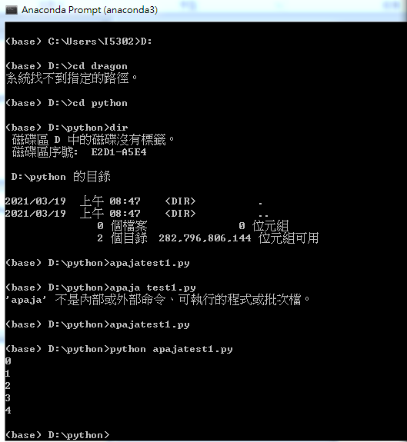
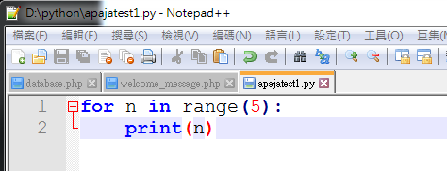
Learn guihub with any code

Slide 3
