Slide 1
開發環境建置==> Anaconda
4070E107

Slide 2
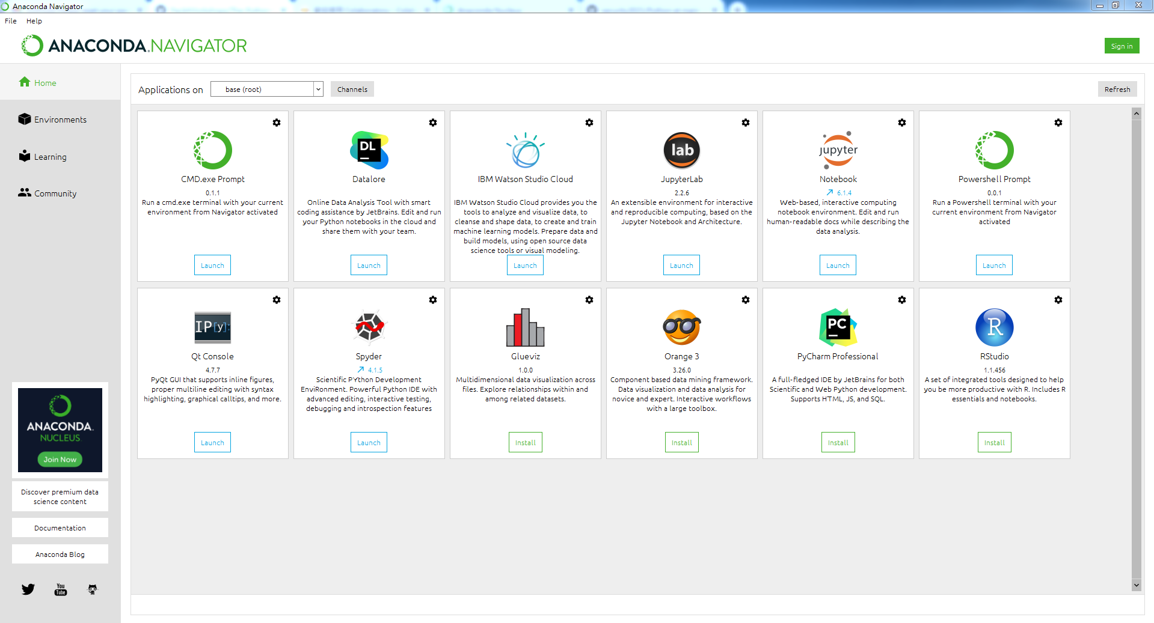
Anaconda Navigator

Slide 3
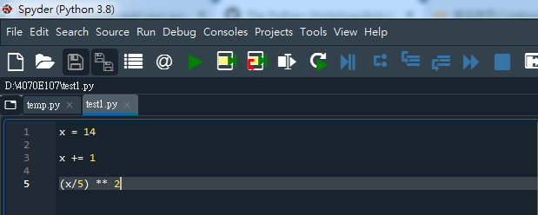
Spyder IDE

Slide 4
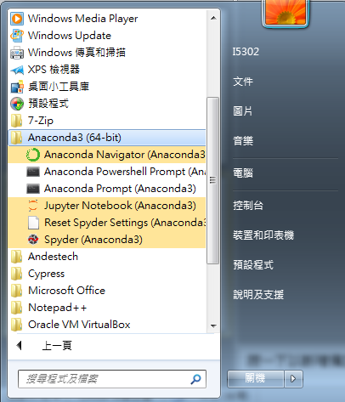
Anaconda Location File

Slide 5
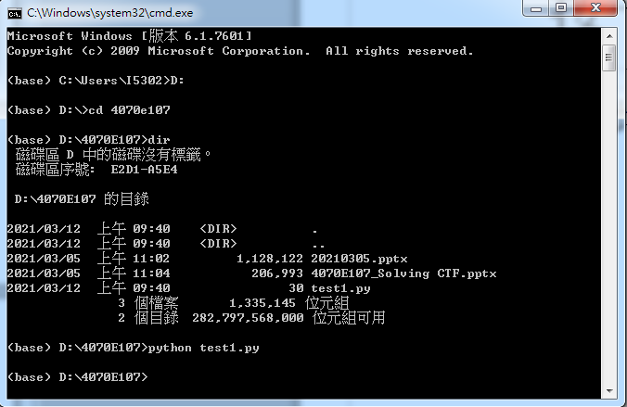
Anaconda cmd

