Slide 1
20210305

Slide 2
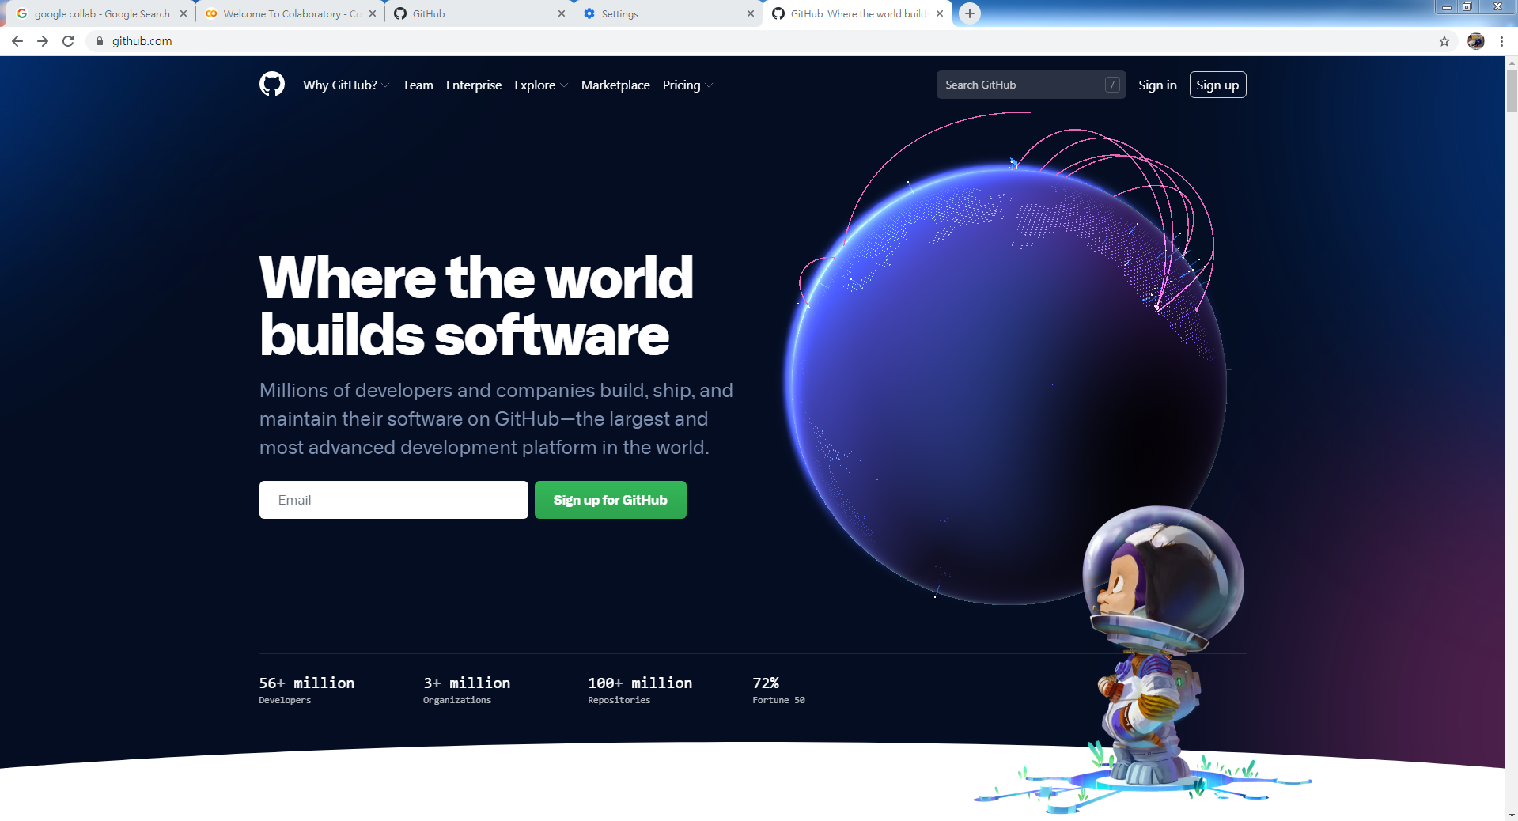

Slide 3
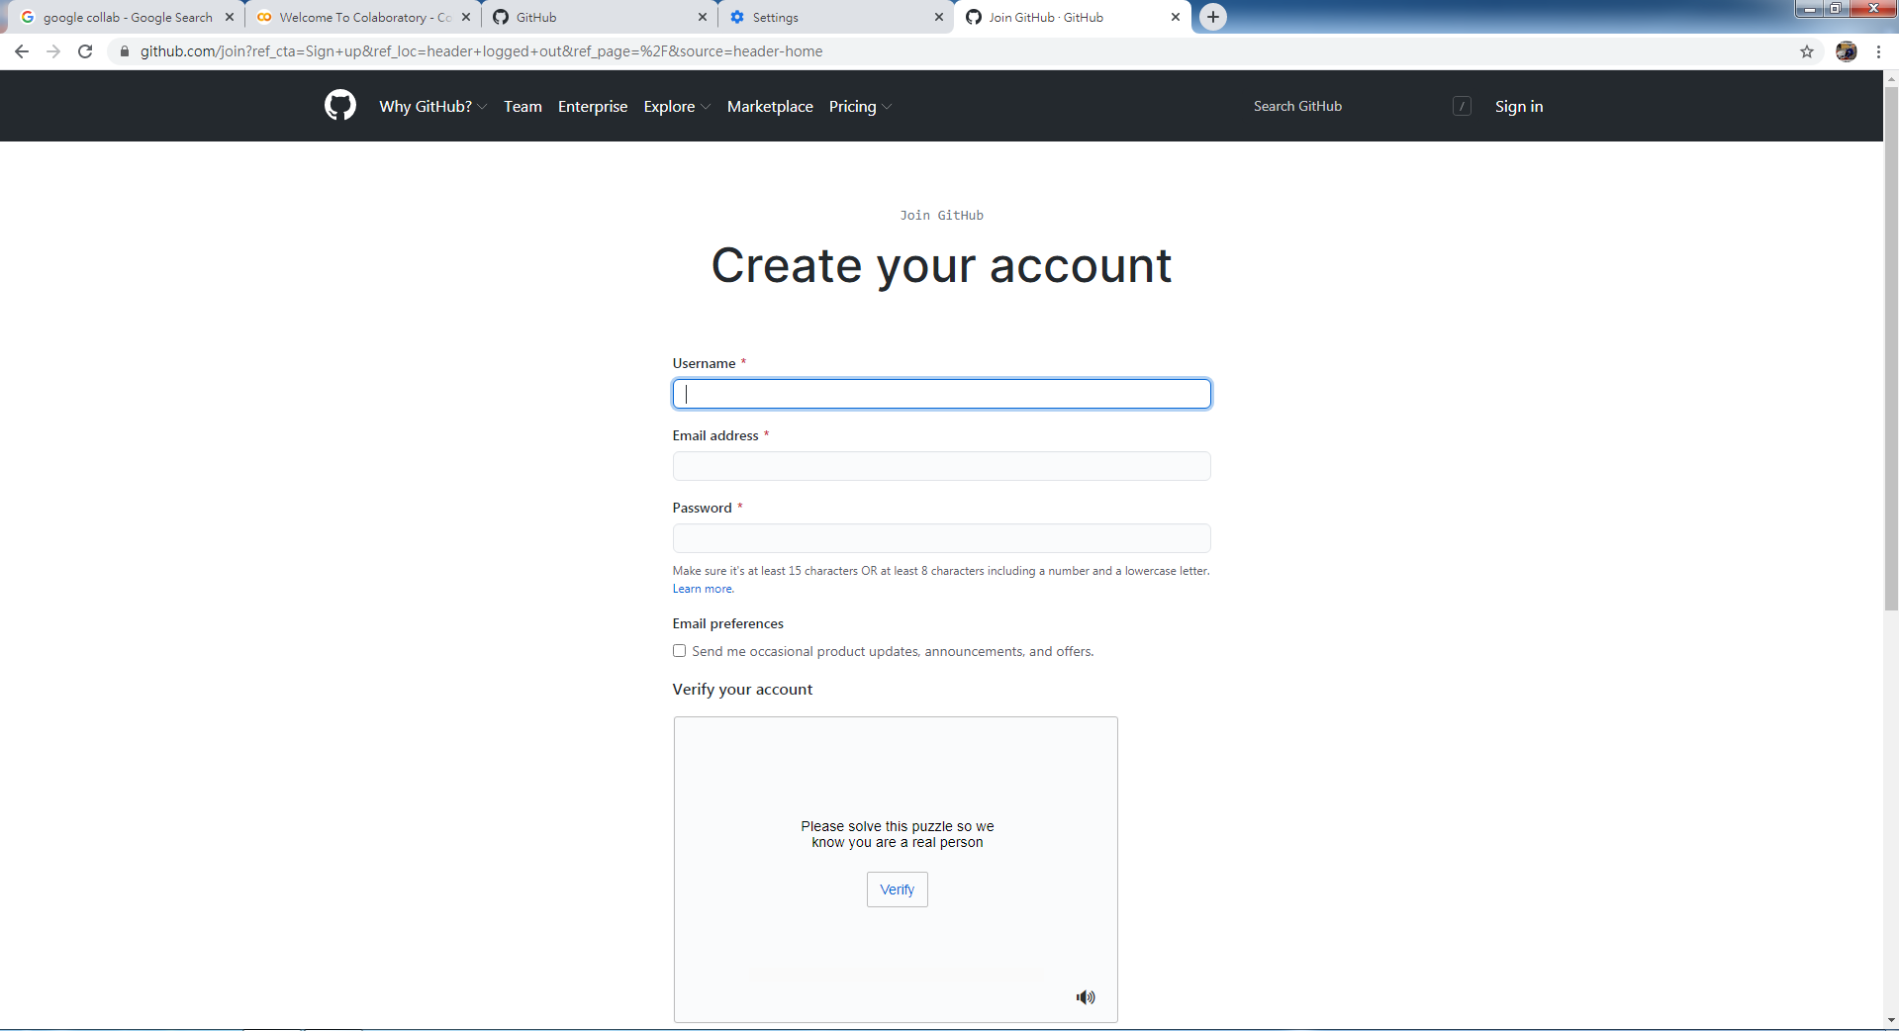
Create new account

Slide 4
htpps://github.com/mydeargreatteacher
mydeargreatteacher

Slide 5
